Slide 1

Customer Shopping Behavior Analysis
Uncovering spending patterns, customer segments, and product preferences from 3,900 transactions to guide strategic business decisions.

Slide 2
Dataset at a Glance
3,900
18
Transactions
Data Columns
37
$59.76
Missing Values
Avg Purchase
Review Rating column
Features include demographics, purchase details, and shopping behavior — 37 missing Review Ratings imputed by category median.

Slide 3

Data Preparation in Python
Clean & Standardize
Snake_case columns, null checks, median imputation for Review Rating
Feature Engineering
Created age_group bins and purchase_frequency_days
Database Load
Cleaned DataFrame loaded into PostgreSQL for SQL analysis

Slide 4
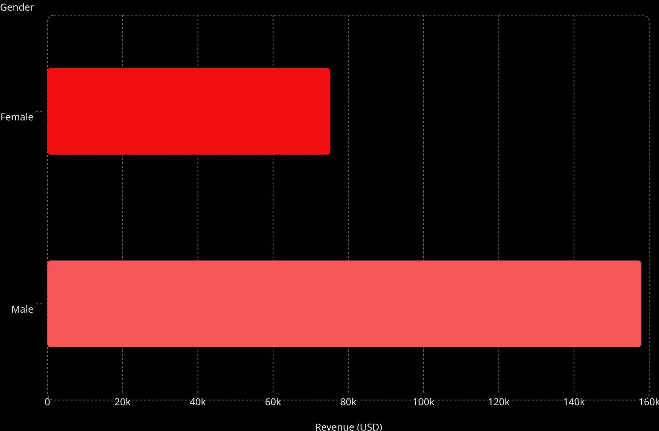
Revenue by Gender
Key Insight
Male customers generated 2.1× more revenue than female customers across 3,900 transactions.

Slide 5
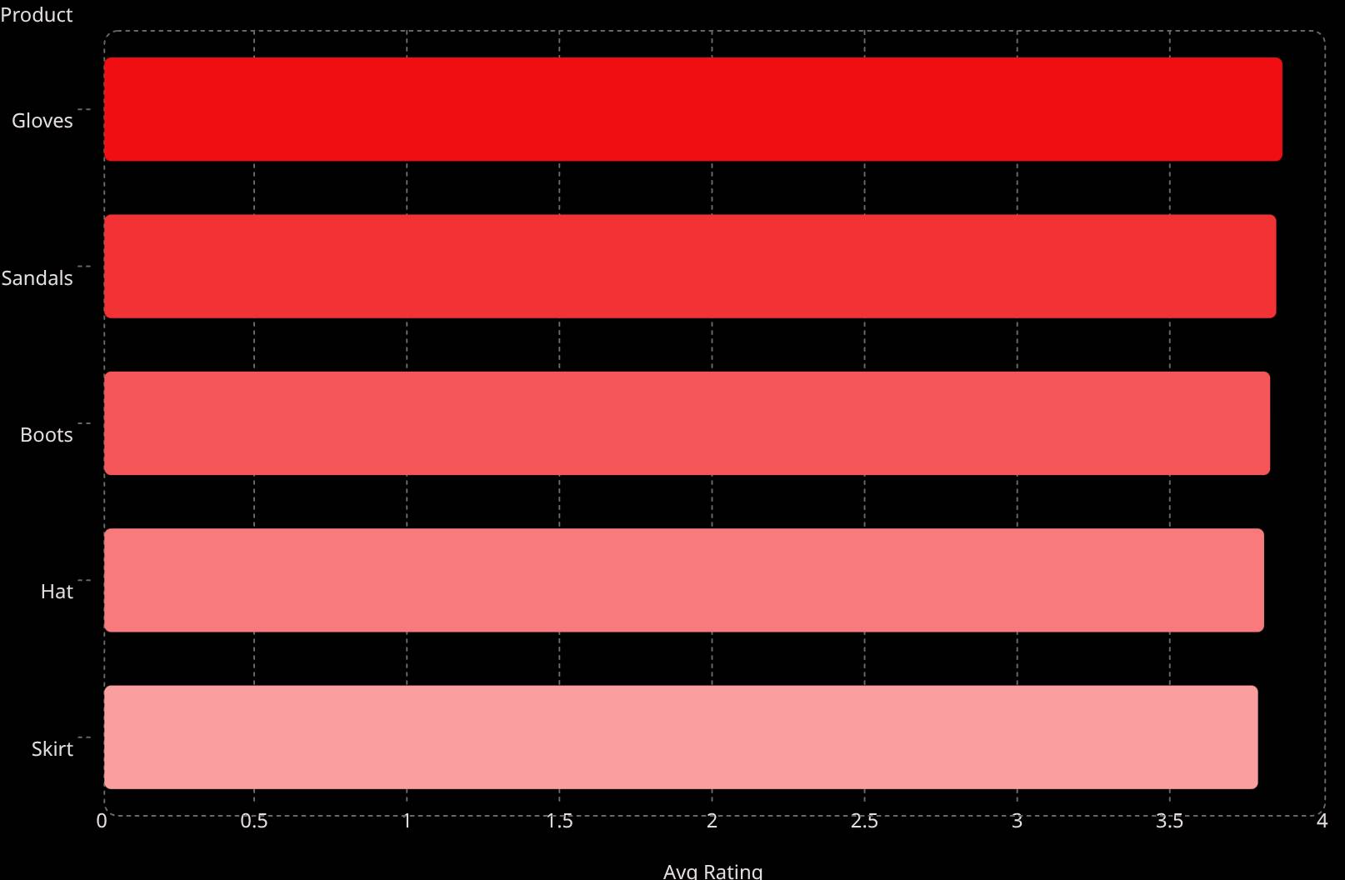
Top Products & Shipping
Top 5 by Rating
Shipping Comparison
Express shipping averages $60.48 vs. Standard at $58.46 — minimal difference.

Slide 6
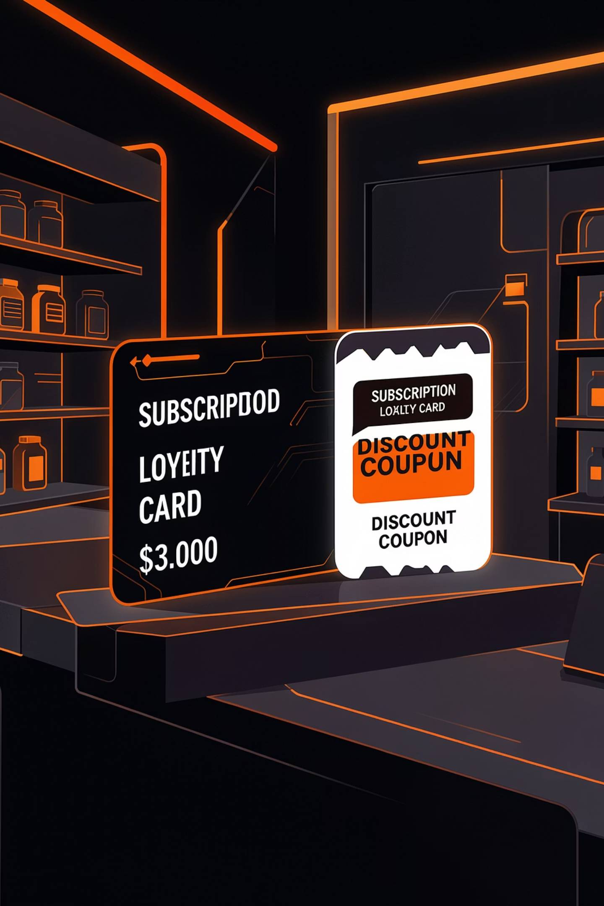
Subscribers vs. Non-Subscribers
Subscribers — 27%
1,053 customers · $59.49 avg spend · $62,645 total revenue
Non-Subscribers — 73%
2,847 customers · $59.87 avg spend · $170,436 total revenue

Slide 7
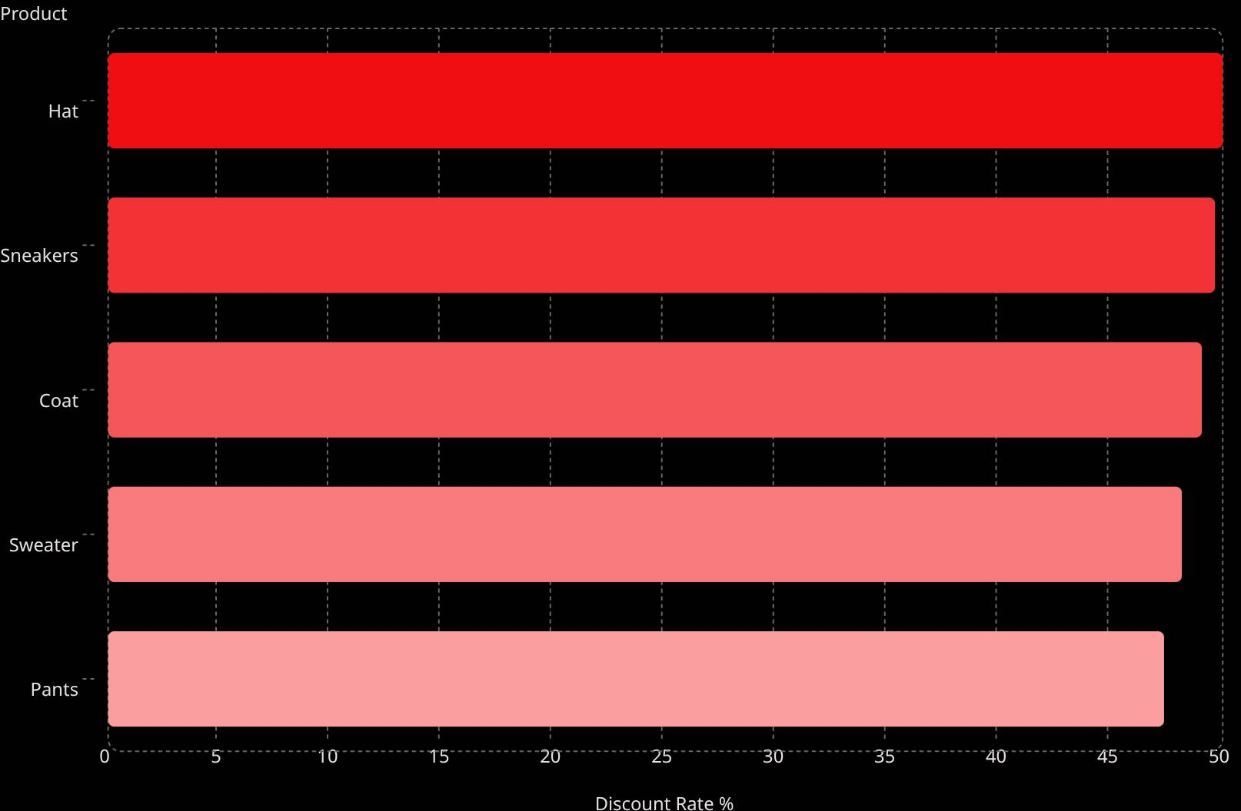
Discount Dependency & Customer Segments
Most Discounted Products
Customer Segments
Loyal
Returning
3,116 customers
701 customers
New
83 customers

Slide 8
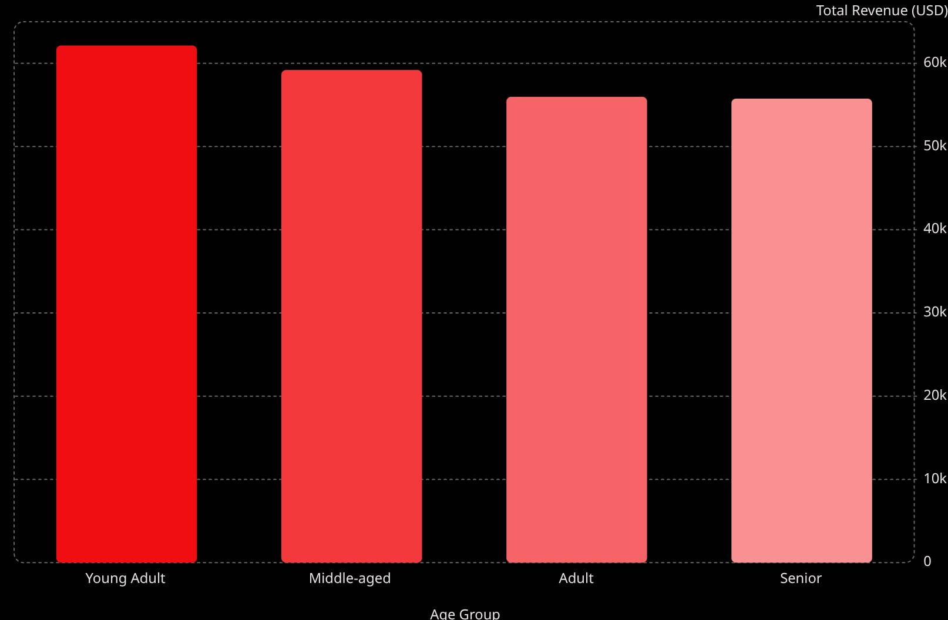
Revenue by Age Group
Key Insight
Young Adults lead revenue contribution. Revenue is relatively evenly distributed across all age groups.

Slide 9
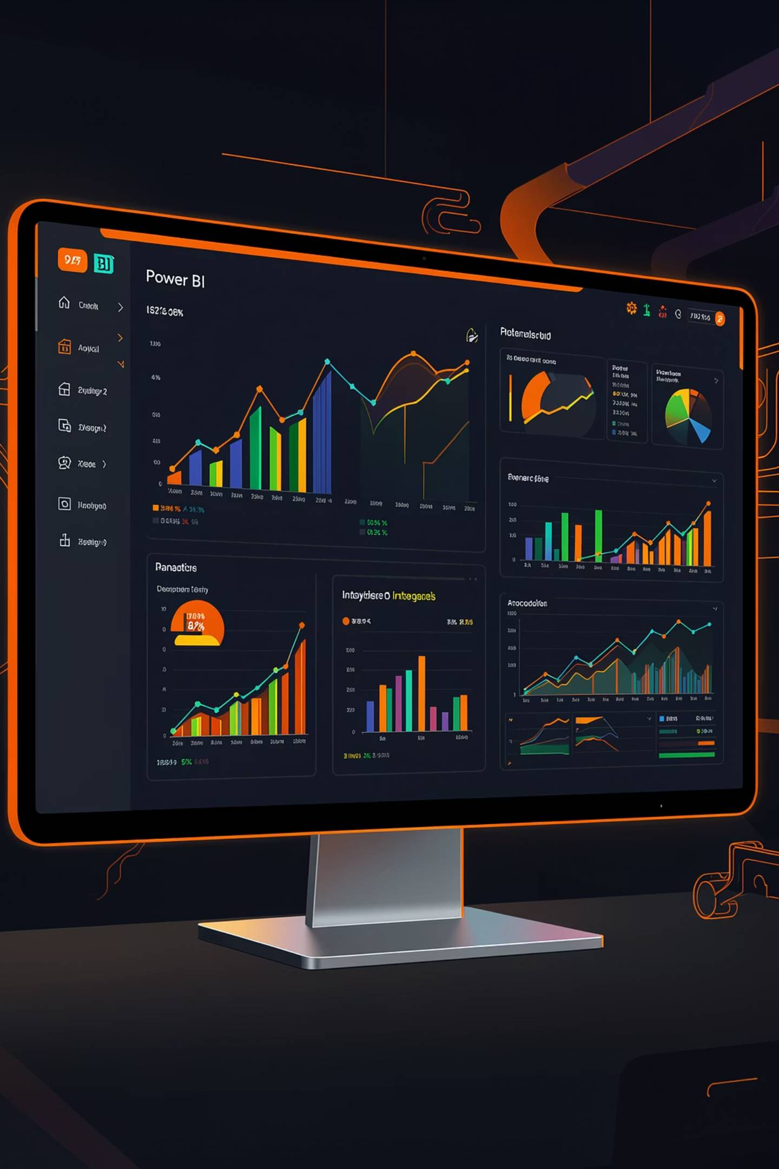

Power BI Dashboard
Subscription Split
27% subscribers vs. 73% non-subscribers
Revenue by Category
Clothing, Accessories, Footwear, Outerwear
3.9K Customers
Avg purchase $59.76 · Avg rating 3.75

Slide 10

Business Recommendations
Boost Subscriptions
Promote exclusive subscriber benefits
Loyalty Programs
Reward repeat buyers to grow Loyal segment
Review Discount Policy
Balance sales lift with margin control
Targeted Marketing
Focus on high-revenue age groups & express-shipping users

