Slide 1

SOCIAL NETWORKING
SYSTEM

Slide 2
GROUP MEMBERS
NAMES : INSHAL AYAZ
ROLL NO: B191030
NAMES: AREEBA MEHMOOD
ROLL NO: B19103013

Slide 3
INTRODUCTION OF THE PROJECT
A social networking site is an online platform that allows users to create a public profile and interact with other users. Social networking sites usually allow a new user to provide a list of people with whom they share a connection, and then allow the people on the list to confirm or deny the connection. After connections are established, the new user can search the networks of connections to make more connections.
A social networking site is also known as a social networking website or social website.
SCOPE OF THE PROJECT
The scope of social networking is widening, and today it offers a strong support to the companies in providing the much desired touch of concern. It enables users to post some informative materials, users can join different groups to stay tuned, users may also follow some groups for seeking information according to their concern, users can also like or post any material they liked. Basically the SNS turned this world into a global village in which everyone is connected and updated.

Slide 4
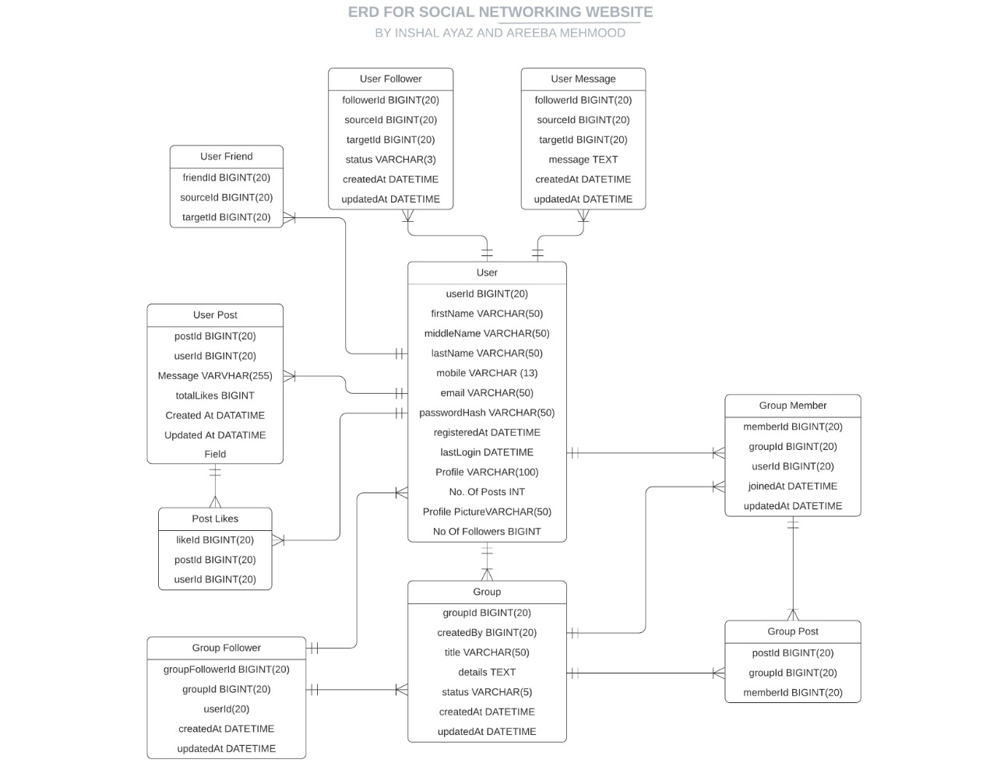
ER DIAGRAM

Slide 5
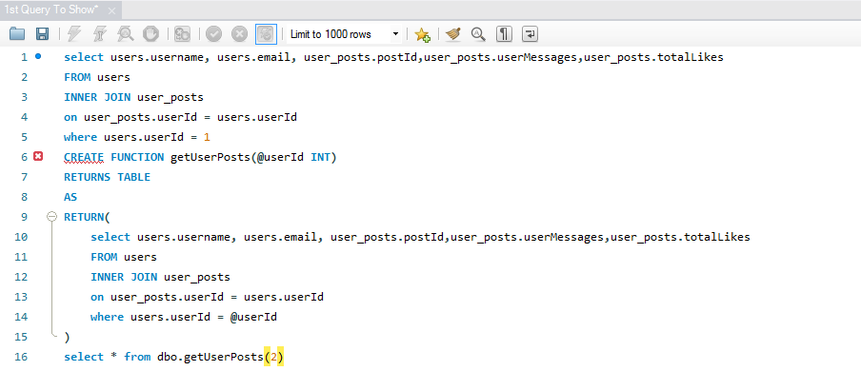
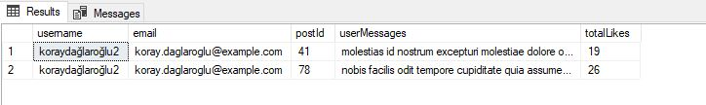
QUERY 1
In the first query we pass the user Id as argument then it will fetch out the name of the user and it will enlist all the posts made by the user and the likes received on that post. The data is coming from two different tables from User Table and User Post Table
RESULT

Slide 6
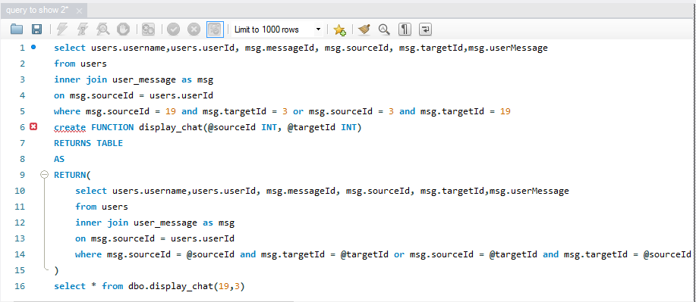
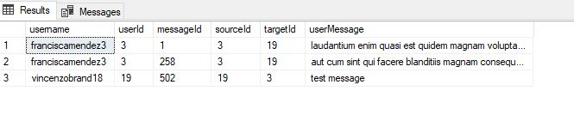
QUERY 2
In Query 2 it displays the chat of the user with other people, we pass the
Two User Id’s as argument, the sender of the message and other is the
Receiver of the message and also displays the conversation among these
Friends.
RESULT

Slide 7
QUERY 3

