Slide 1
Lessons Learned
INB/INN370 Assignment One

Slide 2
Agenda
Interfaces and Classes
Specifications
Tests
Code Quality
Submission

Slide 3
Interfaces & Classes
Javadoc is for interfaces
Inherit the comments – use the tool for this
Except when it is a constructor
The compiler checks all the methods
Interfaces and implementing classes correspond
Except when it is a constructor
[Then it is *your* problem]
[NOTE: This *doesn’t* apply to assign 2 much]

Slide 4
Specifications
Follows on from the constructor issues
People did a good job in general
But signatures matter
So do public methods
So do additional classes

Slide 5
Tests
Rule number 1: you can never have too many
Rule number 2: see rule number 1
Rule number 3: tests are there to find bugs
Rule number 4: see rule number 1
Rule number 5: bugs are usually at the extremes. You need to have some test cases to make sure that your code is ok, but look at the boundary values, the exceptions, the unusual
Oh, and Rule number 6? See rule number 1

Slide 6
Code Quality
Basic code quality is good.
Very little terrible code submitted
Sparse commenting is better than too much
But some people took this to extremes.
Consistency in indentation, commenting, whitespace and so many things is critical

Slide 7
Submission
Please read the submission document when it appears.
Please follow the instructions
Please ask if you have any doubts

Slide 8
A graph

Slide 9
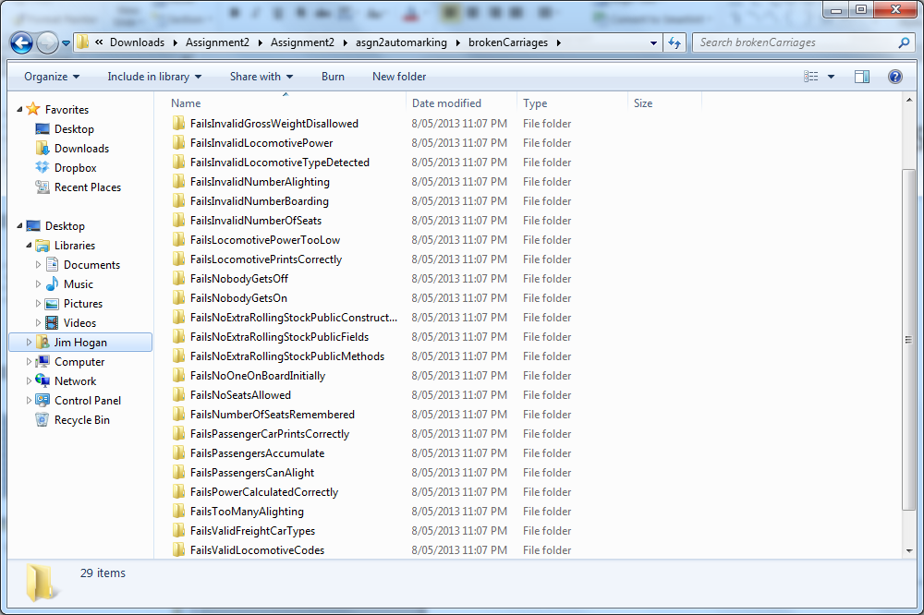
Some thoughts for assignment 2
Most, but not all brokenCarriages

Slide 10
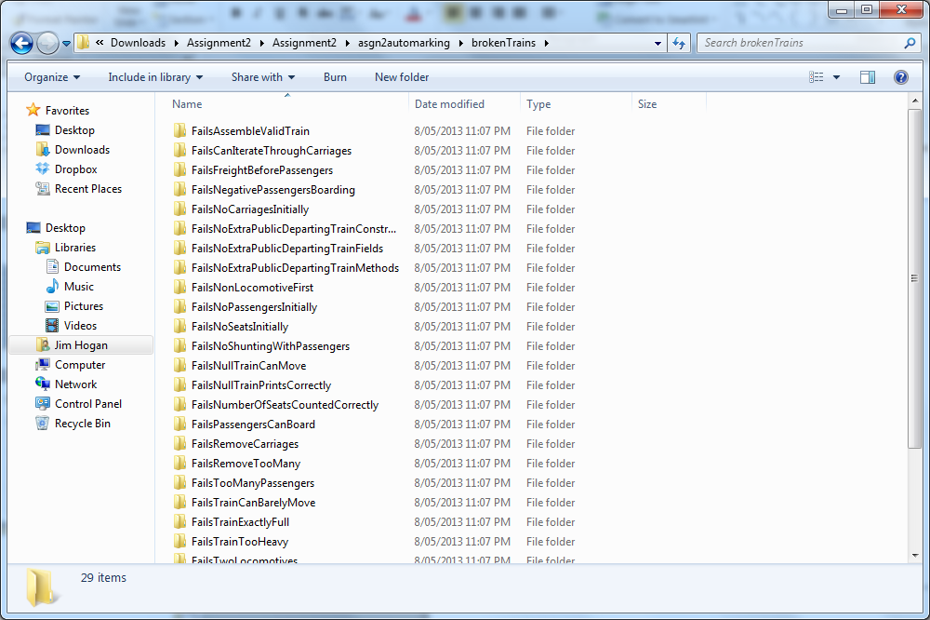
And more…
Most, but not all brokenTrains

Slide 11
Submission Instructions
Will appear tomorrow…
Enjoy…

