Slide 1
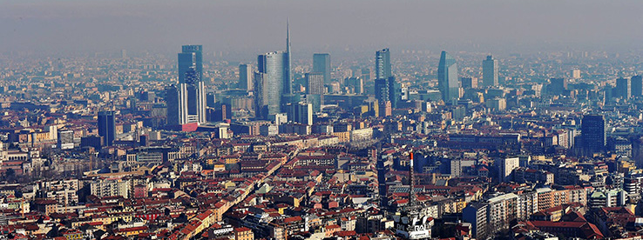
PowerEnJoy
A new way of doing car sharing

Slide 2
Topics
Problem analysis
Status of the market
System to be
Goals & Requirements

Slide 3
Problem analysis
We manage to design and develop a digital management system for a car-sharing service that exclusively employs electric cars
Why electric cars only?
Because big cities are already experiencing high levels of pollution, and their citizens are looking for a new way to move that may be, at the same time, cheaper and green.

Slide 4
Problem analysis
The system will allow registered users to discover available cars nearby their current position
Registered users will be allowed to book a car for a limited time (1 hour)
Within this time, the user will be allowed to delete his/her reservation
The user will be asked to pay a fee of 1 euro if the reservation expires
After a reservation is concluded or expired, the reserved will become available for other users
The system will incentivize the virtuous behaviors of the users by means of applying discounts or fees in the appropriate contexts.

Slide 5
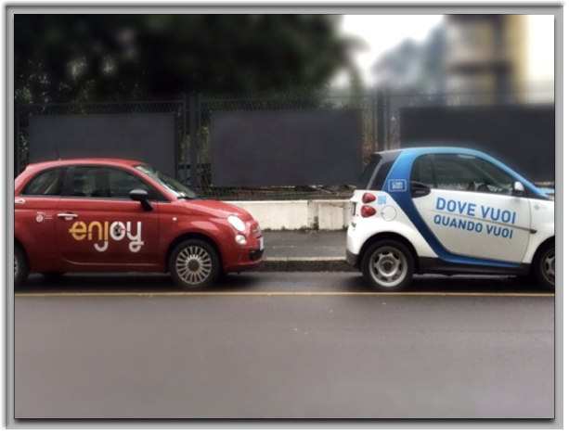
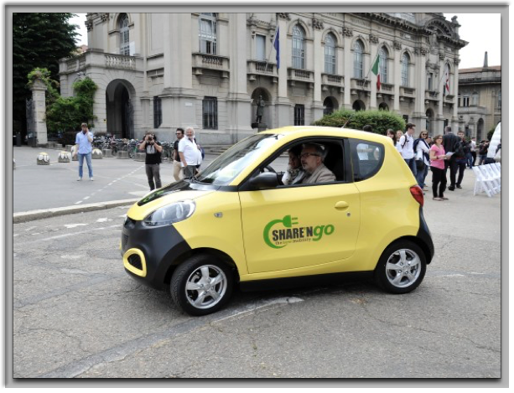
Status of the Market
Only in the city of Milan there are approximately:
6 car sharing services involving only vehicles with combustion engines
3 car sharing services involving only electric vehicles

