Slide 1

PowerEnJoy
A new way of doing car sharing

Slide 2
Topics
Problem analysis
Status of the market

Slide 3
Problem analysis
We manage to design and develop a digital management system for a car-sharing service that exclusively employs electric cars
Why electric cars only?
Because big cities are already experiencing high levels of pollution, and their citizens are looking for a new way to move that may be, at the same time, cheaper and green.

Slide 4
Problem analysis
The system will allow registered users to discover available cars nearby their current position
Registered users will be allowed to book a car for a limited time (1 hour)
Within this time, the user will be allowed to delete his/her reservation
The user will be asked to pay a fee of 1 euro if the reservation expires
After a reservation is concluded or expired, the reserved will become available for other users
The system will incentivize the virtuous behaviors of the users by means of applying discounts or fees in the appropriate contexts.

Slide 5
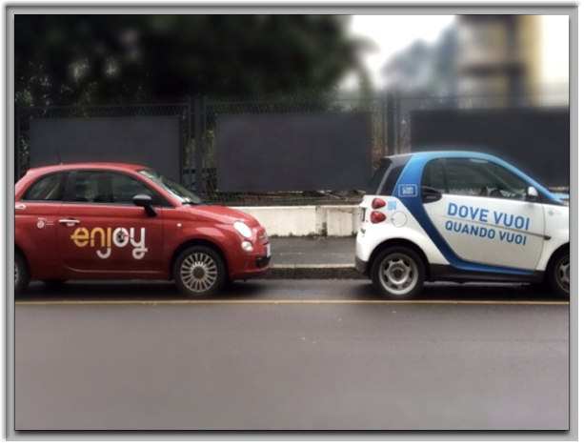
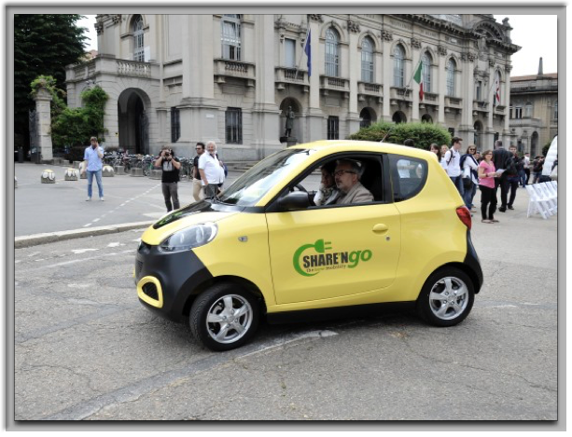
Status of the Market
Only in the city of Milan there are approximately:
6 car sharing services involving only vehicles with combustion engines
3 car sharing services involving only electric vehicles

Slide 6
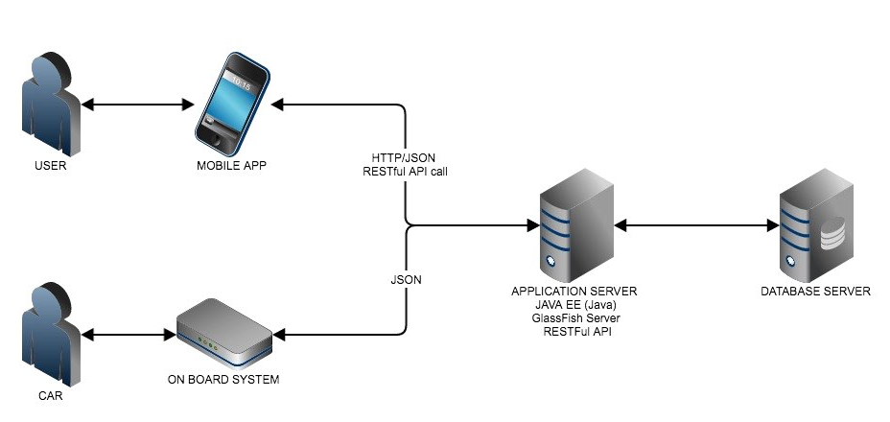
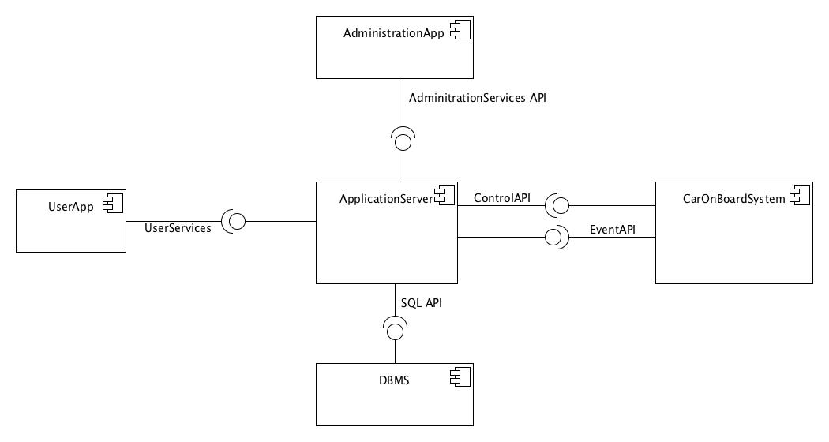
Architecture
High level overview
Mobile application: software component installed on the user’s device which renders the user interface and handles interactions with the user
Administration application: web application meant to provide all those functionalities required for the administration of the system
Car on board system: set of software components installed on the car’s system (provided by the manufacturer which handles car’s relevant sensors and commands coming from the application server
Application server: set of software components that handle the business logic of the system
Database server: set of software components which allows to store permanent data.

Slide 7
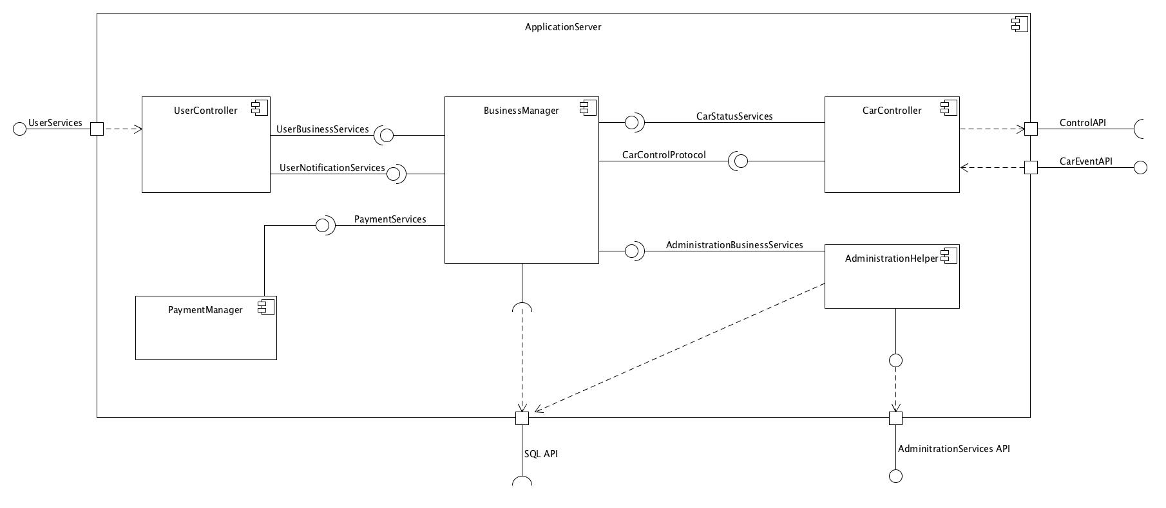
Application server
High level description

Slide 8
Application server
High level description
Exposes a RESTful API to the Mobile application to provide all the functionalities that a user might call directly or indirectly
Exposes a RESTful API to the Administration Web application to provide all the functionalities that the administration of the service needs.
Exposes a RESTful API to the Car on board system to allow it to notify events of interests from the the point of view of the business logic (i.e. car engine starts)
Forwards commands to the Cars by means of the software API provided by the Car on board system
Interacts directly with the Database server by means of the standard SQL interface (2011)

Slide 9
Application server
Components’ description
Business Manager: software component which handles the entire business logic of the system
User Controller: handles the bidirectional communication between the mobile applications and the application server.
Payment Manager: software component which handles all the interactions between the business logic and with third-part payment services (by now, PayPal is the only one supported)
AdministrationHelper: software components which handles all the requests coming from the administration’s web application (AdministrationServices API)
CarController: handles the bidirectional communication between the on board car system and the application server.

Slide 10
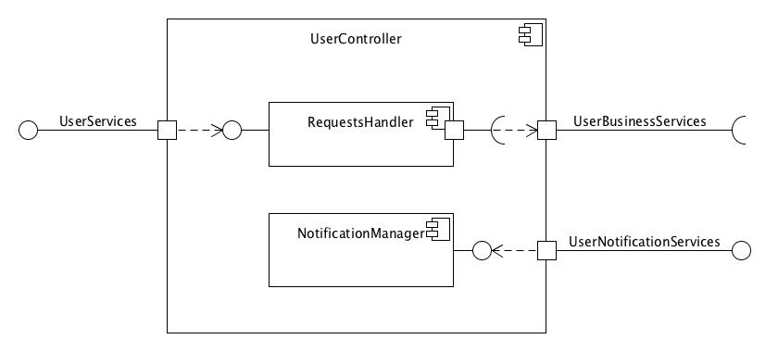
User Controller
High level description
Following the MVC paradigm, this controller performs checks on the incoming user requests
It also exposes an interface to provide means to forward notifications of various type to the user.

Slide 11
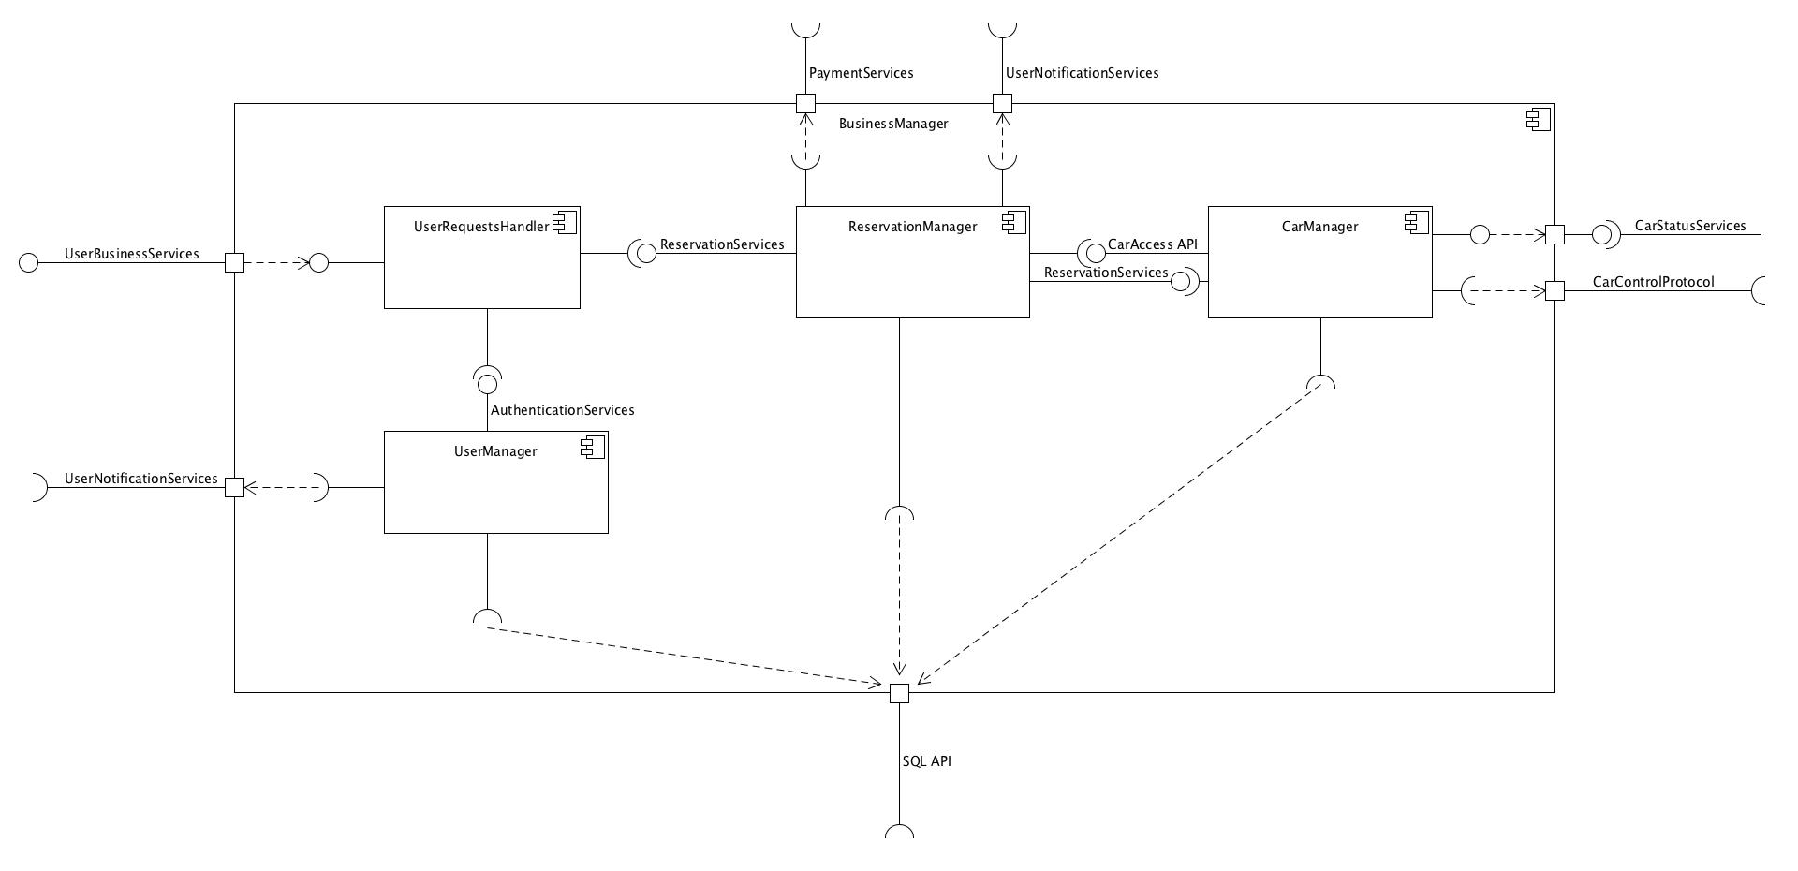
Business Manager
High level description

Slide 12
Business Manager
High level description
Exposes interfaces to provide all the business logic functionalities both to users and physical car.
Relies directly on the SQL interface to interact with the database services
Relies on the UserNotificationServices interface provided by the UserController to forward notifications to the users.
Relies on the CarControlProtocol interface provided by the CarController to forward commands to the cars.
Relies on PaymentServices provided by the Payment software component

Slide 13
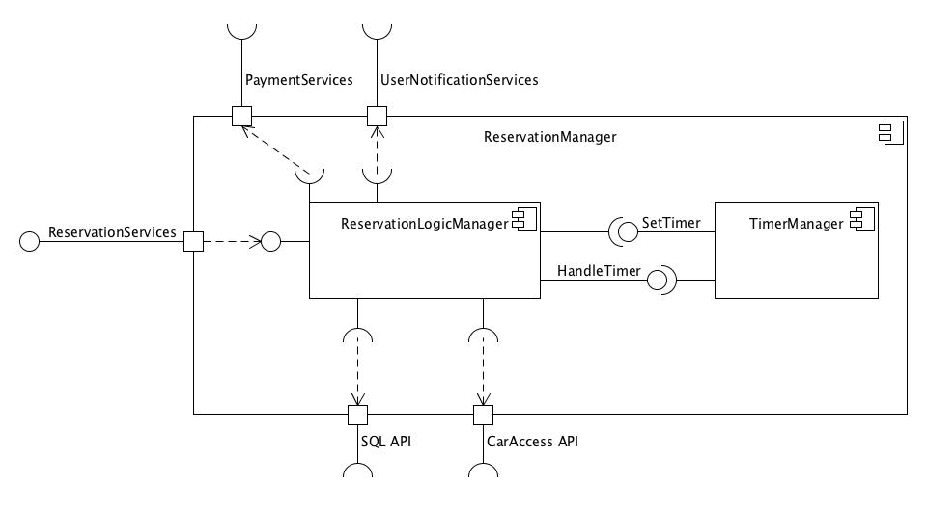
Reservation Manager
High level description
It Is one of the core software components of the business logic
The Reservation Manager is in charge of all reservation operations, including the computation of a reservation's cost.

