Slide 1

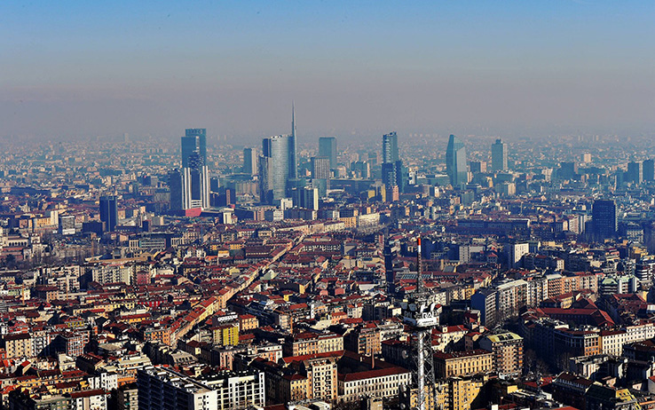
Sequence Diagrams Analysis

Slide 2
Entry considerations
Before starting to show the Diagrams in details, it is important to bear in mind some preliminary considerations about the various interactions among the User, the Application and the Environment in which the two entities are centered:
  Software pre-requisites are well set
  There isn't any problems of internet connection, GPS services in their software components and in their infrastructures
  In general: everything concerning external elements of environment which supports the role of application, works fine for the purpose.

Slide 3
Sequence Diagrams: First Analysis
A first analysis of the Sequence Diagrams brought to a “glimpse” of the interactions between the various Actors in the entire System.
These diagrams can be found in the RASD document and take into account the first definition of goals and requirements to be satisfied, as well as the actors and the scenarios.

Slide 4
Sequence Diagrams: Second Analysis
The detailed analysis of the Diagrams shows some important features came up during the design of the Architecture
In these diagrams there is a deeper spectrum of the Actors and Parts involved in the interactions
A first draft of the implementation is schematized too, the objective of the Diagrams are not to go through the aspect, but to surely give some important guidelines for the complete project of the topic.
These Diagrams can be found in the DD document.

Slide 5
Sequence Diagram: Catalog
The catalog of whole the sequence diagrams in the documentation are rolled out below. Coupled sequence diagrams, which are in the same row, means a modification from the RASD to the DD for the same context of the diagram, passing from one document to the other.
Some sequence diagrams are not coupled, they were designed only with the DD document.
RASD Document
- (13.1) Registration Phase
- (13.2) Authentication Phase
- (13.3) Searching and Booking a nearby car
- (13.4) Time expiration
- (13.5) The System unlocks a Car
- (13.6) End of the ride and payment
- (13.7) Activating the “Money Saving Option”
Design Document
- (2.8.1) Registration
- (2.8.2) Authentication
- (2.8.5) Searching and Booking a nearby car
- (2.8.6) Time expiration
- (2.8.8) Unlocking a Car
- (2.8.4) Finish a ride
- (2.8.3) Activating the “Money Saving Option”
- (2.8.7) Locking a Car
- (2.8.9) Telemetry

Slide 6
Some more... Mapping of some goals and requirements satisfied with the Diagrams' design!
Below are listed some of the goals and requirements covered by the specifications of the various Sequence Diagrams, there are also some important notes regarding the shifting between the two documents and the eventual renovation of the diagrams towards the initial set of goals and requirements:
Goals | Corresponding Requirement | RASD corresponding diagram(s) | DD corresponding diagram(s)
[G1.1] (Registration topics) [G6.1] (Errors alerting topics) | [R1.1]: processing the registration and controlling inputs [R1.2]: alerting the User in case of error [R1.3]: storing data [R6.1]: errors alerting and restore point | (13.1) Registration Phase Interactions only between User and System in a general way satisfying [R1.1] and [R1.2]. [R6.1] is satisfied by the mean of cycles in the diagram, which makes implicitly the System to understand when “restart” the operation towards the User. | (2.8.1) Registration The integration of the Mobile Application and the Database System are also considered, in addition to the RASD document diagram [R1.3] is satisfied too.

Slide 7
Goals | Corresponding Requirement | RASD corresponding diagram(s) | DD corresponding diagram(s)
[G1.1] (Registration topics) [G6.1] (Errors alerting topics) | [R1.1]: processing the registration and controlling inputs [R1.2]: alerting the User in case of error [R6.1]: errors alerting and restore point | (13.2) Authentication Phase | (2.8.2) Authentication
[G2.1] (discovering positions of cars) [G2.2] (updating cars positions) [G2.3] (multiple requests management) [G3.1] (cars information and reservation form) [G3.2] (reservation correctness and completion) [G6.1] [G7.1] (mailing service) | [R2.1], [R2.2], [R2.3], [R2.4]: internal functions and instances management [R3.1]: instances wrt the Database [R3.2]: instances correctness [R3.3]: user's request confirmation [R7.1]: automatic messages management. | (13.3) Searching and Booking a nearby car [R2.1], [R2.2], [R2.3], [R2.4] are correctly handled considering that the System (the unique entities in addition to the User in this case) implicitly makes the needed actions for guaranteed them. The presence of cycles and recurrences in the diagrams points out that the [R3.2] and [R3.3] are managed as well | (2.8.5) Searching and Booking a nearby car In addition to what has been said for the RASD diagram, we can confirm the respect of the requirements [R3.1], because the mobile app and the Database are integrated in this new Diagram and their interactions too. Concerning the [R7.1] the assumption is that his management is implicit: when a ride is confirmed and taken in the account of the System, a mailing service advice the User of those events as guarantee.

Slide 8
Goals | Corresponding Requirement | RASD corresponding diagram(s) | DD corresponding diagram(s)
[G4.1] (reason of expiration) [G4.2] (consequences towards the User) [G4.3] (User's possible actions within the our) [G6.1] | [R4.1]: the System keeps track of the elapsed time [R4.3]: reservation is tagged as expired by the System [R4.5]: the System advises the User if the reservation is expired [R6.1]: errors alerting | (13.4) Time expiration All the requirements expressed in the previous column were showed with this Diagram: the System sets a countdown from the moment that the reservation was made. The User is notified if the associated time expired. | (2.8.6) Time expiration In this case the System alerts the User about the expiration by the mean of the Mobile App, the concepts are identical. Note: there are some extra requirements which are not exposed by the diagrams: they will be discussed later.
[G5.1], [G5.2], [G5.3] (condition of nearness, when the car shall be unlocked) | [R5.1], [R5.2], [R5.3]: actions taken by the System wrt the definition of the corresponding numbered goals. | (13.5) The System unlocks a Car There's a precise schema of actions for the Diagram to be correct through the definitions of the goals and requirements. The basic interactions between the User, the System and the System and the On Board System are shown for the case. | (2.8.8) Unlocking a Car Some analogies are shared between this diagram and the previous one. In this diagram is also introduced the Mobile App, but the chains of events is equal.

Slide 9
Goals | Corresponding Requirement | RASD corresponding diagram(s) | DD corresponding diagram(s)
[G5.6] (end of ride conditions) [G5.7] (penalties conditions) [G5.9], [G5.10], [G5.11], [G5.12], [G5.15], [G5.16] (discounts and fees conditions) | [R5.6], [R5.7], [R5.8], R[5.9], [R5.10], [R5.11]: the requirements listed refer to the various condition of extra payment or a discount towards the User [R5.12]: refers to the interaction between the System and the Transaction System. This last entity alerts the System when a transaction was well made or not. | (13.6) End of the ride and payment The Diagram in this case is almost completed. It aims to show the interactions in three steps (User-System, User-Payment System, Payment System-System). Requirements are satisfied when the interactions between the Car's System and the System take place and when the interactions between System and Payment System are correctly made. | (2.8.4) Finish a ride At this level, the exchanging of information between System and Mobile App is also pointed out. When the User finish the ride, it continues the operation of payment from its App and this is exactly the concept added by this diagram.

Slide 10
Goals | Corresponding Requirement | RASD corresponding diagram(s) | DD corresponding diagram(s)
[G5.13] (money saving option conditions) [G5.14] (seeing the list of parking area) [G5.15] (activating the discount) [G5.16] (total cost computation) | [R5.13]: System actions towards the User decision to activate the money saving option [R5.14]: computing the list of the safe parking area and showing it to the User [R5.15]: final cost computation (taking into account discounts and fees to be applied). | (13.7) Activating the “Money Saving Option” The Diagram show all the steps followed by the User, the Car's System and the central System for obtaining the path to the nearest safe parking area as a result on the Car System display. | (2.8.3) Activating the “Money Saving Option” In this case the Diagram is equal to the rasd one. The various computation of the central System and the Car's one brings at same conclusions.
[G5.8] (car locking conditions) | [R5.8]: actions of the System wrt the respective goal | The Diagram is not present in the document. | (2.8.7) Locking a Car
 |  | The Diagram is not present in the document. | (2.8.9) Telemetry

Slide 11
Finishing with the mapping of Goals and Requirements
Few goals and requirements are not been considering in the mapping of the Sequence Diagrams in particular:
- [G3.1]: refers to the possibility of the User, through the Mobile App, to see the available cars from a list built by the Server. This actions are taken during the decision of the Car for compiling the reservation.
- [G4.4], [G4.5]: are referred to the possibility for the User to delete its active reservation. The steps taken are a simple exchanging of requests and responses between the User and the System though the utilization of the Mobile App followed by the effective cancellation of the reservation and the re allocation of the Car in the list of available ones.
- [G5.4]: refers to a change of state of the active reservation to an active ride. For simplicity it wasn't considered but it is always important to understand that it is considered as a different object for the server.
- [G5.5]: refers to the information displayed by the Car System to the User during its drive. Car System has the particularity to compute some information from its own (see the mean of the GPS service, as well as the computation of the path from the current position to a destination) or with the Server support (for instance sending and receiving some important data, like the payment information). In any case the User has to be alerted and eventually compiled some forms.

Slide 12
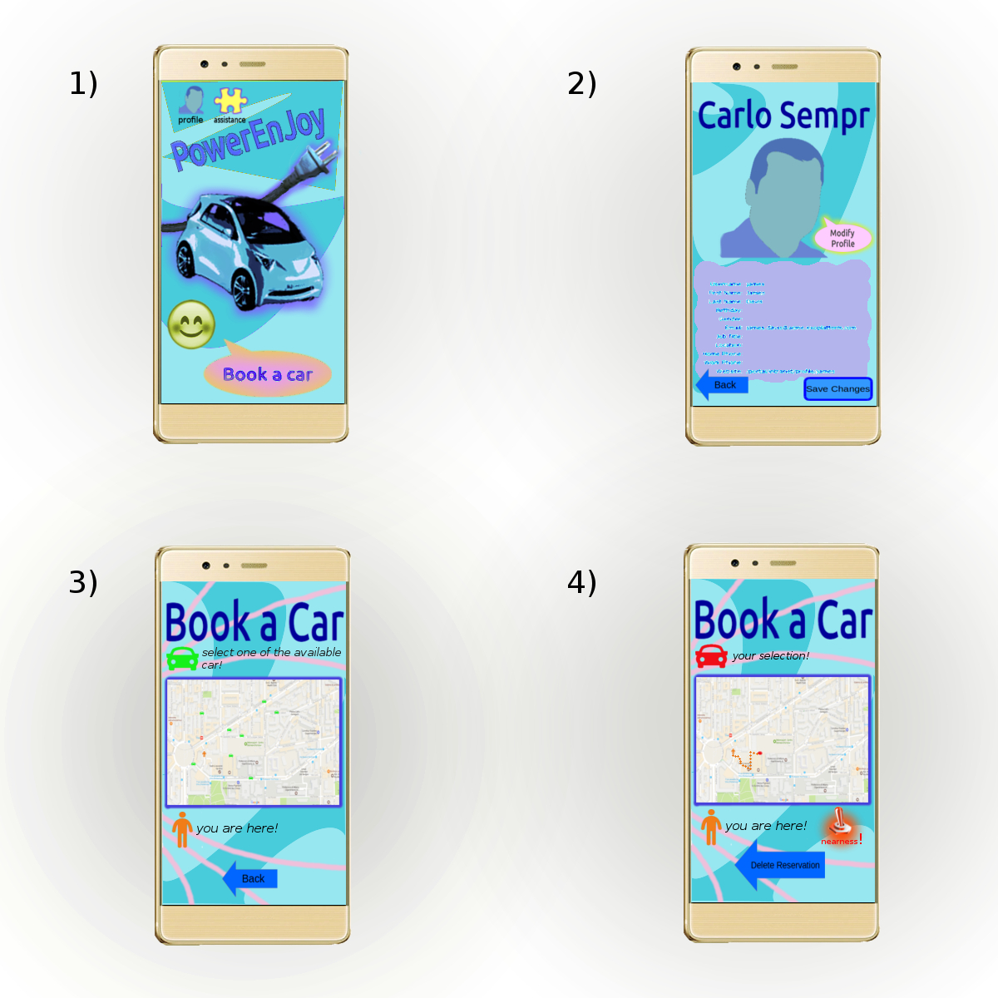
Non Functional Requirements: a very simple view for the Mobile App

