Slide 1
E-WASTE MANAGEMENT

Slide 2
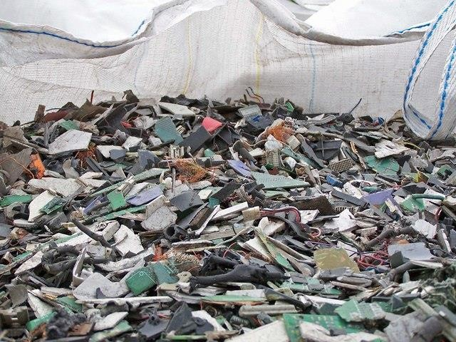
Introduction to E-Waste
Definition: E-waste (electronic waste) refers to discarded electrical or electronic devices that are no longer in use, such as computers, smartphones, televisions, refrigerators, and other household appliances.
Importance of the Topic: With the rapid growth of technology, the amount of e-waste is increasing, leading to environmental concerns due to harmful chemicals and materials.

Slide 3
2. Key Components of E-Waste
Common Components:
Metals (gold, silver, copper, etc.)
Plastics
Glass
Hazardous Materials (lead, mercury, cadmium, etc.)
Life Cycle of Electronics:
Production: Manufacturing of electronics using raw materials.
Use Phase: The period when the device is in use.
End-of-Life: When the device becomes obsolete or broken, leading to disposal

Slide 4
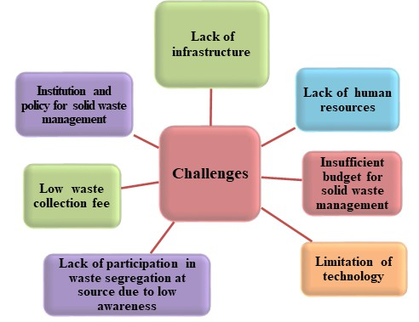
Challenges in E-Waste Management
Environmental Pollution: Toxic substances in e- waste can contaminate soil, water, and air.
Health Risks: Exposure to hazardous substances can lead to severe health issues like neurological damage and cancer.
Informal Recycling: Often e-waste is dismantled in unregulated conditions, posing risks to workers' health and causing environmental damage.

Slide 5
Importance of Proper E-Waste Management
Environmental Protection: Proper recycling prevents the release of harmful chemicals into the environment.
Resource Recovery: E-waste contains valuable materials like gold, silver, and copper, which can be recovered and reused.
Sustainability: Recycling e-waste reduces the need for mining new raw materials, thus conserving natural resources.

Slide 6
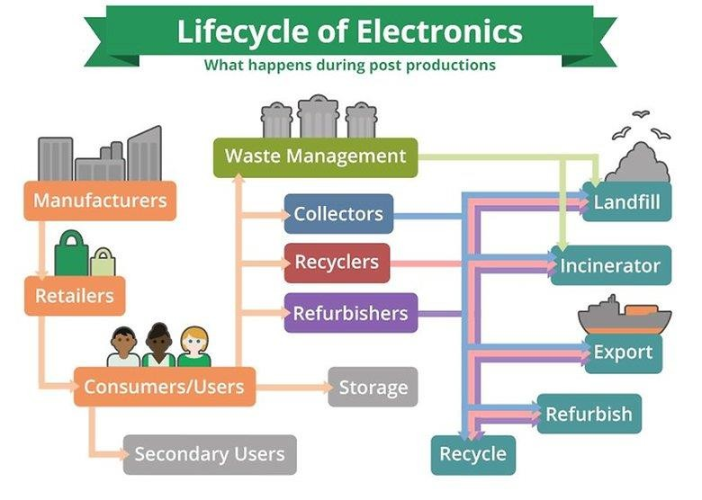
5. Theories and Strategies in E-Waste Management
Circular Economy: Focuses on the reuse, recycling, and refurbishing of electronic products to extend their lifecycle.
Design for Disassembly: Manufacturers can design products in a way that they can be easily dismantled at the end of their life cycle.
Product Take-back Programs: Encouraging consumers to return old products to the manufacturer for responsible recycling.
Extended Producer Responsibility (EPR): A policy approach where manufacturers take responsibility for the entire lifecycle of their products, including post- consumer disposal and recycling.
Technological Innovations: New recycling technologies that are more efficient in recovering valuable materials from e-waste.
ThePhoto by PhotoAuthor is licensed under CCYYSA.

Slide 7
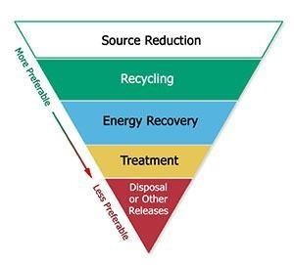
E-Waste Management Hierarchy
Prevention: Design products to be more durable and less harmful to the environment.
Reuse: Refurbish electronics for further use.
Recycle: Properly process e-waste to recover materials.
Dispose: Safe disposal of non-recyclable e-waste

Slide 8

7. Current Solutions for E-Waste Management
Recycling Centers: Formal recycling facilities that ensure safe processing of e-waste.
Responsible Consumer Practices: Consumers can drop off old electronics at recycling centers or use take-back services offered by manufacturers.
International Regulations: Policies like the Basel Convention that regulate the movement and disposal of hazardous e-waste across borders.
ThePhoto by PhotoAuthor is licensed under CCYYSA.

Slide 9
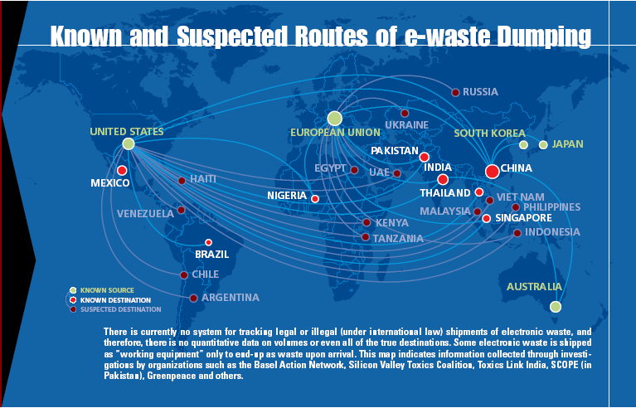
8. Global Examples and Best Practices
Japan: Highly efficient e-waste management practices with widespread use of e-waste recycling centers.
Switzerland: A leader in responsible recycling and extended producer responsibility policies.
India: Emerging policies and regulations, along with growth in e-waste recycling businesses.
Jenish Badarshahi & Mandip Jadeja
ThePhoto by PhotoAuthor is licensed under CCYYSA.

Slide 10
Conclusion
Sustainable Future: The goal of e-waste management is not only to reduce the environmental impact but to create a circular economy where electronic products are continuously reused and recycled.
Call to Action: Encourage individuals, businesses, and governments to take collective responsibility for e-waste management to ensure a cleaner, healthier planet.

Slide 11
THANK YOU

