Slide 1

CYBER SECURITY
Made by: Rudra and Pabitra
Class:11th

Slide 2

Introduction:
•Now a days we can not even think our lives without internet. Internet has not only provided so many facilities to us but also made tasks really easy.
•At the other hand, if it is not used carefully then it may be dangerous too.
• Therefore, it is required to know that what are the risks of using internet and what are the ethics of using internet. Today we are going to learn about cybersecurity.

Slide 3

What is cyber security?
-Cyber security is the practice of protecting systems, networks, and data from cyber threats such as hacking, malware, phishing, and data breaches.
-It involves a combination of technologies, processes, and best practices to safeguard sensitive information.

Slide 4
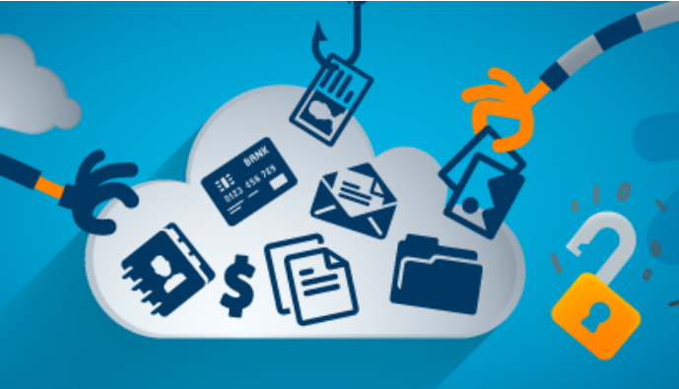
Key Aspects of Cybersecurity:
Network Security – Protecting networks from unauthorized access, attacks, and intrusions.
Information Security – Ensuring the confidentiality and integrity of data.
Application Security – Securing software and applications.
Cloud Security – Protecting data stored in cloud environments.
Endpoint Security – Safeguarding devices like computers, phones, and tablets.
6.Cyber Threat Intelligence – Identifying and analyzing potential cyber threats.

Slide 5

Common Cyber Threats:-
Phishing – Fraudulent emails or messages tricking users into revealing sensitive information.
Malware – Malicious software such as viruses, ransomware, and spyware.
DDoS Attacks– Overloading a website or network to cause disruption.
Man-in-the-Middle Attacks– Intercepting communication between two parties.
Zero-Day Exploits– Attacks on software vulnerabilities before they are fixed.

Slide 6

Importance of Cybersecurity:
Protects personal and financial information.
Prevents identity theft and fraud.
Ensures business continuity.
Safeguards national security.
Prevents Data Breaches.
Ensures that personal data is not misused.
Defends Against Cyber Attacks.

Slide 7
Key Sectors at Risk –
Banking & Finance– Digital payments and online banking make financial institutions vulnerable.
Healthcare – Data security in hospitals and online medical records is crucial.
Government & Defence – Protection of classified information from cyber espionage.
E-Commerce– Securing online transactions and customer data.
Telecommunications– Preventing hacking and data breaches in mobile networks.

Slide 8

Government Initiatives & Policies:
National Cyber Security Policy (NCSP) 2013.
Cyber Surakshit Bharat Initiative Indian.
India passed the Digital Personal Data Protection (DPDP) Act 2023.
IT Act, 2000 – The primary law dealing with cybercrime.

Slide 9

Tips Cybersecurity:
Use Strong Passwords (Create complex passwords).
Enable Two-Factor Authentication (2FA).
Beware of Phishing Attacks (Don't click on suspicious links) .
Keep Your Devices Updated (check for updates regularly).
Avoid Public Wi-Fi for Sensitive Activities .
Use Antivirus and Security Software.
Avoid sharing personal information on social media.

Slide 10

THANK
YOU

