Slide 1
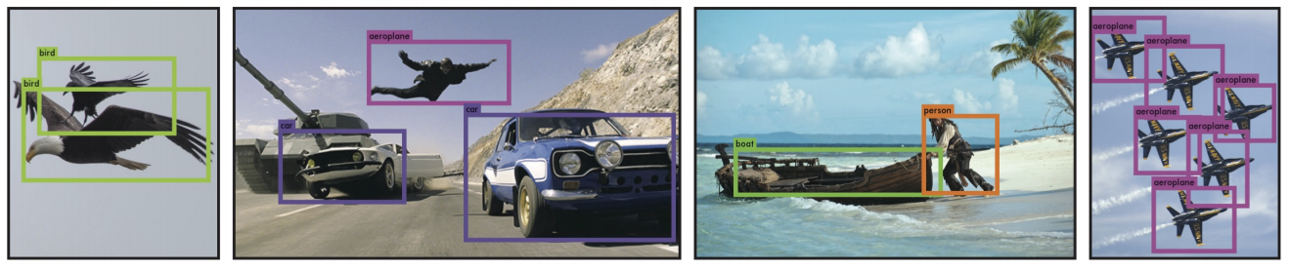
YOLO
You Only Look Once: Unified, Real-Time Object Detection
Joseph Redmon, Santosh Divvala, Ross Girshick, Ali Farhadi
University of Washington, Allen Institute for AI, Facebook AI Research

Slide 2
Image Understanding 3 levels
如何从图像中解析出可供计算机理解的信息，是机器视觉的中心问题。深度学习模型由于其强大的表示能力，加之数据量的积累和计算力的进步，成为机器视觉的热点研究方向。
那么，如何理解一张图片？根据后续任务的需要，有三个主要的层次。
Classification
Detection
Segmentation
即是将图像结构化为某一类别的信息，用事先确定好的类别(string)或实例ID来描述图片。这一任务是最简单、最基础的图像理解任务，也是深度学习模型最先取得突破和实现大规模应用的任务。其中，ImageNet是最权威的评测集，每年的ILSVRC催生了大量的优秀深度网络结构，为其他任务提供了基础。在应用领域，人脸、场景的识别等都可以归为分类任务。
分类任务关心整体，给出的是整张图片的内容描述，而检测则关注特定的物体目标，要求同时获得这一目标的类别信息和位置信息。相比分类，检测给出的是对图片前景和背景的理解，我们需要从背景中分离出感兴趣的目标，并确定这一目标的描述（类别和位置），因而，检测模型的输出是一个列表，列表的每一项使用一个数据组给出检出目标的类别和位置（常用矩形检测框的坐标表示）。
分割包括语义分割（semantic segmentation）和实例分割（instance segmentation），前者是对前背景分离的拓展，要求分离开具有不同语义的图像部分，而后者是检测任务的拓展，要求描述出目标的轮廓（相比检测框更为精细）。分割是对图像的像素级描述，它赋予每个像素类别（实例）意义，适用于理解要求较高的场景，如无人驾驶中对道路和非道路的分割。

Slide 3
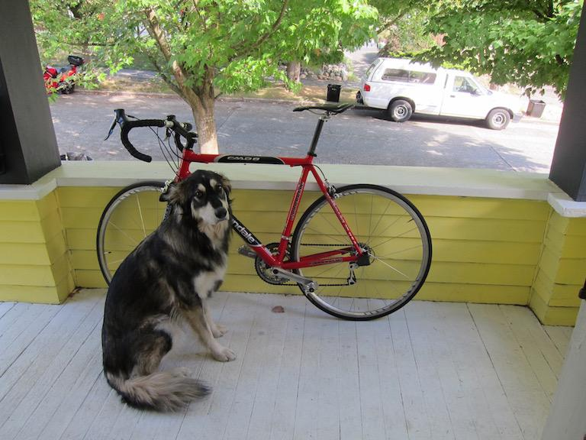
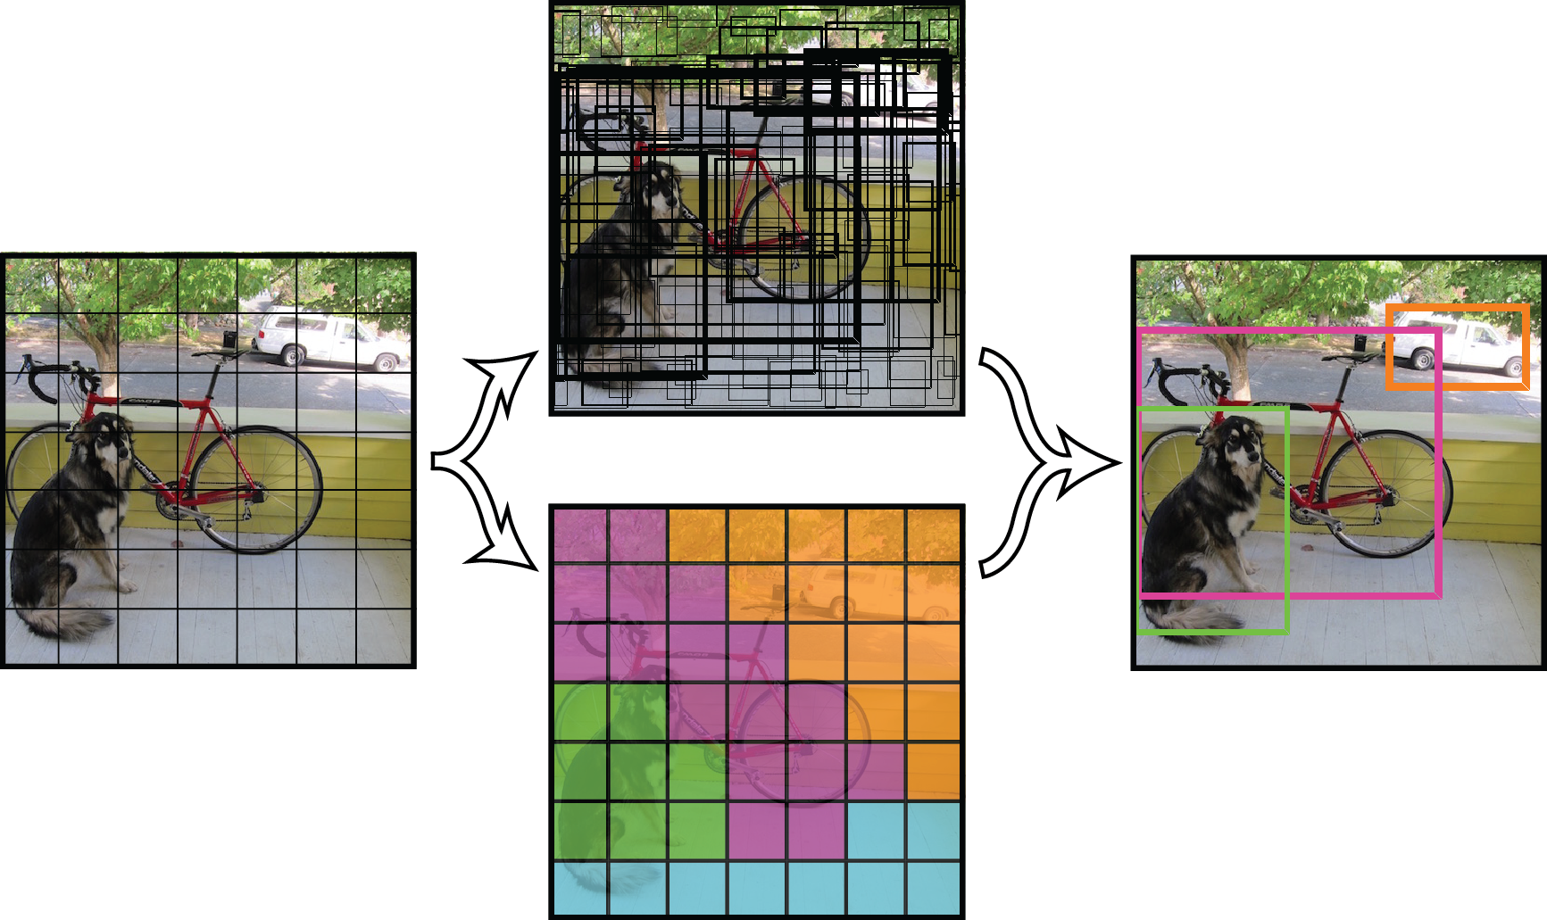
Object Detection Task
Input
image
448x448x3
output
image
x - coordinate of bbox center inside cell ([0; 1] wrt grid cell size)
y - coordinate of bbox center inside cell ([0; 1] wrt grid cell size)
w - bbox width ([0; 1] wrt image size)
h - bbox height ([0; 1] wrt image size)
c - class index i

Slide 4
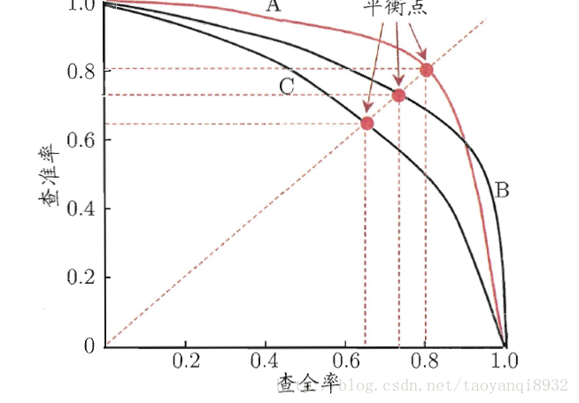
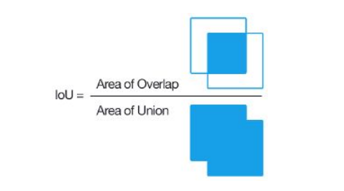
Evaluation Metric
平均精度（Average-Precision，AP）
AP就是Precision-recall 曲线下的面积，一个越好的分类器，AP值越高。
mean Average Precision(mAP)
mAP是多个类别AP的平均值。这个mean的意思是对每个类的AP再求平均，得到的就是mAP的值，mAP的大小一定在[0,1]区间，越大越好。该指标是目标检测算法中最重要的一个。

Slide 5
Big picture
mAP
YOLOv2
Faster R-CNN
FPS: 40
mAP: 78.6
FPS: 7
mAP: 73.2
SSD
Fast R-CNN
FPS: 58
mAP: 72.1
FPS: 0.5
mAP: 70
YOLO
FPS: 45
mAP: 63.4
R-CNN
FPS: -
mAP: 58.5
DPM
FPS: 0.5
mAP: 34.3
Dec 2016
Time
Nov 2013
Apr 2015
June 2015
Dec 2015
Test sets Pascal VOC 2007. trainval sets VOC 2007+2012

Slide 6
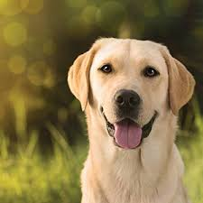
Pretrain on ImageNet1000- GoogLeNet modification (20 layers)
20 Conv.Layers
Input
image
Conv.Layers
Conv.Layers
Conv.Layers
Conv.Layers
Avgpool
FC
224x224x3
112x112x192
56x56x256
28x28x512
14x14x1024
7x7x1024
1000x1
Dog score
1
Dog score
0.9
categorical_crossentropy
softmax

Slide 7
Inference
Input
image
448x448x3

Slide 8
Inference
Input
image
GoogLeNet modification
(20 layers)
14x14x1024
448x448x3

Slide 9
Inference
Input
image
GoogLeNet modification
(20 layers)
C,R
14x14x1024
14x14x1024
448x448x3

Slide 10
Inference
Input
image
GoogLeNet modification
(20 layers)
C,R
C,R
14x14x1024
14x14x1024
14x14x1024
448x448x3

Slide 11
Inference
Input
image
GoogLeNet modification
(20 layers)
C,R
C,R
C,R
14x14x1024
14x14x1024
14x14x1024
7x7x1024
448x448x3

Slide 12
Inference
Input
image
GoogLeNet modification
(20 layers)
C,R
C,R
C,R
C,R
14x14x1024
14x14x1024
14x14x1024
7x7x1024
7x7x1024
448x448x3

Slide 13
Inference
Input
image
GoogLeNet modification
(20 layers)
C,R
C,R
C,R
C,R
FC,R
14x14x1024
14x14x1024
14x14x1024
7x7x1024
7x7x1024
4096x1
448x448x3

Slide 14
Inference
Input
image
GoogLeNet modification
(20 layers)
C,R
C,R
C,R
C,R
FC,R
FC
14x14x1024
14x14x1024
14x14x1024
7x7x1024
7x7x1024
4096x1
1470x1
448x448x3

Slide 15
Inference
Input
image
GoogLeNet modification
(20 layers)
C,R
C,R
C,R
C,R
FC,R
FC
Reshape
7x7x1024
7x7x1024
7x7x30
14x14x1024
14x14x1024
14x14x1024
4096x1
1470x1
448x448x3

Slide 16
Inference
Input
image
GoogLeNet modification
(20 layers)
C,R
C,R
C,R
C,R
FC,R
FC
Reshape
7x7x1024
7x7x1024
7x7x30
14x14x1024
14x14x1024
14x14x1024
4096x1
1470x1
448x448x3
Detection Procedure

Slide 17
Inference
Input
image
GoogLeNet modification
(20 layers)
C,R
C,R
C,R
C,R
FC,R
FC
Reshape
7x7x1024
7x7x1024
7x7x30
14x14x1024
14x14x1024
14x14x1024
Train from scratch
4096x1
1470x1
448x448x3
Detection Procedure

Slide 18
Inference
use new additional conv layers => better performance
Input
image
GoogLeNet modification
(20 layers)
C,R
C,R
C,R
C,R
FC,R
FC
Reshape
7x7x1024
7x7x1024
7x7x30
14x14x1024
14x14x1024
14x14x1024
4096x1
1470x1
448x448x3
Detection Procedure

Slide 19
Inference
Input
image
Detection
Procedure
GoogLeNet modification
(20 layers)
C,R
C,R
C,R
C,R
FC,R
FC
Reshape
7x7x30
14x14x1024
14x14x1024
14x14x1024
7x7x1024
7x7x1024
4096x1
1470x1
448x448x3
Tensor values interpretation
7
7
30

Slide 20
Inference
Input
image
Detection
Procedure
GoogLeNet modification
(20 layers)
C,R
C,R
C,R
C,R
FC,R
FC
Reshape
7x7x30
14x14x1024
14x14x1024
14x14x1024
7x7x1024
7x7x1024
4096x1
1470x1
448x448x3
Tensor values interpretation
7
7
30

Slide 21
Inference
Input
image
Detection
Procedure
GoogLeNet modification
(20 layers)
C,R
C,R
C,R
C,R
FC,R
FC
Reshape
7x7x30
14x14x1024
14x14x1024
14x14x1024
7x7x1024
7x7x1024
4096x1
1470x1
448x448x3
Tensor values interpretation
7
7
30
7
grid cell
7

Slide 22
Inference
Input
image
Detection
Procedure
GoogLeNet modification
(20 layers)
C,R
C,R
C,R
C,R
FC,R
FC
Reshape
7x7x30
14x14x1024
14x14x1024
14x14x1024
7x7x1024
7x7x1024
4096x1
1470x1
448x448x3
Tensor values interpretation
7
7
30
7
grid cell
7

Slide 23
Inference
Input
image
Detection
Procedure
GoogLeNet modification
(20 layers)
C,R
C,R
C,R
C,R
FC,R
FC
Reshape
7x7x30
14x14x1024
14x14x1024
14x14x1024
7x7x1024
7x7x1024
4096x1
1470x1
448x448x3
Tensor values interpretation
1x30
7
7
30
7
grid cell
7

Slide 24
Inference
Input
image
Detection
Procedure
GoogLeNet modification
(20 layers)
C,R
C,R
C,R
C,R
FC,R
FC
Reshape
7x7x30
14x14x1024
14x14x1024
14x14x1024
7x7x1024
7x7x1024
4096x1
1470x1
448x448x3
Tensor values interpretation
1x30
5
7
x - coordinate of bbox center inside cell ([0; 1] wrt grid cell size)
y - coordinate of bbox center inside cell ([0; 1] wrt grid cell size)
w - bbox width ([0; 1] wrt image)
h - bbox height ([0; 1] wrt image)
c - bbox confidence ~ P(obj in bbox1)
7
30
7
grid cell
7

Slide 25
Inference
Input
image
Detection
Procedure
GoogLeNet modification
(20 layers)
C,R
C,R
C,R
C,R
FC,R
FC
Reshape
7x7x30
14x14x1024
14x14x1024
14x14x1024
7x7x1024
7x7x1024
4096x1
1470x1
448x448x3
Tensor values interpretation
1x30
5
5
7
x - coordinate of bbox center inside cell ([0; 1] wrt grid cell size)
y - coordinate of bbox center inside cell ([0; 1] wrt grid cell size)
w - bbox width ([0; 1] wrt image)
h - bbox height ([0; 1] wrt image)
c - bbox confidence ~ P(obj in bbox2)
7
30
7
grid cell
7

Slide 26
Inference
Input
image
Detection
Procedure
GoogLeNet modification
(20 layers)
C,R
C,R
C,R
C,R
FC,R
FC
Reshape
7x7x30
14x14x1024
14x14x1024
14x14x1024
7x7x1024
7x7x1024
4096x1
1470x1
448x448x3
Tensor values interpretation
1x30
5
5
7
7
30
two bboxes for each grid cell
7
grid cell
7

Slide 27
Inference
Input
image
Detection
Procedure
GoogLeNet modification
(20 layers)
C,R
C,R
C,R
C,R
FC,R
FC
Reshape
7x7x30
14x14x1024
14x14x1024
14x14x1024
7x7x1024
7x7x1024
4096x1
1470x1
448x448x3
Tensor values interpretation
1x30
5
5
20 - number of classes
7
7
30
7
grid cell
7

Slide 28
Inference
Input
image
Detection
Procedure
GoogLeNet modification
(20 layers)
C,R
C,R
C,R
C,R
FC,R
FC
Reshape
7x7x30
14x14x1024
14x14x1024
14x14x1024
7x7x1024
7x7x1024
4096x1
1470x1
448x448x3
Tensor values interpretation
i (from 1 to 20)
1x30
5
5
20 - number of classes
Class score ~ P(obj is class_i | obj in box)
7
7
30
7
grid cell
7

Slide 29
Inference
Input
image
Detection
Procedure
GoogLeNet modification
(20 layers)
C,R
C,R
C,R
C,R
FC,R
FC
Reshape
7x7x30
14x14x1024
14x14x1024
14x14x1024
7x7x1024
7x7x1024
4096x1
1470x1
448x448x3
Tensor values interpretation
bb1 confidence
1x30
5
5
20
MUL
7
7
30
7
grid cell
Class scores for bb1
7
20x1

Slide 30
Inference
Input
image
Detection
Procedure
GoogLeNet modification
(20 layers)
C,R
C,R
C,R
C,R
FC,R
FC
Reshape
7x7x30
14x14x1024
14x14x1024
14x14x1024
7x7x1024
7x7x1024
4096x1
1470x1
448x448x3
Tensor values interpretation
bb2 confidence
1x30
5
5
20
MUL
7
7
30
7
grid cell
Class scores for bb2
7
20x1

Slide 31
Inference
Input
image
Detection
Procedure
GoogLeNet modification
(20 layers)
C,R
C,R
C,R
C,R
FC,R
FC
Reshape
7x7x30
14x14x1024
14x14x1024
14x14x1024
7x7x1024
7x7x1024
4096x1
1470x1
448x448x3
Tensor values interpretation
bb2 confidence
1x30
5
5
20
MUL
7
7
30
7
Do this operation for each bbox in each grid cell
grid cell
Class scores for bb2
7
20x1

Slide 32
Inference
Input
image
Detection
Procedure
GoogLeNet modification
(20 layers)
C,R
C,R
C,R
C,R
FC,R
FC
Reshape
7x7x30
14x14x1024
14x14x1024
14x14x1024
7x7x1024
7x7x1024
4096x1
1470x1
448x448x3
Tensor values interpretation
2 bboxes for first cell (1, 1)
bb1
bb2
7
7
30
grid cell (1, 1)
7
7
20x1
20x1

Slide 33
Inference
Input
image
Detection
Procedure
GoogLeNet modification
(20 layers)
C,R
C,R
C,R
C,R
FC,R
FC
Reshape
7x7x30
14x14x1024
14x14x1024
14x14x1024
7x7x1024
7x7x1024
4096x1
1470x1
448x448x3
Tensor values interpretation
2 bboxes for second cell (1, 2)
bb1
bb2
bb4
bb3
7
7
30
grid cell (1, 2)
7
7
20x1
20x1
20x1
20x1

Slide 34
Inference
Input
image
Detection
Procedure
GoogLeNet modification
(20 layers)
C,R
C,R
C,R
C,R
FC,R
FC
Reshape
7x7x30
14x14x1024
14x14x1024
14x14x1024
7x7x1024
7x7x1024
4096x1
1470x1
448x448x3
Tensor values interpretation
2 bboxes for last cell (7, 7)
bb1
bb2
bb4
bb97
bb98
bb3
7
7
30
7
…….
grid cell (7, 7)
7
20x1
20x1
20x1
20x1
20x1
20x1
20x1
20x1
20x1
20x1
20x1
20x1
20x1
20x1
20x1

Slide 35
Inference
Input
image
Detection
Procedure
GoogLeNet modification
(20 layers)
C,R
C,R
C,R
C,R
FC,R
FC
Reshape
7x7x30
14x14x1024
14x14x1024
14x14x1024
7x7x1024
7x7x1024
4096x1
1470x1
448x448x3
Tensor values interpretation
Total 7*7*2 = 98 bboxes
bb1
bb2
bb4
bb97
bb98
bb3
7
7
30
7
…….
grid cell (7, 7)
7

Slide 36








Loss Function for Training
判断第i个网格中第j个bbox是否负责这个object：与object的ground truth box的IoU最大的bbox负责该object
4: x y w h
坐标预测
1: confidence
$${ c}_{i}=P_{r}\left(object\right)∗{IoU}_{pred}^{truth}$$
$$λ_{coord}=5$$
$${ λ}_{noobj}=0.5$$
$$1_{ij}^{obj}=$$
$$1_{i}^{obj}=$$
4: x y w h
1: confidence
含有object的bbox的Confidence预测
1 If object center locate in grid i bbox j
20: p(ci)
不含object的bbox的Confidence预测
0 else
1 If object center locate in grid i
类别预测
0 else
判断是否有object的中心落在网格中：如果object的中心落在该网格中，则该网格就负责预测该object的该别概率

Slide 37
How to train？
Pretrain first 20 convolutional layers on ImageNet1000-class competition dataset for a week
→ achieve a single crop top-5 accuracy of 88%
Convert the model to perform detection.
Increase the input resolution from 224x224 to 448x448
Train the network on training and validation data from PASCAL VOC 2007 and 2012
Use the leaky Relu activation except for final layer
Train for about 135 epochs
batch_size -> 64 , momentum 0.9, decay 0.0005
First epoch : raise the learning rate from 10^-3 to 10^-2
Next 75 epochs : learning rate with 10^-2
Next 30 epochs : learning rate with 10^-3
Finally 30 epochs: learning rate with 10^-4
To avoid overfiting : use dropout layer with rate = 0.5 after the first fc layer
Data augumentation:
Introduce random scaling and translation of up to 20% of the original image size
random ajust the exposure and saturation by up to a factor of 1.5 in the HSV space

Slide 38
Look at detection procedure
Detection
Procedure
7x7x30

Slide 39
bb1
bb2
bb3
bb98
bb4
bb97
…….
20x1
20x1
Class scores for each bbox

Slide 40
bb1
bb2
bb3
bb98
bb4
bb97
Dog scores
…….
20x1
20x1
Class scores for each bbox
Get first class scores for each bbox

Slide 41
bb1
bb2
bb3
bb98
bb4
bb97
bb1
bb2
bb3
bb98
bb4
bb97
Dog scores
0
0
0
Set zero
if score < thresh1 (0.2)
…….
…….
20x1
20x1

Slide 42
bb98
bb1
bb2
bb98
bb1
bb2
bb3
bb3
bb98
bb4
bb97
bb1
bb2
bb3
bb98
bb4
bb4
bb97
Dog scores
0
0
0
0
0
0
Set zero
if score < thresh1 (0.2)
Sort descending
…….
…….
…….
20x1
20x1

Slide 43
bb98
bb1
bb2
bb98
bb1
bb2
bb3
bb3
bb98
bb4
bb97
bb1
bb2
bb3
bb98
bb4
bb4
bb97
bb1
bb2
bb98
bb3
bb98
bb4
Dog scores
0
0
0
0
0
0
0
0
0
0
Set zero
if score < thresh1 (0.2)
NMS algorithm set
scores to zero for redundant bboxes
Sort descending
…….
…….
…….
…….
20x1
20x1

Slide 44
bb98
bb1
bb2
bb98
bb1
bb2
bb3
bb3
bb98
bb4
bb97
bb1
bb2
bb3
bb98
bb4
bb4
bb97
bb1
bb2
bb98
bb3
bb98
bb4
Dog scores
0
0
0
0
0
0
0
0
0
0
Set zero
if score < thresh1 (0.2)
NMS algorithm set
scores to zero for redundant bboxes
Sort descending
…….
…….
…….
…….
20x1
20x1
How it works

Slide 45
Non-Maximum Suppression: intuition

Slide 46
Non-Maximum Suppression: intuition
class (dog) scores for each bbox
bb47
bb20
bb15
bb7
bb1
bb4
bb8
bb98
class: dog
0.5
0.3
0.2
0.1
0
0
0
0
1x98

Slide 47
Non-Maximum Suppression: intuition
class (dog) scores for each bbox
bb47
bb20
bb15
bb7
bb1
bb4
bb8
bb98
class: dog
0.5
0.3
0.2
0.1
0
0
0
0
1x98

Slide 48
Non-Maximum Suppression: intuition
class (dog) scores for each bbox
bb47
bb20
bb15
bb7
bb1
bb4
bb8
bb98
class: dog
0.5
0.3
0.2
0.1
0
0
0
0
1x98

Slide 49
Non-Maximum Suppression: intuition
class (dog) scores for each bbox
bb47
bb20
bb15
bb7
bb1
bb4
bb8
bb98
class: dog
0.5
0.3
0.2
0.1
0
0
0
0
1x98

Slide 50
Non-Maximum Suppression: intuition
class (dog) scores for each bbox
bb47
bb20
bb15
bb7
bb1
bb4
bb8
bb98
class: dog
0.5
0.3
0.2
0.1
0
0
0
0
1x98

Slide 51
Non-Maximum Suppression: intuition
class (dog) scores for each bbox
bb47
bb20
bb15
bb7
bb1
bb4
bb8
bb98
class: dog
0.5
0.3
0.2
0.1
0
0
0
0
1x98

Slide 52
Non-Maximum Suppression: intuition
class (dog) scores for each bbox
bb47
bb20
bb15
bb7
bb1
bb4
bb8
bb98
class: dog
0.5
0.3
0.2
0.1
0
0
0
0
1x98
Get bbox with max score. Let’s denote it “bbox_max”

Slide 53
Non-Maximum Suppression: intuition
class (dog) scores for each bbox
bb47
bb20
bb15
bb7
bb1
bb4
bb8
bb98
class: dog
0.5
0.3
0.2
0.1
0
0
0
0
1x98
Compare “bbox_max” with others less score (non-zero!) bboxes. Let’s denote it “bbox_cur”

Slide 54
Non-Maximum Suppression: intuition
class (dog) scores for each bbox
bb47
bb20
bb15
bb7
bb1
bb4
bb8
bb98
class: dog
0.5
0.3
0.2
0.1
0
0
0
0
1x98
If IoU(bbox_max, bbox_cur) > 0.5 then set 0 score to bbox_cur.

Slide 55
Non-Maximum Suppression: intuition
class (dog) scores for each bbox
bb47
bb20
bb15
bb7
bb1
bb4
bb8
bb98
class: dog
0.5
0
0.2
0.1
0
0
0
0
1x98
If IoU(bbox_max, bbox_cur) > 0.5 then set 0 score to bbox_cur.
In this case: set to 0.

Slide 56
Non-Maximum Suppression: intuition
class (dog) scores for each bbox
bb47
bb20
bb15
bb7
bb1
bb4
bb8
bb98
class: dog
0.5
0
0.2
0.1
0
0
0
0
1x98
Go to next bbox_cur.

Slide 57
Non-Maximum Suppression: intuition
class (dog) scores for each bbox
bb47
bb20
bb15
bb7
bb1
bb4
bb8
bb98
class: dog
0.5
0
0.2
0.1
0
0
0
0
1x98
Go to next bbox_cur.
If IoU(bbox_max, bbox_cur) > 0.5 then set 0 score to bbox_cur.

Slide 58
Non-Maximum Suppression: intuition
class (dog) scores for each bbox
bb47
bb20
bb15
bb7
bb1
bb4
bb8
bb98
class: dog
0.5
0
0.2
0.1
0
0
0
0
1x98
Go to next bbox_cur.
If IoU(bbox_max, bbox_cur) > 0.5 then set 0 score to bbox_cur.
In this case: continue.

Slide 59
Non-Maximum Suppression: intuition
class (dog) scores for each bbox
bb47
bb20
bb15
bb7
bb1
bb4
bb8
bb98
class: dog
0.5
0
0.2
0.1
0
0
0
0
1x98
Go to next bbox_cur.

Slide 60
Non-Maximum Suppression: intuition
class (dog) scores for each bbox
bb47
bb20
bb15
bb7
bb1
bb4
bb8
bb98
class: dog
0.5
0
0.2
0.1
0
0
0
0
1x98
Go to next bbox_cur.
If IoU(bbox_max, bbox_cur) > 0.5 then set 0 score to bbox_cur.

Slide 61
Non-Maximum Suppression: intuition
class (dog) scores for each bbox
bb47
bb20
bb15
bb7
bb1
bb4
bb8
bb98
class: dog
0.5
0
0.2
0.1
0
0
0
0
1x98
Go to next bbox_cur.
If IoU(bbox_max, bbox_cur) > 0.5 then set 0 score to bbox_cur.
In this case: continue.

Slide 62
Non-Maximum Suppression: intuition
class (dog) scores for each bbox
bb47
bb20
bb15
bb7
bb1
bb4
bb8
bb98
class: dog
0.5
0
0.2
0.1
0
0
0
0
1x98
Go to next bbox_cur.
If IoU(bbox_max, bbox_cur) > 0.5 then set 0 score to bbox_cur.
In this case: continue.
Do this procedure for other “bbox_cur”. After that ...

Slide 63
Non-Maximum Suppression: intuition
class (dog) scores for each bbox
bb47
bb20
bb15
bb7
bb1
bb4
bb8
bb98
class: dog
0.5
0.2
0
1x98
0
0.1
0
0
0
Go to next bbox with big score. Let’s denote it “bbox_max”

Slide 64
Non-Maximum Suppression: intuition
class (dog) scores for each bbox
bb47
bb20
bb15
bb7
bb1
bb4
bb8
bb98
class: dog
0.5
0.2
0
1x98
0
0.1
0
0
0
Go to next bbox_cur.

Slide 65
Non-Maximum Suppression: intuition
class (dog) scores for each bbox
bb47
bb20
bb15
bb7
bb1
bb4
bb8
bb98
class: dog
0.5
0.2
0
1x98
0
0.1
0
0
0
Go to next bbox_cur.
If IoU(bbox_max, bbox_cur) > 0.5 then set 0 score to bbox_cur.

Slide 66
Non-Maximum Suppression: intuition
class (dog) scores for each bbox
bb47
bb20
bb15
bb7
bb1
bb4
bb8
bb98
class: dog
0.5
0.2
0
0
1x98
0
0
0
0
Go to next bbox_cur.
If IoU(bbox_max, bbox_cur) > 0.5 then set 0 score to bbox_cur.
In this case: set to 0.
Do this procedure for other “bbox_max” and for other corresponding “bbox_cur”.

Slide 67
Non-Maximum Suppression: intuition
class (dog) scores for each bbox
bb47
bb20
bb15
bb7
bb1
bb4
bb8
bb98
class: dog
0.5
0.2
0
0
1x98
0
0
0
0
After comparison almost all pairs of bboxes the only two bboxes left with non-zero class score value.

Slide 68
bb98
bb1
bb2
bb98
bb1
bb2
bb3
bb3
bb98
bb4
bb97
bb1
bb2
bb3
bb98
bb4
bb4
bb97
bb1
bb2
bb98
bb3
bb98
bb4
Cat scores
0
0
0
0
0
0
0
0
0
0
Set zero
if score < thresh1 (0.2)
NMS algorithm set
scores to zero for redundant bboxes
Sort descending
…….
…….
…….
…….
20x1
20x1
Do this procedure for next class

Slide 69
bb98
bb1
bb2
bb98
bb1
bb2
bb3
bb3
bb98
bb4
bb97
bb1
bb2
bb3
bb98
bb4
bb4
bb97
bb1
bb2
bb98
bb3
bb98
bb4
Set zero
if score < thresh1 (0.2)
NMS algorithm set
scores to zero for redundant bboxes
Sort descending
…….
…….
…….
…….
person scores
0
0
0
0
0
0
0
0
0
0
20x1
20x1
Do this procedure for all classes

Slide 70
bb98
bb1
bb2
bb98
bb1
bb2
bb3
bb3
bb98
bb4
bb97
bb1
bb2
bb3
bb98
bb4
bb4
bb97
bb1
bb2
bb98
bb3
bb98
bb4
0
0
0
Set zero
if score < thresh1 (0.2)
NMS algorithm set
scores to zero for redundant bboxes
Sort descending
0
…….
…….
…….
…….
0
0
person scores
0
0
0
0
0
0
0
0
0
0
20x1
20x1
After this procedure -
a lot of zeros

Slide 71
bb98
bb1
bb2
bb98
bb1
bb2
bb3
bb3
bb98
bb4
bb97
bb1
bb2
bb3
bb98
bb4
bb4
bb97
bb1
bb2
bb98
bb3
bb98
bb4
0
0
0
Set zero
if score < thresh1 (0.2)
NMS algorithm set
scores to zero for redundant bboxes
Sort descending
0
…….
…….
…….
…….
0
0
person scores
0
0
0
0
0
0
0
0
0
0
20x1
20x1
Select bboxes to draw by class score values

Slide 72


bb98
bb1
bb2
bb97
bb1
bb2
bb3
bb3
bb98
bb4
bb97
bb1
bb2
bb3
bb98
bb4
bb4
bb97
bb1
bb2
bb97
bb3
bb98
bb4
0
0
0
Set zero
if score < thresh1 (0.2)
NMS algorithm set
scores to zero for redundant bboxes
Sort descending
0
…….
…….
…….
…….
0
0
0
0
0
0
0
0
0
0
0
0
20x1
20x1
class = max_index(scores for bb3);
score = max(scores for bb3);
skip bbox
no
Score > 0
yes
draw bbox with class color

Slide 73
bb98
bb1
bb2
bb97
bb1
bb2
bb3
bb3
bb98
bb4
bb97
bb1
bb2
bb3
bb98
bb4
bb4
bb97
bb1
bb2
bb97
bb3
bb98
bb4
0
0
0
Set zero
if score < thresh1 (0.2)
NMS algorithm set
scores to zero for redundant bboxes
Sort descending
0
…….
…….
…….
…….
0
0
0
0
0
0
0
0
0
0
0
0
20x1
20x1
class = max_index(scores for bb1);
score = max(scores for bb1);
skip bbox
no
Score > 0
yes
draw bbox with class color

Slide 74
bb98
bb1
bb2
bb97
bb1
bb2
bb3
bb3
bb98
bb4
bb97
bb1
bb2
bb3
bb98
bb4
bb4
bb97
bb1
bb2
bb97
bb3
bb98
bb4
0
0
0
Set zero
if score < thresh1 (0.2)
NMS algorithm set
scores to zero for redundant bboxes
Sort descending
0
…….
…….
…….
…….
0
0
0
0
0
0
0
0
0
0
0
0
20x1
20x1
class = max_index(scores for bb98);
score = max(scores for bb98);
skip bbox
no
Score > 0
yes
draw bbox with class color

Slide 75
bb98
bb1
bb2
bb97
bb1
bb2
bb3
bb3
bb98
bb4
bb97
bb1
bb2
bb3
bb98
bb4
bb4
bb97
bb1
bb2
bb97
bb3
bb98
bb4
0
0
0
Set zero
if score < thresh1 (0.2)
NMS algorithm set
scores to zero for redundant bboxes
Sort descending
0
…….
…….
…….
…….
0
0
0
0
0
0
0
0
0
0
0
0
20x1
20x1
class = max_index(scores for bb97);
score = max(scores for bb97);
skip bbox
no
Score > 0
yes
draw bbox with class color

Slide 76
bb98
bb1
bb2
bb97
bb1
bb2
bb3
bb3
bb98
bb4
bb97
bb1
bb2
bb3
bb98
bb4
bb4
bb97
bb1
bb2
bb97
bb3
bb98
bb4
Set zero
if score < thresh1 (0.2)
NMS algorithm set
scores to zero for redundant bboxes
Sort descending
…….
…….
…….
…….
0
0
0
0
0
0
0
0
0
0
20x1
20x1

Slide 77
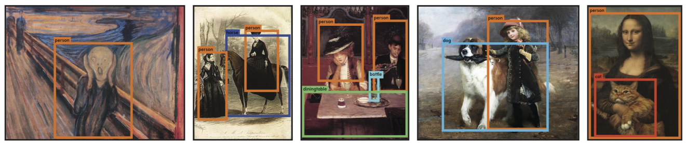
Key Points
Fast: YOLO - 45 fps, YOLO-tiny - 155 fps.
End-to-end training.
Makes more localization errors but is less likely to predict false positives on background
Performance is lower than the current state of the art.
Combined Fast R-CNN + YOLO model is one of the highest performing detection methods.
Learns very general representations of objects: it outperforms other detection methods, including DPM and R-CNN, when generalizing from natural images to other domains like artwork.

Slide 78
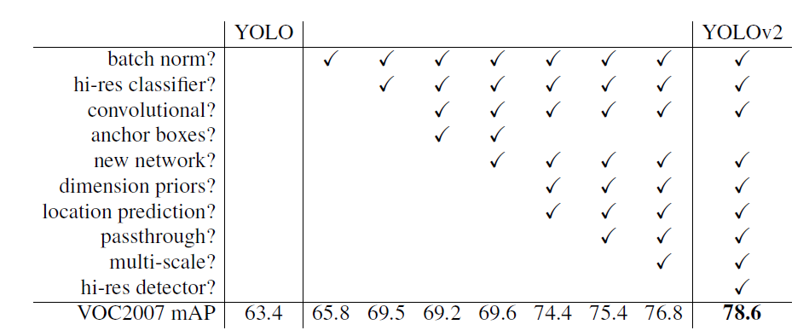
The path from YOLO to YOLOv2

Slide 79
Links
Arxiv: https://arxiv.org/abs/1506.02640
Blog: http://pjreddie.com/publications/yolo/
Darknet: https://github.com/pjreddie/darknet
Caffe: https://github.com/xingwangsfu/caffe-yolo
Tensorflow:
Test+train: https://github.com/thtrieu/yolotf
Test: https://github.com/gliese581gg/YOLO_tensorflow

Slide 80
欢迎大家批评指正
谢谢大家 !

