Slide 1


Untrodden Paths for Near Data Processing
Rajeev Balasubramonian
School of Computing, University of Utah

Slide 2

Near Data Processing
Present Day
Expectations
1995
2005
Time
Peak of Inflated Expectations
Plateau of Productivity
The Gartner Hype Curve

Slide 3

Zooming In
Expectations
Zero novelty ➔
See PIM
2011-2013: Many rejected papers
Too costly ➔
See DRAM vendors
Time
Plateau of Productivity
The Gartner Hype Curve

Slide 4
The Inflection Point
Inspired the term “Near Data Processing”
Micron’s Hybrid Memory Cube
Spawned the Workshop on NDP, 2013-2015
IEEE Micro Article, 2014
IEEE Micro Special Issue on NDP, 2016

Slide 5
The Inflection Point
Micron’s Hybrid Memory Cube
A low-cost approach to data/compute co-location

Slide 6
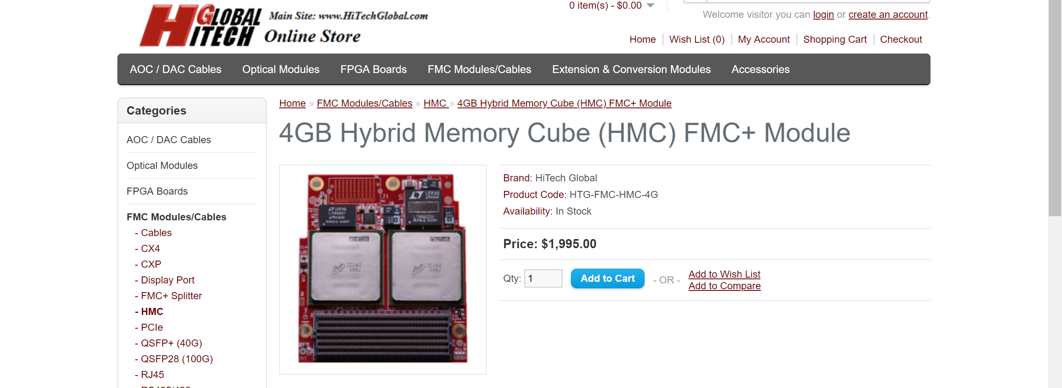
Low-Cost?
Demands a diversified portfolio …

Slide 7

Talk Outline
In-situ acceleration
Feature-rich DIMMs
Near-data security
MC
BoB
Processor
Image source: gizmodo

Slide 8
Memristors

Slide 9
In-Situ Operations
x₀
w₀₀
w₀₁
w₀₂
w₀₃
V1
G1
x₁
w₁₀
w₁₁
w₁₂
w₁₃
I1 = V1.G1
x₂
w₂₀
w₂₁
w₂₂
w₂₃
V2
G2
x₃
w₃₀
w₃₁
w₃₂
w₃₃
I2 = V2.G2
y₀
y₁
y₂
y₃
I = I1 + I2 =
V1.G1 + V2.G2

Slide 10
Machine Learning Acceleration
T
T
T
T
σ
OR
MP
eDRAM
Buffer
S+A
OR
DAC
XB
T
T
T
T
S+A
IR
ADC
S+H
T
T
T
T
ADC
IMA
IMA
IMA
IMA
DAC
XB
ADC
T
T
T
T
IMA
IMA
IMA
IMA
ADC
S+H
EXTERNAL IO INTERFACE
TILE
In-Situ Multiply Accumulate
CHIP (NODE)
Low leakage
No weight fetch
No Storage vs. Compute

Slide 11
DaDianNao

Slide 12
Challenges
High ADC power
Difficult to exploit sparsity
Precision and noise
Other workloads

Slide 13
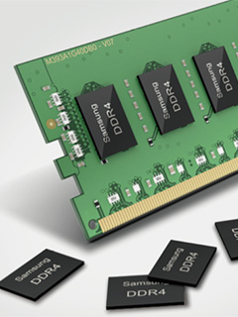
Focusing on Cost
Commodity DDR3 DRAM 70 pJ/bit
Commodity LPDDR2 40 pJ/bit
GDDR5 14 pJ/bit
HMC data access 10.5 pJ/bit
HMC SerDes links 4.5 pJ/bit
HBM data access 3.6 pJ/bit
HBM interposer link 0.3 pJ/bit
References:
Malladi et al., ISCA’12
Jeddeloh & Keeth, Symp. VLSI’12
O’Connor et al. MICRO’17
Image source: HardwareZone

Slide 14
Memory Interconnects
Wang et al., HPCA 2018
BoB
MC
Pugsley et al., IEEE Micro 2014
Processor
Interconnect architecture
Computation off-loading (what, where)
Auxiliary functions: coding, compression, encryption, etc.

Slide 15
Talk Outline
In-situ acceleration
Feature-rich DIMMs
Near-data security
MC
BoB
Processor
Image source: gizmodo

Slide 16
Memory Vulnerabilities
Malicious OS or hardware can modify data
Processor
OS
VM 1
CORE 1
Victim
MC
VM 2
CORE 2
Attacker
All buses are exposed

Slide 17
Spectre Overview
x is controlled by attacker
Thanks to bpred, x can be anything
array1[ ] is the secret
if (x < array1_size)
y = array2[ array1[x] ];
Victim Code
5
10
20
SECRETS
array1[ ]
Access pattern of array2[ ] betrays the secret
array2[ ]

Slide 18
Memory Defenses
Memory timing channels
Requires dummy memory accesses – overhead of up to 2x
Memory access patterns
Requires ORAM semantics – overhead of 280x
Memory integrity
Requires integrity trees and MACs – overhead of 10x
Prime candidate for NDP!

Slide 19
InvisiMem, ObfusMem
Exploits HMC-like active memory devices
MACs, deterministic schedule, double encryption
Easily handles integrity, timing channels, trace leakage
From Awad et al., ISCA 2017

Slide 20
Path ORAM
Leaf 17
Data
0x1
17
Data
0x1
25
Step 1. Check the PosMap for 0x1.
0x0
CPU
Step 2. Read path 17 to stash.
17
0x1
25
Step 3. Select data and change its leaf.
0x2
Stash
Step 4. Write back stash to path 17.
0x3
PosMap

Slide 21
Distributed ORAM with Secure DIMMs
Authenticated buffer chip
MC
ORAM operations shift from Processor to SDIMM.
ORAM traffic pattern shifts from the memory bus to on-SDIMM “private” buses.
Bandwidth α # SDIMMs.
No trust in memory vendor.
Commodity low-cost DRAM.
Processor
All buses are exposed
Buffer chip and processor communication is encrypted

Slide 22
SDIMM: Independent Protocol
ORAM split into 2 subtrees
Steps:
ACCESS(addr,DATA) to ORAM₀.
2
ORAM₀
2. Locally perform accessORAM.
CPU sends PROBE to check.
1
4
3
ORAM₁
4
CPU sends FETCH_RESULT.
New leaf ID assigned in CPU.
CPU
4. CPU broadcasts APPEND to all
SDIMMs to move the block.

Slide 23
SDIMM: Split Protocol
A
B
C
D
M
SDIMM 0
SDIMM 1
A₀
B₀
C₀
D₀
M₀
A₁
B₁
C₁
D₁
M₁
Odd bits of Data/Meta
Even bits of Data/Meta

Slide 24
SDIMM: Split Protocol
Read a path to local stashes.
1
5
2. Send metadada to CPU.
2
3. Re-assemble and decide writing
order.
1
5
4. Send metadata back to SDIMMs.
0
4
5. Write back the path based on
the order determined by CPU.
3

Slide 25
Take-Homes
NDP is the key to reduced data movement
3D-stacked memory+logic devices are great, but expensive!
Need diversified efforts:
New in-situ computation devices
Focus on traditional memory and interconnects
Focus on auxiliary features: security/privacy, compression, coding
Acks:
Utah Arch students: Ali Shafiee, Anirban Nag, Seth Pugsley
Collaborators: Mohit Tiwari, Feifei Li, Viji Srinivasan, Alper Buyuktosunoglu, Naveen Muralimanohar, Vivek Srikumar
Funding: NSF, Intel, IBM, HPE Labs.

