Slide 1
13th Workshop on General Purpose Processing Using GPU (GPGPU 2020) @ PPoPP2020
https://insight-archlab.github.io/gpgpu.html

Slide 2
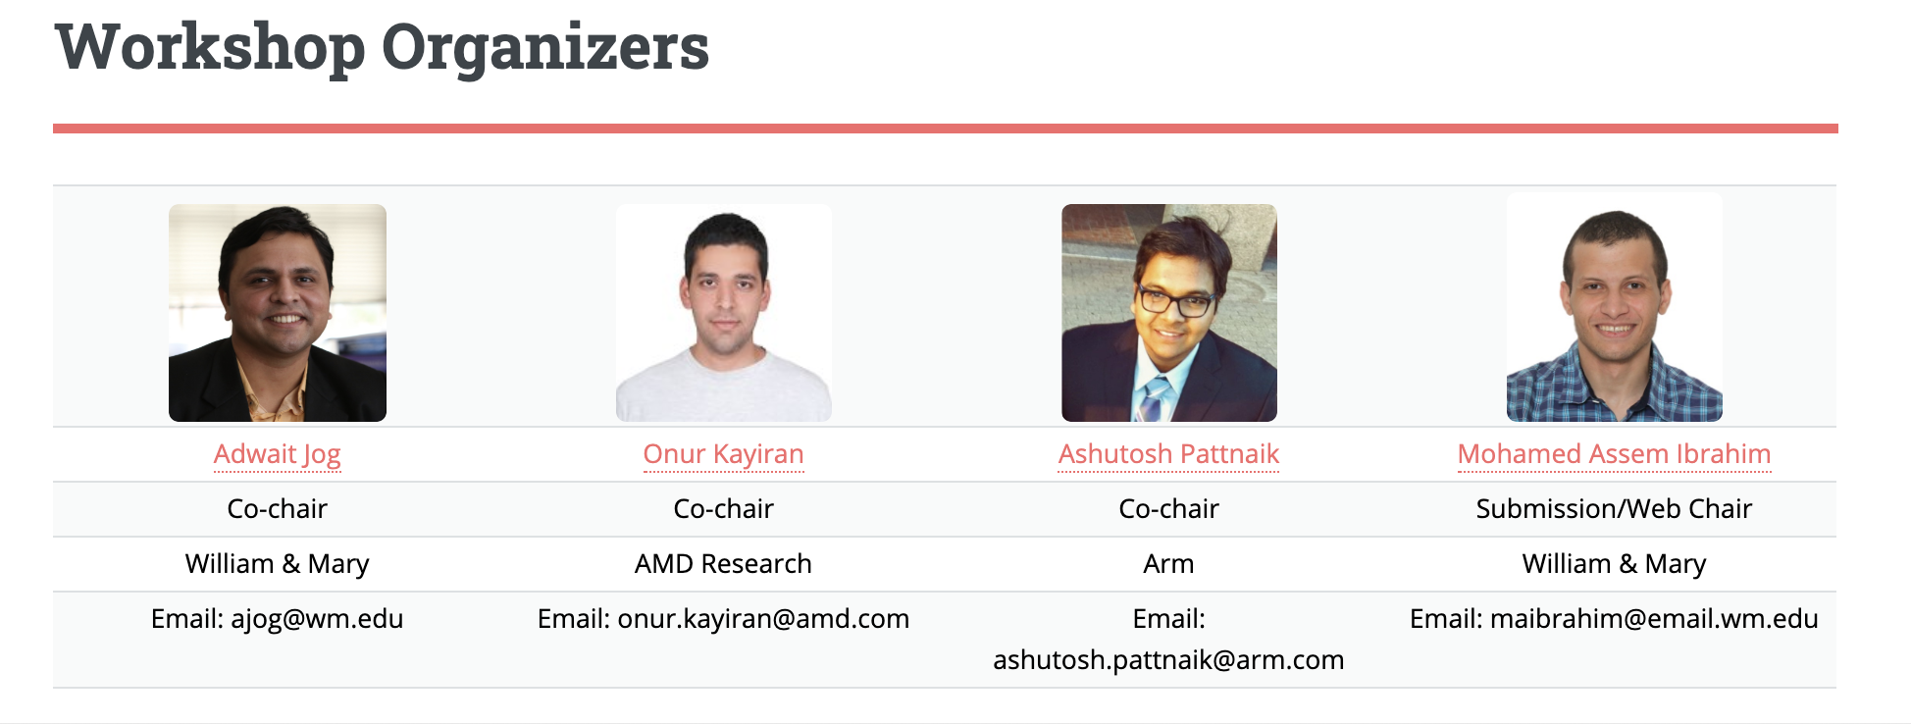

Slide 3
Scope
The goal of this workshop is to provide a forum to discuss new and emerging general-purpose graphics processing architectures, programming environments, and platforms, as well as evaluate applications that have been able to harness the horsepower provided by these platforms. Papers are being sought on many aspects of GPUs or accelerators, including (but not limited to):
GPU Applications
GPU Programming Environments
GPU Runtime Systems
GPU Compilation
GPU Architectures
Multi-GPU Systems
GPU Power/Efficiency
GPU Reliability
GPU Benchmarking/Measurements
Heterogeneous Architectures/Platforms
Non-von Neumann Architectures
Domain-specific Architectures
GPU Security
Machine/Deep Learning
Graphics

Slide 4
Paper Selection Process
12 full submissions
Each paper received 4 reviews from experts
Online discussion helped in reaching a consensus
7 papers accepted; 10 pages each
Topics span across: Graphs, Perf. Estimation, Implementation, Mobile-GPUs, Software, Testing, and Characterization
Accepted papers appear in ACM Online Conference Proceedings Series

Slide 5
Program Committee
Akhil Arunkumar, AMD
Amir Yazdanbakhsh, Google Research
Anthony Gutierrez, AMD Research
Bin Ren, William & Mary
Biswabandan Panda, IIT Kanpur
Bo Wu, Colorado School of Mines
Daniel Wong, UC Riverside
David Kaeli, Northeastern University
Elaheh Sadredini, University of Virginia
Gunjae Koo, Hongik University
Huiyang Zhou, North Carolina State University
Hyeran Jeon, San Jose State University
Jieming Yin, AMD Research
Jin Wang, NVIDIA
Karthik Vadambacheri Manian, The Ohio State University
Meena Arunachalam, Intel
Mehmet E. Belviranli, Colorado School of Mines
Michael Gowanlock, Northern Arizona University
Michael LeBeane, AMD Research
Nael Abu-Ghazaleh, UC Riverside
Nandita Vijaykumar, Carnegie Mellon University
Newsha Ardalani, Baidu Research
Philip Garcia, Arm
Rachata Ausavarungnirun, TGGS, KMUTNB
Sonia Lopez Alarcon, Rochester Institute of Technology
Xia Zhao, Ghent University
Yifan Sun, Northeastern University
Zeid Samoail, Arm

Slide 6
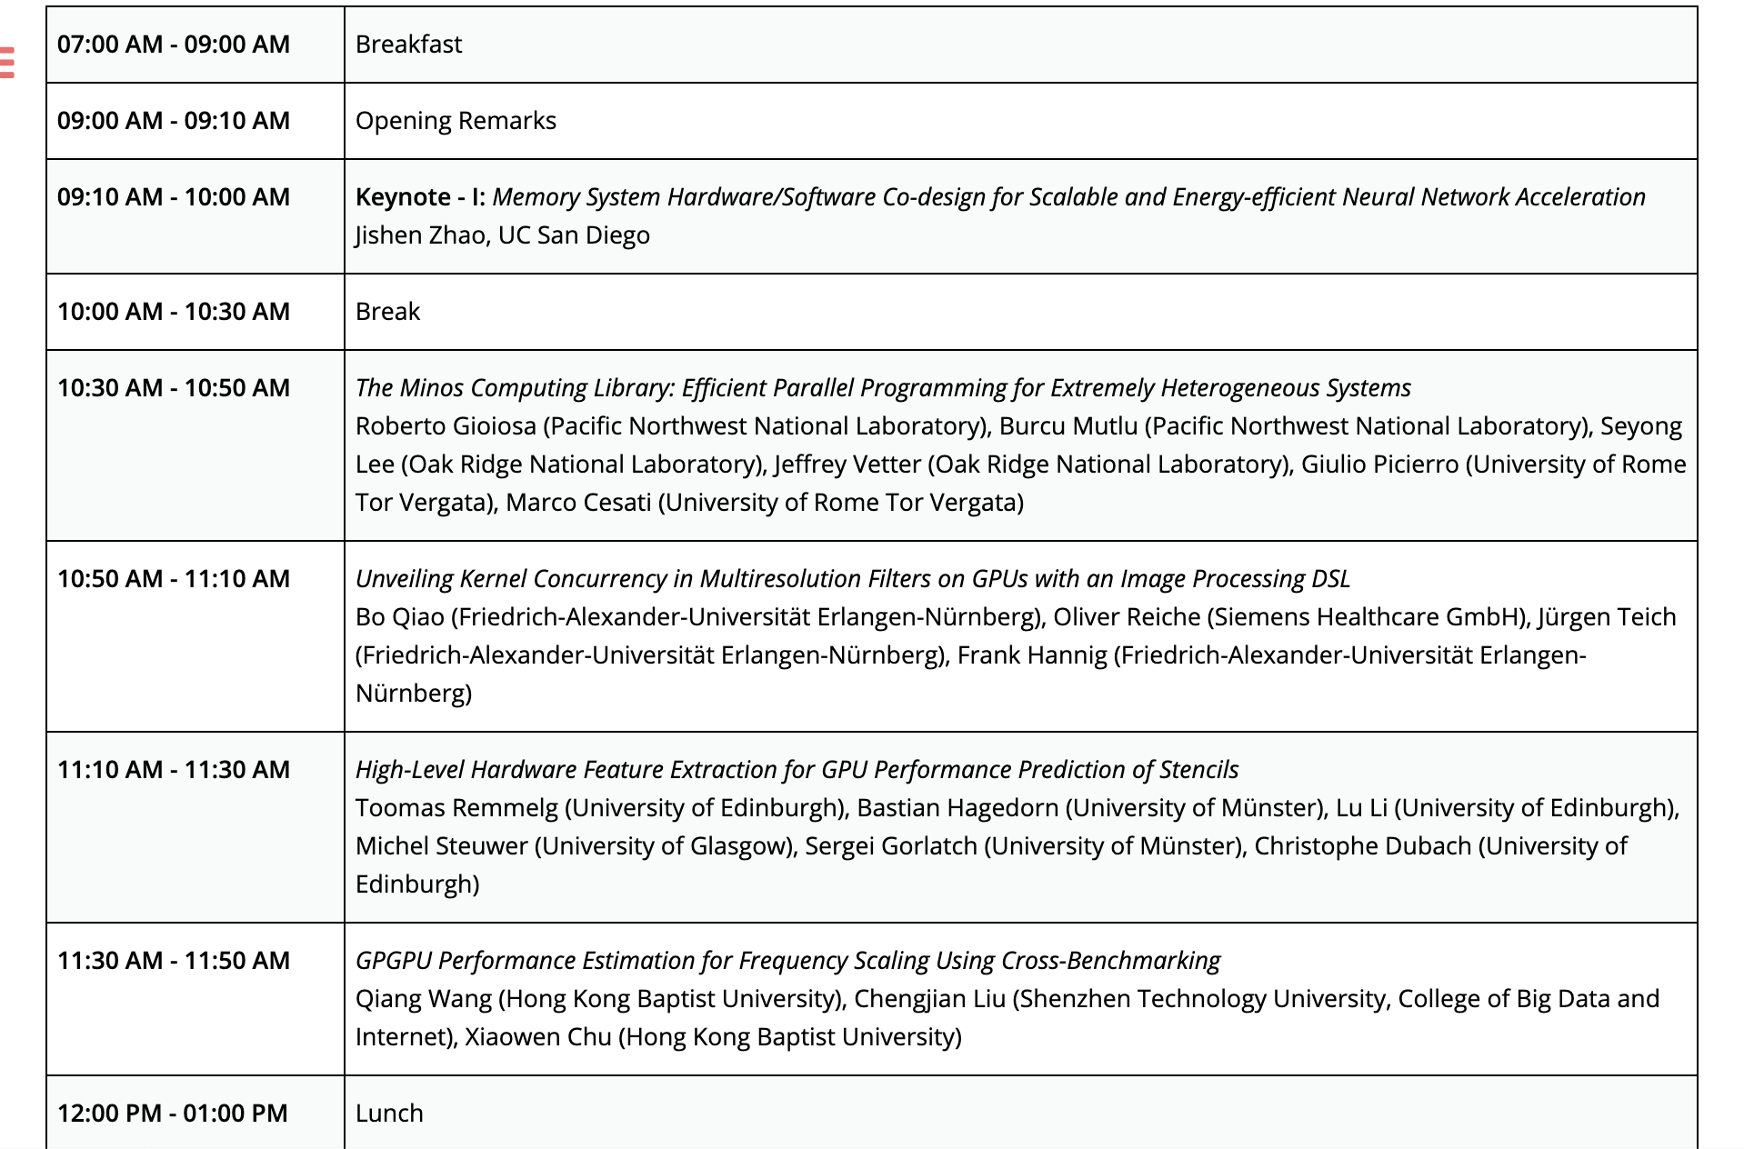
Morning Schedule

Slide 7
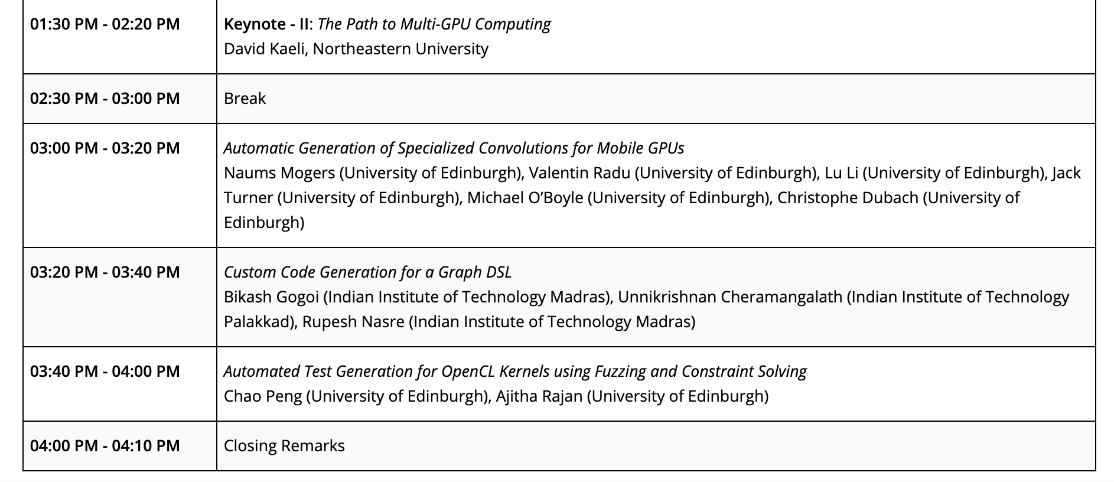
Afternoon Schedule

Slide 8
Keynote Speakers
Jishen Zhao
Assistant Professor, UC San Diego
Memory System Hardware/Software Co-design for Scalable and Energy-efficient Neural Network Acceleration
David Kaeli
Distinguished Professor, Northeastern
The Path to Multi-GPU Computing

Slide 9
Keynote 1
Jishen Zhao
Memory System Hardware/Software Co-design for Scalable and Energy-efficient Neural Network Acceleration

Slide 10
Closing Remarks

Slide 11
Closing
Hope you enjoyed the workshop
We thank authors for submitting papers to the workshop and making it successful.
We thank all speakers for their wonderful talks
Please send us feedback – What can be done in the future to make the workshop better?
If you want to serve on the PC or on the organizing committee, please send us email!
We want to make this workshop more inclusive
Email: ajog@wm.edu, onur.kayiran@amd.com, ashutosh@psu.edu

