Slide 1
Computing In-Situ and In-Transit
Lizy K. John
The University of Texas at Austin
Notes:
Big Data Benchmarking

Slide 2
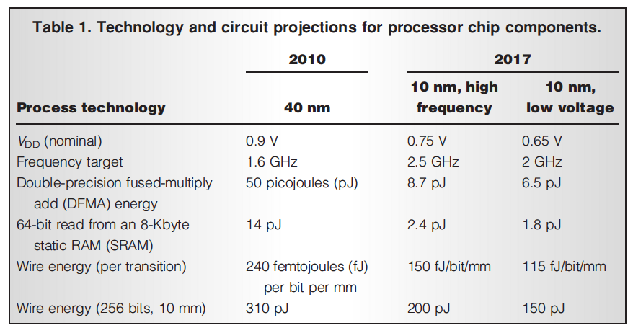
ENERGY COST OF MOVING DATA
Keckler et al (Nvidia) IEEE Micro Sept 2011
Laboratory of Computer Architecture, UT Austin

Slide 3
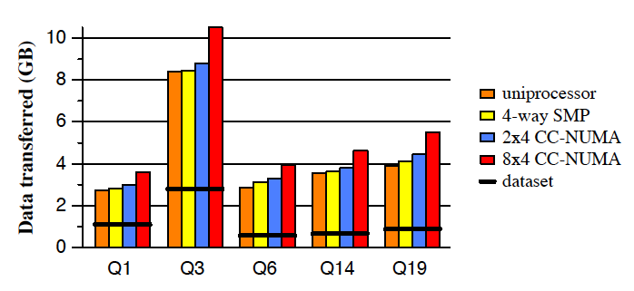
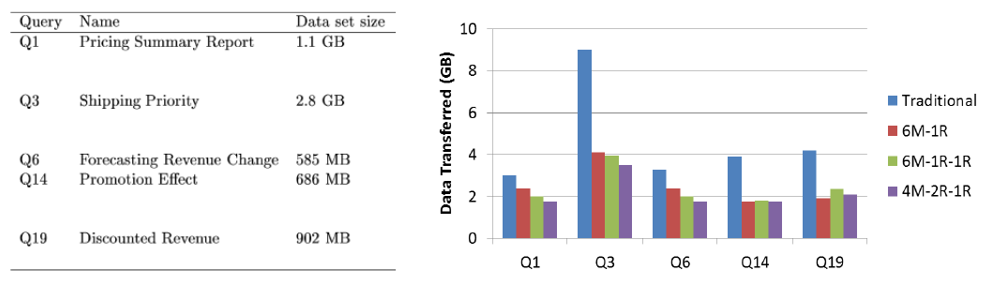
Moving Data is Expensive but We Often Move Lots of Data
Amount of Data Moved Versus Amount of Data to be Processed
JUAN RUBIO’s Ph. D Dissertation, 2005 (UT ECE)
Laboratory of Computer Architecture, UT Austin

Slide 4
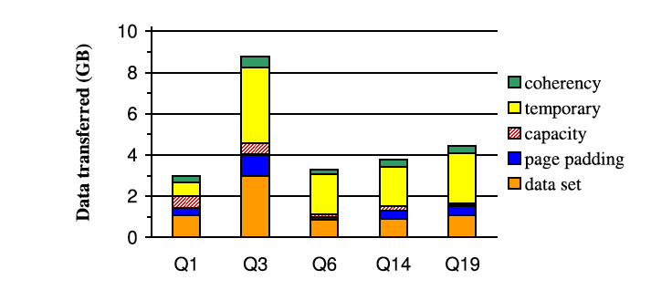
Classification of the Data Transferred (Rubio)
Laboratory of Computer Architecture, UT Austin

Slide 5
COMPUTE IN-SITU
Compute in the Caches
Compute in the DRAM
Compute in the Disk
Compute in the core the data is (heterogeneous cores)
Compute where the data is
Compute in the CPU or the accelerator where the data is?
Laboratory of Computer Architecture, UT Austin

Slide 6
COMPUTE IN-TRANSIT
Compute while moving data from memory to core
Compute in the Memory Controllers
Compute while moving from CPU to GPU or vice versa
Compute while moving data to accelerators
Laboratory of Computer Architecture, UT Austin

Slide 7
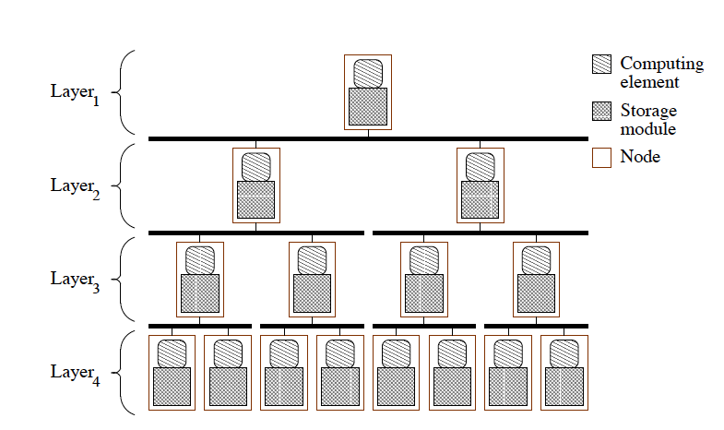
Hierarchical Computing (Rubio Dissertation)
Laboratory of Computer Architecture, UT Austin

Slide 8
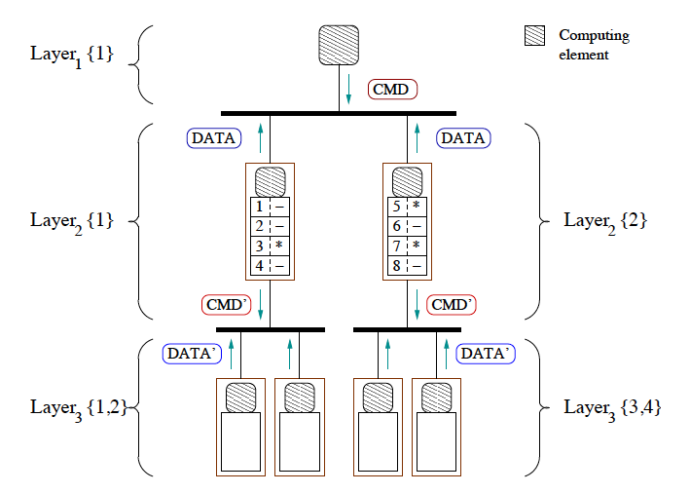
Hierarchical Computing – Task Decomposition
Laboratory of Computer Architecture, UT Austin

Slide 9
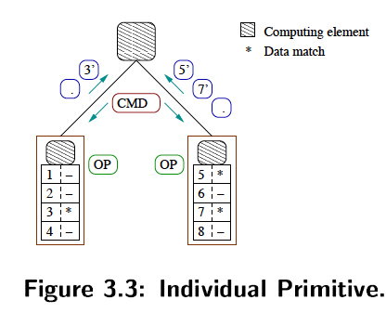
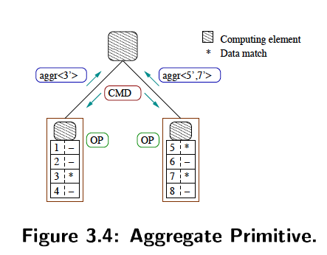
Primitives
Laboratory of Computer Architecture, UT Austin

Slide 10
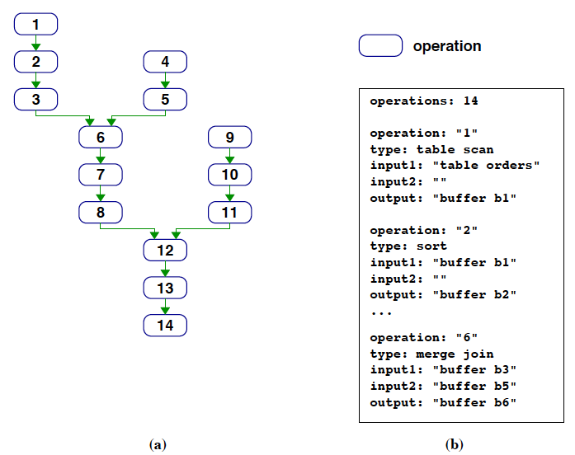
Task Mapping
Laboratory of Computer Architecture, UT Austin

Slide 11
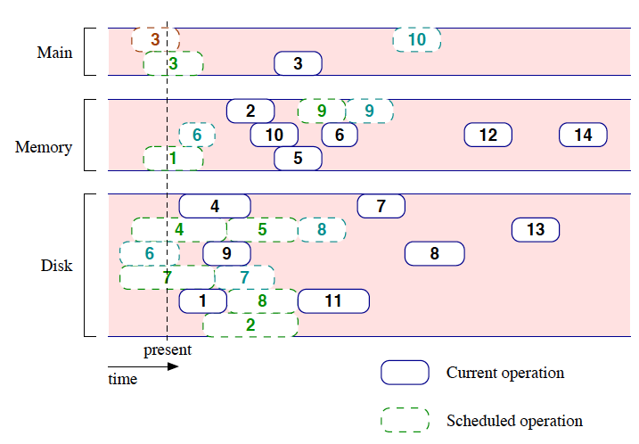
Tasks mapped to various layers in the hierarchical system
Laboratory of Computer Architecture, UT Austin

Slide 12
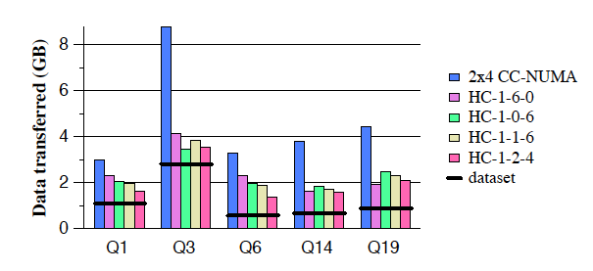
Data Transfer in the Hierarchical Computing
Laboratory of Computer Architecture, UT Austin

Slide 13
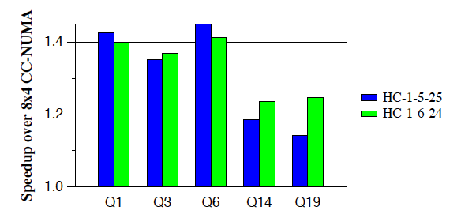
Speedup of Hierarchical Computing
Laboratory of Computer Architecture, UT Austin

Slide 14
Technology Developments Better Aligned Now
Laboratory of Computer Architecture, UT Austin

Slide 15
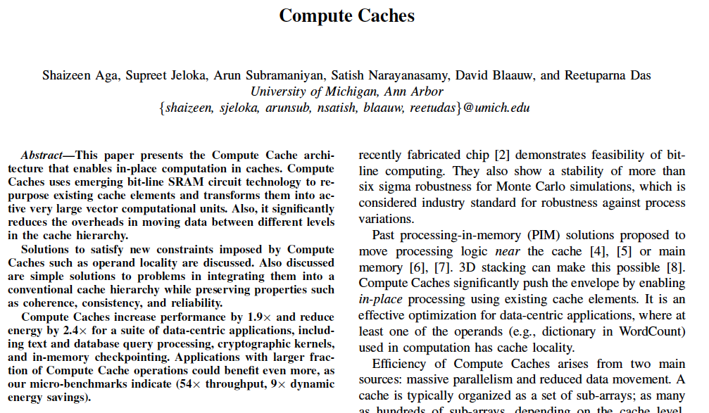
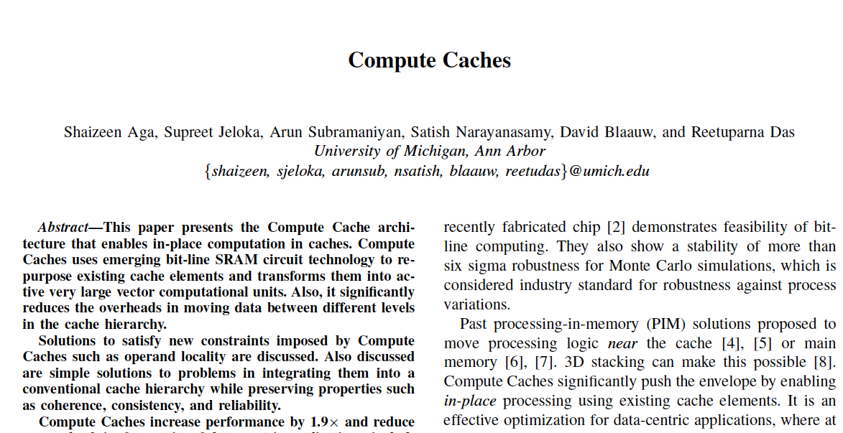
HPCA 2017
Laboratory of Computer Architecture, UT Austin

Slide 16
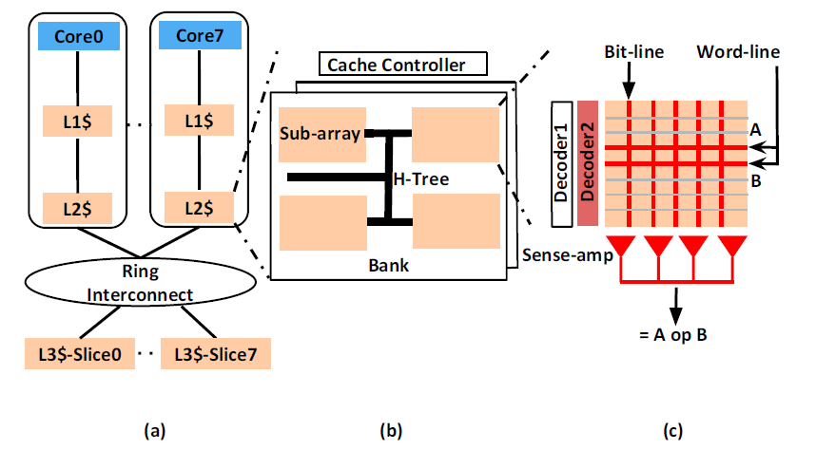
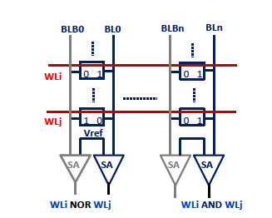
Compute Cache Overview
(a) Cache hierarchy. (b) Cache Geometry (c) In-place compute in a sub-array.

Slide 17
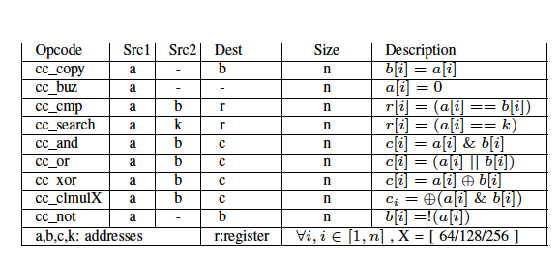
Compute Cache ISA
Laboratory of Computer Architecture, UT Austin

Slide 18
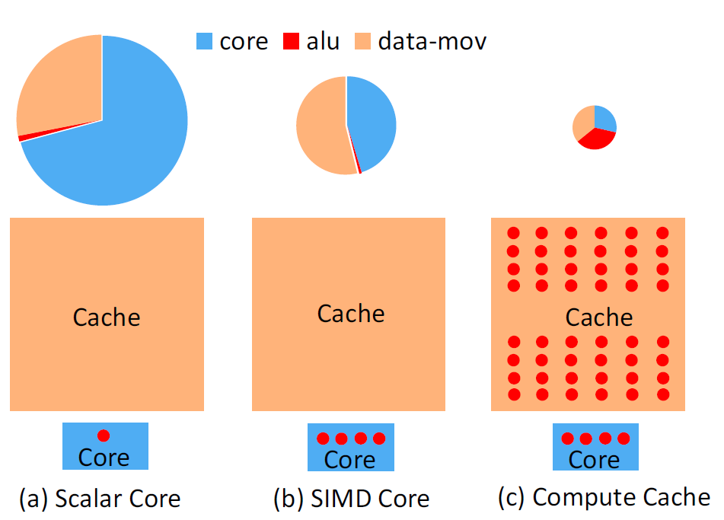
Proportion of energy (top) for bulk comparison operation and area (bottom).
Red dot depicts logic capability.

Slide 19
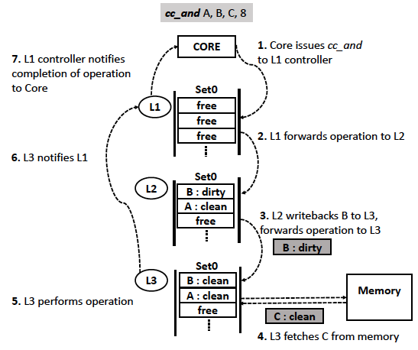
Compute Caches in operation

Slide 20
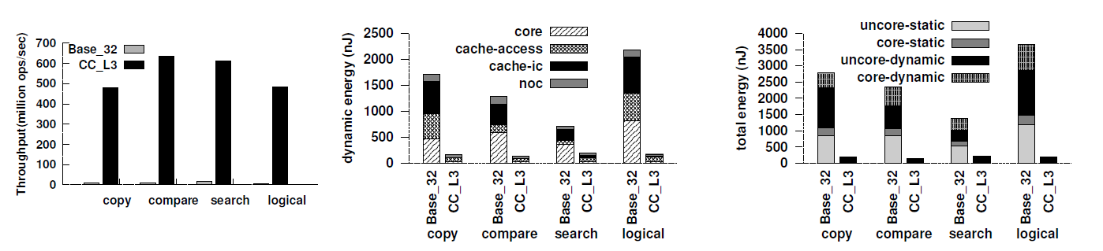
Benefit of compute cache
Throughput b) Dynamic energy c) Total energy
Base_32: supports 32-byte SIMD loads and stores
CC: compute cache

Slide 21
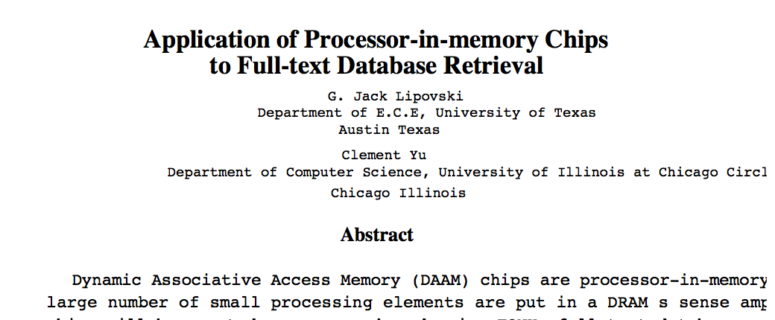
Dynamic Associative Memory - Lipovski
Laboratory of Computer Architecture, UT Austin

Slide 22
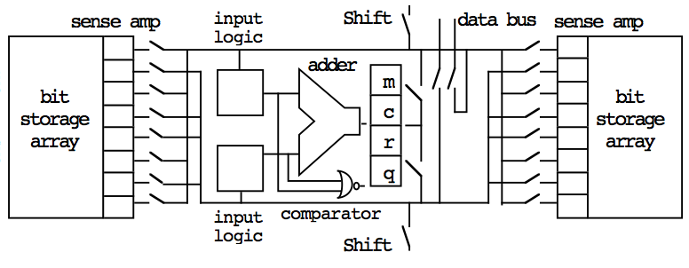
DAAM Chips – Dynamic Associative Memory - Lipovski
Laboratory of Computer Architecture, UT Austin

Slide 23
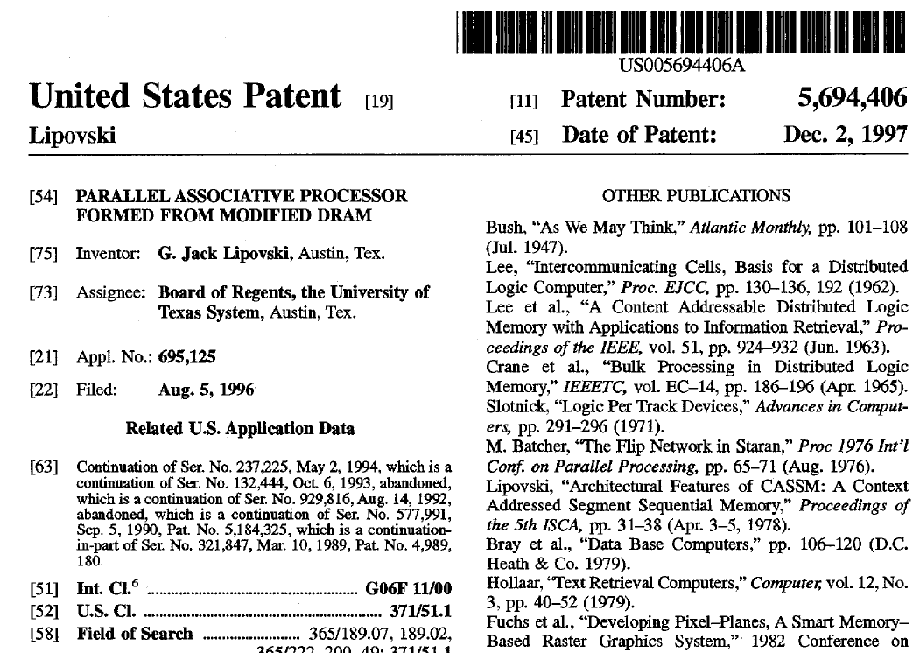
Laboratory of Computer Architecture, UT Austin

Slide 24
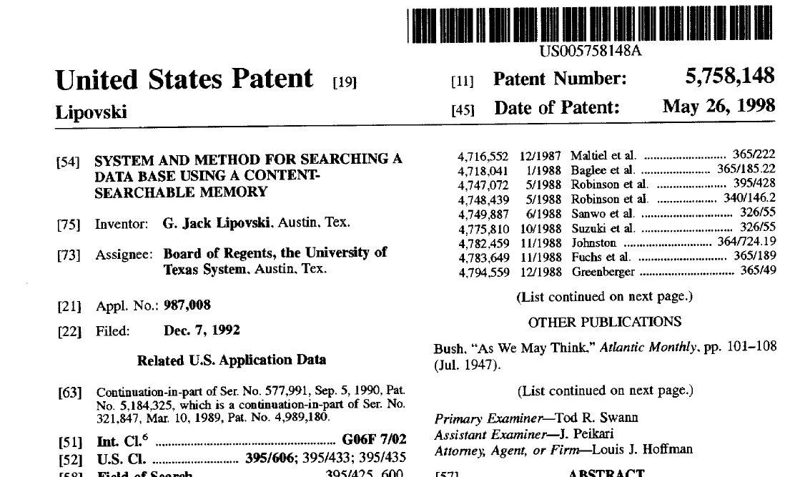
Laboratory of Computer Architecture, UT Austin

Slide 25
Lipovski Patents
G. J. Lipovski, System and Method for Searching a Data Base Using a Content Searchable Memory, May 1998
K. Liu, G. J. Lipovski and C. Yu, “Efficient Processing of Queries in Full-text Search Using Associative Memory”
G. J. Lipovski, “Parallel Computer Within Dynamic Random Access Memory”, June 1998
G. J. Lipovski, “Dynamic Systolic Associative Memory Chip”, International Symposium on Application Specific Array Processors, pp. 481-492, 1990, Sep
G. J. Lipovski, “Dynamic Associative Memory with Login-In-Refresh, January 1991
Laboratory of Computer Architecture, UT Austin

Slide 26
Dynamic Associative Memory - Lipovski
1999 IEEE International Workshop on Memory Technology, Design and Testing
Laboratory of Computer Architecture, UT Austin

Slide 27
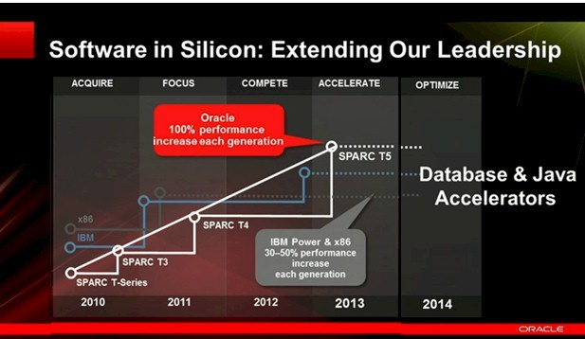
News from Oracle at the Hot Chips Symposium ‘13
Laboratory of Computer Architecture, UT Austin

Slide 28
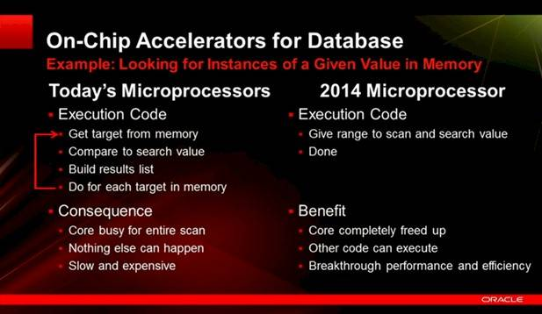
Oracle at Hot Chips 2013 Conference
Laboratory of Computer Architecture, UT Austin

Slide 29
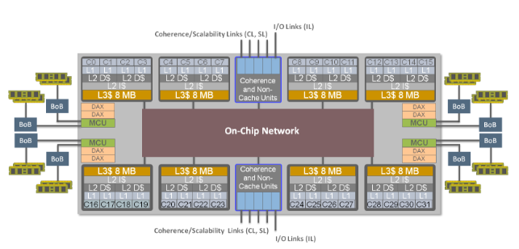
SPARC M7 Data Accelerator
SWIS (Software in Silicon)
Laboratory of Computer Architecture, UT Austin
Notes:
Big Data Benchmarking

Slide 30
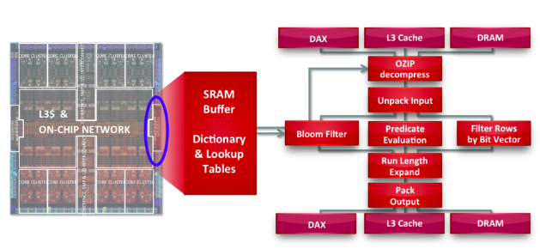
SPARC M7 Data Accelerator
SWIS (Software in Silicon)
Laboratory of Computer Architecture, UT Austin
Notes:
Big Data Benchmarking

Slide 31
SPARC DAX Accelerator Pipeline
The first stage is decompression.
Uncompressed data is then unpacked (extract)
Next joins (called Bloom Filter); evaluates conditions such as less than, greater than, or equal to; or performs matches based on an existing result of bit vectors.
Resulting data is expanded via repeating decompressions.
Then output is packed (if it was expanded or unpacked initially) can also be pipelined either into another DAX / L3 cache /DRAM
Very specialized pipeline; equivalent to having 32 extra cores for queries and 64 extra cores for decompression; very cost effective.
Laboratory of Computer Architecture, UT Austin

Slide 32
SPARC M7 Data Accelerator
SWIS (Software in Silicon)
Laboratory of Computer Architecture, UT Austin
Notes:
Big Data Benchmarking

Slide 33
COMPUTE IN-TRANSIT
Avoid Allocating and Storing Intermediate Results in DRAM
Simply move data to the Consuming Element
Systolic Processing Concepts
Perform an Operation as part of data transfer
Fixed function or limited programmable
Scatter-gather, Address Mapping Transformations, Reductions, Projections
Simple integer units or small overhead hardware
Programming models to support
Laboratory of Computer Architecture, UT Austin

Slide 34
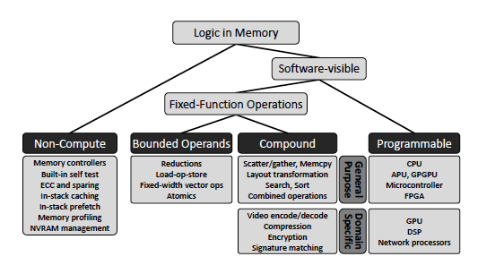
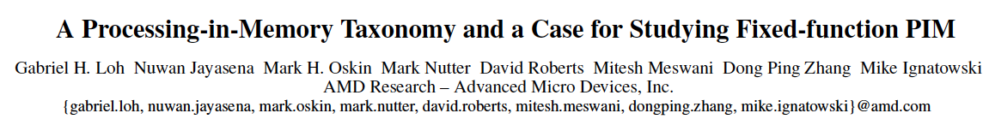
PIM Taxonomy
Laboratory of Computer Architecture, UT Austin

Slide 35
CHIPS THAT REMEMBER AND COMPUTE (ISCA 97 ISCA 98)
IRAM (Berkeley)
EXECUBE (Kogge)
FlexRAM (Torrellas)
Yan Solihin’s HPCA 2001 Paper
DAAM Memory Chips (Lipovski)
Active Pages (Oskin, ISCA 1998)
PIM Enabling Instructions (PEIs) (Onur Mutlu ISCA 2015)
Active Disk (ASPLOS 1998)
Laboratory of Computer Architecture, UT Austin

Slide 36
Challenges for PIMs
Locality and Data Reuse is the main reason why computing in memory often does not yield performance benefits
Memory is still slow
Die-stacked DRAM is still DRAM and slow like DRAM
If data reuse, temporary creation and reuse, challenging to get performance from integrating compute with slow memory
Laboratory of Computer Architecture, UT Austin

Slide 37
Cache energy (pJ) per cache-block (64-byte) (Compute Cache Paper)
Cache | Write | Read | Cmp | Copy | Search | Not | Logic
L3 | 2852 | 2452 | 840 | 1340 | 3692 | 1340 | 1672
L2 | 1154 | 802 | 242 | 608 | 1396 | 608 | 704
L1 | 375 | 295 | 186 | 324 | 561 | 324 | 387

Slide 38
Task Mapping Challenges
Laboratory of Computer Architecture, UT Austin

Slide 39
CONCLUDING REMARKS
Computing in Situ offers quite some potential
Quite a lot of Passion went into PIM in its earlier waves
Several technology Challenges and Market factors
Computing in Transit is interesting
Proliferation of Accelerators
Instead of Move as little as possible, focus on move what benefits from the move
Be in the right place at the right time
Software Support is key for Success
Laboratory of Computer Architecture, UT Austin

Slide 40

Thank You! Questions?
Laboratory for Computer Architecture (LCA)
The University of Texas at Austin
lca.ece.utexas.edu
Laboratory of Computer Architecture, UT Austin

