Slide 1
Min-Move 2017 1st Workshop on Hardware/Software Techniques for Minimizing Data Movement

Slide 2
Organizers
Adwait Jog
Assistant Professor, College of William and Mary
Computer Architecture, GPUs, Memory Systems
www.cs.wm.edu/~adwait
EJ Kim
Associate Professor, Texas A&M University
Computer Architecture, Interconnects, Performance Evaluation
http://faculty.cse.tamu.edu/ejkim/

Slide 3
Scope
Any idea/technique that can help in reducing the data movement is appropriate for this workshop. Some topics (but not limited to) are:
Near Data Processing (e.g., near caches or memory or storage devices)
In-Memory Computing (e.g., in caches or memory or storage devices)
Approximate Computing (e.g., load value approximations)
Cache/DRAM Locality Optimizations
Data Compression Techniques
Emerging Memory Technologies (e.g., STT-RAM, Memristor)
Non Von-Neumann Architectures (e.g., Quantum Architectures, Automata Processor)
Interconnection Architectures (e.g., on-chip, off-chip, Ethernet, interposer system, flexible interconnects for FPGA)
Programming and Language Support for Minimizing Data Movement

Slide 4
Program Committee
Murali Annavaram (USC)
Rajeev Balasubramonian (Utah)
Reetuparna Das (UMich)
Lizy Kurian John (UT Austin)
David Kaeli (Northeastern)
Onur Kayiran (AMD)
Hyesoon Kim (Gatech)
Asit Mishra (Intel)
Lawrence Rauchwerger (Texas A&M)
Sudhakar Yalamanchalli (Gatech)

Slide 5
Highlights of the Workshop
Keynotes from
Lizy Kurian John (UT Austin)
Yan Solihin (NSF/NCSU)
Jun Yang (UPitt)
Peer-Reviewed Workshop Papers (most of the papers received three reviews)
Exploring Non-Uniform Processing In-Memory Architectures (UT Austin)
Evaluating a Trade-Off between DRAM and Persistent Memory for Persistent-Data Placement on Hybrid Main Memory (Fujitsu Laboratories)
Opportunities for Processing Near Non-Volatile Memory in Heterogeneous Memory Systems (UIUC and AMD)

Slide 6
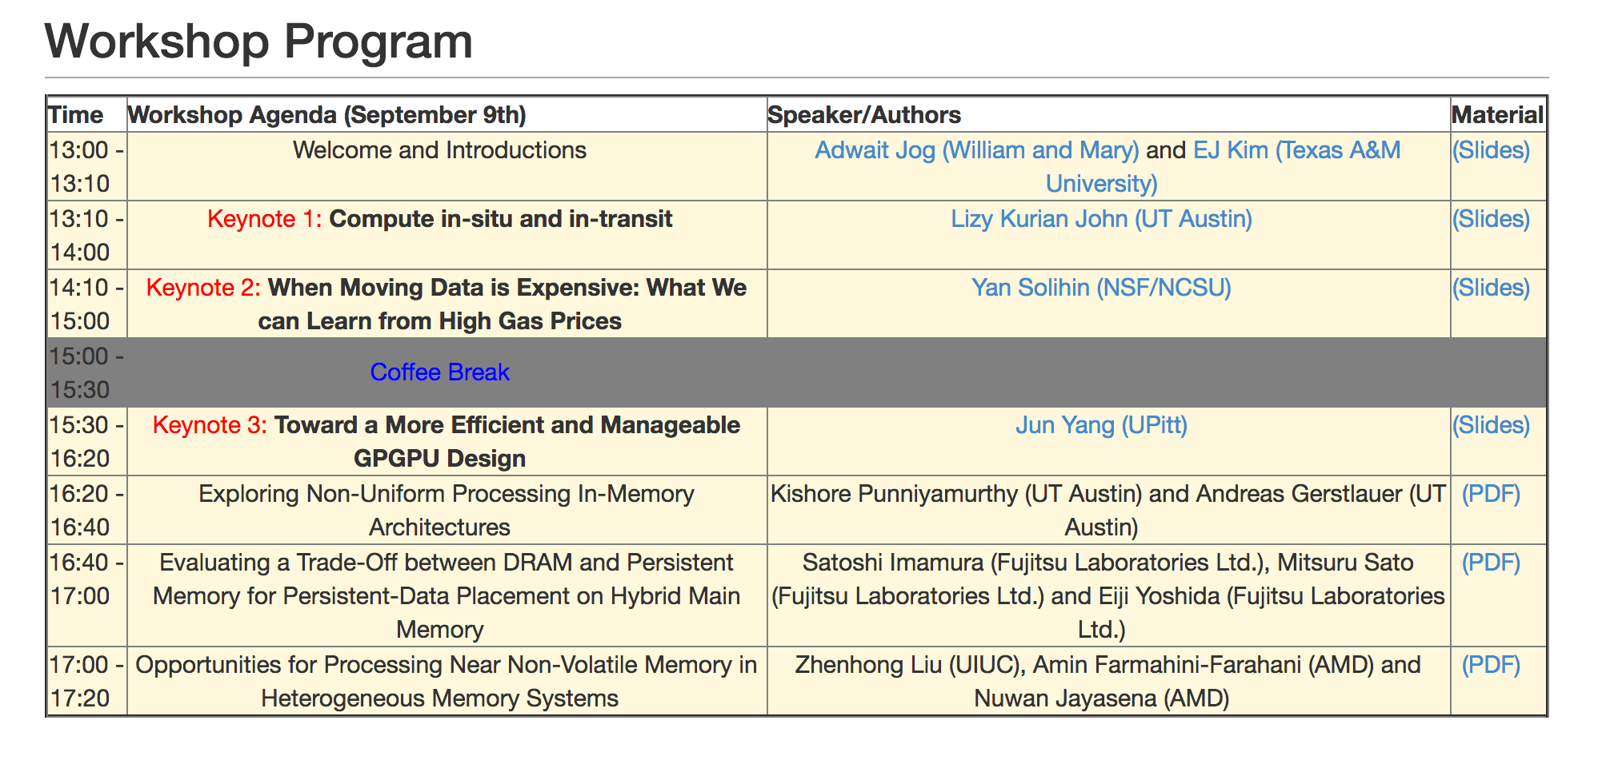
Workshop Schedule
http://insight-archlab.github.io/minmove.html

