Slide 1
Exploring Non-Uniform Processing
In-Memory Architectures
Kishore Punniyamurthy and Andreas Gerstlauer
Electrical and Computer Engineering
University of Texas at Austin
http://www.ece.utexas.edu/~gerstl

Slide 2
Traditional PIM
Central compute + external memory stacks
  Small compute into external logic layers
  Offload memory intensive part of application
  Limited by small in-memory compute
}-- DRAM
Layers
Logic Layer
with compute
Off-chip links
GPU
clusters
CPU
cores
GPU
clusters
Notes:
Traditionally pim arch consists of a central compute connected to external stack memories containing small amount of compute, researchers have previously suggested extracting performance in this arch by identifying and smartly offloading memory intensive sections of code into Pim units to exploit the higher bandwidth. This is because these arch are limited by the amount of compute capability available in memory,
however advancement in packaging technology allows integrating high bandwidth mem in the same pkg as that of compute. Resulting in high memory bandwidth being available to large compute elements. These advancements are widely expected to be used in exascale systems to meet their BW requirements.
The feasibility of such opens the possibilities of many

Slide 3
Technology Trends
In-package high bandwidth memory now feasible
  Needed in exascale system for bandwidth [Vijayraghavan’17]
Move memory into central package
GPU
clusters
CPU
cores
GPU
clusters
Notes:
Traditionally pim arch consists of a central compute connected to external stack memories containing small amount of compute, researchers have previously suggested extracting performance in this arch by identifying and smartly offloading memory intensive sections of code into Pim units to exploit the higher bandwidth. This is because these arch are limited by the amount of compute capability available in memory,
however trends in packaging technology allows integrating high bandwidth mem in the same pkg as that of compute. These advancements are widely expected to be used in exascale systems to meet their BW requirements.
Given the feasibility, memory can be integrated into the central compute

Slide 4
Centralized Compute & Memory
Large central compute can exploit in-package bandwidth
  Offloading of application section not required
Still need external memory for capacity
Integrate more compute into external memory stacks
Logic Layer
GPU
clusters
Interposer
CPU
cores
Notes:
Resulting in large central compute with in-pkg mem and external mem stacks,
Since large compute is available to exploit high in-pkg bandwidth, the need for identifying aan offloading mem intensice pieces of app is reduced or potentially eliminated.
However, we still need ext mem stacks to meet capacity requirements,
Given, their availability some more compute could be integrated into ext memory stacks

Slide 5
Non-Uniform Multi-Element
Multiple elements with different memory to compute ratio
  Application that can be partition with high memory footprint
Further distribute compute
CPU
cores
Notes:
Resulting in non –uniform multi-elements config. We have multiple elements with diff mem to compute ratio..
App with mem footprint too big to fit in central elements and which can be potentially partitioned can exploit these config.
Going to extreme case, we can further distribute compute

Slide 6
Uniform Multi-Element
Multiple elements with same memory to compute ratio
  Extreme case is completely homogeneous
Different non-uniform PIM architectures possible
  Each with different benefits and cost
  Highly application dependent
Need to determine suitability of different architectures
CPU
cores
Notes:
Resulting in uniform multi-element configuration where diff elements have same m/c ratio
We see that there are multiple ways an exa node can be architected, containing multiple pkgs of varying sizes and types. Therby opening up a space of NUPIM arch
Each individual configuration has its benefits and trade-offs which are influenced by app and potentially other factors
In this paper we evaluate different architecture configurations and analyze the factors which determine the suitability of an arch for an application.
We use GPGPU app and SM as out compute elements but our insights obtained should be applicable for arbitrary compute element

Slide 7
Outline
Background
  Non-uniform PIM (NUPIM) architecture space
Application Analysis
  Low sharing
  High sharing
Experiments & Results
  Architectures evaluated
  Performance results & analysis
Summary, Conclusions and Future work
Notes:
We begin with an analyzing the application followed by the exp setip and the archi evaluated.
We then look at the sim results and do a deeper analysis of Lulesh benchmark and finally we end with conclusion and futurework

Slide 8
Application Analysis
Understanding inter-thread sharing behavior vital
Classify applications according to sharing behavior
  Low sharing
  High sharing
Based on pre-dominant behavior
  Benchmarks in reality fall between classes
Notes:
Analysing the mem access pattern of application is important as ass with diff inter thread page sharing will behave differently in diff arch. Based on the dominant behavior seen in benchmarks evaluated, we classify the benchmarks as low/high.
However, across wide range of benchmarks , they may not strictly belong to a single category

Slide 9
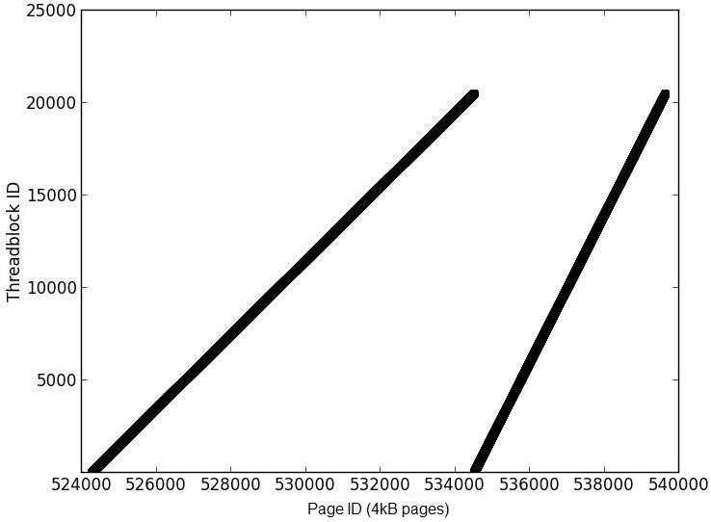
Low Sharing
Regular behavior
  Memory footprint scales with threadblocks
Distributed without increasing off-chip accesses
  Potentially favors uniform memory to compute ratio
Nearest
Neighbor (NN)
[Rodinia]
Notes:
We analyze mem access pattern of NN, which is a representative for low sharing benchmark . In the graph we plot the theradblocks in x axis and page id in y axis. This graph shows the pages which have been accessed by the threadblocks
The memory footprint increases with threadblocks, so if all computation is done in single element, the memory footprint will eventually spill into external memory and result in remote accesses.
From this graph we see that NN has regular mem access, threadblocks access subsequent pages. And thus there is less page sharing. Such applications can be distributed without increas

Slide 10
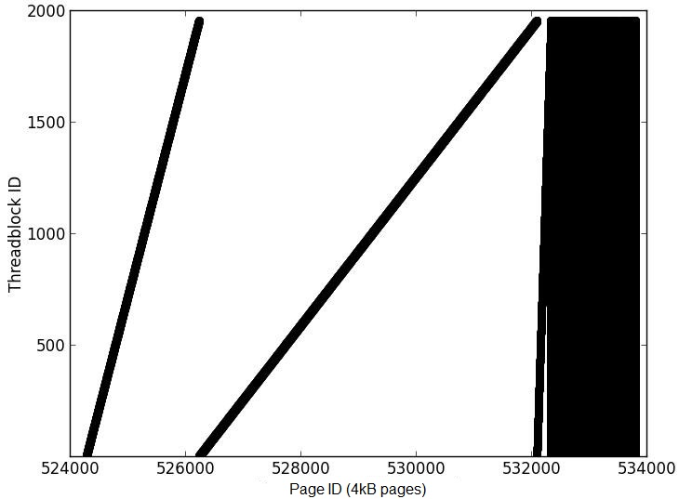
High Sharing
Irregular behavior
  Data dependent accesses
Distributing threadblocks increases off-chip accesses
  Potentially favor large centralized compute
BFS [Rodinia]
Notes:
Next we look at BFS bechamrk, which represents high page sharing benchmark. We see that BFS has regular mem access but it also results in irregular accesses where a page is accessed by multiple TBs. In order to find the extent of irregular accesses we plot comm matric , it……
from the matrix we see that this benchmark has high page sharing , this is due to data dependent accesses.
For such benchmarks , distributing threadblocks across multiple compute elements could increase off-chip accesses .. Instesd A single large compute element potentially would suit better

Slide 11
Experimental Setup
GPGPUSim v3.2.2
  Modified to replicate different architecture configurations
Data Mapping
  Locality based for low page sharing applications [Diener’13]
  Interleaved data mapping for high page sharing [Mariano’16]
Benchmarks
Benchmark | Page sharing | Input | Suite
NN | Low | 5120k | Rodinia
BFS | High | Graph1MW | Rodinia
Lulesh | High | Default (first 26 kernels) | Lulesh
SPMV | High | Large (first 5 kernels) | Parboil
Btree | High | Default (1M) | Rodinia

Slide 12
Architectures Evaluated (1)
Centralized compute
  SMs only in central element
  In-package and external memory stacks
  No external compute
SM
Cluster 0
SM
Cluster 1
SM
Cluster 7
- - -
Memory
Memory
Interconnect
Memory
Memory
Memory
Memory
Memory
Memory
Central package

Slide 13
Architectures Evaluated (2)
Non-uniform multi-element
  BigLittle2
  BigLittle4
SM
Cluster 0
SM
Cluster 1
SM
Cluster 7
SM
Cluster 0
- - -
SM
Cluster 8
Memory
Interconnect
Interconnect
Interconnect
Memory
Memory
Memory
Memory
Memory
Memory
Memory
Central package
SM
Cluster 2
SM
Cluster 3
SM
Cluster 9
SM
Cluster 0
SM
Cluster 1
- - -
SM
Cluster 10
SM
Cluster 11
Interconnect
Interconnect
Interconnect
Interconnect
Interconnect
Memory
Memory
Memory
Memory
Memory
Memory
Memory
Memory
Central package

Slide 14
Architectures Evaluated (3)
Uniform multi-element
  Identical memory stacks with compute
  Uniform memory to compute ratio
SM
Cluster 0
SM
Cluster 1
SM
Cluster 7
- - -
Interconnect
Interconnect
Interconnect
Memory
Memory
Memory

Slide 15
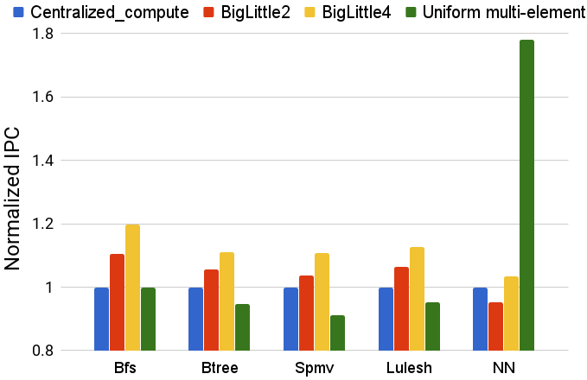
Results: Speedup
NN performs 78% better in uniform multi-element architecture
High page sharing applications perform better in BigLittle2 (avg. 6%) and BigLittle4 (avg. 13%) than centralized compute

Slide 16
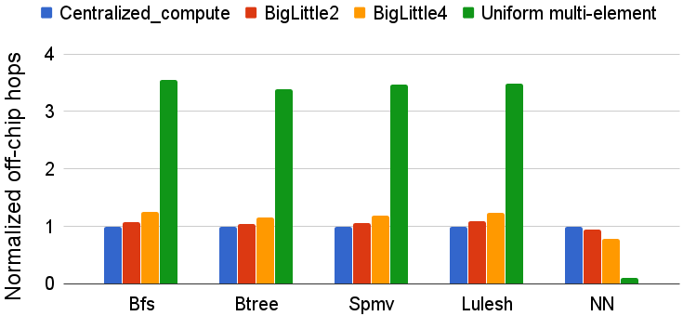
Results: Off-Chip Hops
NN has lower off-chip hops in uniform multi-element architecture
BigLittle2 and BigLittle4 have higher off-chip hops, 7% and 20% respectively for high page sharing applications

Slide 17
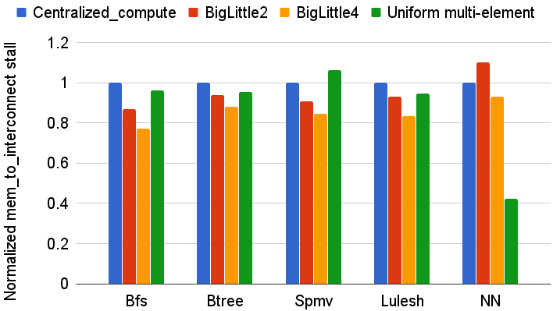
Results: Interconnect Congestion
NN has lower interconnect congestion in uniform multi-element architecture
BigLittle2 and BigLittle4 have 9% and 17% less stalls due to interconnect congestion

Slide 18
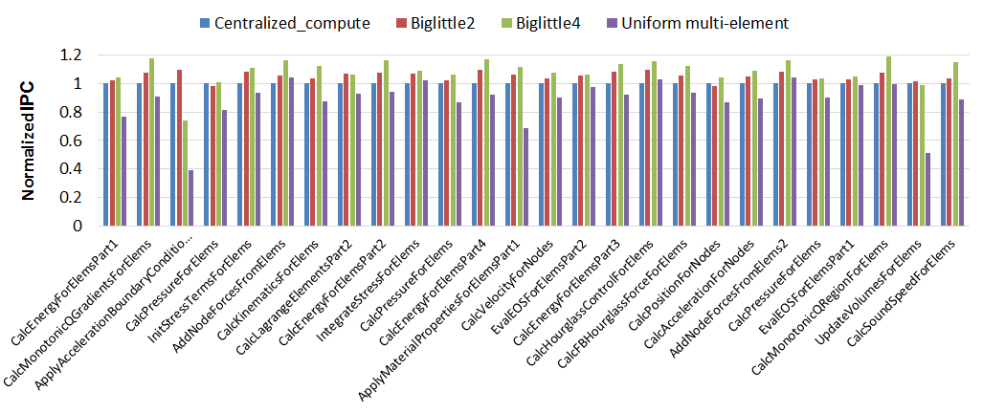
Deepdive: Lulesh
CalcPressureForElems and UpdateVolumeForElems kernels perform equally good in centralized compute and BigLittle4
BigLittle2 performs as good as BigLittle4 for CalcLagrangeElemPart2 and ApplyAccelerationBoundaryCondition kernels
Notes:
Remind biglittl4 is default best

Slide 19
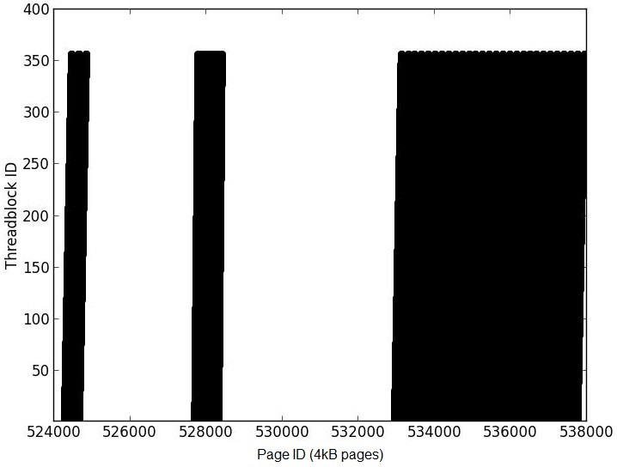
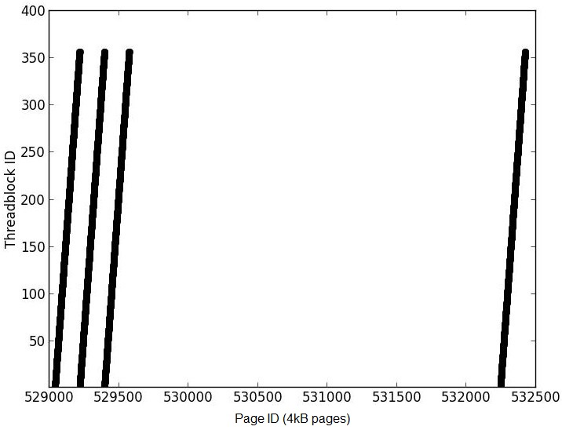
Deepdive: Lulesh
IntegrateStressForElem
  Dominant kernel
  Irregular memory accesses
  Results in higher contention
  Favors BigLittle4
Different kernels have different behaviors
  No optimal single configuration
Potential for kernel-level dynamic mapping
CalcLagrangeElemPart2
  Regular memory accesses
  Less contention
  Favors BigLittle2 under interleaved mapping

Slide 20
Summary, Conclusions and Future Work
No global optimal architecture
  Low sharing: uniform multi-element
  High sharing: non-uniform multi-element
  Dynamic mapping on NUPIM baseline architecture
Less remote accesses not always better
  Other factors (e.g. contention) can offset adverse impact
Future work
  More benchmarks and applications
  Power considerations
  Architecture configurations
  Dynamic mapping schemes

Slide 21
Thank You!
Questions?

