Slide 1
KNN-Joins Using a Hybrid Approach: Exploiting CPU/GPU Workload Characteristics
Mike Gowanlock
Northern Arizona university
School of informatics, computing, and cyber systems
Flagstaff, AZ, USA
GPGPU-12, April 13, 2019, Providence, RI, USA

Slide 2
K-nearest neighbor (KNN) joins
K Nearest Neighbor searches find the K nearest points to a given query point
When all points in a dataset are searched, it is called a KNN self-join
A fundamental operation that is used/studied in many fields
Machine learning
Databases
Clustering
Computational geometry
And others

Slide 3
Parallel Algorithms and architectures
CPU-Only
GPU-Only
CPU+GPU
+

Slide 4
Parallel Algorithms and architectures
CPU-Only
GPU-Only
CPU+GPU
+
Parallelize algorithm on multi-core CPUs

Slide 5
Parallel Algorithms and architectures
CPU-Only
GPU-Only
CPU+GPU
+
Parallelize algorithm on multi-core CPUs
Parallelize algorithm on GPUs
CPU performs minimal tasks (e.g., orchestrate data transfers)

Slide 6
Parallel Algorithms and architectures
CPU-Only
GPU-Only
CPU+GPU
+
Parallelize algorithm on multi-core CPUs
Parallelize algorithm on GPUs
CPU performs minimal tasks (e.g., orchestrate data transfers)
Use both multi-core CPUs and GPUs

Slide 7
Parallel Algorithms and architectures
CPU+GPU
Most GPU research is “GPU-only”
But this is changing! [1]
Instead of comparing CPU vs. GPU algorithms
Compare against CPU+GPU algorithms
Parallel CPU algorithms are still very efficient
+
Use both multi-core CPUs and GPUs
[1] Mittal, S., & Vetter, J. S. (2015). A survey of CPU-GPU heterogeneous computing techniques. ACM Computing Surveys (CSUR), 47(4), 69.

Slide 8
Indexing and dimensionality
In low dimensionality: KNN searches use an indexing data structure to prune the search
For example: using a kd-tree, R-tree, quad-tree, or partitioned grid
Reduces the number of point comparisons (the complexity can be reduced to roughly O(n log n))

Slide 9
Indexing and dimensionality
In low dimensionality: KNN searches use an indexing data structure to prune the search
For example: using a kd-tree, R-tree, quad-tree, or partitioned grid
Reduces the number of point comparisons (the complexity can be reduced to roughly O(n log n))
In high dimensionality: more points need to be compared to each other and index search performance degrades
Index searches become more exhaustive
The index search itself adds overhead
This is the well-known curse of dimensionality problem
Typically use a brute force search to find the KNN (e.g., all pairs distance matrix)

Slide 10
Utilizing the GPU for index searches
CPU-based KNN searches are often characterized by an irregular data and instruction flow:
Spatial index searches use tree traversals
Insights into spatial indexes for the GPU
J. Kim, W.-K. Jeong, and B. Nam, “Exploiting massive parallelism for indexing multi-dimensional datasets on the gpu,” IEEE Transactions on Parallel and Distributed Systems, vol. 26, no. 8, pp. 2258–2271, 2015.
J. Kim, B. Nam, “Co-processing heterogeneous parallel index for multi-dimensional datasets” JPDC, 113, pp. 195–203, 2018.
This paper implemented an R-tree on the GPU that avoided some of the drawbacks of the SIMT architecture

Slide 11
Utilizing the GPU for index searches
CPU-based KNN searches are often characterized by an irregular data and instruction flow:
Spatial index searches use tree traversals
Insights into spatial indexes for the GPU
J. Kim, W.-K. Jeong, and B. Nam, “Exploiting massive parallelism for indexing multi-dimensional datasets on the gpu,” IEEE Transactions on Parallel and Distributed Systems, vol. 26, no. 8, pp. 2258–2271, 2015.
J. Kim, B. Nam, “Co-processing heterogeneous parallel index for multi-dimensional datasets” JPDC, 113, pp. 195–203, 2018.
This paper showed its best to implement the traversal of the internal nodes (branching) on the CPU and the scan of the data elements in the leaf nodes on the GPU

Slide 12
Utilizing the GPU: takeaway
We use an index for low dimensional KNN searches
Due to the GPU’s SIMT architecture, branching can significantly reduce performance when performing tree traversals
It is better to have a bounded search, where all threads take the same or very similar execution pathways

Slide 13
GPU Grid index
Grid Index
A grid is constructed with cells of length epsilon
Point search
For each query point, the points within epsilon can be found by checking adjacent grid cells and performing distance calculations to the points in these cells
Adjacent cells: 3^{n} where n is the number of dimensions

Slide 14
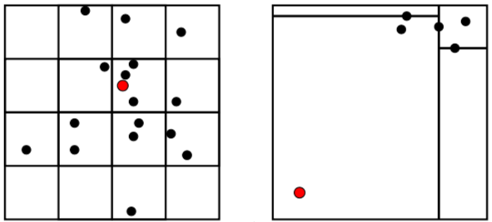
Overall idea in one picture
Dense data region:
Good for the GPU
Use GPU-efficient grid index
Compute many distance calculations
Sparse data region:
Good for the CPU
Use CPU-efficient kd-tree index
Compute fewer distance calculations

Slide 15
finding the KNN on the GPU
A number of CPU KNN search techniques dynamically expand the search to find the KNN for each query point
Try to find at least K neighbors
If K neighbors are not found, backtrack up the index and expand the search
This is highly inefficient on the GPU
Threads performing index searches on different query points will have significant branch divergence
This will cause a loss of parallel efficiency

Slide 16
finding the KNN on the GPU
Need to exploit the GPU’s high-throughput architecture while minimizing branch divergence
Key idea: we do not need to find at least K neighbors for each query point
Perhaps they can be found later by the GPU if not found during a given search

Slide 17
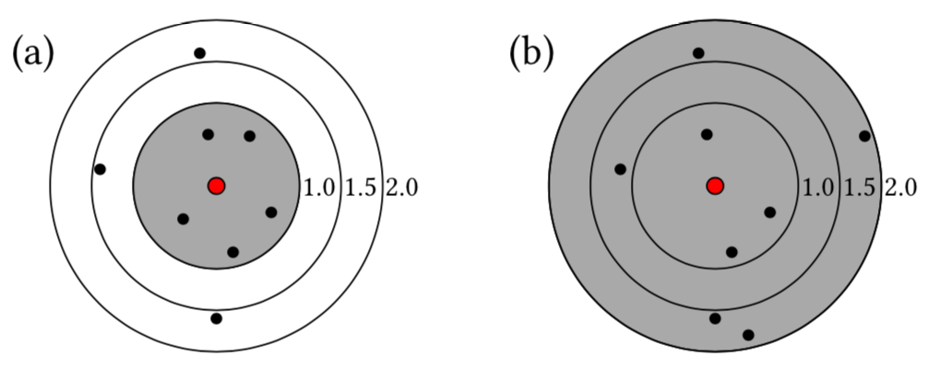
finding the KNN on the GPU
Assume K=5
(a) 5 neighbors are found within a distance epsilon=1.0
(b) 5 neighbors are found within a distance epsilon=2.0

Slide 18
finding the KNN on the GPU
Begin with an initial search radius, epsilon
Search for points within epsilon
Only search a single epsilon-distance in a given batch/kernel invocation
If a query point does not find at least K neighbors, we mark that query point as incomplete
It will be found later by either the CPU or GPU algorithm
Re-index the GPU algorithm with a larger epsilon search distance when a threshold number of queries fail to find their KNN

Slide 19
Major components of the hybrid CPU/GPU algorithm
Hybrid-CPU | Hybrid-GPU
Index: kd-tree using the approximate nearest neighbors algorithm (but returns exact neighbors) [2] | Index: GPU-efficient grid index [3]
Work unit size: small, each processor independently finds the KNN of a small batch of query points | Work unit size: large, the GPU is given a large batch of query points to find the KNN to ensure high throughput
Average query complexity: low (sparse regions) | Average query complexity: high (dense regions)
[2] Arya, S., Mount, D. M., Netanyahu, N. S., Silverman, R., & Wu, A. Y. (1998). An optimal algorithm for approximate nearest neighbor searching fixed dimensions. Journal of the ACM (JACM), 45(6), 891-923.
[3] Gowanlock, M., and Karsin, B. "GPU Accelerated Self-join for the Distance Similarity Metric." 2018 IEEE International Parallel and Distributed Processing Symposium Workshops (IPDPSW). IEEE, 2018.

Slide 20
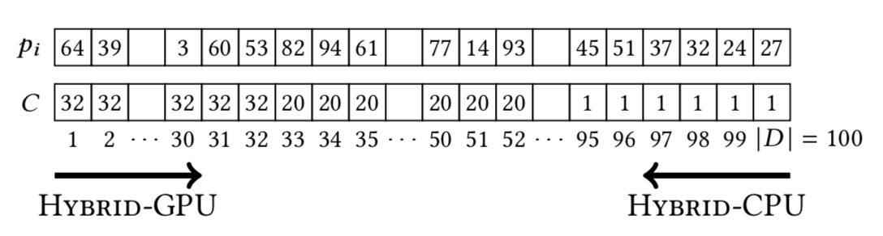
Cpu/GPU work queue
Each query point is assigned an approximation for the amount of work it is expected to compute
This information has already been computed for the GPU grid index
The approximation of the total work is the number of points that exist in each point’s grid cell
Sort this by work in non-increasing order

Slide 21
Cpu/gpu work queue objectives
Mitigate load imbalance: performance degrades when one architecture waits for the other to complete its work at the end of the computation
Work queue overhead: assigning very small batches of query points to the CPU or GPU will incur overhead
Maintain GPU throughput: The GPU requires large batches of queries to maintain high query throughput

Slide 22
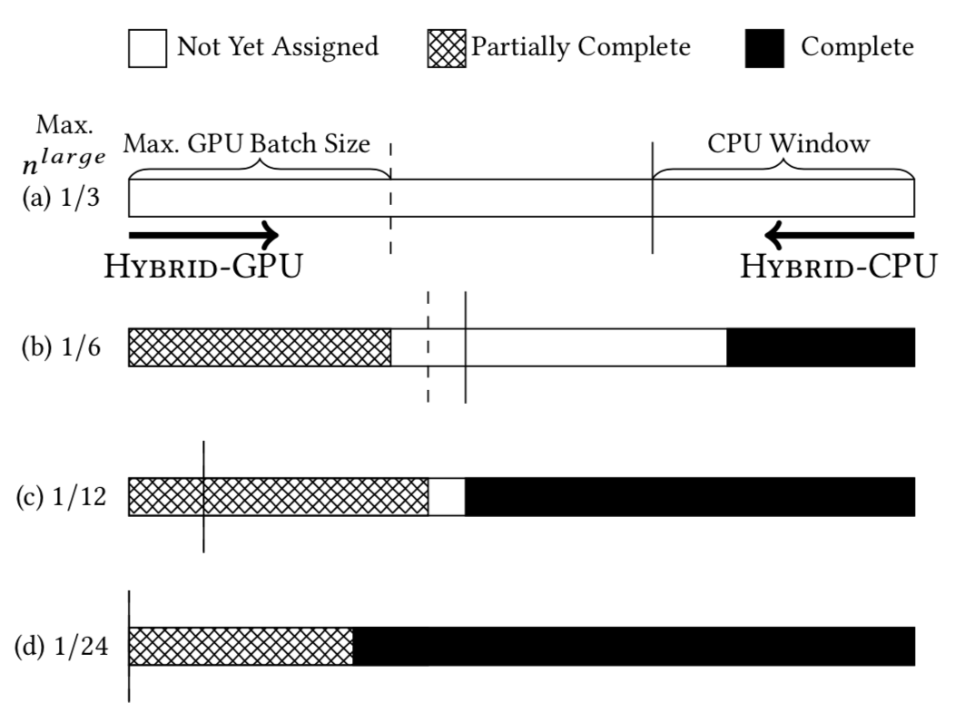
Cpu/GPU work queue: monolithic batch rounds

Slide 23
Default Work queue configuration
GPU initially is assigned 40% of the query points in the dataset, and this size decreases each time the GPU accesses the work queue
Each CPU rank takes 0.5% of the query points in the dataset each time it accesses the work queue
When there are only 5% of the data points left to compute their KNN, this becomes 0.25% (similar to guided scheduling in OpenMP)

Slide 24
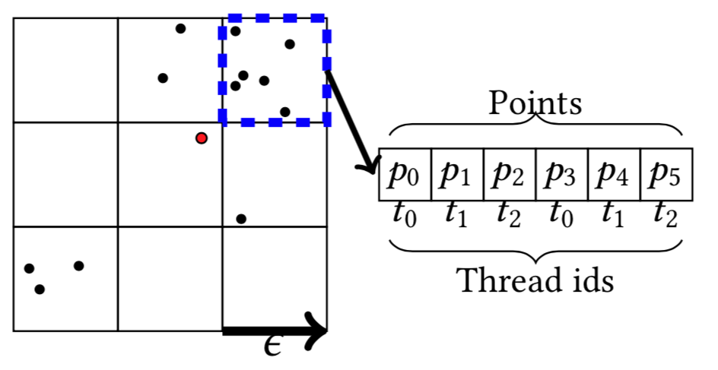
Kernel optimization: assign multiple threads to compute a single query point
If one query point is processed by one thread, then there are potentially 32 different workloads in each warp
This leads to low warp execution efficiency
We assign multiple threads to process each query point
Improves warp execution efficiency and decreases divergence
Three threads compute the distance between a query point (red) and six candidate points (in dashed blue box)

Slide 25
Experimental Evaluation
CPU: 2x Intel E5-2620v4 2.1 GHz CPUs, with 16 total physical cores
GPU: NVIDIA GP100 (Pascal) with 16 GiB global memory
Comparison implementations:
CPU-only: Hybrid-CPU uses 16 processes. Each processes independently computes batches of query points in the dataset. The work queue uses 1 process.
Hybrid: Hybrid-CPU with 15 processes, and Hybrid-GPU and the work queue each use 1 process.
We do not compare to GPU-only
Would need to be designed much differently (discussed in future work)
Code:
C/C++ with the -O3 compiler optimization flag
CUDA v.9
OpenMPI v.3.3.1

Slide 26
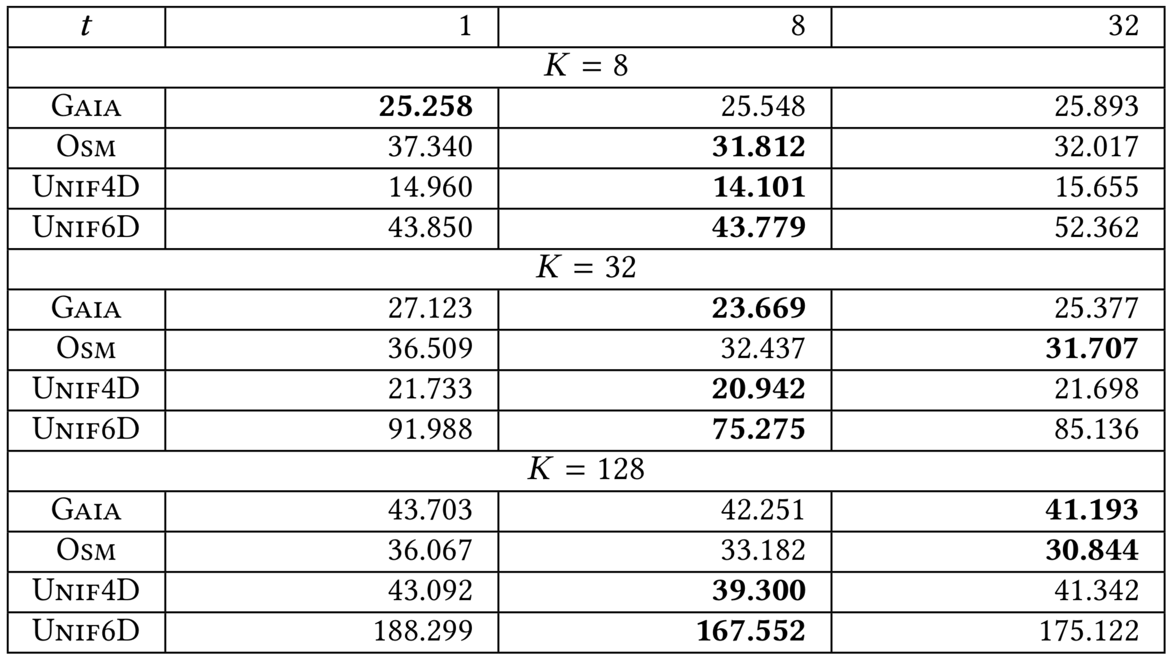
Using multiple GPU threads to compute distance calculations
On two synthetic and two real world datasets, K=8, 32, 128
The total response time of the hybrid algorithm in seconds is shown for t=1, 8, 32 threads assigned to compute the distance for each query point
Assigning a single thread (t=1) to compute the distance calculations for each query point has the worst performance

Slide 27
Using multiple GPU threads to compute distance calculations
Assigning t=8 threads to compute the distance calculations per query point performs the best
Improves warp execution efficiency and decreases divergence due to fewer workloads within each warp
Reduces load imbalance at the end of the computation

Slide 28
What is the best Hybrid-GPU batch size?
To maintain high query throughput, the GPU should process large batches of query points
2-D dataset: 15-35% of the dataset should initially be assigned to the GPU
2-D synthetic dataset (10 million points), K=32
Response time vs. the initial fraction of the dataset assigned to the GPU

Slide 29
What is the best Hybrid-GPU batch size?
To maintain high query throughput, the GPU should process large batches of query points
6-D dataset: roughly 35-60% of the dataset should initially be assigned to the GPU
6-D synthetic dataset (10 million points), K=32
Response time vs. the initial fraction of the dataset assigned to the GPU

Slide 30
What is the best Hybrid-GPU batch size?
On larger workloads (dimensionality, K) we can assign a larger initial fraction of query points to the GPU
A very large batch size will starve the CPU
A very small batch size will diminish GPU query throughput
2-D synthetic dataset
6-D synthetic dataset

Slide 31
What is the best Hybrid-GPU batch size?
The initial Hybrid-GPU batch size can be selected in a fairly large range to achieve good performance across 2-6-D datasets (e.g., 25-40%)
On larger workloads (dimensionality, K) we can assign a larger initial fraction of query points to the GPU
A very large batch size will starve the CPU
A very small batch size will diminish GPU query throughput
2-D synthetic dataset
6-D synthetic dataset

Slide 32
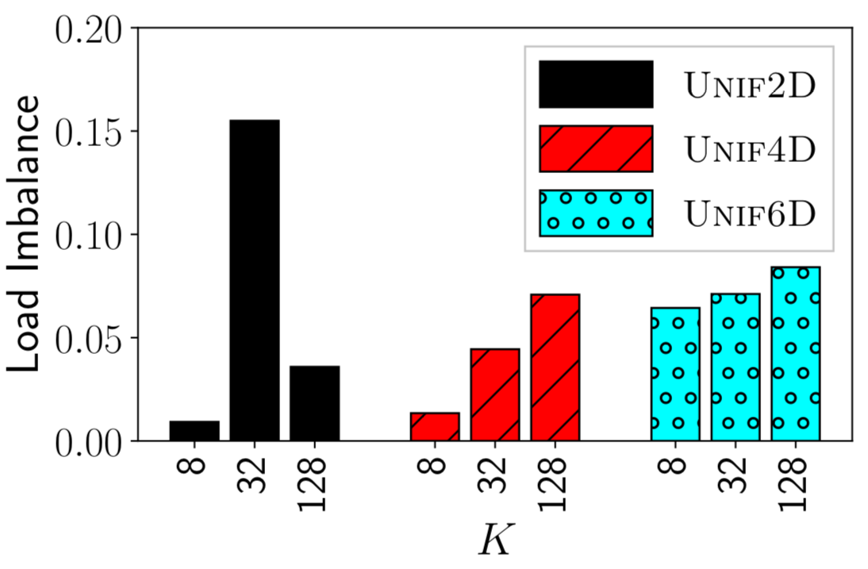
Load balance
In work queues, if chunks of work are too large, then load imbalance can degrade performance
Load imbalance increases with K
If a chunk of work is assigned to the GPU at the end of the computation and it needs to re-index due to too many failed query points on the previous batch, then the load imbalance can be high (K=32 on Unif2D)
Load imbalance: difference between when the last executing CPU rank finishes and the GPU rank finishes as a fraction of the total time

Slide 33
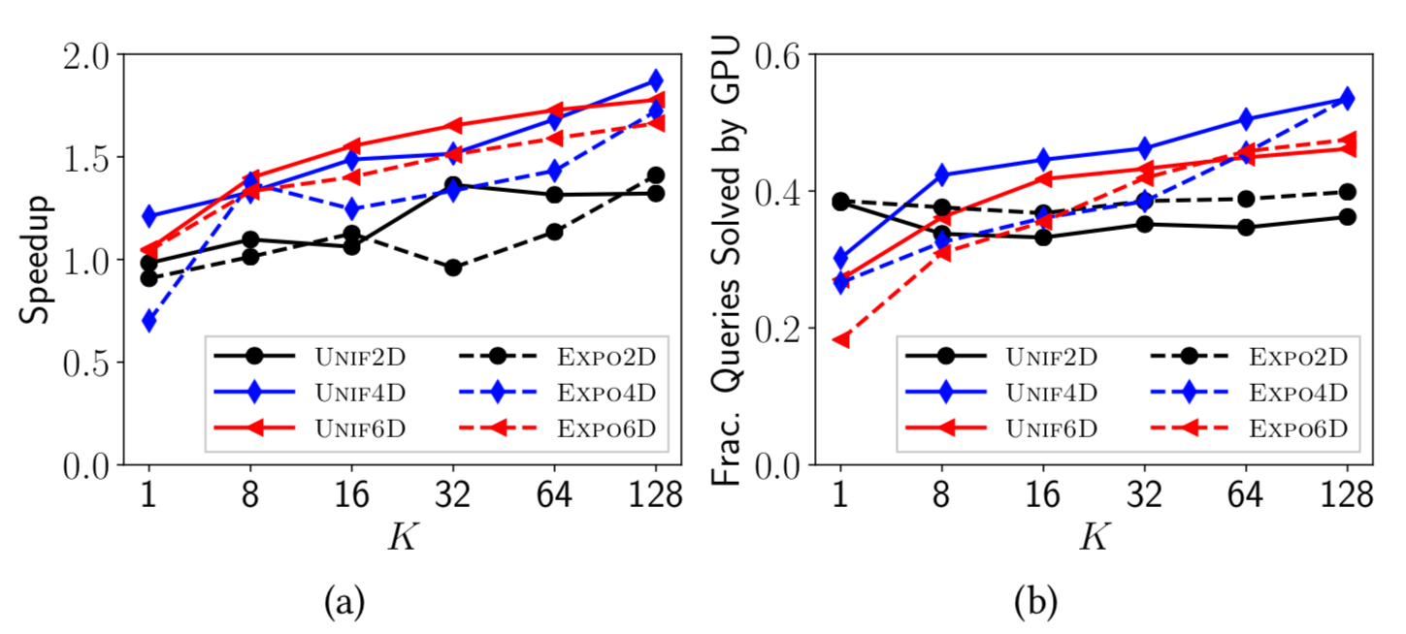
Summary: speedup and fraction computed on the GPU vs. k on synthetic datasets
Figure: (a) Speedup of Hybrid over CPU-only vs. K on 6 synthetic datasets (10 million points); (b) fraction computed on the GPU in (a).
Speedup increases with K and dimensionality in most cases
The larger the fraction of query points computed by the GPU, the larger the speedup

Slide 34
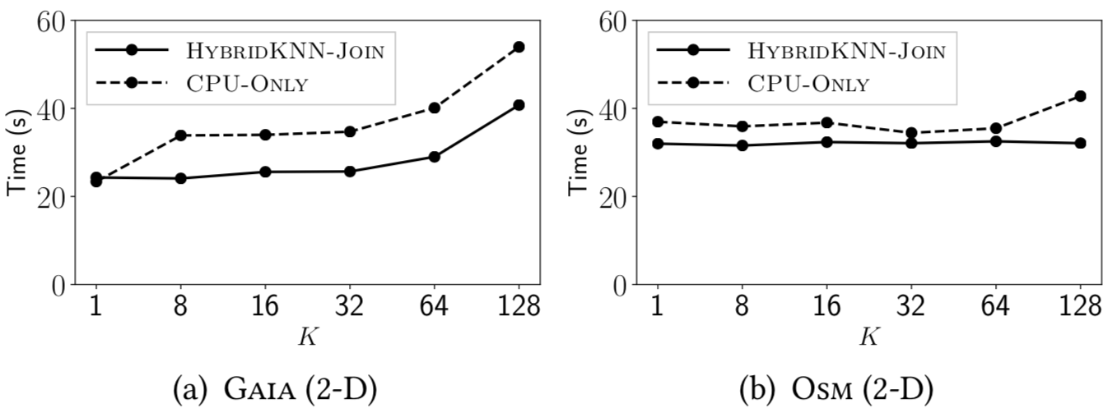
Time vs. k on real-world datasets
Figure: (a) 25 million points from the Gaia catalog; (b) 25 million points from the Open Street Map dataset. Both datasets are in 2-D.
Even low dimensional 2-D datasets can take advantage of a hybrid approach

Slide 35
Conclusions
We address low dimensional data on the GPU
Most previous work focuses on the high-dimensional case
We focus on the low-dimensional case where the GPU is less likely to achieve major performance gains
Our hybrid approach can improve performance even in low dimensionality

Slide 36
Conclusions
We address low dimensional data on the GPU
Most previous work focuses on the high-dimensional case
We focus on the low-dimensional case where the GPU is less likely to achieve major performance gains
Our hybrid approach can improve performance even in low dimensionality
We transform the distance similarity self-join into the KNN-join
Search an epsilon distance for query points and allow some to fail to find their KNN and reattempt with a larger search distance

Slide 37
Conclusions
We address low dimensional data on the GPU
Most previous work focuses on the high-dimensional case
We focus on the low-dimensional case where the GPU is less likely to achieve major performance gains
Our hybrid approach can improve performance even in low dimensionality
We transform the distance similarity self-join into the KNN-join
Search an epsilon distance for query points and allow some to fail to find their KNN and reattempt with a larger search distance
We concurrently exploit CPU and GPU resources through the work queue
Prevents starvation by reserving queries for the CPU
Allows the GPU to achieve high query throughput by assigning it large batches of queries compared to the CPU
Reduce the extent of load imbalance by dynamically reducing the CPU and GPU batch sizes

Slide 38
Future work
Expand epsilon and re-index on the GPU
Indexing currently occurs on the CPU
Takes resources from the CPU component of the algorithm
Likely to be much faster on the GPU
Implement a GPU-only algorithm
Currently, we expand epsilon when we fail to find at least K neighbors for a significant fraction of points (25%)
Could assign a probability of each point being found by a given epsilon search distance
Assign the GPU batches of query points based on this probability and epsilon value (e.g., use better local density estimates)
Work queue optimizations
Avoid the GPU taking work towards the end of the computation, and then needing to re-index causing large load imbalance between CPU and GPU algorithm components

Slide 39
ACKNOWLEDGMENTS
The National Science Foundation
The state of Arizona
The program committee and workshop organizers

