Slide 1
Scatter-and-Gather Revisited: High-Performance Side-Channel-Resistant AES on GPUs
Zhen Lin, Utkarsh Mathur, Huiyang Zhou
North Carolina State University

Slide 2
Introduction
GPUs have been widely used for performance acceleration
~10x speedup for AES encryption algorithm
Side channel attacks make the crypto algorithms vulnerable
Timing attacks
Access-driven cache attacks
Our work: Scatter and Gather (SG) approach
Goal: side-channel resistance & high performance
Idea: reorganize the tables so that table lookups won’t leak key-related information

Slide 3
Outline
Introduction
Background
Scatter-and-Gather (SG) Approach
Security Analysis
SG with Shared Memory
Evaluation
Conclusions

Slide 4
Outline
Introduction
Background
Memory coalescing
Bank conflict
AES Implementation on GPUs
Timing attacks
Access-driven cache attacks

Slide 5
Memory Coalescing
0x0
0x1
0x2
0x3
Line 0
tid 0
0x4 Line 1
tid 1
0x2 Line 0
Line 0, 1, 2
tid 2
0x7 Line 1
0x4
0x5
0x6
0x7
Line 1
tid 3
0xB Line 2
0x8
0x9
0xA
0xB
Line 2
Warp
Coalescing unit
L1 data cache
Different addresses -> different # cache lines -> different access latency

Slide 6
Bank Conflict
tid 0
0x0
0x1
0x2
0x3
0x4 Bank 0
tid 1
0x2 Bank 2
0x4
0x5
0x6
0x7
tid 2
0x7 Bank 3
Two-way
bank conflict
tid 3
0xB Bank 3
0x8
0x9
0xA
0xB
Warp
Bank 0
Bank 1
Bank 2
Bank 3
Shared memory
Different addresses -> different # bank conflicts -> different access latency

Slide 7
AES Implementation on GPUs
Symmetric-key block-cipher algorithm, AES-128
Each thread encrypts a 128-bit block, 10 rounds
OpenSSL implementation based on table lookups
Small tables, can fit in L1 cache or shared memory

Slide 8






Timing Attacks on GPUs [Jiang’16]
$$c_{j}^{tid}$$
Ciphertext
Last round:
$c_{j}^{tid}=T_{4}\left[t_{i}^{tid}\right]⊕k_{j}$
$$T_{4}$$
T-table, 1024-byte size
$$t_{i}^{tid}$$
Input text of last round
$$k_{j}$$
Round key
$$t_{i}^{tid}$$
tid 0
Addr0
Coalescing unit
tid 1
Addr1
1 ~ 8 (1024/128) cache line accesses
Different access
latency
. . .
tid 31
Addr31
Assume 128-byte cache line
Jiang et al., A complete key recovery timing attack on a GPU, HPCA’16

Slide 9


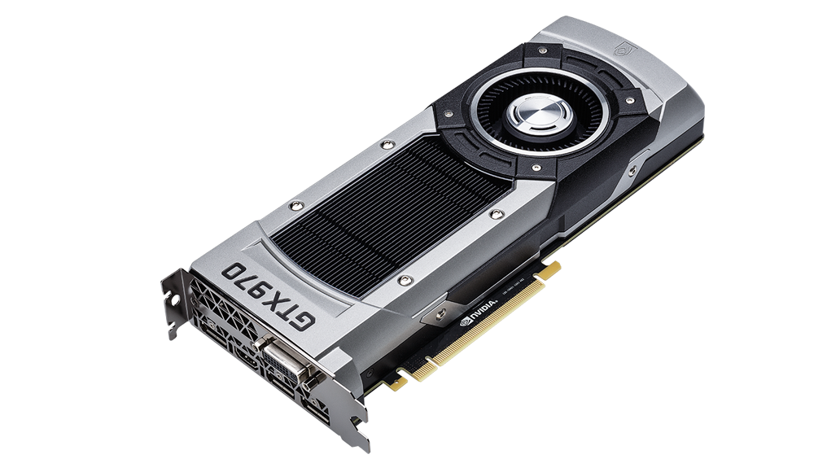






Timing Attacks on GPUs [Jiang’16]
Source: G. Kadam, “RCoal: Mitigating GPU Timing Attack via Subwarp-based Randomized Coalescing Techniques”, HPCA’18
Server
Plaintexts | Ciphertexts | Time duration
Plaintext # 1
Ciphertext # 1
time₁
Plaintext # 2
Ciphertext # 2
time₂
Plaintext # 3
Ciphertext # 3
time₃
…
…
…
Correct Key??
Correct Key
K₁ , K₂ , … ,
, …
K_{i}
Attacker
time_{start}
- time_{stop} = time₁
Key guesses
Notes:
This should be a general timing attack description

Slide 10



Timing Attacks on GPUs [Jiang’16]
Last round:
$c_{j}^{tid}=T_{4}\left[t_{i}^{tid}\right]⊕k_{j}$
Time (real key)
Inverse table lookup:
${t′}_{i}^{tid}= T_{4}^{−1}[c_{j}^{tid} ⊕{k′}_{j}]$
High
correlation?
Table lookup address
Guessed key
Redo table lookup
$${c′}_{j}^{tid}=T_{4}\left[{t′}_{i}^{tid}\right]⊕{k′}_{j}$$
Time’ (guessed key)
Table lookup timing information leaks key!

Slide 11
Access-Driven Cache Attacks
Prime-and-Probe on CPUs
Prime: attacker fills all cache sets
Idle: waits for victim to access cache
Probe: attacker monitors which cache sets were accessed by victim
Set # => table index => key
GPU allows multiple kernels co-run on the same GPU core
Potential threat
Attacker
Victim
Set 0
Set 1
. . .
Set x
Data cache
L1 data cache

Slide 12
Outline
Introduction
Background
Scatter-and-Gather (SG) Approach
Security Analysis
SG with Shared Memory
Evaluation
Conclusions

Slide 13
Scatter-and-Gather (SG) Approach
Goals
Side channel resistance
High performance
Software design
Table lookups is vulnerable
Idea
Re-organize the table so that table lookups won’t leak the key

Slide 14






Motivation
256 entries (1024 bytes)
4 bytes
4 bytes
4 bytes
1 byte
$$T_{4}$$
. . .
$$T_{4}\left[t_{3}^{tid}\right]$$
$$⊕k_{j}$$
$$\& 0x000000FF$$
1024 bytes, 8 lines
Assume 128-byte
cache line size
$$T_{40}$$
. . .
$$T_{40}\left[t_{3}^{tid}\right]$$
256 bytes
256 bytes, 2 lines

Slide 15


Scatter-and-Gather (SG) Approach
1024 (256x4) bits = 128 bytes
32 bits
Line 0
0
byte 0
Line 1
1
Line 2
2
byte 1
256
entries
Line 3
.
.
.
Line 4
byte 2
Line 5
Line 6
byte 3
255
Line 7
.
.
.
$T_{4}\left[t_{}^{tid}\right]$ & 0x0000FF00
0
1
4 bits
2
255
1 ~ 8 lines
2 x 1 line
Constant latency!

Slide 16
For Different Cache Line Sizes
32 bits
Cache line size | Column width | SG version
256 bytes
128 bytes
64 bytes
32 bytes
0
1
2
256
entries
8 bits SG-8
.
.
.
.
.
.
4 bits SG-4
2 bits SG-2
255
width
1 bit SG-1

Slide 17
Outline
Introduction
Background
Scatter-and-Gather (SG) Approach
Security Analysis
SG with Shared Memory
Evaluation
Conclusions

Slide 18
Resistance to Access-Driven Cache Attacks
Original table
Cache line # => table index
Miss => index was accessed
Re-organized table
Cache line # is independent on table index
Miss won’t reveal table index
SG is resistant to access-driven cache attacks
Motivation of SG for CPUs*
Table index
Line 0
0 ~ 31
Line 1
32 ~ 63
Line 2
64 ~ 95
Line 3
96 ~ 127
Line 4
128 ~ 159
Line 5
160 ~ 191
Line 6
192 ~ 223
Line 7
.
.
.
224 ~ 255
0
Table index
1
2
255
[*] Blomer et al., Analysis of countermeasures against access driven cache attacks on AES, SAC’07

Slide 19
Resistance to Cache Timing Attacks
# keys can be recovered in 100,000 samples
Model | Architecture | L1D line size | SG-x
Tesla K40 | Kepler | 128 bytes | SG-4
GTX 980 | Maxwell | 32 bytes | SG-1
GTX 1080 | Pascal | 32 bytes | SG-1
RTX 2080 | Turing | 128 bytes | SG-4
TeslaK40 GTX980 GTX1080 RTX2080
Base
SG-8
SG-4
SG-2
SG-1
16 16 16 16
16
0
0
0
16
16
16
16
16
16
16
16
16
0
0
0
All 16 keys can be recovered within 1000 samples! Why?

Slide 20
A New Side Channel
// Launch kernel with 32 threads
idx = random[tid]; // Random indices (0~31)
start = clock();
dummy = input[idx] ; // Load one byte per thread
dummy ^= 0x1; // Wait for load to be finished
latency = clock() - start;
Index pattern | Latency
Access the same cache line
0, 1, 2, …, 31 (linear) 97 cycles
x, x, x, …, x (uniform) 97 cycles
1 cache line access ≠ constant access latency,
vulnerable to timing attacks!
Random_1 97 cycles
Random_2 98 cycles
Random_3 99 cycles
Random_4 100 cycles
Results on GTX 1080

Slide 21
Outline
Introduction
Background
Scatter-and-Gather (SG) Approach
Security Analysis
SG with Shared Memory
Evaluation
Conclusions

Slide 22
SG with Shared Memory
0x0
0x1
0x2
0x3
Row 0
0x4
0x5
0x6
0x7
Row 1
1 row access == Constant latency
0x8
0x9
0xA
0xB
Row 2
Bank 0
Bank 1
Bank 2
Bank 3
Shared memory
Confirmed with experiments!

Slide 23
SG with Shared Memory
32 bits
1024 (256x4) bits
Assume 128-byte row size
0
Row 0
1
Row 1
2
256
entries
Row 2
.
.
.
Row 3
Row 4
Row 5
255
Row 6
Row 7
4 bits
0
1
2
255
Original Table
Re-organized Table
Shared memory

Slide 24
Resistance to Timing Attacks
# keys can be recovered in 100,000 samples
Model | Architecture | Shared mem row size | SG-x
Tesla K40 | Kepler | 256 bytes | SG-8
GTX 980 | Maxwell | 128 bytes | SG-4
GTX 1080 | Pascal | 128 bytes | SG-4
RTX 2080 | Turing | 128 bytes | SG-4
TeslaK40 GTX980 GTX1080 RTX2080
Base
SG-8
SG-4
SG-2
SG-1
16 16 16 16
0
0
0
0
15
0
0
0
14
0
0
0
16
0
0
0
SG with shared memory is resistant to timing attacks!

Slide 25
Resistance to Access-Driven Cache Attacks
Yes!
Shared memory cannot be evicted

Slide 26
Outline
Introduction
Background
Scatter-and-Gather (SG) Approach
Security Analysis
SG with Shared Memory
Evaluation
Conclusions

Slide 27
Methodology
AES: 128-bit ECB mode
Baseline: OpenSSL ported to CUDA
4 NVIDIA GPUs:
Tesla K40 (Kepler), GTX 980 (Maxwell), GTX 1080 (Pascal), RTX 2080 (Turing)
Open source on Github
https://github.com/zhenlin36/scatter_gather_aes_cuda

Slide 28
Results on GTX 1080
Baseline: OpenSSL
SG_last: SG for last round
SG_all: SG for all 10 rounds
SG_first+last: SG for first and last round
All known attacks target first or last round
Similar performance compared to baseline
Shared memory has higher performance

Slide 29
Overall Performance
GPU | SG_first+last throughput | % Baseline
Tesla K40 | 84 Gbps | 105%
GTX 980 | 152 Gbps | 99%
GTX 1080 | 301 Gbps | 104%
RTX 2080 | 261 Gbps | 90%
Intel Xeon CPU (E5-1607) with build in AES instructions: 27 Gbps throughput

Slide 30
Outline
Introduction
Background
Scatter-and-Gather (SG) Approach
Security Analysis
SG with Shared Memory
Evaluation
Conclusions

Slide 31
Conclusions
Side channel attacks make GPU vulnerable
SG approach reorganizes the tables so that the key-dependent information becomes not observable
A new side channel on GPU L1 data cache
SG with shared memory is resistant to side channels
High performance using SG_first+last

Slide 32
Thanks & Questions

Slide 33
Table-Based AES Implementations
Sbox AES: original implementation
All rounds: 8-bit memory accesses
T-table AES: optimized for 32-bit processors (OpenSSL)
First 9 rounds: 32-bit memory accesses
Last round: 8-bit memory accesses
SG-based AES: expensive for 32-bit memory accesses
First 9 rounds: SG-based Sbox
Last round: SG-based T-table

Slide 34
A New Side Channel
// Launch kernel with 32 threads
idx = random[tid]; // Random indices (0~31)
start = clock();
dummy = input[idx] ^ 0x1; // Load one byte per thread
latency = clock() - start;
Access the same cache line
Index pattern | Latency
0, 1, 2, …, 31 (linear) 97 cycles
1 cache line access ≠ constant access latency,
fixing the coalescing is not sufficient!
x, x, x, …, x (uniform) 97 cycles
Random_1 97 cycles
4,4,8,4,4,4,4,8,4,4,4,8,4,4,4,4,8,4,4,4,4,8,4,4,4,4,4,8,4,4,4,4
Random_2 98 cycles
0,1,2,3,4,5,6,7,8,9,10,11,12,13,14,15,16,17,18,19,20,4,22,23,24,25,26,27,28,29,30,31
Random_3 99 cycles
11,8,5,29,5,1,0,19,25,13,2,19,15,28,28,10,27,30,14,0,3,6,20,23,5,3,21,15,17,27,30,28
Random_4 100 cycles
3,6,11,6,25,0,6,30,25,11,28,29,9,0,7,10,8,29,14,24,11,26,8,7,27,13,24,23,4,17,10,7
Results based on GTX 1080

