Slide 1
Characterizing CUDA Unified Memory (UM)-Aware MPI Designs on Modern GPU Architectures
Presentation at GPGPU ‘19
Karthik Vadambacheri Manian, Ammar Ahmad Awan, Amit Ruhela, Ching-Hsiang Chu, Hari Subramoni, and Dhabaleswar K. Panda
Network Based Computing Laboratory (NBCL)
Dept. of Computer Science and Engineering
The Ohio State University
{vadambacherimanian.1,awan.10,ruhela.2,chu.368,subramoni.1,panda.2}@osu.edu

Slide 2
Agenda
Introduction
Motivation
Research Challenges
UM-Aware MPI Performance Characterization
Conclusion

Slide 3
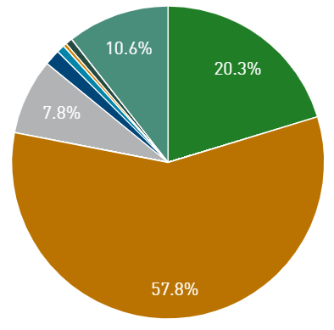
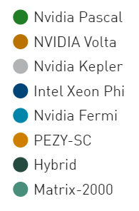
GPUs in HPC
Accelerator/CP Family
Performance Share
GPUs are growing faster in the HPC arena
NVIDIA GPUs - main driving force for
Accelerating traditional HPC applications
Accelerating AI thru faster training of Deep Neural Networks (DNNs)
https://www.top500.org (Nov ‘18)

Slide 4
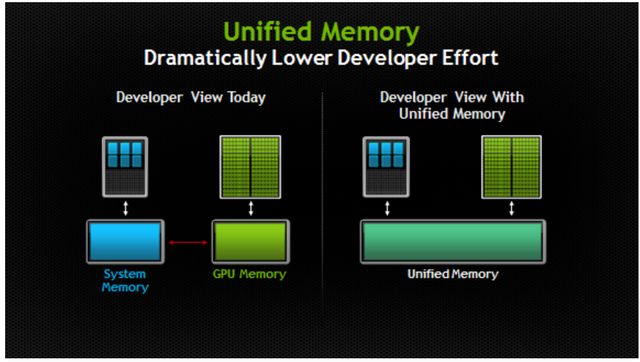
Managed/Unified Memory
Courtesy: NVIDIA developer blogs

Slide 5
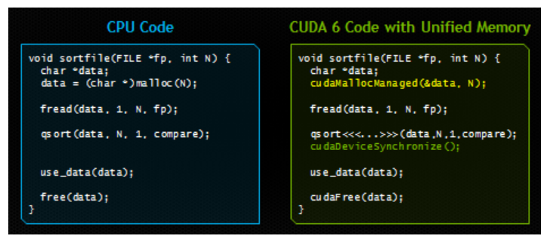
Managed/Unified Memory (Contd)
Courtesy: NVIDIA developer blogs

Slide 6
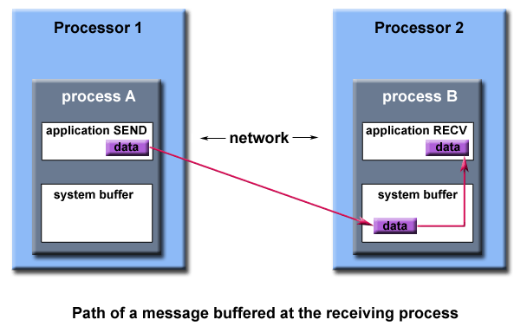
Message Passing Interface (MPI)
Popular parallel programming model to harness the power of nodes in a clusters
Data is explicitly sent by one process and received by another process in a cooperative fashion.
MPI libraries can be
CUDA Aware
UM Aware

Slide 7
Agenda
Introduction
Motivation
Research Challenges
UM-Aware MPI Performance Characterization
Conclusion

Slide 8
Basic Unified Memory (UM) Awareness in MPI
CUDA Unified Memory(UM) => no memory pin down
No IPC support for intra-node communication
No GDR support for Inter-node communication
Initial and basic support in MVAPICH2-GDR MPI library
For both intra- and inter-nodes use “pipeline through” host memory
D.Banerjee, K. Hamidouche, and D. K Panda, CUDA Designing High Performance Communication Runtime for GPU Managed Memory: Early Experiences, GPGPU-9

Slide 9
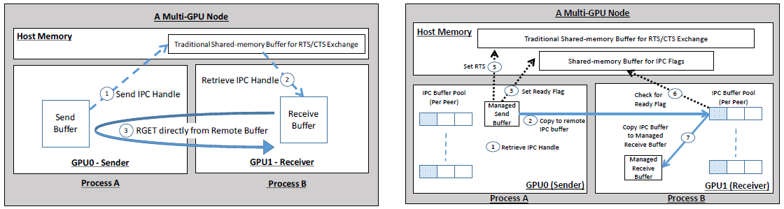
Enhanced Support for UM Awareness in MVAPICH2
Designs are motivated due to the poor UM performance on Kepler series of NVIDIA GPUs
K. Hamidouche, A. Awan, A. Venkatesh, and D. K Panda, CUDA M3: Designing Efficient CUDA Managed Memory-aware MPI by Exploiting GDR and IPC, HiPC ‘16

Slide 10
Enhanced H/W Support for Unified Memory on Pascal/Volta
GPU page faulting hardware support introduced in Pascal/Volta
Only faulting pages need to be migrated on-demand
Hardware access counters makes only the most needed pages migrated on-demand
On IBM Power systems, new Address Translation Services (ATS) allows a GPU to access CPU’s page table directly

Slide 11
Enhanced API Support for Unified Memory on Pascal/Volta
Hints like cudaMemAdvise and cudaMemPrefetchAsync() are very useful
Courtesy: http://on-demand.gputechconf.com/gtc/2017/presentation/s7285-nikolay-sakharnykh-unified-memory-on-pascal-and-volta.pdf

Slide 12
Time to Revisit UM-Aware Designs in MVAPICH2?
The substantial improvement in UM performance in latest Pascal/Volta GPUs motivates one to:
Explore whether UM-Aware designs in MVAPICH2 done for Kepler era are still valid for Pascal/Volta?
A thorough UM-Aware MPI library characterization will get the answer

Slide 13
Agenda
Introduction
Motivation
Research Challenges
UM-Aware MPI Performance Characterization
Conclusion

Slide 14
Broad Challenge
How can UM-Aware MPI runtimes deal with diverse GPU architectures and maintain efficient and high-performance designs for UM data movement across GPU generations?

Slide 15

Research Challenges
How advances in UM need to be dealt with in the context of MPI on different GPUs?
Can the performance of UM aware MPI be characterized completely?
Does the UM designs done during Kepler era still valid for Volta/Pascal GPUs?
What is the fundamental H/W changes in Volta over Kepler wrt UM performance?
Let’s characterize the performance of UM-Aware MPI

Slide 16
Agenda
Introduction
Motivation
Research Challenges
UM-Aware MPI Performance Characterization
Conclusion

Slide 17
Evaluation Platforms
Experiments were performed on a local cluster containing three generations of GPUs
Kepler K-80 hosted on a node containing 2 Intel Broadwell E5 v2680 processors running at 2.4 GHz with 125 GB RAM
Pascal P100 hosted on a node containing 2 Intel Haswell E5-2687W processors running at 3.1 GHz with 62 GB RAM
Volta V100 are hosted on following systems:
A node containing 2 Intel Haswell E5-2687W processors running at 3.1 GHz with 62 GB RAM
A node containing 2 POWER9 processors running at 3.8 GHz each connected to 2 V100s using NVLink2

Slide 18
Experimental Setup
Experiments were conducted using OSU Micro Benchmark (OMB) suite* of benchmarks.
OMB suite contains benchmarks for analyzing the following types of MPI operations:
Point to Point
Collectives
One-sided
‘osu_latency’ benchmark is chosen from the OMB suite* for UM characterization study
* OSUMicrobenchmarks, http://mvapich.cse.ohio-state.edu/benchmarks/

Slide 19
Experimental Setup: OMB
‘osu_latency’ benchmark measures latency by sending messages in a pingpong fashion on a UM buffer
It sets the effective location of UM buffer as ‘Host’ by default
Not much useful in characterizing the UM Aware MPI designs

Slide 20
Experimental Setup: MOMB
OMB is modified to make the effective location of UM buffer as ‘Device’
Achieved by launching a sender-side CUDA kernel during every pingpong iteration
The CUDA kernel also modifies the UM buffer during every CUDA kernel launch
More successful in characterizing the UM Aware MPI

Slide 21
Experimental design
Both the benchmarks are evaluated for:
Host to Host transfer (HH)
Device to Device transfer (DD)
Unified (Managed) to Unified (Managed) buffer transfer (MM)
Benchmark performance is evaluated using:
MVAPICH2-GDR & OpenMPI (Intel systems)
Spectrum MPI (IBM Power systems)

Slide 22
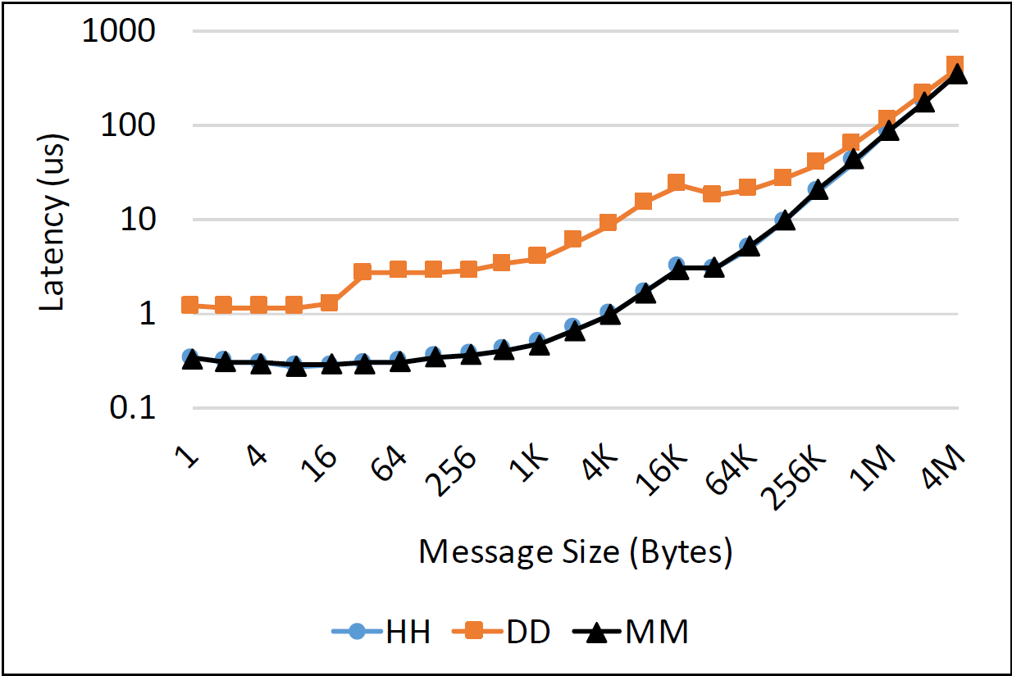
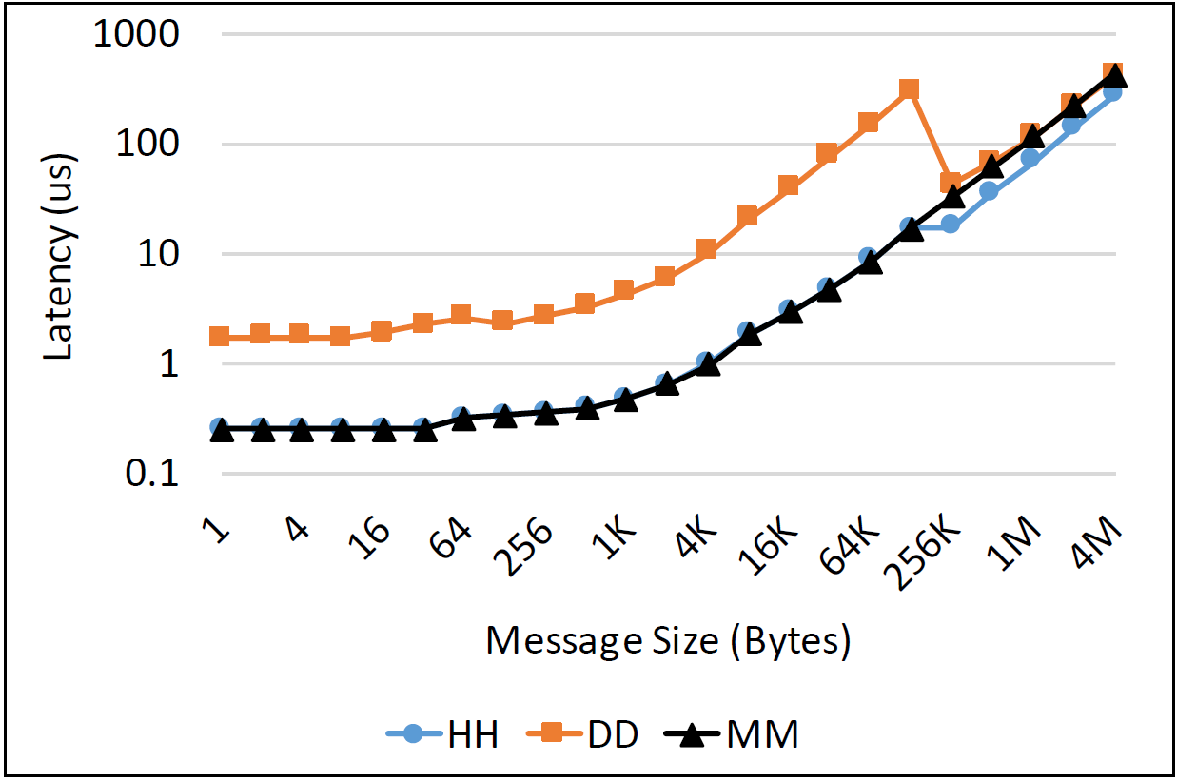
UM-Aware MPI Characterization on V100 with OMB
MVAPICH2-GDR
OpenMPI (w/ UCX CUDA)
MM and HH overlap in both these graphs shows OMB’s improper characterization of UM

Slide 23
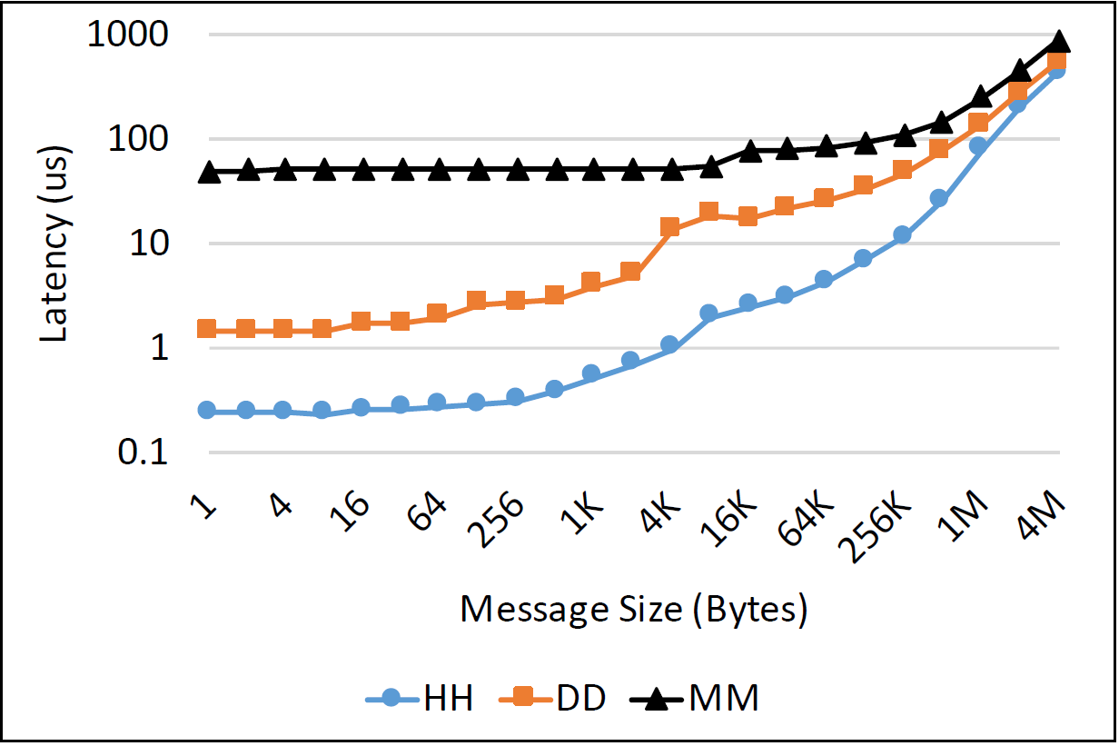
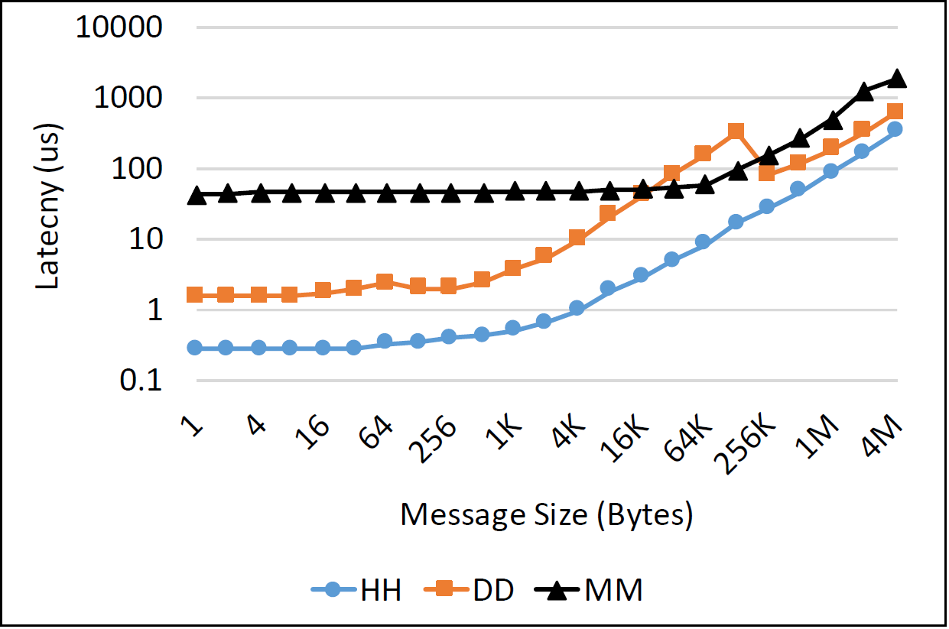
UM-Aware MPI Characterization on K80 with MOMB
MVAPICH2-GDR
OpenMPI (w/ UCX CUDA)
Proper characterization of UM on K80 using MOMB: UM performance is worse than device memory

Slide 24
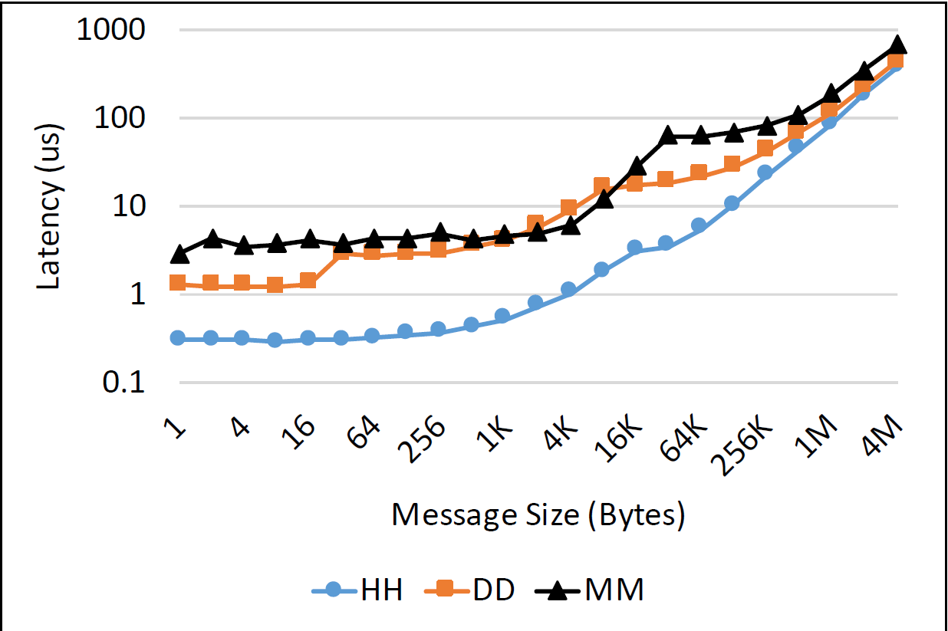
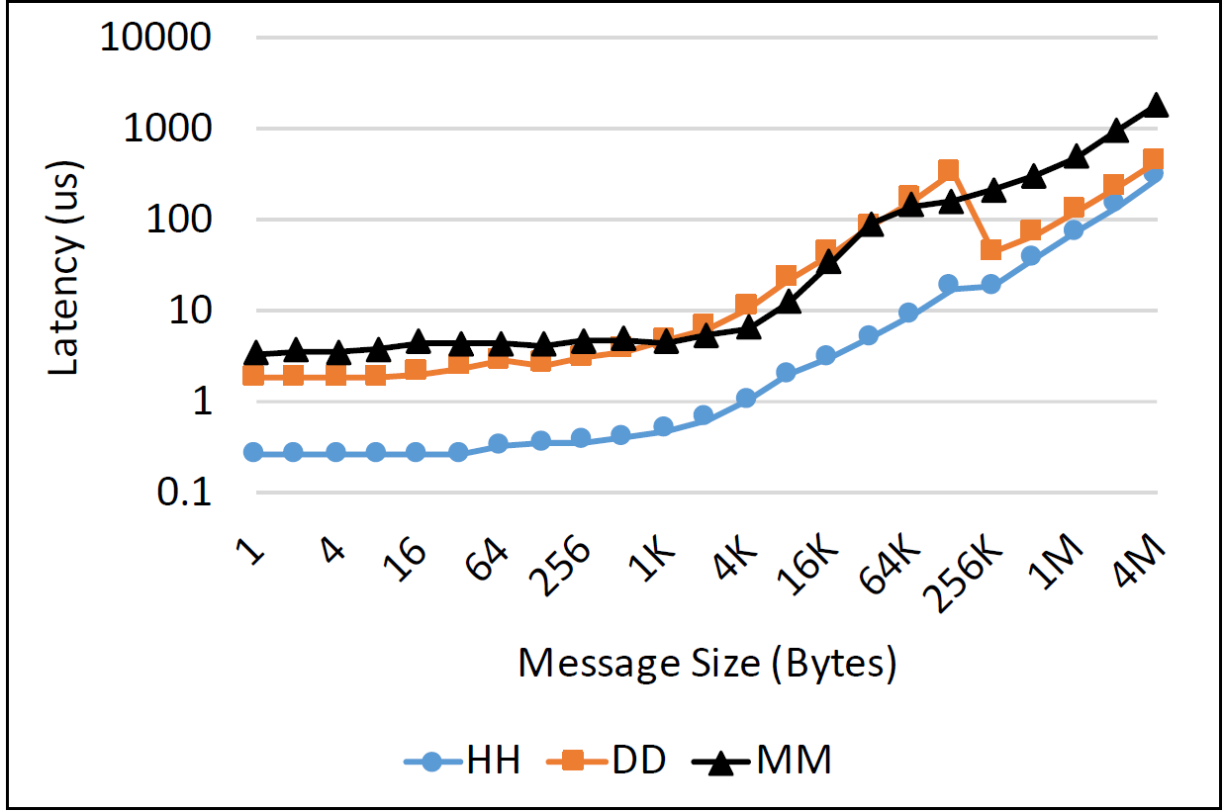
UM-Aware MPI Characterization on V100 with MOMB
MVAPICH2-GDR
OpenMPI (w/ UCX CUDA)
Proper characterization of UM on V100 using MOMB: UM performance is on par with device memory

Slide 25
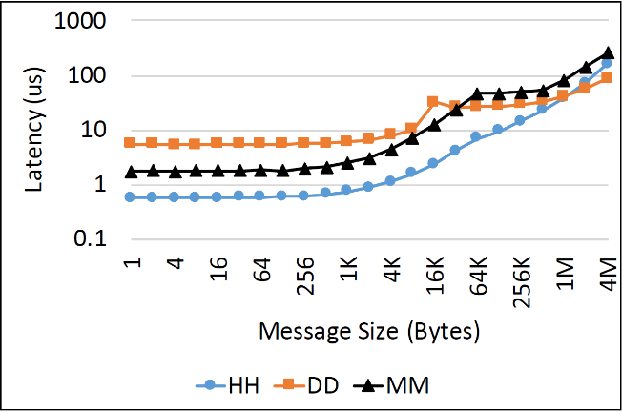
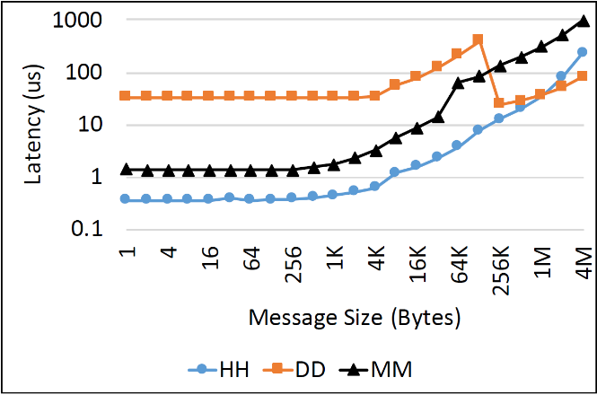
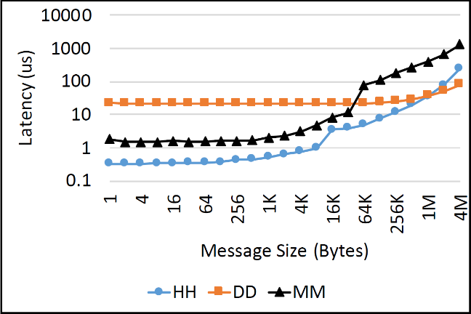
UM-Aware MPI Characterization on V100 + Power9 + NVLink with MOMB (Power Systems)
MVAPICH2-GDR
OpenMPI (w/ UCX CUDA)
Spectrum MPI
Proper characterization of UM on V100 using MOMB: UM performance is better than device memory

Slide 26
Let’s Dig Deeper
Page Faults while running MOMB
GPU Architecture | Host Architecture | GPU Page Faults | CPU Page Faults
K-80 | Intel X86 | N/A | 282800
Volta | Intel X86 | 31653 | 6550
Volta | POWER9 | 259 | 335

Slide 27
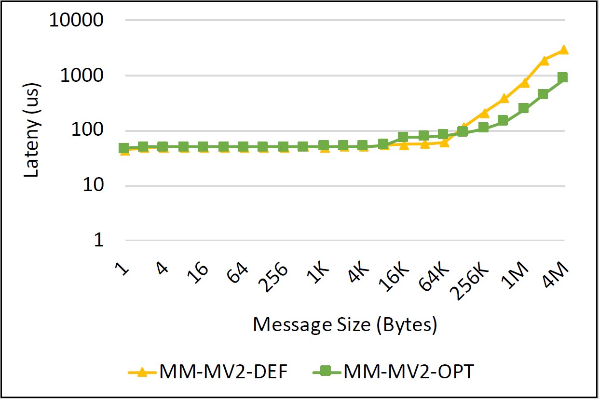
Gains From Enhanced UM Support on K80
4.2X
Enhanced UM designs certainly improved performance during Kepler era.

Slide 28
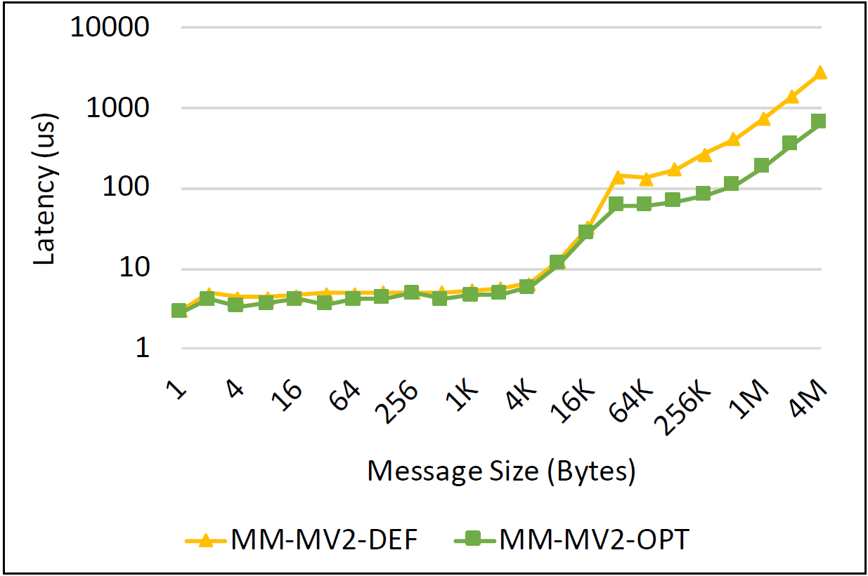
Gains From Enhanced UM Support on V100
4.2X
The enhanced UM designs from Kepler era still provides benefits for Volta GPUs!!

Slide 29
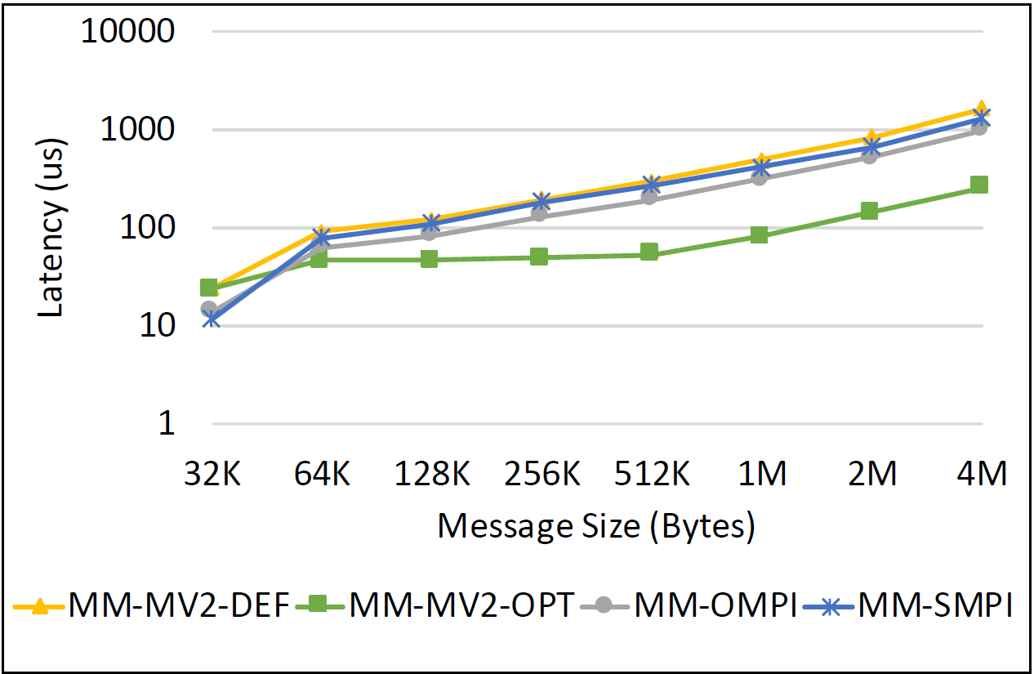
Gains From Enhanced UM Support on V100 + Power9 + NVLink (Power Systems)
The enhanced UM designs provides benefits for Volta GPUs on Power systems too!!

Slide 30
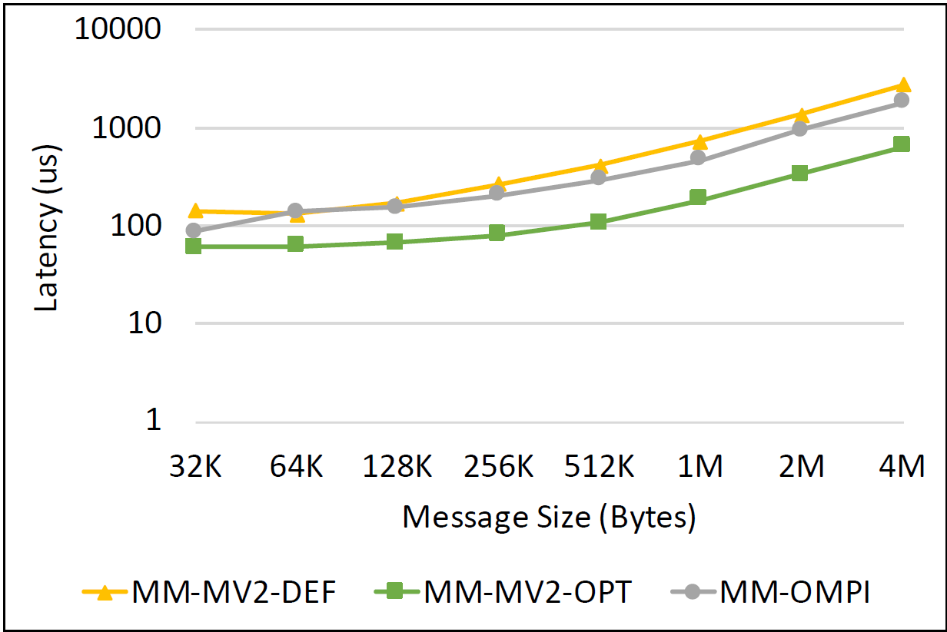
Gains from Enhanced UM Support on V100: MVAPICH2 Vs OpenMPI
2.8X
The enhanced UM designs in MVAPICH2 fares better than OpenMPI

Slide 31
Agenda
Introduction
Background
Research Challenges
UM-Aware MPI Performance Characterization
Conclusion

Slide 32
Conclusion
Hardware support for UM in latest Pascal/Volta GPUs greatly improved the UM performance
This does not mean that the UM aware designs conceived in MPI libraries during Kepler era are not valid any more
The conducted UM characterization study clearly shows that previous UM aware designs still improve the UM performance of latest Pascal/Volta GPUs
MVAPICH2-OPT containing enhanced UM aware designs outperforms regular MVAPICH2-GDR by 4.2x and OpenMPI by 2.8x for Intel Systems

Slide 33

Thank You!
{vadambacherimanian.1,awan.10,ruhela.2,chu.368,subramoni.1,panda.2}@osu.edu
Network-Based Computing Laboratory
http://nowlab.cse.ohio-state.edu/
The High-Performance MPI/PGAS Project
http://mvapich.cse.ohio-state.edu/

Slide 34
Backup Slides

Slide 35
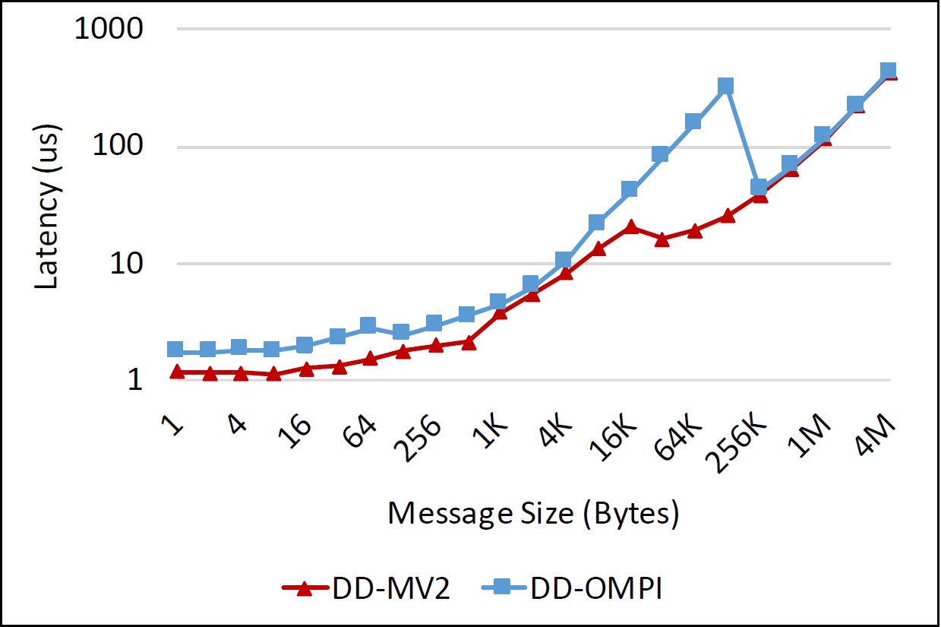
MVAPICH2-GDR Vs OpenMPI: Pure Device Buffer Performance
MVAPICH2-GDR vs OpenMPI

