Slide 1
12th Workshop on General Purpose Processing Using GPU (GPGPU 2019) @ ASPLOS 2019
https://insight-archlab.github.io/gpgpu.html

Slide 2
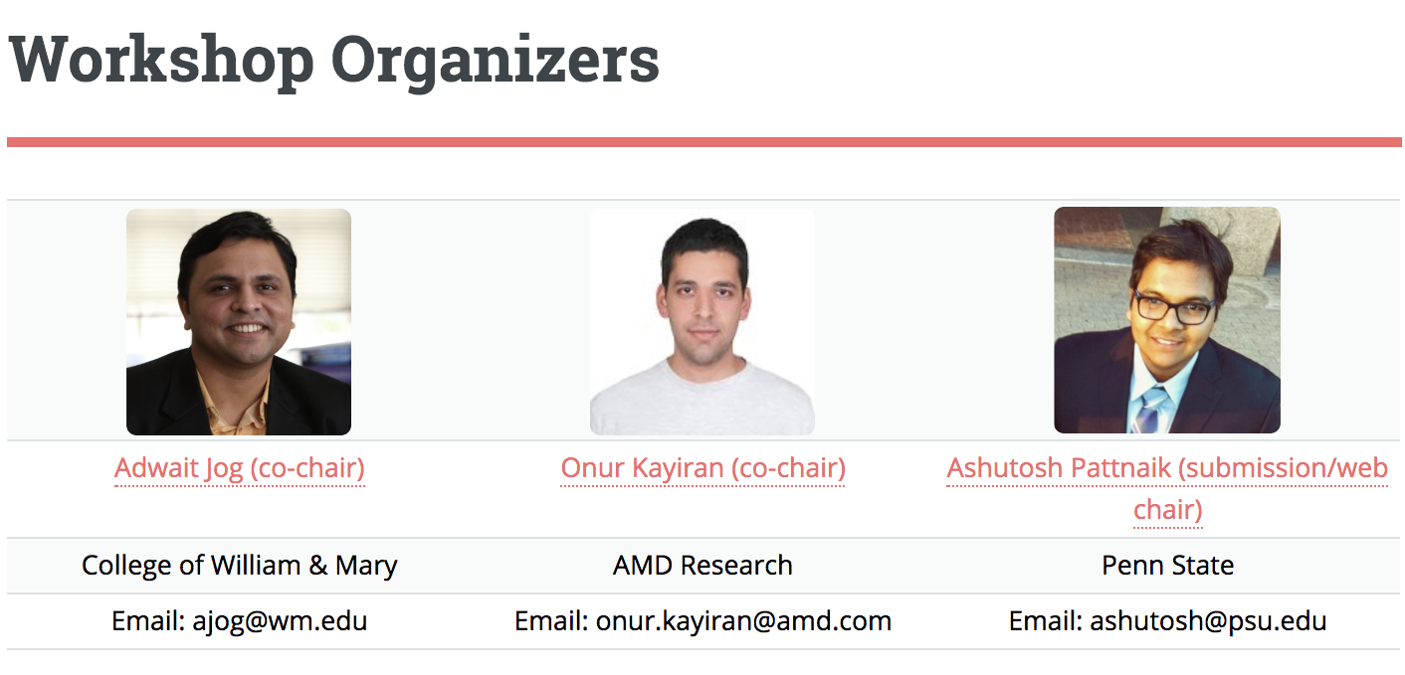

Slide 3
Scope
The goal of this workshop is to provide a forum to discuss new and emerging general-purpose programming architectures, environments, and platforms, as well as evaluate applications that have been able to harness the horsepower provided by these platforms. This year's workshop is particularly interested in security, new heterogeneous architecture or platforms, new forms of concurrency, and novel or irregular applications that can leverage these platforms. Papers are being sought on many aspects of GPUs or accelerators, including (but not limited to):
GPU applications
GPU programming environments
GPU runtime systems
GPU compilation
GPU architectures
Multi-GPU systems
GPU power/efficiency
GPU reliability
GPU benchmarking/measurements
Heterogeneous architectures/platforms
GPU security (NEW)
Non-von Neumann architectures (NEW)
Domain-specific architectures (NEW)

Slide 4
Paper Selection Process
15 full submissions
Each paper received 3 reviews from experts
Online discussion helped in reaching a consensus
6 papers accepted; 10 pages each
Topics span across: Security, DNN, Graphs, Implementation, Software, and Characterization
Accepted papers appear in ACM Online Conference Proceedings Series

Slide 5
Program Committee
Anthony Gutierrez, AMD Research
Arkaprava Basu, IISc
Asit Mishra, NVIDIA
Bin Ren, William and Mary
Biswabandan Panda, IIT Kanpur
Daniel Wong, UCR
David Kaeli, Northeastern
Evgeny Bolotin, NVIDIA
Hyeran Jeon, SJSU
John Kim, KAIST
Kapil Vaswani, MSR, India
Mark Silberstein, Technion
Martin Burtscher, Texas State
Minsoo Rhu, KAIST
Nandita Vijaykumar, CMU
Rachata Ausavarungnirun, CMU/KMUTNB, Thailand
Sonia Lopez Alarcon, RIT
Sooraj Puthoor, AMD Research
Sreepathi Pai, Rochester
Tao Li, University of Florida
Tim Rogers, Purdue
Trevor E. Carlson, National University of Singapore
Xin Fu, University of Houston
Yash Ukidave, AMD

Slide 6
Keynote Speakers
Prof. Nael Abu Ghazaleh
Professor, UC Riverside
Is my GPU Secure? Covert and Side channel attacks on GPUs
Prof. Xipeng Shen
Professor, NCSU
Augmenting GPU Hardware through Software Innovations - A Reflection on a Dozen Years of Efforts

Slide 7
Morning Schedule
9:00 AM - 10:00 AM | Keynote - I: "Is my GPU Secure? Covert and Side channel attacks on GPUs", Nael Abu-Ghazaleh, UC Riverside
10:00 AM - 10:30 AM | Break
10:30 AM - 11:00 AM | Scatter-and-Gather Revisited: High-Performance Side-Channel-Resistant AES on GPUs Zhen Lin, Utkarsh Mathur, Huiyang Zhou (North Carolina State University)
11:00 AM - 11:30 AM | Detailed Characterization of Deep Neural Networks on GPUs and FPGAs Aajna Karki, Chethan Palangotu Keshava, Spoorthi Mysore Shivakumar, Joshua Skow, Goutam Madhukeshwar Hedge, Hyeran Jeon (San Jose State University)
11:30 AM - 12:00 Noon | Which Graph Representation to Select for Static Graph-Algorithms on a CUDA-capable GPU Thorsten Blaß, Michael Philippsen (Friedrich-Alexander University Erlangen-Nürnberg)

Slide 8
Afternoon Schedule
2:00 PM - 3:00 PM | Keynote - II: "Augmenting GPU Hardware through Software Innovations - A Reflection on a Dozen Years of Efforts", Xipeng Shen, NCSU
3:00 PM - 3:30 PM | Break
3:30 PM - 4:00 PM | KNN-Joins Using a Hybrid Approach: Exploiting CPU/GPU Workload Characteristics Michael Gowanlock (Northern Arizona University)
4:00 PM - 4:30 PM | Characterizing CUDA Unified Memory (UM)-AwareMPI Designs on Modern GPU Architectures Karthik Vadambacheri Manian, Ammar Ahmad Awan, Amit Ruhela, Ching-Hsiang Chu, Hari Subramoni, Dhabaleswar Panda (The Ohio State University)
4:30 PM - 5:00 PM | Quantifying the NUMA Behavior of Partitioned GPGPU Applications Alexander Matz, Holger Fröning (Heidelberg University)
5:00 PM - 5:15 PM | Closing Remarks

Slide 9
Keynote 1
Nael Abu Ghazaleh
Is my GPU Secure? Covert and Side channel attacks on GPUs

Slide 10
Closing Remarks

Slide 11
Closing
Hope you enjoyed the workshop
Please send us feedback – What can be done in the future to make the workshop better?
If you want to serve on the PC or on the organizing committee, please send us email!
We want to make this workshop more inclusive
Email: ajog@wm.edu, onur.kayiran@amd.com
We acknowledge David Kaeli (Northeastern) for his support and guidance.
We thank authors for submitting papers to the workshop and making it successful.
Finally, we thank all speakers for their wonderful talks.

