Slide 1

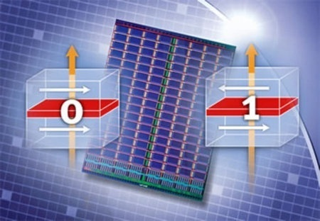
Cache Revive: Architecting Volatile STT-RAM Caches for Enhanced Performance in CMPs
Adwait Jog†, Asit K. Mishra‡, Cong Xu†, Yuan Xie†, N. Vijaykrishnan†, Ravi Iyer‡, Chita R. Das†
†The Pennsylvania State University
‡ Intel Corporation
Notes:
Enter Title of Presentation Here
Google Confidential
1

Slide 2

STT-RAM as Emerging Memory Technology
Spin-Torque Transfer RAM (STT-RAM) combines the speed of SRAM, density of DRAM, and non-volatility of Flash memory, making it attractive for on chip cache hierarchies.
STT-RAM caches suffer from long write latency and higher write energy consumption when compared to traditional SRAM caches.

Slide 3
SRAM vs. STT-RAM
 | Area (mm²) | Read Energy (nJ) | Write Energy (nJ) | Leakage Power at (mW) | Read Latency (ns) | Write latency (ns) | Read @ 2 GHz (cycles) | Write @2 GHz (cycles)
1 MB SRAM | 2.61 | 0.578 | 0.578 | 4542 | 1.012 | 1.012 | 2 | 2
4MB STT-RAM | 3.00 | 1.035 | 1.066 | 2524 | 0.998 | 10.61 | 2 | 22
~3-4x denser (capacity benefit)
1.8x lower leakage energy
Comparable read
latency
~11x higher write latency
(@ 2GHZ)

Slide 4
Proposal : Reduce Retention Time
Years of data-retention time for STT-RAM may
not be required.
Trade-off retention time for lower STT-RAM write latency
Challenge: Architecting “Volatile STT-RAM” Caches
Advantage: Performance and Energy Benefits!

Slide 5
How to Calculate Optimal Retention Time?
(1) Device Constraints:
Retention Time of STT-RAM can be reduced to a certain limit.
(2) Application Needs:
Application Characteristics show that data-retention time in range of milliseconds is sufficient enough to make STT-RAM caches effective for CMPs.
Both Device Constraints and Application Needs should be considered for Optimal Results!

Slide 6
How to Reduce STT-RAM Write Latency?
Retention Time
Operating Point
Write current goes down with reduction in retention time
Retention Time of STT-RAM | Write Latency @ 2 GHz
10 Years | 22 cycles
1 second | 12 cycles
10 millisecond | 6 cycles

Slide 7
Inter-Write Time (Refresh Time) Distributions of Multi-threaded and Multi-Programmed Benchmarks
How much non-volatility can be traded off?
PARSEC
SPEC 2006
Majority (> 50%) of L2 Cache Blocks get refreshed within 10ms

Slide 8
Volatile STT-RAM Based Last level Cache Design
How to save rest 50% of the blocks?
Answer: Use Selective Refresh Policy.
Only refresh cache blocks which are in MRU Slots.
Dying Blocks (Refresh)
Dying Blocks
(Do not Refresh)
WAY ID
0 | 1 | 2 | 3 | 4 | 5 | 6 | 7 | 8 | 9 | 10 | 11 | 12 | 13 | 14 | 15
Block
State
IMP Blocks
NON- IMP Blocks

Slide 9
How to refresh?
IMP Blocks
NON- IMP Blocks
WAY ID
0 | 1 | 2 | 3 | 4 | 5 | 6 | 7 | 8 | 9 | 10 | 11 | 12 | 13 | 14 | 15
Block
State
COPY BACK
Is Buffer Full?
YES
Dirty?
COPY
YES
NO
Write-back to DRAM

Slide 10
Results: Speedup Improvement
On Average, 18 % Performance Improvement for PARSEC Multithreaded Benchmarks
On Average, 10% Improvement in Instruction Throughput for
Multi-programmed workloads
PARSEC Benchmarks
SPEC Benchmarks

Slide 11
Results: Energy Improvements
Nominal Increase in Dynamic Energy (4%) over M-4MB because of Buffer Scheme
60 % reduction in Leakage Energy over SRAM designs

Slide 12
Summary
STT-RAM is a promising technology, which has high density, low leakage and competitive read latencies compared to SRAM.
High Write Latency and Energy is impeding its widespread adoption.
Reducing Retention time can directly reduce the write-latency and write energy of STT-RAM.
A Simple Buffering Scheme is presented to refresh important diminishing blocks.

