Slide 1

Application-aware Memory System for Fair and Efficient Execution of Concurrent GPGPU Applications
Adwait Jog¹, Evgeny Bolotin², Zvika Guz^{2,a}, Mike Parker^{2,b},
Steve Keckler^{2,3}, Mahmut Kandemir¹, Chita Das¹
Penn State¹, NVIDIA², UT Austin³,
now at (Samsungª, Intel^{b})
GPGPU Workshop @ ASPLOS 2014
Notes:
This work was performed when I was an intern at NVIDIA Research last summer.

Slide 2
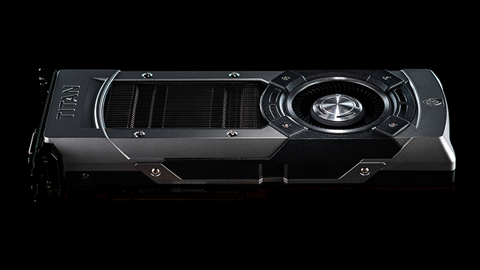
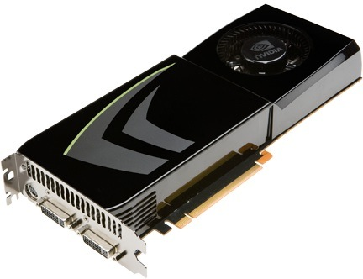

Era of Throughput Architectures
GPUs are scaling: Number of CUDA Cores, DRAM bandwidth
GTX 275
(Tesla) 240 cores
(127 GB/sec)
GTX 480
(Fermi) 448 cores
(139 GB/sec)
GTX 780 Ti
(Kepler) 2880 cores
(336 GB/sec)
Notes:
As we know GPU are scaling both in terms of number of CUDA cores as well peak DRAM
Bandwidth. For example, the latest NVIDIA GPU GTX 780 Ti has more than 2000 cores.
Given such powerful GPUs, the question is -- Are we “still” using them efficiently?

Slide 3
Prior Approach (Looking Back)
Execute one kernel at a time
Works great, if kernel has enough parallelism
Single Application
SM-1
SM-2
SM-30
SM-31
SM-32
SM-X
Interconnect
Cache
Memory
Notes:
Well, we “were”, when application/kernel had enough parallelism to fill the whole GPU.
But as newer GPUs are growing and applications are not scaling enough,
it is more and more challenging to do so.

Slide 4
Current Trend
What happens when kernels do not have enough threads?
Execute multiple kernels (from same application/context) concurrently
CURRENT ARCHITECTURES SUPPORT THIS FEATURE
Fermi
Kepler
4
Notes:
When applications/kernels don’t have enough parallelism, current architectures
Actually allow execution of multiple kernels on the same GPU hardware. Technically,
They come from same context/applications. Fermi and Kepler architectures support
This feature.

Slide 5
Future Trend (Looking Forward)
We study execution of
multiple kernels from
multiple applications (contexts)
Application-1
Application-2
Application-N
SM-1
SM-A
SM-A+1
SM-B
SM-B+1
SM-X
Interconnect
Cache
Memory
Notes:
In our work, we take a step forward and study the impact of executing multiple kernels originating from
Multiple applications. The goal is to understand what are inefficiencies of current GPUs that prevent
Fair and performance efficient execution of applications concurrently.

Slide 6
Why Multiple Applications (Contexts)?
Improves overall GPU throughput
Improves portability of multiple old apps (with limited thread-scalability) on newer scaled GPUs
Supports consolidation of multiple-user requests on to the same GPU
Notes:
As concurrent execution of kernels helped in improving GPU throughput, this technique also does, because
The resources that otherwise are not able to be utilized, now can put to use by additional concurrent kernels.
Secondly, this feature also allows porting of multiple old legacy CUDA codes that probably cannot be parallelized otherwise.
Instead of improving parallelism, we can concurrently executing multiple of those. Thirdly, this feature also allows consolidation
Of multiple user requests on to the same GPU, thereby improving GPU hardware efficiency.

Slide 7
We study two applications scenarios
1. One application runs alone on 60 SM GPU (Alone_60)
Single Application (Alone)
SM-1
SM-2
SM-3
SM-59
SM-60
Interconnect
Cache
Memory
2. Co-scheduling two apps
Assumed equal partitioning, 30 SM + 30 SM
Application-1
Application-2
SM-1
SM-30
SM-31
SM-60
Interconnect
Cache
Memory
Notes:
In this context, we study two application case, where the baseline 60 SM GPUs is used. First application is
Scheduled on first half of the GPU, and the second half GPU executes other application. Hence, we use
A simple equal partitioning technique, we leave more sophisticated techniques as a part of future work.

Slide 8
Metrics
Instruction Throughput (Sum of IPCs)
IPC (App1) + IPC (App2) + …. IPC (AppN)
Weighted Speedup
With co-scheduling:
Speedup (App-N) = Co-scheduled IPC (App-N) / Alone IPC (App-N)
Weighted Speedup = Sum of speedups of ALL apps
Best case:
Weighted Speedup = N (Number of apps)
With destructive interference
Weighted Speedup can be between 0 to N
Time-slicing – running alone:
Weighted Speedup = 1 (Baseline)

Slide 9
Outline
Introduction and motivation
Positives and negatives of co-scheduling multiple applications
Understanding inefficiencies in memory-subsystem
Proposed DRAM scheduler for better performance and fairness
Evaluation
Conclusions

Slide 10
Positives of co-scheduling multiple apps
→ Gain in weighted speedup (application throughput)
Baseline
Weighted Speedup = 1.4, when HIST is concurrently executed with DGEMM
40% improvement over running alone (time-slicing)

Slide 11
Negatives of co-scheduling multiple apps (1)
(A) Fairness
Unequal performance degradation indicates unfairness in the system

Slide 12
Negatives of co-scheduling multiple apps (2)
(B) Weighted speedup (Application Throughput)
With destructive Interference
Weighted speedup can be between 0 to 2 (can also go below baseline = 1)
Baseline
GAUSS+GUPS: Only 2% improvement in weighted speedup, over running alone

Slide 13
Summary: Positives and Negatives
Baseline
Highlighted workloads: Exhibit unfairness (imbalance in red-green portions) & low throughput
Naïve coupling of 2 apps is probably not a good idea

Slide 14
Outline
Introduction and motivation
Positives and negatives of co-scheduling multiple applications
Understanding inefficiencies in memory-subsystem
Proposed DRAM scheduler for better performance and fairness
Evaluation
Conclusions

Slide 15
Primary Sources of Inefficiencies
Application Interference at many levels
L2 Caches
Interconnect
DRAM (Primary Focus of this work)
Application-1
Application-2
Application-N
SM-1
SM-A
SM-A+1
SM-B
SM-B+1
SM-X
Interconnect
Cache
Memory

Slide 16
Bandwidth Distribution
Red portion is the fraction of wasted DRAM cycles during which data is not transferred over bus
Bandwidth intensive applications (e.g. GUPS) takes majority of memory bandwidth
Notes:
Alone_30 has same configuration as Alone_60, except that it application runs on 30SMs instead of 60

Slide 17
Revisiting Fairness and Throughput
Baseline
Imbalance in green and red portions indicates unfairness

Slide 18
Current Memory Scheduling Schemes
Agnostic to different requirements of memory requests coming from different applications
Leads to
Unfairness
Sub-optimal performance
Primarily focus on improving DRAM efficiency

Slide 19
Commonly Employed Memory Scheduling Schemes
Request to
Row-1
Row-2
Row-3
App-1
App-2
R1
R2
R3
Time
Time
R3
R3
Row Switch
Row Switch
R2
R2
R2
R2
Row Switch
R1
R2
Row Switch
Row Switch
R2
R1
Row Switch
R1
R1
R1
R1
Bank
Bank
Simple FCFS
Out of order (FR-FCFS)
Low DRAM Page Hit Rate
High DRAM Page Hit Rats
Both schedulers are application agnostic! (App-2 suffers)
Notes:
There are two commonly employed memory schedulers – FCFS (in-order) and FR-FCFS (out-of-order). I am showing 7 memory requests served in FCFS order on the left-hand side. Out of 7 requests, 6 of them are from App-1, and the last one is from App-2. In FCFS, we basically observe two problems: First, there are many row-switches because requests are served in the order they are received. This leads to low DRAM Page Hit Rate. Secondly, the app-2 request is starved for long time. To solve
The first problem, out-of-order FR-FCFS is used, where requests to the opened row are served first. In this case, although row-switches are reduced; thereby improving page hit rate, app-2 request is again served because green application occupies the memory request queue. Therefore both schedulers are unable to serve app-2 in fair manner → both schedulers are app agonsitc

Slide 20
Outline
Introduction and motivation
Positives and negatives of co-scheduling multiple applications
Understanding inefficiencies in memory-subsystem
Proposed DRAM scheduler for better performance and fairness
Evaluation
Conclusions

Slide 21
Proposed Application-Aware Scheduler
As an example of adding application-awareness
Instead of FCFS, schedule requests in Round-Robin Fashion
Preserve the page hit rates
Proposal:
FR-FCFS (Baseline) → FR-(RR)-FCFS (Proposed)
Improves Fairness
Improves Performance

Slide 22
Proposed Application-Aware FR-(RR)-FCFS Scheduler
Request to
Row-1
Row-2
Row-3
App-1
App-2
R1
R2
R3
Time
Time
R3
R2
Row Switch
R2
R2
R2
R2
Row Switch
R2
R3
Row Switch
Row Switch
R1
R1
R1
R1
R1
R1
Bank
Bank
Baseline FR-FCFS
Proposed FR-(RR)-FCFS
App-2 is scheduled after App-1 in Round-Robin order

Slide 23
DRAM Page Hit-Rates
Same Page Hit-Rates as Baseline (FR-FCFS)

Slide 24
Outline
Introduction and motivation
Positives and negatives of co-scheduling multiple applications
Understanding inefficiencies in memory-subsystem
Proposed DRAM scheduler for better performance and fairness
Evaluation
Conclusions

Slide 25
Simulation Environment
GPGPU-Sim (v3.2.1)
Kernels from multiple applications are issued to different concurrent CUDA Streams
14 two-application workloads considered with varying memory demands
Baseline configuration similar to scaled-up version of GTX480
60 SMs, 32-SIMT lanes, 32-threads/warp
16KB L1 (4-way, 128B cache block) + 48KB SharedMem per SM
6 partitions/channels (Total Bandwidth: 177.6 GB/sec)

Slide 26
Improvement in Fairness
Lower is Better
r1 = Speedup(app1)
Speedup(app2)
r2 = Speedup(app2)
Speedup(app1)
Fairness = max (r1, r2)
Index
On average 7% improvement (up to 49%) in fairness
Significantly reduces the negative impact of BW sensitive applications (e.g. GUPS) on overall fairness of the GPU system

Slide 27
Improvement in Performance (Normalized to FR-FCFS)
Instruction Throughput
Weighted Speedup
On average 10% improvement (up to 64%) in instruction throughput performance and up to 7% improvement in weighted speedup performance.
Significantly reduces the negative impact of BW sensitive applications (e.g. GUPS) on overall performance of the GPU system

Slide 28
Bandwidth Distribution with Proposed Scheduler
Lighter applications get better DRAM bandwidth share

Slide 29
Conclusions
Naïve coupling of applications is probably not a good idea
Co-scheduled applications interfere in the memory-subsystem
Sub-optimal Performance and Fairness
Current DRAM schedulers are agnostic to applications
Treat all memory request equally
Application-aware memory system is required for enhanced performance and superior fairness
Notes:
To conclude, we show that naïve coupling for applications is probably not a good idea, because
Co-scheduled applications significantly interfere in the memory sub-system, and an application-unaware
Memory hierarchy will lead to sub-optimal performance and fairness. In this context, the current DRAM
Schedulers are application-agnostic, and treat all memory requests equally and assume that they are
Coming from same application/kernel. Therefore, we claim that adding application-awareness is important for better performance and fairness. We showed one example case, where application-awareness actually works. As part of future work, we can design more sophisticated application aware mechanisms.

Slide 30
Thank You!
Questions?
Notes:
Thanks, and I will be happy to take any questions.

