Slide 1

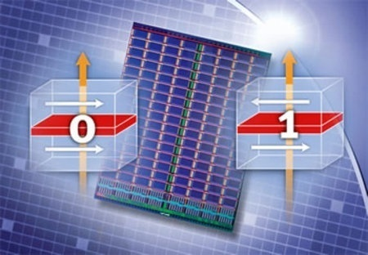
Cache Revive: Architecting Volatile STT-RAM Caches for Enhanced Performance in CMPs
Adwait Jog†, Asit K. Mishra‡, Cong Xu†, Yuan Xie†,
N. Vijaykrishnan†, Ravi Iyer‡, Chita R. Das†
†The Pennsylvania State University
‡ Intel Corporation
Years of data-retention time for STT-RAM (traditionally non-volatile) may not be required.
Trade-off retention time for lower STT-RAM write latency and energy
Challenge: Architecting “Volatile STT-RAM” Caches
Advantage: Performance and Energy Benefits!
Retention Time of STT-RAM | Write Latency @ 2 GHz
10 Years | 22 cycles
1 second | 12 cycles
10 millisecond | 6 cycles
Notes:
Enter Title of Presentation Here
Google Confidential
1

