Slide 1
Min-Move 2018 2nd Workshop on Hardware/Software Techniques for Minimizing Data Movement

Slide 2
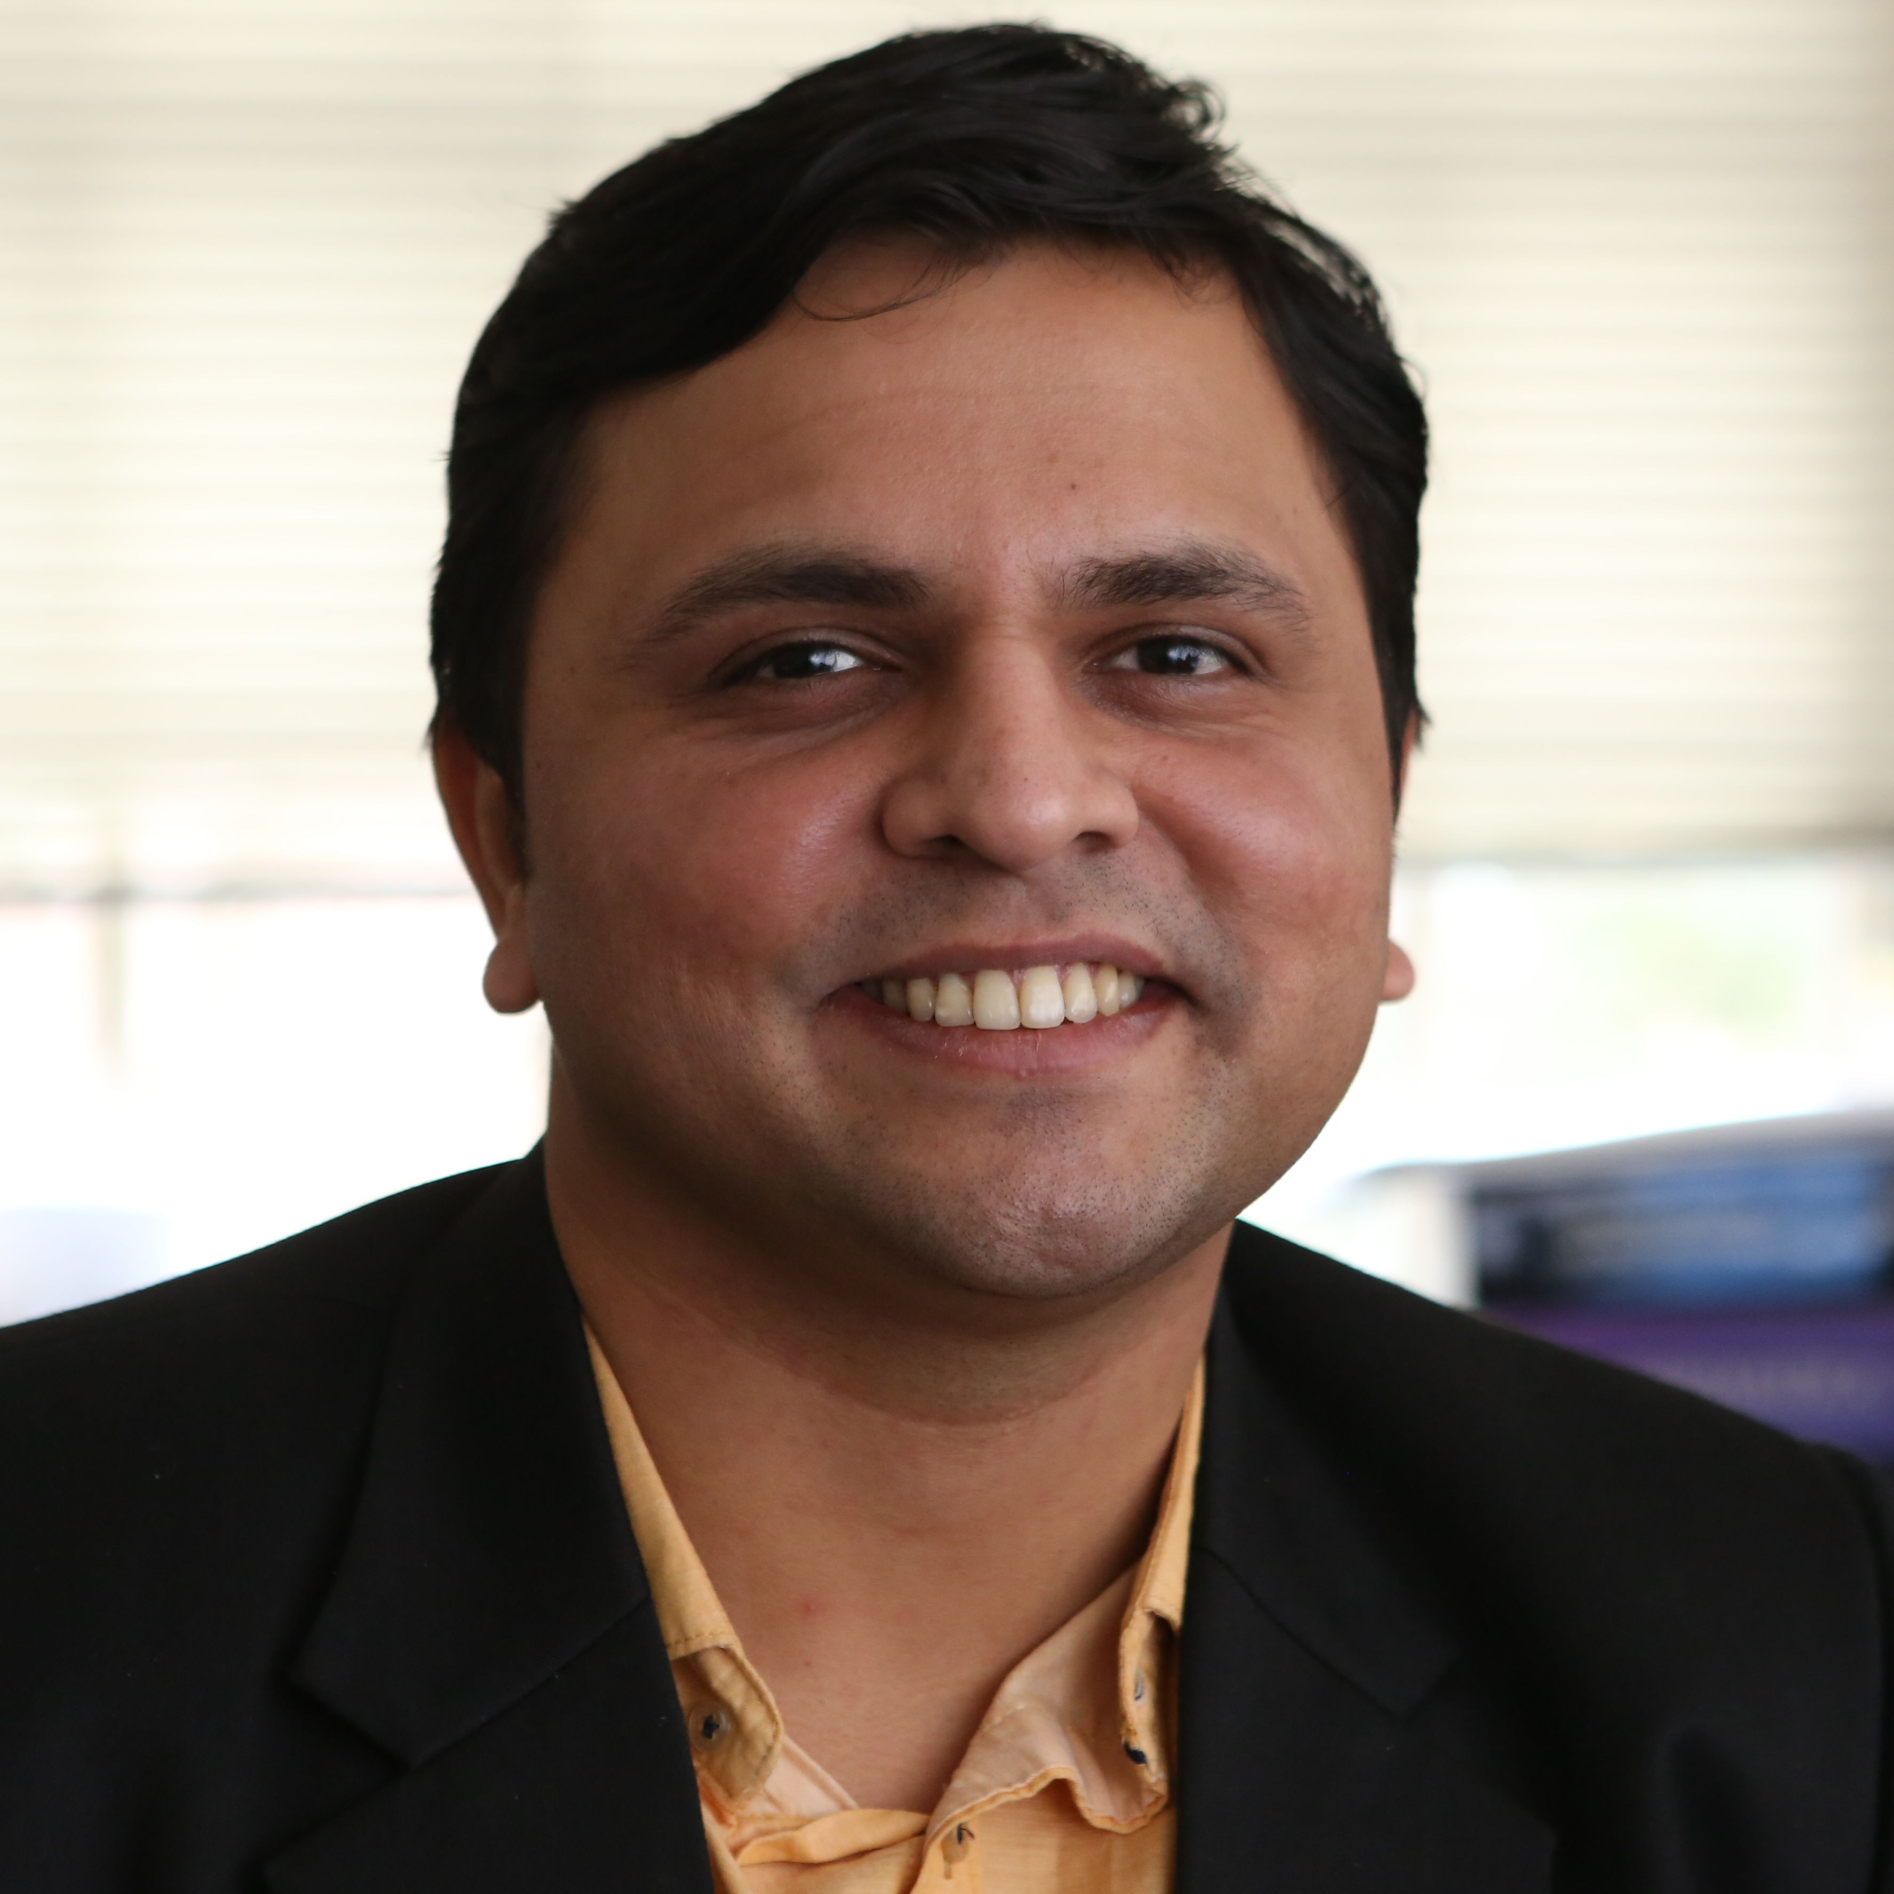
Organizers
Adwait Jog
Assistant Professor (William & Mary)
Computer Architecture, GPUs
www.cs.wm.edu/~adwait
Also local arrangements co-chair for ASPLOS -- Happy to help ☺
EJ Kim
Associate Professor, Texas A&M University
Computer Architecture, Interconnects, Performance Evaluation
http://faculty.cse.tamu.edu/ejkim/

Slide 3
Scope
Any idea/technique that can help in reducing the data movement is appropriate for this workshop. Some topics (but not limited to) are:
Near Data Processing (e.g., near caches or memory or storage devices)
In-Memory Computing (e.g., in caches or memory or storage devices)
Approximate Computing (e.g., load value approximations)
Cache/DRAM Locality Optimizations
Data Compression Techniques
Emerging Memory Technologies (e.g., STT-RAM, Memristor)
Non Von-Neumann Architectures (e.g., Quantum Architectures, Automata Processor)
Interconnection Architectures (e.g., on-chip, off-chip, Ethernet, interposer system, flexible interconnects for FPGA)
Programming and Language Support for Minimizing Data Movement

Slide 4
Program Committee
Niladrish Chatterjee (Nvidia)
Reetuparna Das (UMich)
Myoungsoo Jung (Yonsei)
David Kaeli (Northeastern)
Onur Kayiran (AMD Research)
Aasheesh Kolli (VMWare and Penn State)
Asit Mishra (Intel)
Yoonho Park (IBM)
Gennady Pekhimenko (UToronto)
Lawrence Rauchwerger (Texas A&M)

Slide 5
Highlights of the Workshop
Keynotes from
Rajeev Balasubramonian (UT Austin)
Reetuparna Das (Michigan)
Alessandro Morari (IBM)
Peer-Reviewed Workshop Paper (received three reviews)
An Extensible Scheduler for the OpenLambda FaaS Platform
Authors: Gustavo Totoy, Edwin Boza, and Cristina Abad (ESPOL, Eucador)

