Slide 1
VACCINE DISTRIBUTION SYSTEM

Slide 2
OVERVIEW
MAIN PURPOSE:
To develop a vaccine distribution system that will operate at national, state and local level.
Key requirement is to ensure that vaccine was flowing to the right places at the right time.
Efficient Vaccine Adverse Event management.
Efficient financial and inventory management.

Slide 3
KEY ISSUES:
Vaccine Safety: The CDC should learn about an adverse event as quickly as possible if a particular batch of vaccine is spoiled or making people sick
A system to track the vaccines incase of an adverse event.
Ensure proper delivery of vaccines at the right place at right time.

Slide 4
PROJECT FEATURES
Manufacturer can recall a vaccine LOT incase of an adverse event.
Multi-level support to report any adverse event directly to CDC.
CDC can post any Vaccine shortage information to the required entities.
CDC has a state-wise overview of the total number of vaccines available currently throughout the system

Slide 5
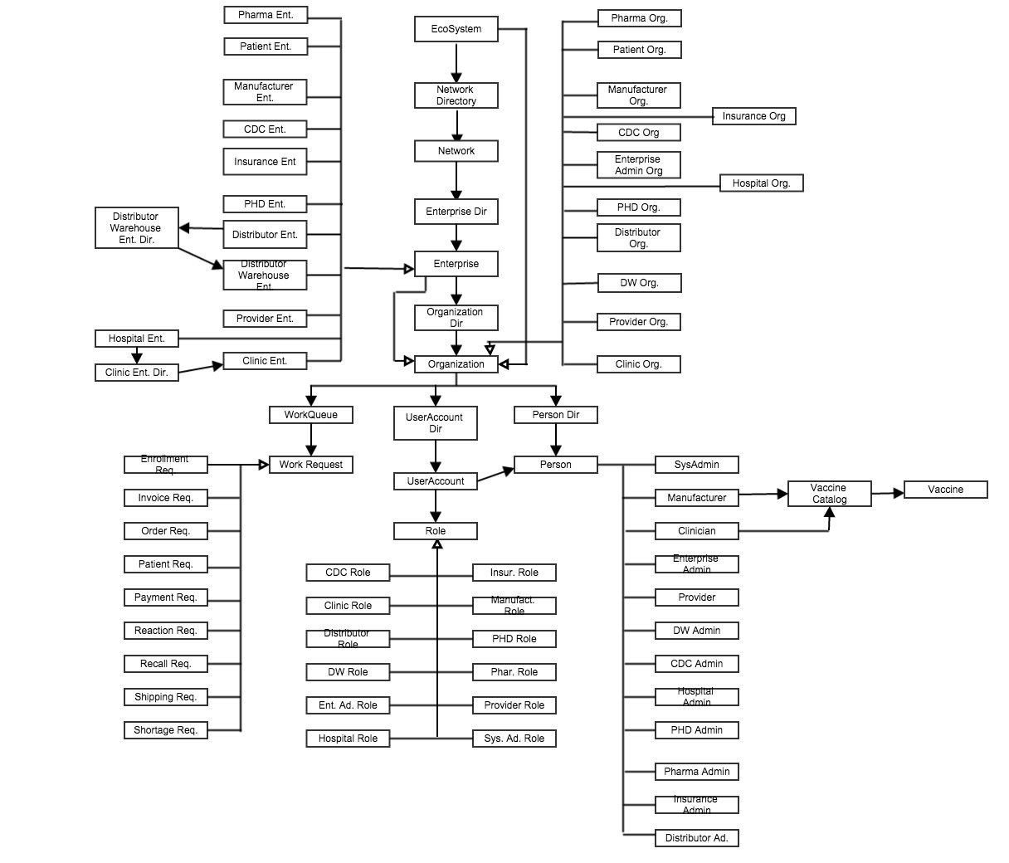

Slide 6
Assumptions
CDC manages the Department of public health
State-wise Providers
State-wise Distributor Warehouse
Clinics are responsible for providing vaccines to the patients.
Patients have 2 types of insurance status : Insured and Uninsured

Slide 7
Roles and Responsibilities
CDC:
Responsible for approving/rejecting order from the PHD .
Report any vaccine shortage notification to all the entities in the system.
Receives Vaccine Adverse Event report from all the entities and take required action based the seriousness of the adverse effect.
Keep track of the vaccines available thoughout the system.

Slide 8
PHD:
Responsible for receiving order request from the registered providers .
Can report any adverse event to the CDC.

Slide 9
Providers:
Providers receive order request from the registered sites and forward it to PHD.
Responsible for making payment to the Distributor Warehouse after collecting it from its registered sites.
Can report any adverse event to CDC.

Slide 10
Hospitals and Phamaceuticals:
Responsible for taking order request from its Clinics .
Make payments for the order request.
Can report any adverse event to the CDC.

Slide 11
Clinics:
Send order request to its Hospitals and Phamaceuticals.
Provide Vaccines to the patients.
Maintains vaccine catalog
Send invoice and receive payments from the CDC and Insurance Company based on whether the person is insured or not.
Can report any adverse event to CDC.

Slide 12
Manufacturer:
Maintains Vaccine inventory.
Ships orders to the Distributor Warehouses.
Receives payment from the Distributor Warehouse.
Receives adverse event notifications from CDC and recalls the LOT of vaccines if needed

Slide 13
Distributor Warehouse:
Receives Shipment from the manufacturer and sends it to the Sites directly.
Sends invoice to the providers and receives payment.
Makes payment to the manufacturer.

Slide 14
Insurance:
Receives invoice from the Clinics on behalf of the insured patients.
Makes payment to the Clinics.

