Slide 1
Chapter 1
Databases and Database Users

Slide 2
Chapter 1 Outline
Introduction
An Example
Characteristics of the Database Approach
Actors on the Scene
Workers behind the Scene
Advantages of Using the DBMS Approach
A Brief History of Database Applications
When Not to Use a DBMS

Slide 3
Overview
Traditional database applications
  Store textual or numeric information
Multimedia databases
  Store images, audio clips, and video streams digitally
Geographic information systems (GIS)
  Store and analyze maps, weather data, and satellite images

Slide 4
Overview (cont'd.)
Data warehouses and online analytical processing (OLAP) systems
  Extract and analyze useful business information from very large databases
  Support decision making
Real-time and active database technology
  Control industrial and manufacturing processes

Slide 5
Introduction
Database
  Collection of related data
  Known facts that can be recorded and that have implicit meaning
  Miniworld or universe of discourse (UoD)
  Represents some aspect of the real world
  Logically coherent collection of data with inherent meaning
  Built for a specific purpose

Slide 6
Introduction (cont'd.)
Example of a large commercial database
  Amazon.com
Database management system (DBMS)
  Collection of programs
  Enables users to create and maintain a database
Defining a database
  Specify the data types, structures, and constraints of the data to be stored

Slide 7
Introduction (cont'd.)
Meta-data
  Database definition or descriptive information
  Stored by the DBMS in the form of a database catalog or dictionary
Manipulating a database
  Query and update the database miniworld
  Generate reports

Slide 8
Introduction (cont'd.)
Sharing a database
  Allow multiple users and programs to access the database simultaneously
Application program
  Accesses database by sending queries to DBMS
Query
  Causes some data to be retrieved

Slide 9
Introduction (cont'd.)
Transaction
  May cause some data to be read and some data to be written into the database
Protection includes:
  System protection
  Security protection
Maintain the database system
  Allow the system to evolve as requirements change over time

Slide 10
An Example
UNIVERSITY database
  Information concerning students, courses, and grades in a university environment
Data records
  STUDENT
  COURSE
  SECTION
  GRADE_REPORT
  PREREQUISITE

Slide 11
An Example (cont'd.)
Specify structure of records of each file by specifying data type for each data element
  String of alphabetic characters
  Integer
  Etc.

Slide 12
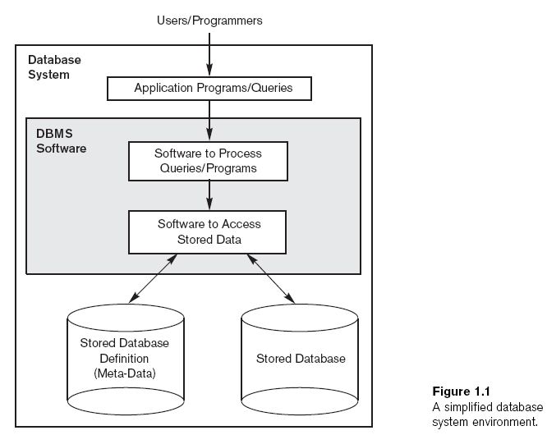

Slide 13
An Example (cont'd.)
Construct UNIVERSITY database
  Store data to represent each student, course, section, grade report, and prerequisite as a record in appropriate file
Relationships among the records
Manipulation involves querying and updating

Slide 14
An Example (cont'd.)
Examples of queries:
  Retrieve the transcript
  List the names of students who took the section of the ‘Database’ course offered in fall 2008 and their grades in that section
  List the prerequisites of the ‘Database’ course

Slide 15
An Example (cont'd.)
Examples of updates:
  Change the class of ‘Smith’ to sophomore
  Create a new section for the ‘Database’ course for this semester
  Enter a grade of ‘A’ for ‘Smith’ in the ‘Database’ section of last semester

Slide 16
An Example (cont'd.)
Phases for designing a database:
  Requirements specification and analysis
  Conceptual design
  Logical design
  Physical design

Slide 17
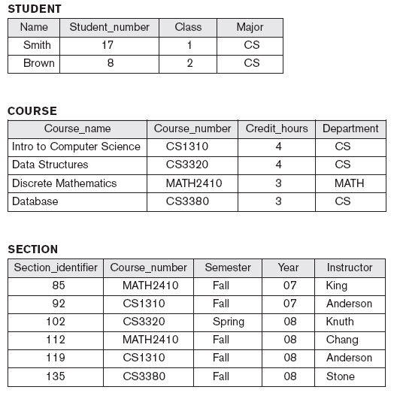
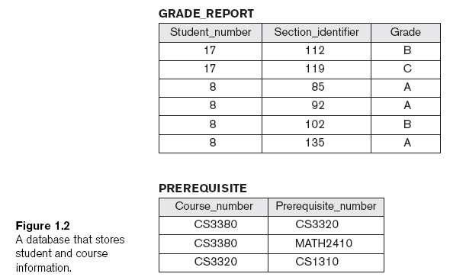

Slide 18
Characteristics of the Database Approach
Traditional file processing
  Each user defines and implements the files needed for a specific software application
Database approach
  Single repository maintains data that is defined once and then accessed by various users

Slide 19
Characteristics of the Database Approach (cont'd.)
Main characteristics of database approach
  Self-describing nature of a database system
  Insulation between programs and data, and data abstraction
  Support of multiple views of the data
  Sharing of data and multiuser transaction processing

Slide 20
Self-Describing Nature of a Database System
Database system contains complete definition of structure and constraints
Meta-data
  Describes structure of the database
Database catalog used by:
  DBMS software
  Database users who need information about database structure

Slide 21
Insulation Between Programs and Data
Program-data independence
  Structure of data files is stored in DBMS catalog separately from access programs
Program-operation independence
  Operations specified in two parts:
    Interface includes operation name and data types of its arguments
    Implementation can be changed without affecting the interface

Slide 22
Data Abstraction
Data abstraction
  Allows program-data independence and program-operation independence
Conceptual representation of data
  Does not include details of how data is stored or how operations are implemented
Data model
  Type of data abstraction used to provide conceptual representation

Slide 23
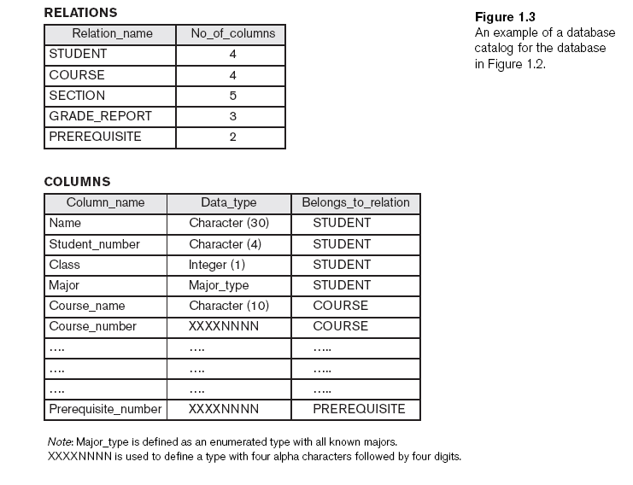

Slide 24
Support of Multiple Views of the Data
View
  Subset of the database
  Contains virtual data derived from the database files but is not explicitly stored
Multiuser DBMS
  Users have a variety of distinct applications
  Must provide facilities for defining multiple views

Slide 25
Sharing of Data and Multiuser Transaction Processing
Allow multiple users to access the database at the same time
Concurrency control software
  Ensure that several users trying to update the same data do so in a controlled manner
    Result of the updates is correct
Online transaction processing (OLTP) application

Slide 26
Sharing of Data and Multiuser Transaction Processing (cont'd.)
Transaction
  Central to many database applications
  Executing program or process that includes one or more database
  Isolation property
    Each transaction appears to execute in isolation from other transactions
  Atomicity property
    Either all the database operations in a transaction are executed or none are

Slide 27
Actors on the Scene
Database administrators (DBA) are responsible for:
  Authorizing access to the database
  Coordinating and monitoring its use
  Acquiring software and hardware resources
Database designers are responsible for:
  Identifying the data to be stored
  Choosing appropriate structures to represent and store this data

Slide 28
Actors on the Scene (cont'd.)
End users
  People whose jobs require access to the database
  Types
    Casual end users
    Naive or parametric end users
    Sophisticated end users
    Standalone users

Slide 29
Actors on the Scene (cont'd.)
System analysts
  Determine requirements of end users
Application programmers
  Implement these specifications as programs

Slide 30
Workers behind the Scene
DBMS system designers and implementers
  Design and implement the DBMS modules and interfaces as a software package
Tool developers
  Design and implement tools
Operators and maintenance personnel
  Responsible for running and maintenance of hardware and software environment for database system

Slide 31
Advantages of Using the DBMS Approach
Controlling redundancy
  Data normalization
  Denormalization
    Sometimes necessary to use controlled redundancy to improve the performance of queries
Restricting unauthorized access
  Security and authorization subsystem
  Privileged software

Slide 32
Advantages of Using the DBMS Approach (cont'd.)
Providing persistent storage for program objects
  Complex object in C++ can be stored permanently in an object-oriented DBMS
  Impedance mismatch problem
    Object-oriented database systems typically offer data structure compatibility

Slide 33
Advantages of Using the DBMS Approach (cont'd.)
Providing storage structures and search techniques for efficient query processing
  Indexes
  Buffering and caching
  Query processing and optimization

Slide 34
Advantages of Using the DBMS Approach (cont'd.)
Providing backup and recovery
  Backup and recovery subsystem of the DBMS is responsible for recovery
Providing multiple user interfaces
  Graphical user interfaces (GUIs)
Representing complex relationships among data
  May include numerous varieties of data that are interrelated in many ways

Slide 35
Advantages of Using the DBMS Approach (cont'd.)
Enforcing integrity constraints
  Referential integrity constraint
    Every section record must be related to a course record
  Key or uniqueness constraint
    Every course record must have a unique value for Course_number
  Business rules
  Inherent rules of the data model

Slide 36
Advantages of Using the DBMS Approach (cont'd.)
Permitting inferencing and actions using rules
  Deductive database systems
    Provide capabilities for defining deduction rules
    Inferencing new information from the stored database facts
  Trigger
    Rule activated by updates to the table
  Stored procedures
    More involved procedures to enforce rules

Slide 37
Advantages of Using the DBMS Approach (cont'd.)
Additional implications of using the database approach
  Reduced application development time
  Flexibility
  Availability of up-to-date information
  Economies of scale

Slide 38
A Brief History of Database Applications
Early database applications using hierarchical and network systems
  Large numbers of records of similar structure
Providing data abstraction and application flexibility with relational databases
  Separates physical storage of data from its conceptual representation
  Provides a mathematical foundation for data representation and querying

Slide 39
A Brief History of Database Applications (cont'd.)
Object-oriented applications and the need for more complex databases
  Used in specialized applications: engineering design, multimedia publishing, and manufacturing systems
Interchanging data on the Web for e-commerce using XML
  Extended markup language (XML) primary standard for interchanging data among various types of databases and Web pages

Slide 40
A Brief History of Database Applications (cont'd.)
Extending database capabilities for new applications
  Extensions to better support specialized requirements for applications
  Enterprise resource planning (ERP)
  Customer relationship management (CRM)
Databases versus information retrieval
  Information retrieval (IR)
    Deals with books, manuscripts, and various forms of library-based articles

Slide 41
When Not to Use a DBMS
More desirable to use regular files for:
  Simple, well-defined database applications not expected to change at all
  Stringent, real-time requirements that may not be met because of DBMS overhead
  Embedded systems with limited storage capacity
  No multiple-user access to data

Slide 42
Summary
Database
  Collection of related data (recorded facts)
DBMS
  Generalized software package for implementing and maintaining a computerized database
Several categories of database users
Database applications have evolved
  Current trends: IR, Web

