Slide 1
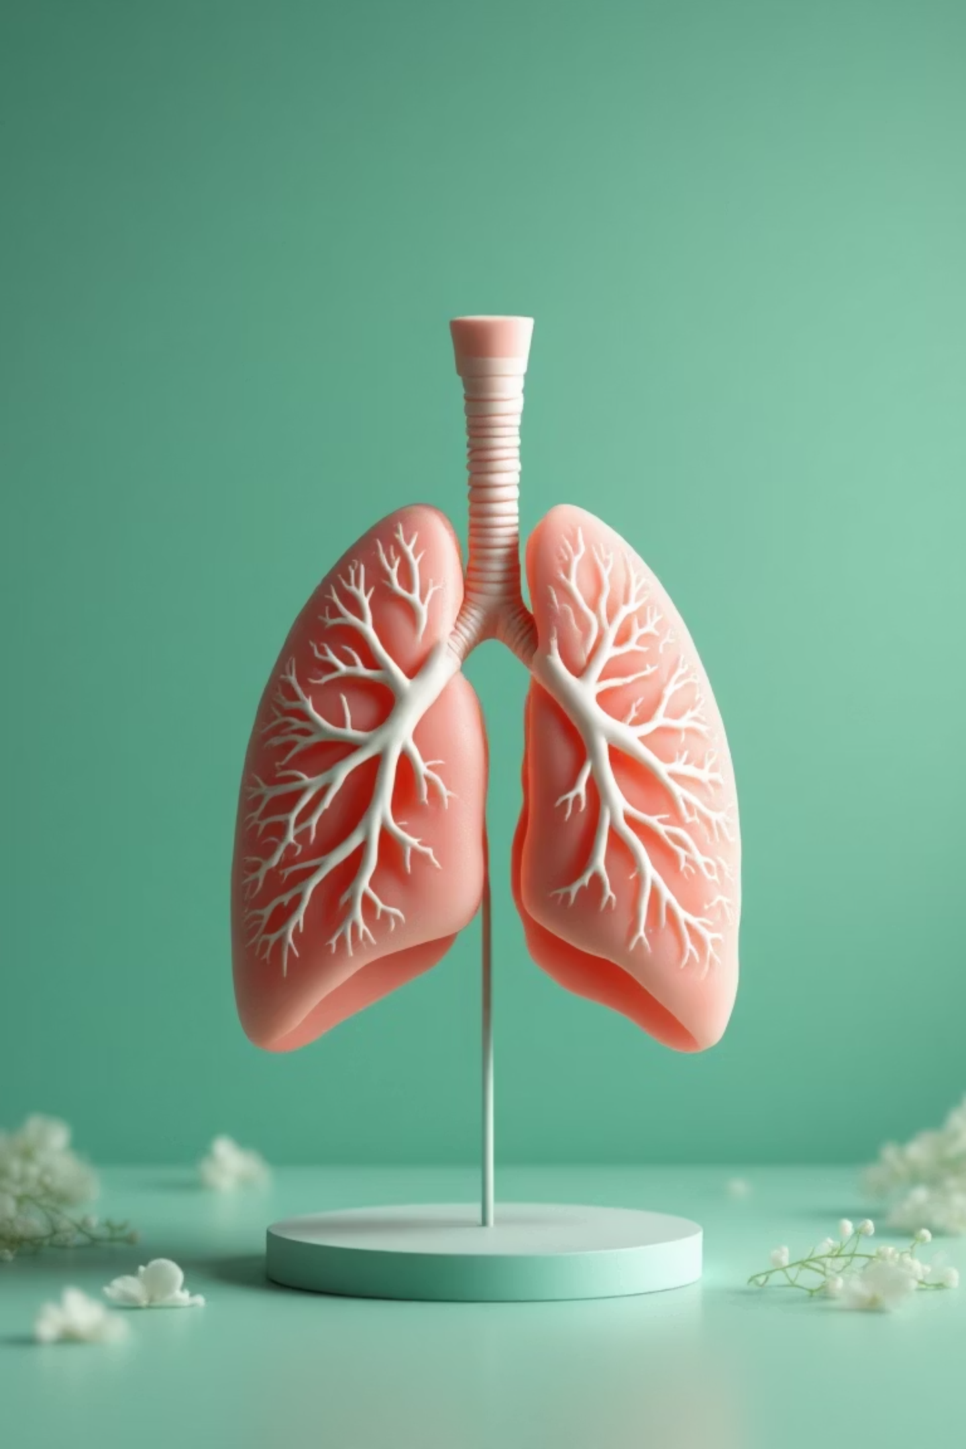
Multi-Model Deep Learning and Ensembling for Early Lung Cancer Detection
Team: Junaid Shariff
Md Adan
Punith J
Md Yousuf
GUIDE: Dr Victor AI

Slide 2

A Race Against Time
Lung cancer is the leading cause of cancer-related deaths worldwide, claiming approximately 1.8 million lives annually. Its aggressive nature and often late-stage diagnosis make it particularly challenging to treat.
Early detection is critical, significantly improving survival rates and treatment efficacy. However, the complexity and variability of medical imaging and clinical data present a significant hurdle.
Our solution leverages the power of Deep Learning, Ensemble Techniques, and Explainable AI to revolutionize early detection.

Slide 3




Key Objectives
Multi-Modal Data Integration
Advanced Model Training
Utilize CT scans, X-rays, and clinical (CSV) data for a holistic view.
Train Convolutional Neural Networks (CNNs) and Multi-Layer Perceptrons (MLP) for precise binary classification (Cancer / No Cancer).
Enhanced Performance through Ensembling
Building Trust with Explainable AI
Improve diagnostic accuracy and robustness by integrating an ensemble averaging approach.
Implement Grad-CAM and LIME to provide transparency and interpretability to AI-driven decisions.

Slide 4
Models
Medical Imaging Analysis (CT & X-ray)
Clinical Data Processing (CSV)
Leveraging powerful, pre-trained Convolutional Neural Networks (CNNs) to extract intricate patterns from visual data.
A Multi-Layer Perceptron (MLP) handles structured clinical data, identifying key diagnostic markers.
Models Used:
EfficientNetB3: Optimized for efficiency and accuracy.
This ensures that patient history and other non-imaging factors are crucial components of the diagnostic process.
ResNet50: Known for deep residual learning.
DenseNet121: Features dense connectivity for feature reuse.
InceptionV3: Excels in multi-scale feature extraction.

Slide 5
Training & Evaluation
Our rigorous training and evaluation protocols ensure the reliability and precision of our models
across all data modalities.
1
2
3
CT Scan Training
X-ray Training
Clinical Data Training
Four distinct CNNs were trained independently on CT scan datasets.
Another four CNNs were trained specifically for X-ray images.
One MLP was trained to process the clinical CSV data.
Key Performance Metrics
To ensure comprehensive assessment, we evaluated our models using a robust suite of metrics:
Accuracy, Precision, Recall, F1-Score: For overall model performance.
ROC Curve: To assess sensitivity and specificity trade-offs.
Cohen’s Kappa: For inter-rater agreement and consistency.

Slide 6

The Power of Ensembling
Method: Our ensemble approach utilizes simple averaging of predictions from individual models. This powerful yet straightforward technique merges the strengths of each component.
Integration: For each modality—CT, X-ray, and clinical data—multiple models are ensembled to enhance diagnostic reliability. The final outputs from each ensembled modality are then presented individually, ensuring robust and modality-specific insights.
Benefits: Ensembling leads to more stable and robust predictions, significantly reducing the risk of overfitting and enhancing generalization across diverse patient data.
Final Output: The ensemble delivers a confident Cancer / No Cancer prediction, informed by all available data modalities.

Slide 7


Explainable AI (XAI)
Making AI Decisions Transparent and Trustworthy
Grad-CAM: Visualizing Focus
LIME: Unveiling Feature Impact
Generates heatmaps over CT/X-ray images, highlighting the exact lung regions that contributed most to the AI's diagnosis.
Provides local explanations for clinical data (CSV) and even within images, revealing which specific features were most influential in the AI's decision.
By integrating XAI, we empower healthcare professionals with interpretable AI insights, fostering trust and facilitating informed clinical decisions.

Slide 8




Compelling Results
Ensemble Outperforms
Robust Performance Indicators
Our ensemble model consistently demonstrates superior performance compared to individual models, validating the strength of multi-modal integration.
Detailed ROC curves and confusion matrices underscore the high sensitivity and specificity of our system.
High Consistency
Interpretability at its Core
A strong Cohen’s Kappa score confirms excellent agreement and reliability in predictions, ensuring diagnostic consistency.
Visual outputs, including Grad-CAM heatmaps and LIME feature importance plots, provide clear, actionable insights into AI decisions.

Slide 9
Conclusion & Future Work
This research demonstrates that integrating multi-modal deep learning with ensemble techniques significantly enhances early lung cancer detection. Coupling this with Explainable AI builds essential trust, bridging the gap between advanced AI and clinical application.
Key Takeaways:
Next Steps:
Multi-modal data (CT, X-ray, CSV) provides a comprehensive diagnostic foundation.
Expand to larger and more diverse datasets for broader generalization.
Ensembling predictions dramatically improves model robustness and accuracy.
Explore advanced deep learning architectures, including transformer models.
Focus on real-world deployment and integration into clinical workflows for practical impact.
XAI tools (Grad-CAM, LIME) foster transparency and clinician confidence.

