Slide 1
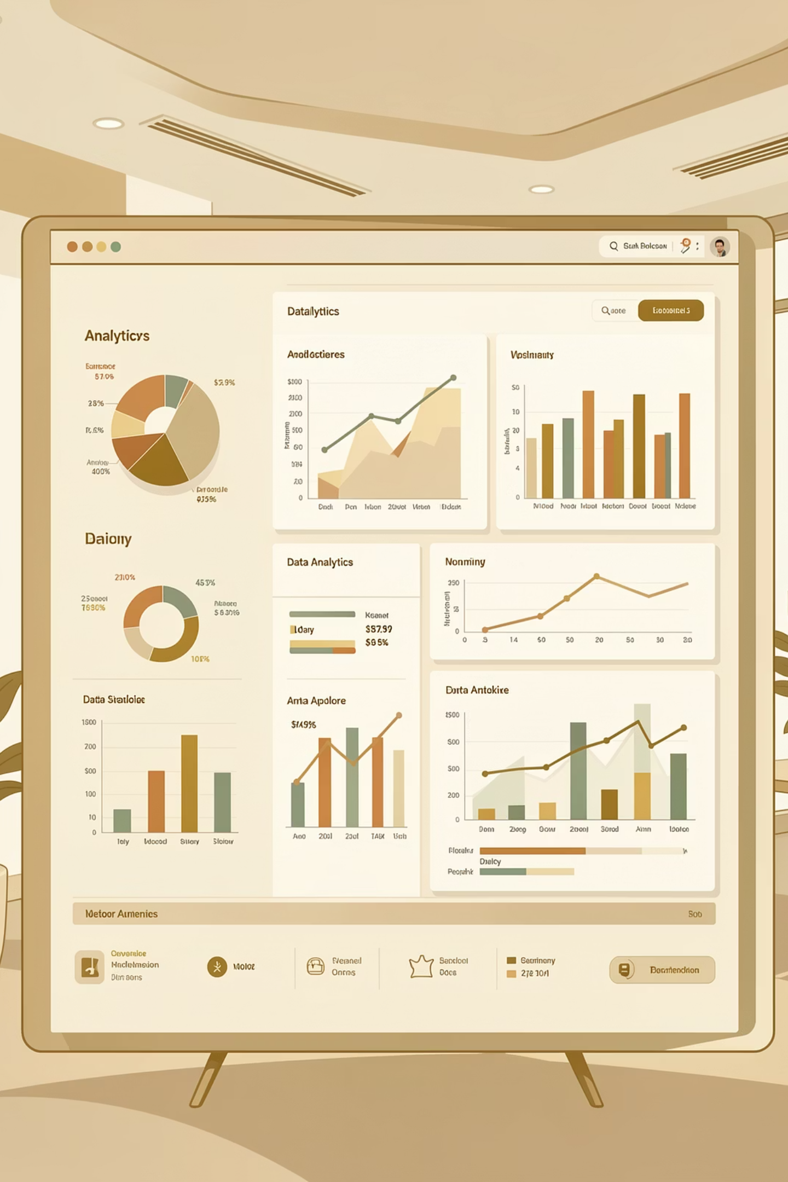
Customer Shopping Behavior Analysis
Uncovering insights from 3,900 purchases to drive strategic decisions

Slide 2
DATASET OVERVIEW
The Foundation
3,900
18
Total Purchases
Data Columns
Key Features Analyzed
Customer demographics & location
Purchase details & product categories
Shopping behavior & preferences
Subscription & loyalty patterns

Slide 3

DATA PREPARATION
Python Analysis Pipeline
01
02
Data Loading & Exploration
Missing Data Handling
Imported dataset, checked structure and summary statistics
Imputed 37 missing review ratings using category medians
03
04
Feature Engineering
Database Integration
Created age groups and purchase frequency metrics
Connected to MySQL for advanced SQL analysis

Slide 4

Revenue Insights
Gender Revenue Comparison
Male customers generated higher total revenue across all categories
Shipping Type Analysis
Express shipping users show higher average purchase amounts than standard shipping

Slide 5


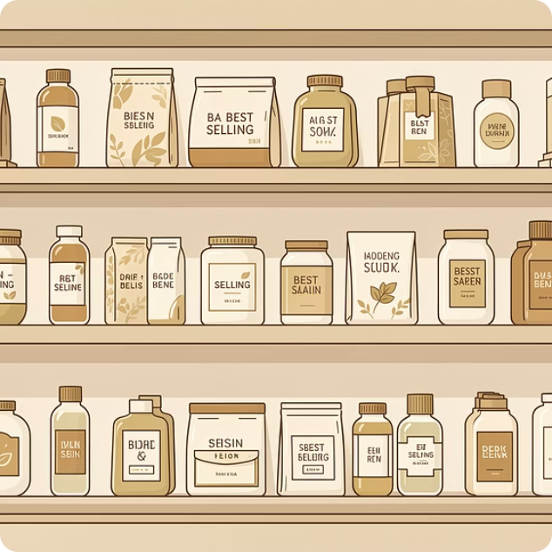

TOP PERFORMERS
Product Excellence
Highest Rated Products
Category Leaders
Discount-Dependent Items
Top 5 products identified by average review ratings
Most purchased products within each category
5 products with highest percentage of discounted purchases

Slide 6
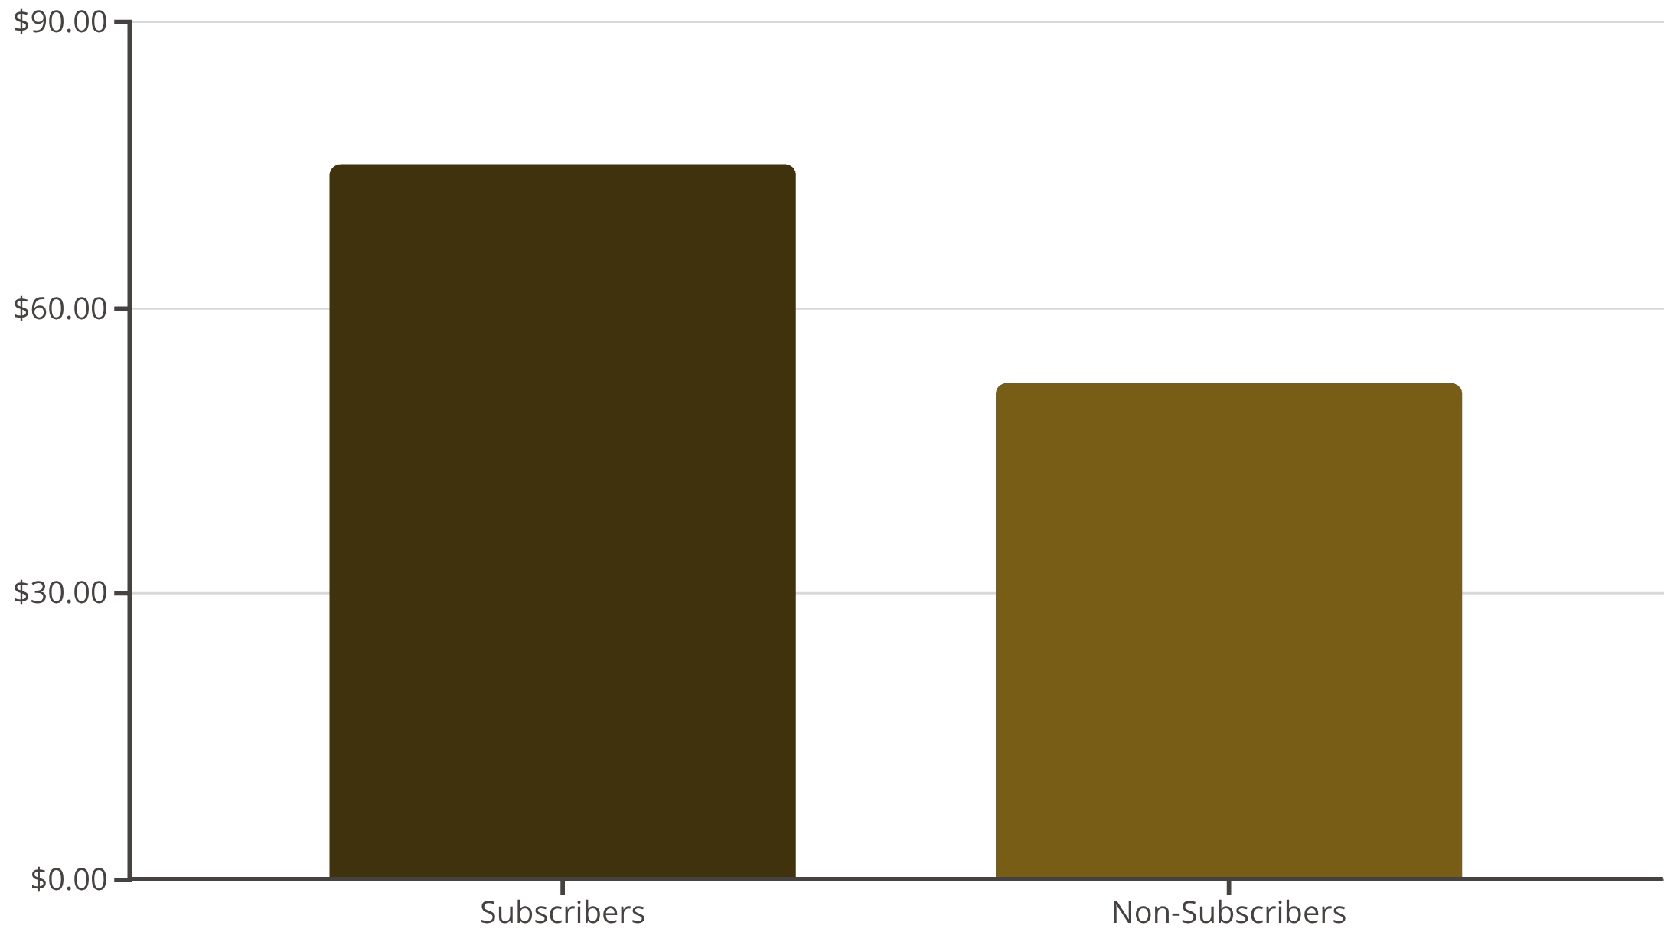
Subscription Impact
Key Finding
Subscribers spend 44% more on average than non-subscribers
Repeat Buyer Correlation
Customers with 5+ purchases show significantly higher subscription rates

Slide 7

CUSTOMER SEGMENTS
Understanding Our Customers
New Customers
Returning Customers
Loyal Customers
First-time buyers exploring our offerings
2-5 purchases, building relationship
5+ purchases, highest lifetime value

Slide 8
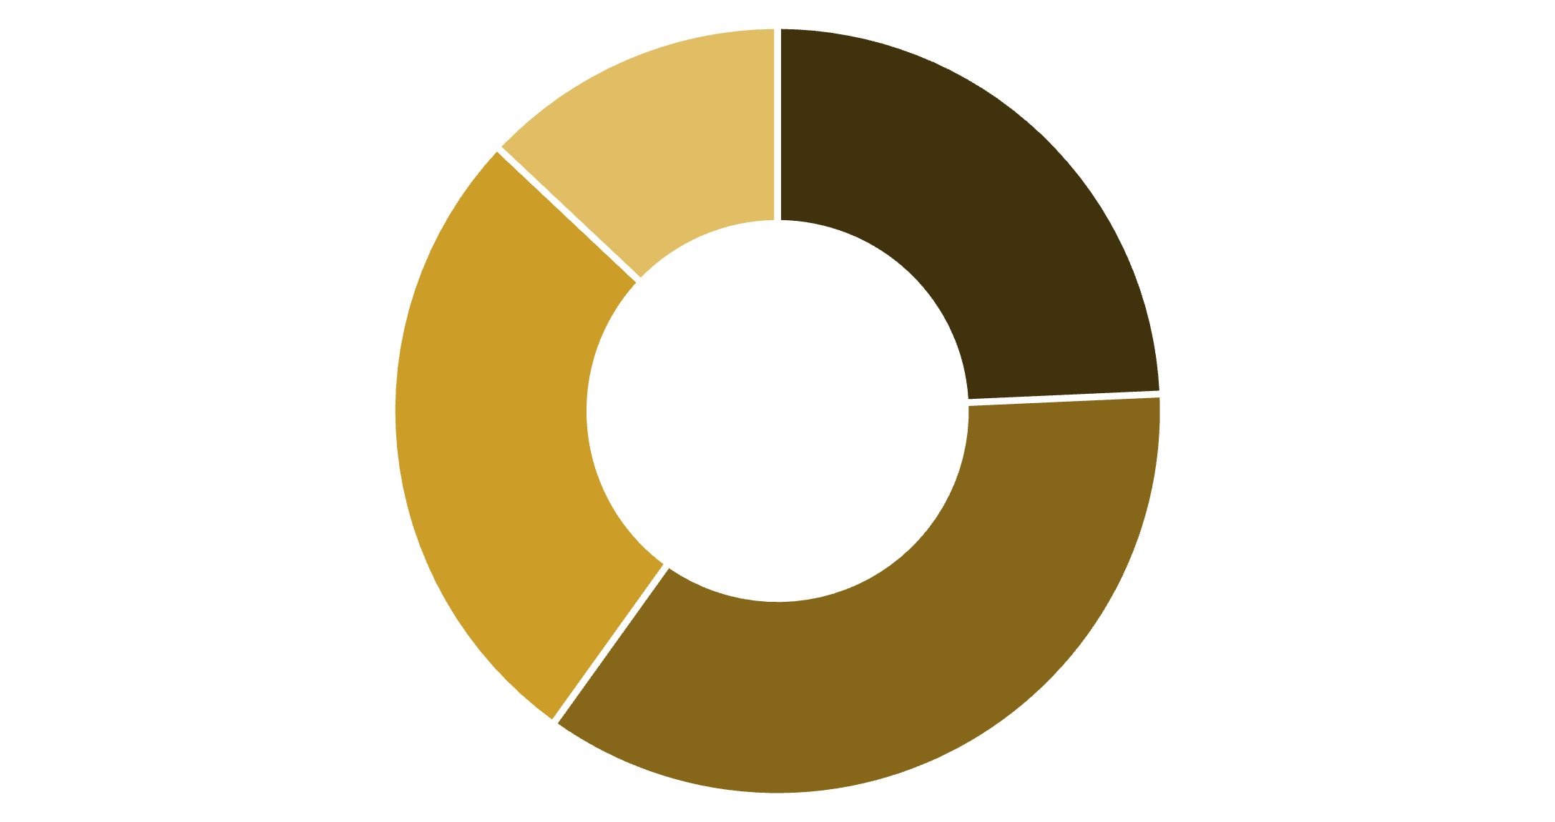
Age Group Revenue Distribution
Revenue Leaders
31-45 age group drives highest revenue contribution
Discount Behavior
High-spending customers still use discounts but maintain above-average purchase amounts
18-30
31-45
46-60
60+

Slide 9
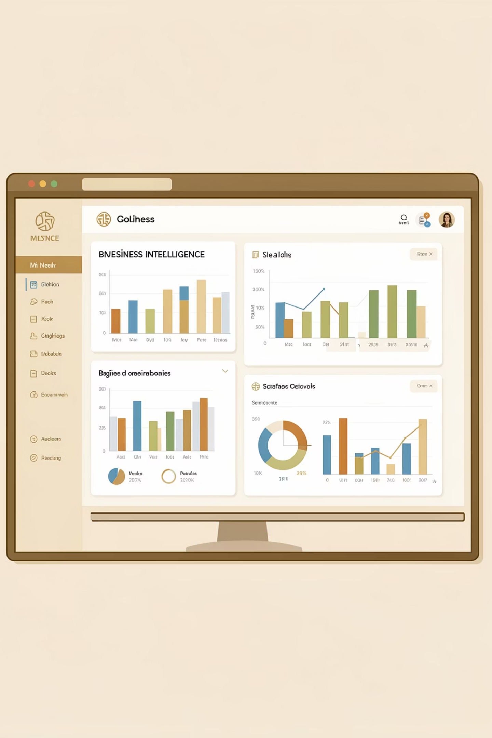
Power BI Dashboard
Interactive visual insights for real-time decision making across all key metrics

Slide 10
STRATEGIC ACTIONS
Business Recommendations
Boost Subscriptions
1
Promote exclusive benefits to convert high-frequency buyers
Loyalty Programs
2
Reward repeat buyers to move them into loyal segment
Review Discount Policy
3
Balance sales growth with margin protection
Product Positioning
4
Highlight top-rated items in marketing campaigns
Targeted Marketing
5
Focus on high-revenue age groups and express shipping users

