Slide 1


From Idea to Impact: Using AI to Support Effective Content Creation
Adam Balcerzak

Slide 2
Agenda
Intruduce and introduction
Structural prompting and prompt boosting (ChatGPT example)
Newsletters: Mailcow + Listmonk + Mail-tester + AI
Content creation: BLAZE AI & Heygen
Closed model knowledge approach: NotebookLM
Mass production: Sample API approach – ChatGPT
Copyright, ownership of content, disputes over models
All-in-one / multiple models tools
Browser extensions
Wordpress AI examples
Is there an AI for that?

Slide 3
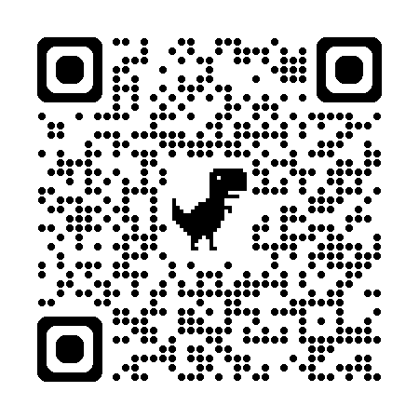
Github repository
https://github.com/insomnia007/idea-impact

Slide 4
Defining the Problems of content creation
Time-consuming – endless demand for fresh posts and visuals
Consistency – keeping tone of voice & branding aligned
Creativity fatigue – hard to generate new ideas daily
Quality vs. Quantity – pressure to post regularly vs. meaningful output
Platform fragmentation – adapting to formats & algorithms
SEO & Visibility – constant race with search & feeds
Resource limits – small teams, tight budgets, missing skills
Multiple tools – many subscriptions and costs
Let’s try to solve these issues using AI and mixed tools and techniques

Slide 5
Structural prompting and prompt boosting
more predictable and consistent responses using conversational tools like ChatGPT

Slide 6
Structural prompting
RTF (Role, Task, Format)
CIO (Context, Input, Output)
PSE (Problem, Solution, Execution)
SAR (Situation, Action, Result)
WWHW (Who, What, How, Why)
STAR (Situation, Task, Action, Result)
GOMR (Goal, Obstacles, Methods, Results)
BPOS (Background, Problem, Objective, Solution)
PASA (Problem, Analysis, Solution, Action)
SCAO (Scenario, Challenge, Approach, Outcome)
TICIP (Task, Instruction, Context, Input, Parameters)

Slide 7
RTF (Role, Task, Format)
Framework RTF (Role, Task, Format)
Role: Define the role the AI should assume (e.g., “As a teacher,” “Acting as a project manager,” “You are a programmer”). Task: Clearly specify what the AI should do (e.g., “explain the process of photosynthesis,” “prepare a project plan,” “write a Python function”). Format: Specify the format in which the answer should be given (e.g., “as a step-by-step guide,” “as a bullet list,” “in code with comments”). Example: “As an expert in ecology, explain what climate change is in a way that is accessible to a high school student, using a bullet list.”

Slide 8
CIO (Context, Input, Output)
Framework CIO (Context, Input, Output)
Context: Provide the background or situation (e.g., “During a business meeting,” “For a beginner programmer”).
Input: Specify the input data that the AI should consider (e.g., “Taking into account the following data: [data],” “Using the Python language”).
Output: Define what the AI should deliver (e.g., “create a summary,” “generate a solution,” “write a short report”).
Example: “For a marketing campaign aimed at young adults, create a social media post highlighting the ecological features of the product.”

Slide 9
PSE (Problem, Solution, Execution)
Framework PSE (Problem, Solution, Execution)
Problem: Describe the problem or challenge (e.g., “My website loads slowly”).
Solution: Ask for a proposed solution (e.g., “What can I do to improve the loading time?”).
Execution: Ask for steps or advice on how to implement the solution (e.g., “Provide a step-by-step guide”).
Example: “My website loads very slowly. What can I do to improve this? Please provide a detailed step-by-step guide.”

Slide 10
SAR (Situation, Action, Result)
SAR Framework (Situation, Action, Result)
Situation: Outline the situation or context (e.g., “I am preparing for a job interview in the field of data science”).
Action: Specify what you want the AI to do (e.g., “Help me prepare answers to common interview questions”).
Result: Define the expected outcome (e.g., “Provide detailed and well-structured answers”).
Example: “I am preparing for a job interview in the field of data science. Help me prepare answers to questions related to machine learning, with clear and detailed explanations.”

Slide 11
WWHW (Who, What, How, Why)
WWHW Framework (Who, What, How, Why)
Who: Define the target audience (e.g., “For a beginner programmer,” “For a team of designers”).
What: Describe what you need (e.g., “Explain the concept of loops in Python,” “Create a project schedule”).
How: Ask for the method or format (e.g., “using simple language,” “in the form of a visual diagram”).
Why: Provide the reason to guide the AI’s focus (e.g., “to help them get started quickly,” “to ensure timely project delivery”).
Example: “For a beginner programmer, explain the concept of loops in Python using simple language, to help them get started quickly.”

Slide 12
STAR (Situation, Task, Action, Result)
STAR Framework (Situation, Task, Action, Result)
Situation: Describe the situation or context (e.g., “I need to plan a marketing campaign for a new product”).
Task: Define the task or goal (e.g., “Develop the campaign strategy”).
Action: Ask for specific steps (e.g., “Suggest target groups and key messages”).
Result: State the expected outcome (e.g., “Create a comprehensive campaign plan”).
Example: “I need to plan a marketing campaign for a new product. Develop a strategy by suggesting target groups, key messages, and create a comprehensive plan.”

Slide 13
GOMR (Goal, Obstacles, Methods, Results)
GOMR Framework (Goal, Obstacles, Methods, Results)
Goal: Define what you want to achieve (e.g., “I want to increase user engagement on the website”).
Obstacles: Identify the challenges or obstacles (e.g., “Our content is not being shared enough on social media”).
Methods: Ask for methods or strategies (e.g., “Suggest ways to increase the number of shares of our content”).
Results: Define the expected results (e.g., “Provide a list of actions to improve social media engagement”).
Example: “I want to increase user engagement on the website, but our content is not being shared enough on social media. Suggest ways to increase the number of shares and provide a list of actions.”

Slide 14
BPOS (Background, Problem, Objective, Solution)
BPOS Framework (Background, Problem, Objective, Solution)
Background: Provide contextual information (e.g., “We are a small startup in the tech industry”).
Problem: Describe the problem (e.g., “We are struggling to attract top talent”).
Objective: Define the goal (e.g., “We want to improve our recruitment process”).
Solution: Ask for a solution or strategy (e.g., “Give suggestions on how to attract top talent, especially in a competitive market”).
Example: “We are a small startup in the tech industry and are struggling to attract top talent. We want to improve our recruitment process. Provide suggestions on how to attract top talent in a competitive market.”

Slide 15
PASA (Problem, Analysis, Solution, Action)
PASA Framework (Problem, Analysis, Solution, Action)
Problem: Define the problem (e.g., “Customer churn rate is high”).
Analysis: Ask for an analysis of the problem (e.g., “What could be causing this issue?”).
Solution: Ask for potential solutions (e.g., “Suggest strategies to reduce the churn rate”).
Action: Request specific implementation steps (e.g., “Provide a step-by-step plan”).
Example: “Customer churn rate is high. What could be causing this? Suggest strategies to reduce the churn rate and provide a step-by-step plan.”

Slide 16
SCAO (Scenario, Challenge, Approach, Outcome)
SCAO Framework (Scenario, Challenge, Approach, Outcome)
Scenario: Describe the context (e.g., “We are planning to launch a new product next quarter”).
Challenge: Point out the challenge (e.g., “We need to quickly build brand awareness”).
Approach: Ask for an approach or strategy (e.g., “What marketing strategies should we apply?”).
Outcome: Define the expected result (e.g., “Create a plan that maximizes our reach in the first month”).
Example: “We are planning to launch a new product next quarter and need to quickly build brand awareness. What marketing strategies should we apply? Create a plan that maximizes our reach in the first month.”

Slide 17
TICIP (Task, Instruction, Context, Input, Parameters)
TICIP Framework (Task, Instruction, Context, Input, Parameters)
Task: Define the task (e.g., “Create a history quiz question”).
Instruction: Specify process-related constraints (e.g., “The question must have a maximum of 200 characters and 4 answer options: a, b, c, and d”).
Context: Define the context of use (e.g., “The text will be used in a test question database for an assessment exam”).
Input: Specify the data to be referenced (e.g., “This will be a question about the first king of Poland, correct answer D”).
Parameters: Define additional fixed parameters for the prompt (e.g., “Use neutral language without emotional connotations; the question should not hint at the correct answer”).
Example: “Create a history quiz question for 6th-grade students. The question must have a maximum of 200 characters and 4 answer options: a, b, c, and d. It will be about the first king of Poland, with D as the correct answer. It will be used in a test question database for an end-of-semester knowledge exam. Use neutral language, without emotional connotations, and ensure the question does not hint at the correct answer.”

Slide 18
Prompt boosting

Slide 19
Boosting prompt model
Zero shot - Prompt written from scratch - Short
Explain blockchain in one sentence.
Prompt with examples - Pattern - Information about the output Provide synonyms. Example: fast → quick, rapid. Example: hard → difficult, challenging. Now: beautiful → ?”
Chain of Thoughts - Supervision over the reasoning proces Calculate: 27 × 13. Show the steps first, then give the final result.
Closed prompt - Set of instructions and data - Prohibition of going beyond the given input set Based on the data below, create one sentence. Do not add anything beyond the data. Data: John – 25 years old – London
Iterative design - Cyclical refinement and improvement based on output evaluation 1. Write a two-sentence description of a coffee shop. 2. Add more details about the interior design and opening hours.

Slide 20
Newsletters: Mailcow + Listmonk + Mail-tester + AI

Slide 21
Open source solution to create and manage email marketing
Open-Source Email Marketing Tools
Mailcow – Open-source mail server suite for managing emails securely.
Listmonk – Newsletter & mailing list manager with API and analytics.
Mail-Tester – Tool for checking deliverability, spam score, and email quality
How to create html ready to go code with newsletter using AI and insert it to listmonk?
Let’s generate sample prompt to create event and convert it to mailing! How to get an audience? – integration on the website

Slide 22
Content creation: BLAZE AI & Heygen

Slide 23
BLAZE AI & Heygen
AI Dashboard Tools for Content Creation
Blaze AI – AI dashboard for creating and managing marketing content.
Heygen – AI dashboard tool for generating video content, especially personalized clips.
➡️ These are AI dashboard models, focused on user interfaces for content and video creation, and they differ from typical conversational models like ChatGPT, which work mainly through text-based chat.
Let’s test it!

Slide 24
Closed model knowledge approach: NotebookLM

Slide 25
NotebookLM
NotebookLM – AI Dashboard for Research & Knowledge Management
NotebookLM – Google’s AI-powered dashboard for organizing, summarizing, and exploring knowledge bases.
Lets you upload documents (PDFs, Google Docs, notes) and interact with them via an AI assistant.
Designed for research, study support, and knowledge workflows, rather than marketing content.
Works as a closed, proprietary repository – not fully open-source or API-driven.
Different from ChatGPT: it focuses on curating and navigating information inside uploaded materials instead of free, open-ended conversation.
Let’s test it!

Slide 26

ChatGPT/OpenAI API approach

Slide 27
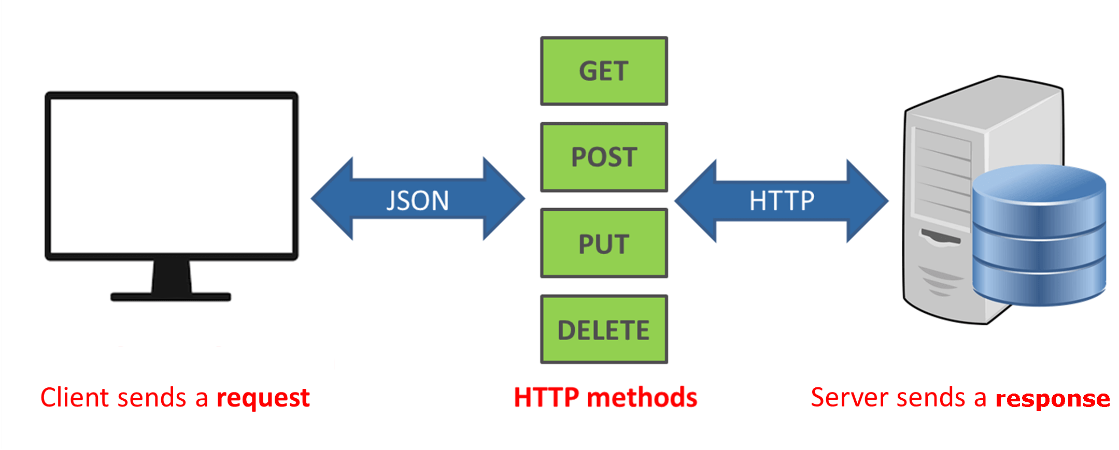
What is API?
API, or Application Programming Interface, is a set of rules and tools that allows different software applications to communicate with each other. In the context of using ChatGPT, an API provides a way for developers to integrate the language model into their own applications, websites, or services.
licencja: CC BY-SA-NC

Slide 28
ChatGPT – API approach vs. Web approach
API Approach (APP IS TALKING TO CHATGPT):
Integration: Developers integrate the ChatGPT model into their applications by making API calls.
Flexibility: Offers more flexibility as developers can control how and when they interact with the model.
Customization: Developers can fine-tune the input prompts and process the model's responses according to their application's specific needs.
Web Approach (PROMPTS SEND VIA WEB INTERFACE):
User Interface: In a web approach, the interaction with ChatGPT may happen through a graphical user interface (GUI) on a website.
User Experience: Users may directly input prompts through a web form, and the website handles the communication with the model in the background.
Limited Control: Developers may have less control over the underlying model and its integration, as it's often handled by the website's interface.

Slide 29
ChatGPT – API approach vs. Web approach
Some important parameters that can be used with the OpenAI API:
Engine: Specifies which engine to use for the model. Options include text-davinci-002, text-davinci-003, text-davinci-004, text-codex-002, text-curie-002, text-babbage-002, and text-gpt-3.5-turbo.
Prompt: The input text or question provided to the model to generate the response. This can be a sentence, paragraph, or even a set of instructions.
Max Tokens: The maximum number of tokens (words) the model can generate in the response. It limits the length of the generated text.
Temperature: Controls the randomness of the model's output. Higher values result in more random and diverse responses, while lower values lead to more conservative and predictable responses.
Top P (Top Probability): Filters the tokens the model considers by probability. It helps in controlling the diversity and quality of the generated text.
Frequency Penalty: Penalizes tokens based on their frequency in the prompt. It encourages the model to generate text that is more diverse and less repetitive.
Presence Penalty: Penalizes tokens based on their presence in the prompt. It encourages the model to generate text that is more independent of the input prompt.
Stop: Specifies one or more sequences of tokens at which the model should stop generating text.
Best Of: Specifies the number of completions to generate and return. The highest scoring completion is returned.

Slide 30
ChatGPT – API approach vs. Web approach
COMMON MISUNDERSTANDING:
SUBSCRIBED CHATGPT
DOESN’T MEAN
YOU CAN USE API!
SUBSCRIBED MEANS YOU ENABLE
EXTRA FEATURES IN WEB VERSION!

Slide 31

ChatGPT – API approach vs. Web approach

Slide 32

ChatGPT – OpenAI API how to start
https://platform.openai.com/login?launch
https://openai.com/pricing

Slide 33
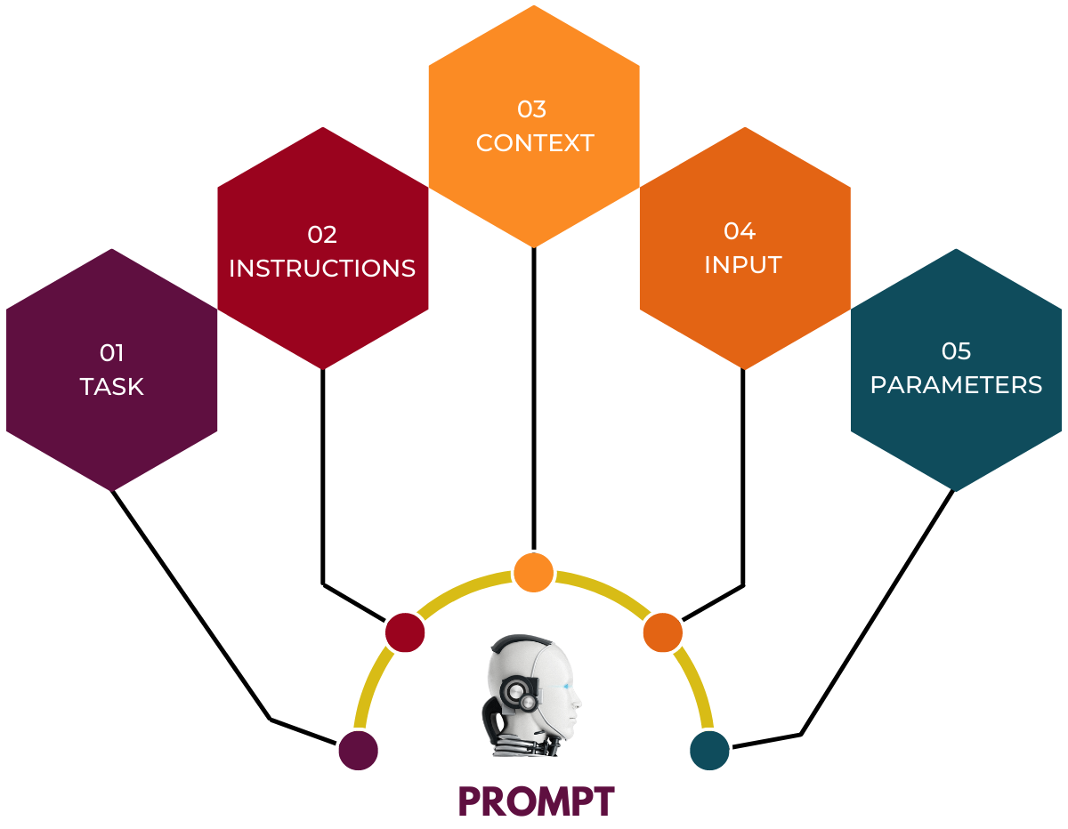
Doesn’t matter API or Web approach - the common feature is always the prompt
https://promptengineering.org/master-prompt-engineering-demystifying-prompting-through-a-structured-approach/

Slide 34
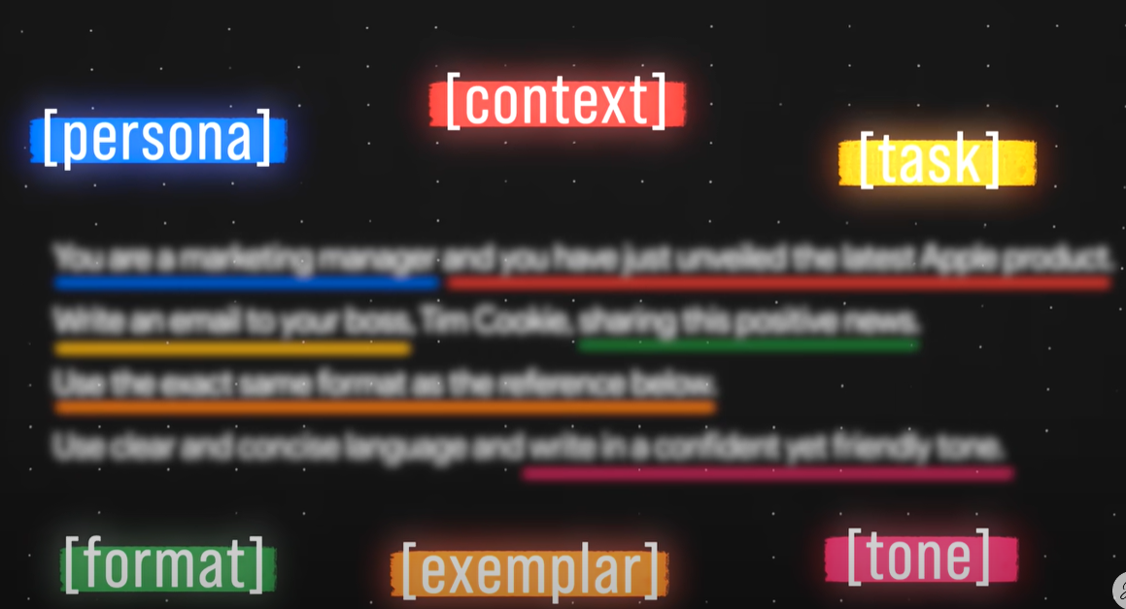
Doesn’t matter API or Web approach - the common feature is always the prompt
Source: https://www.youtube.com/watch?v=jC4v5AS4RIM
Let’s try API approach

Slide 35
AI in Wordpress
Overview

Slide 36

AI in Wordpress
Useful plugins:
Starter templates
AI in popular wordpress builders
Let’s generate the whole site from scratch

Slide 37
All in one – multiple models tools
More – better?

Slide 38

Multiple tools interfaces – use at your own risk – a lot of them are banned or dissapears in mysterious circumstances
Source: https://medium.com/@elisowski/7-all-in-one-ai-platforms-that-let-you-talk-to-multiple-models-612d4890dd95

Slide 39
Browser extensions
Browser extensions that boost productivity

Slide 40

Useful browser extentions
https://chromewebstore.google.com/
WebChatGPT
Jetwriter AI

Slide 41
Is there an AI for that?
How many solutions do we have on the market?

Slide 42

List of useful engines with email list and constant updates
Source: https://theresanaiforthat.com/

Slide 43
Copyright, ownership of content, disputes over models
Lawsuits and so on

Slide 44
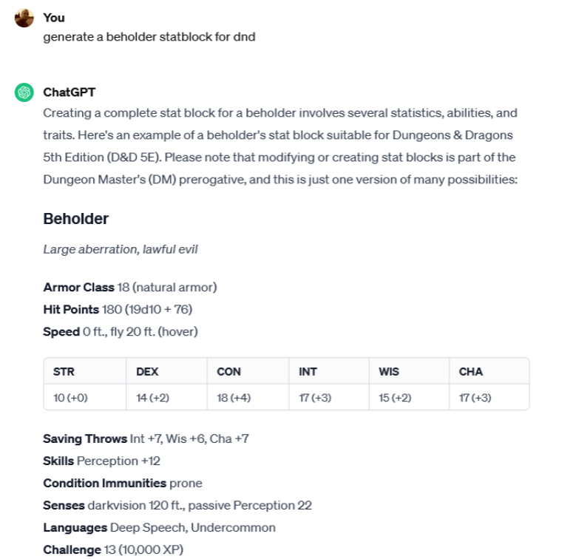

Pesky lawyers and demanding artists

Slide 45
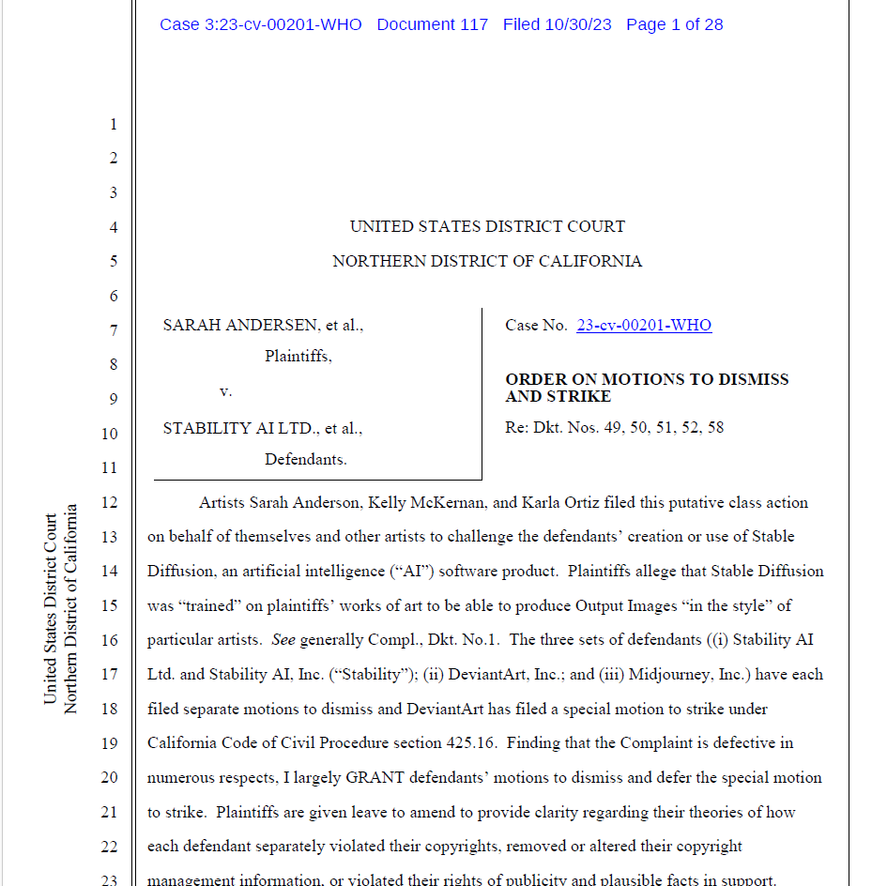
Current lawsuits
Authors vs MidJourney / Stability AI et. al.
30.10.2023 / California
Missconception of the network work - dismissed
Training on copyrighted material without consent - ongoing
https://chatgptiseatingtheworld.com/2023/12/27/master-list-of-lawsuits-v-ai-chatgpt-openai-microsoft-meta-midjourney-other-ai-cos/

Slide 46
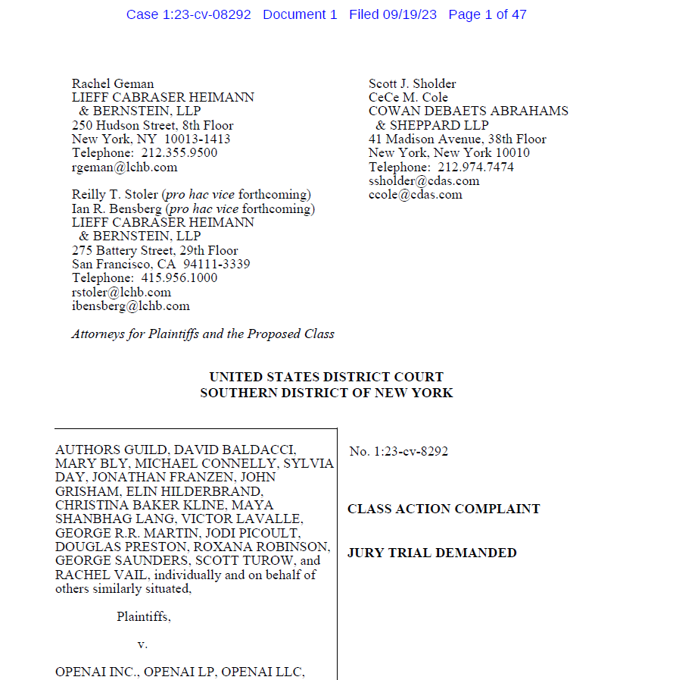
Current lawsuits
Authors Gulid vs OpenAI / Microsoft *
19.09.2023 / New York
Training on copyrighted material without consent - ongoing
*Case consolidated with Alter v. OpenAI, and Basbanes v. Microsoft, OpenAI
https://chatgptiseatingtheworld.com/2023/12/27/master-list-of-lawsuits-v-ai-chatgpt-openai-microsoft-meta-midjourney-other-ai-cos/

Slide 47
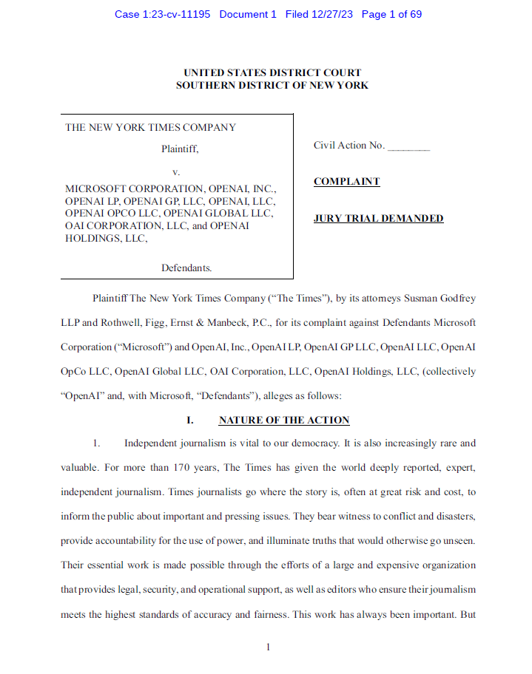
Current lawsuits
The New York Times Co. v. Microsoft Corp., OpenAI
27.12.2023 / New York
Training on copyrighted material without consent, distribution of derivative works without compensation - ongoing
https://chatgptiseatingtheworld.com/2023/12/27/master-list-of-lawsuits-v-ai-chatgpt-openai-microsoft-meta-midjourney-other-ai-cos/

Slide 48
Thank you!

