Slide 1
Chronic Kidney Disease Challenge
PhD(c). Antonio Daniel Martínez Gutiérrez

Slide 2

Agenda
1
Problem Description
2
Approach to solve the problem
3
Modelling
4
Explanation of the model
5
Next Steps

Slide 3
Problem Description
Dataset
300 patients diagnosed with Chronic Kidney Disease (CDK), of which 100 of them progressed and 200 did not
Variables
Longitudinal data from multiple lab measurements such as: Glucose, Creatinine, Meds, LDL, DBP and SBP, Hemoglobine as well as demographic data, such as: Age, Race and Gender
Response variable
Binary variable representing if the patients progressed in their CDK Stage
Challenge
Predict if a patient will progress in their CDK stage based in their past data

Slide 4
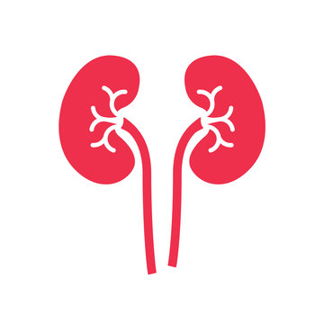
Approaching the problem
Reviewing the International Clinical Guidelines
Feature Engineering and time window determination
01
02
03
04
Modelling
Explanation of the model

Slide 5

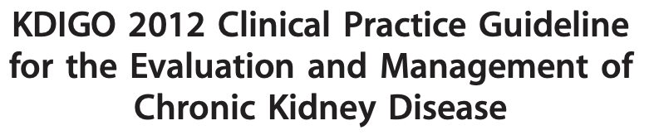


1: Reviewing the International Clinical Guidelines
01
What are the most important clinical variables and their normal values?
02
How is progression in CKD defined?
03
How often does the patients are evaluated?
04
How are the patients classified?

Slide 6
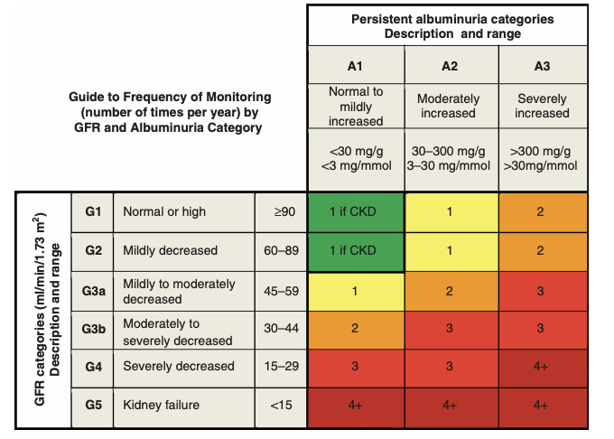
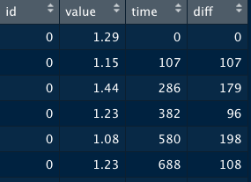
2: Determining Time Window using the clinical guidelines and the dataset
Clinical Guidelines
1
2
Dataset
3+ Evaluations per year in more clinically advanced patients
Mean time differences in all laboratory measurements
Mean time: 121 days
Proposed Time Windows : 120 and 180 days

Slide 7
2: Building the time window algorithm
Time Window algorithm
01
Calculate the maximum time per patient in all laboratory measurements
02
For each laboratory measurement :
03
For each patient:
04
Calculate the number of Windows until the max time of evaluation. Make window and repeat each value until the next time window. If the patient was evaluated before the time window, the last evaluation is used and repeated. Finally, the average is obtained
05
Merge all the laboratory measurements by the time windows

Slide 8
2: Feature Engineering: What can be inferred?
Feature Engineering
Creatinine
Glomerular Filtration Rate (GFR)
GFR Evolution
GFR Categories
Glucose
Diabetes
Difference between normal value and patient value
SBP and DBP
Blood pressure classification: Normal, elevated, Hypertension 1 and 2
Is patient blood pressure controlled?
LDL
Cholesterol classification and Hypercholesterolemia
Hemoglobin
Anemia classification
Meds
Number of drugs per time window
Total daily dosage
Combination of Drugs and Doses

Slide 9
Approaching the problem
Reviewing the International Clinical Guidelines
Feature Engineering and time window determination
01
02
03
04
Modelling
Explanation of the model

Slide 10
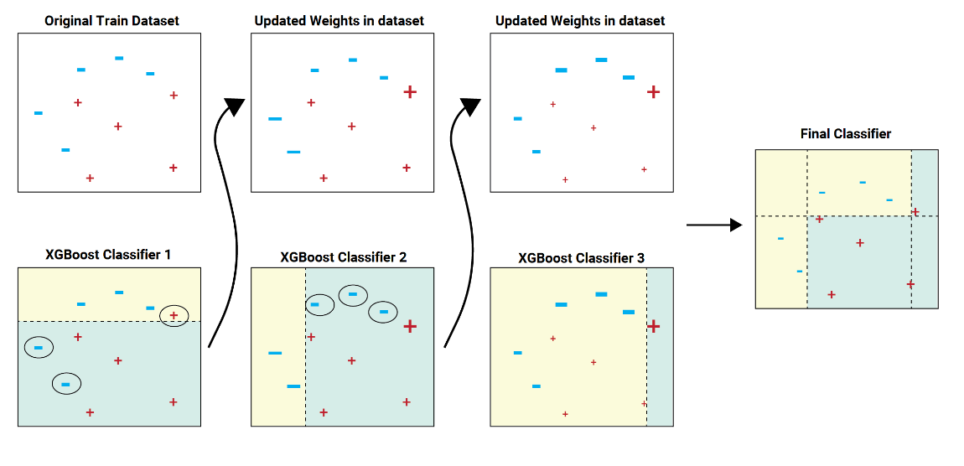
3: Final Pipeline employed for the modelling
Modelling final pipeline
Tested Algorithms and accuracy:
Logistic Regression: 0.76
Random Forests : 0.88
Balanced Bagging Classifier: 0.92
XGBoost : 0.94
XGBoost
HyperOpt
Manual tunning
Shap values
For the 120 time window model:
Feature Selection using permutation importance

Slide 11
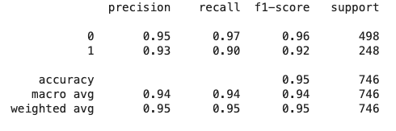
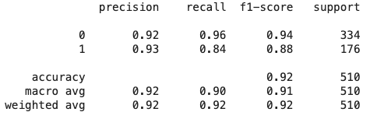
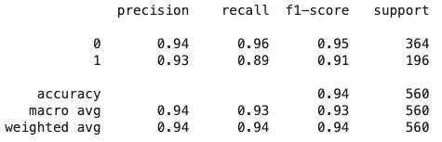
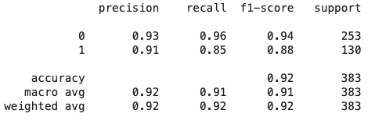
3: F1 Scores and CV Accuracy of both models
Modelling results
120 day Model
180 day Model
Testing
Testing
Validation
Validation
5-Fold Stratified CV Accuracy : 0.91
5-Fold Stratified CV Accuracy : 0.90

Slide 12
Approaching the problem
Reviewing the International Clinical Guidelines
Feature Engineering and time window determination
01
02
03
04
Modelling
Explanation of the model

Slide 13
4: Determining the most important variables for the model
Explaining the model
120 day Model
Main Insights:
Patients with a high GFR and creatinine tend to progress more.
Patients with g3b stages tend to progress less often than patients with less advanced stages.
Patients with a higher number of drugs and doses per time window have a higher risk of progression.
180 day Model
The 180 day model had the same main variables

Slide 14
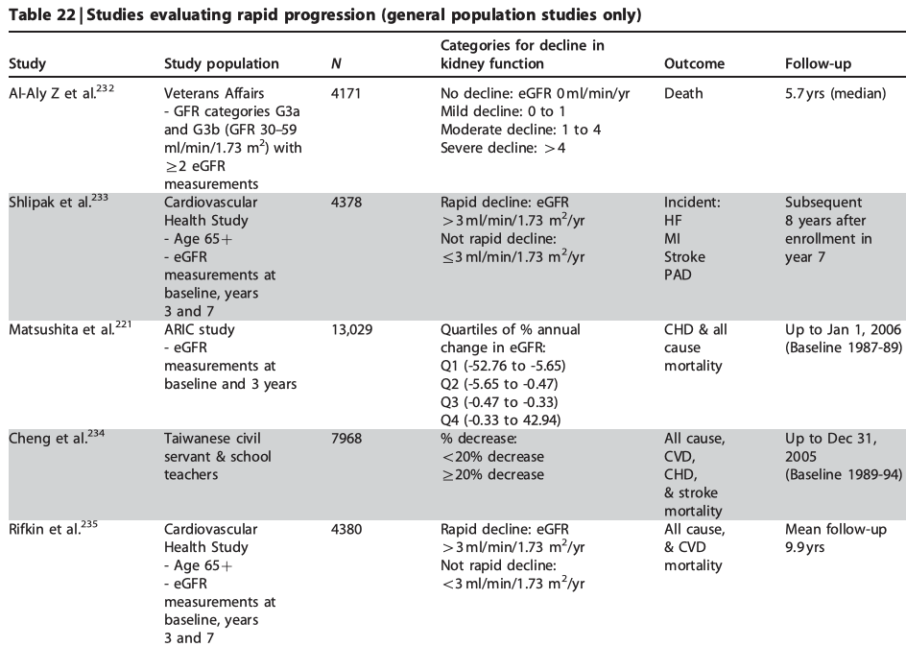
5: Recommendations to improve the model and next steps
Recommendations
Next Steps
Get more data! :
Review the time window with a Nephrologyst
Gain more insights about the patients using the contraindications of the meds they take
Obtain data from key clinical variables such as Albumin and Urea

Slide 15
Thank you for your attention

