Slide 1
Chronic Kidney Disease Challenge
PhD(c). Antonio Daniel Martínez Gutiérrez

Slide 2

Agenda
1
Description and area of opportunity
2
Approach to solve the problem
3
Modelling and potential of the tool
4
Explanation of the clinical relationships learned by the model
5
Improvements and Next Steps

Slide 3




Chronic Kidney Disease (CDK) its a major health and economic problem worldwide
Definition:
Abnormalities of kidney or function, present for 3 > months, with implications for health. Determined by multiple markers of kidney damage such as Albuminuria, Urine abnormalities among others.
2017 Worldwide statistics:
CDK is an economical problem
697.5 million cases. One in ten adults has chronic kidney disease (CKD).
U.S 2013 Total Medicare costs: 50.4 Billion
1.2 million deaths
Cost per patient: $7,537 in early stages to $46,178 in advanced stages per year
Projected to become the 5th cause of years of life lost in 2040
https://doi.org/10.1016/S0140-6736(20)30045-3

Slide 4
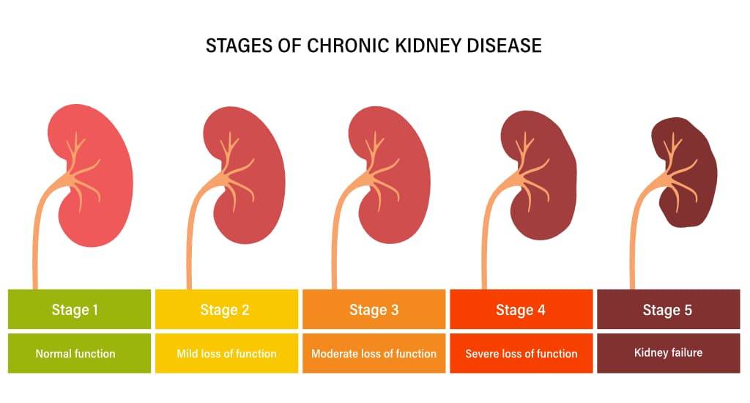
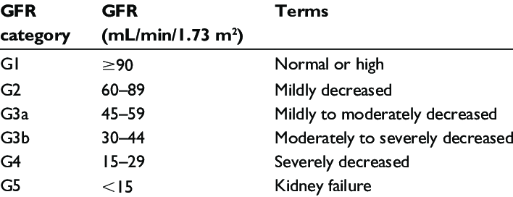
Definition and Consequences of CKD Progression
Glomerular Filtration Rate (GFR)
Progression:
Decline in GFR Category
Rapid Progression:
Consequences:
Sustained decline in GFR of more than 5 units per year
Increase in Disability-adjusted life years (DALYs)
Increase in medical treatments costs
Kidney Disease: Improving Global Outcomes (KDIGO) 2012 Clinical Practice Guidelines

Slide 5

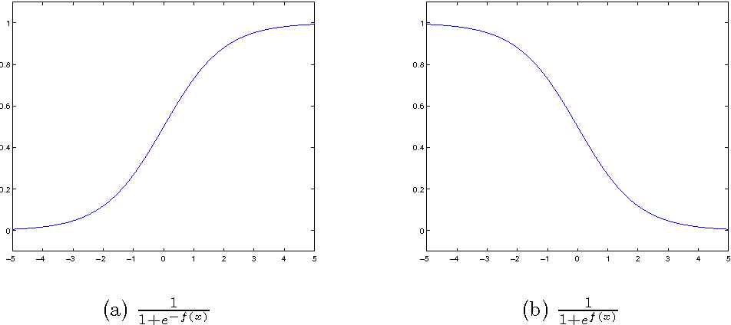
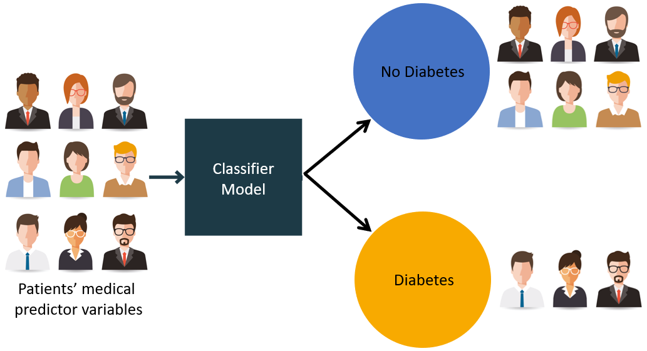
Area of opportunity: Using AI to predict CKD Progression and improve quality of life
Predict here
Ideal deliverable product
An easy to use and accurate AI tool that aids medical staff to predict patients with high risk of progression to treat them preventively, reducing medical costs and improving the quality of life of the patients
GFR
Before this happens
High Risk
AI Tool
Time since diagnosis
Low Risk
Patients medical variables
Notes:
Patients with CKD are evaluated on a regular basis, so there is a lot of information about the history of his disease

Slide 6
Problem Description
Dataset
300 patients diagnosed with Chronic Kidney Disease (CDK), of which 100 of them progressed and 200 did not
Variables
Longitudinal data from multiple lab measurements such as: Glucose, Creatinine, Meds, LDL, DBP and SBP, Hemoglobine as well as demographic data, such as: Age, Race and Gender
Response variable
Binary variable representing if the patients progressed in their CDK Stage
Challenge
Predict if a patient will progress in their CDK stage based in their past data

Slide 7

Approaching the problem
Reviewing the International Clinical Guidelines
Feature Engineering and time window determination
01
02
03
04
Modelling
Explanation of the model

Slide 8

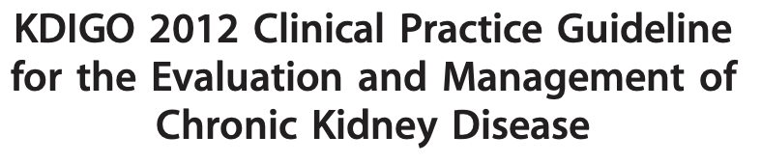


1: Reviewing the International Clinical Guidelines to obtain a comprehensive view of the disease
01
What are the most important clinical variables and their normal values?
02
How is progression in CKD defined?
03
How often does the patients are evaluated?
04
How are the patients classified?

Slide 9
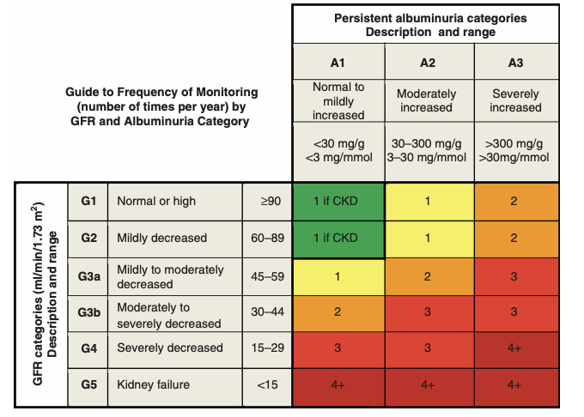
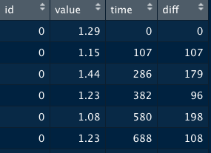
2: Determining Time Window using the clinical guidelines and the dataset
Clinical Guidelines
1
2
Dataset
3+ Evaluations per year in more clinically advanced patients
Mean time differences in all laboratory measurements
Mean time: 121 days
Proposed Time Windows : 120 and 180 days

Slide 10
2: Building the time window algorithm to merge the laboratory measurements
Time Window algorithm
01
Calculate the maximum time per patient in all laboratory measurements
02
For each laboratory measurement :
03
For each patient:
04
Calculate the number of Windows until the max time of evaluation. Make window and repeat each value until the next time window. If the patient was evaluated before the time window, the last evaluation is used and repeated. Finally, the average is obtained
05
Merge all the laboratory measurements by the time windows

Slide 11
2: Feature Engineering: What information can be inferred?
Feature Engineering
Creatinine
Glomerular Filtration Rate (GFR)
GFR Evolution (Diff between current GFR and last 3 Windows)
GFR Categories
Glucose
Diabetes
Difference between normal value and patient value
SBP and DBP
Blood pressure classification: Normal, elevated, Hypertension 1 and 2
Is patient blood pressure controlled?
LDL
Cholesterol classification and Hypercholesterolemia
Hemoglobin
Anemia classification
Meds
Number of drugs per time window
Total daily dosage
Combination of Drugs and Doses

Slide 12
Approaching the problem
Reviewing the International Clinical Guidelines
Feature Engineering and time window determination
01
02
03
04
Modelling
Explanation of the model

Slide 13
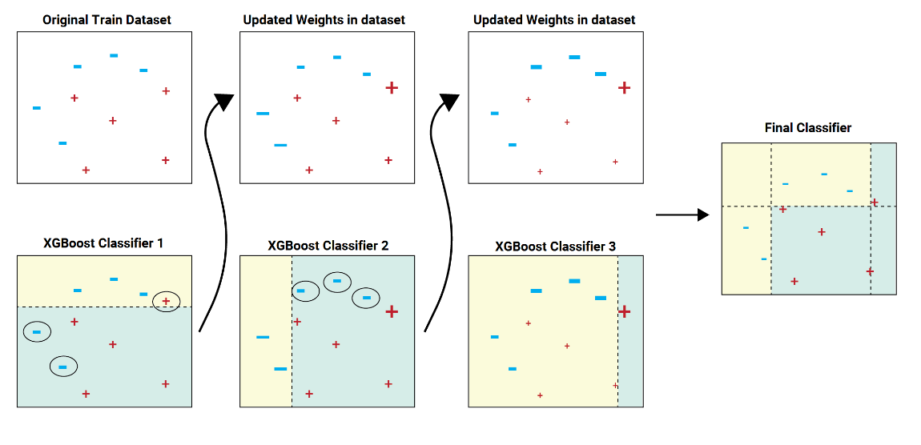
3: We tested multiple algorithms and settled on the best one
Modelling final pipeline
Tested Algorithms and accuracy:
Logistic Regression: 0.76
Random Forests : 0.88
Balanced Bagging Classifier: 0.92
XGBoost : 0.94
XGBoost
HyperOpt
Manual tunning
Shap values
For the 120 time window model:
Feature Selection using permutation importance

Slide 14
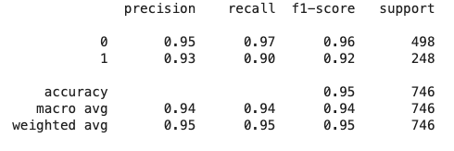
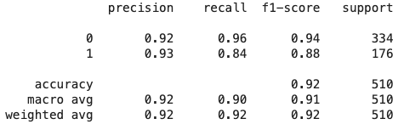
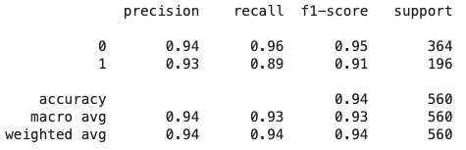
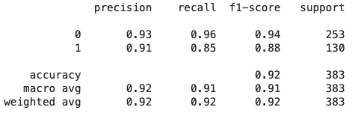
3: The best model could predict up to 90% of the patients that progress
Modelling results
120 day Model
Precision: When the model predicts that a patient will progress, it is right:
180 day Model
Testing
Testing
93% 93%
Of the time
Validation
Validation
Recall: The model predicts correctly:
90% 84%
Of the patients that progress
5-Fold Stratified CV Accuracy : 0.90
5-Fold Stratified CV Accuracy : 0.91

Slide 15
Approaching the problem
Reviewing the International Clinical Guidelines
Feature Engineering and time window determination
01
02
03
04
Modelling
Explanation of the model

Slide 16
4: Determining the most important variables for the model
Protective variables
Risk variables
Explaining the model
Both models had the same main variables
Main Insights
Patients with a high GFR and creatinine tend to progress more.
Patients with G3b stage tend to progress less often than patients with less advanced stages.
Patients with a higher number of drugs and doses per time window have a higher risk of progression.
Hypothesis: Patients in more advanced stages receive more continuous evaluations and are kept under more clinical control, reducing the likelihood of progression.

Slide 17
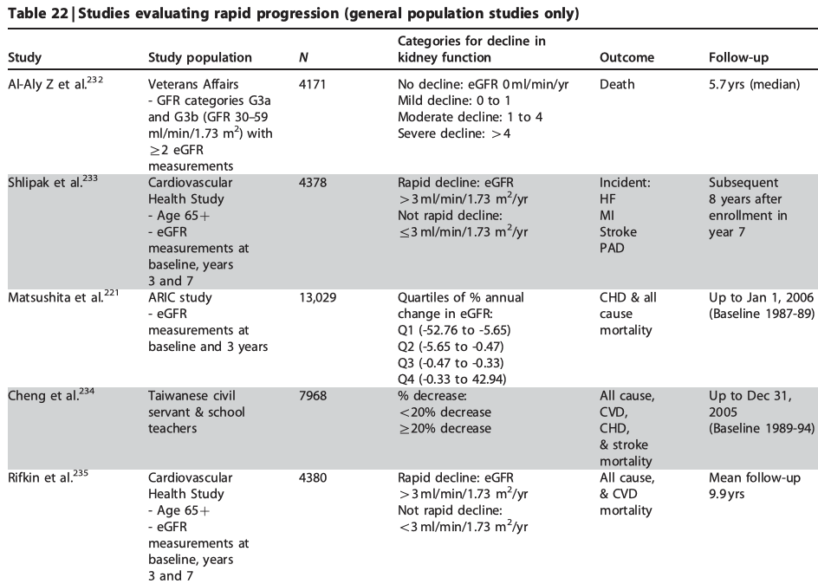
5: Improvements to be achieved to make the model more robust before deployment
Review the time window and results with a Nephrologyst
Gain more insights about the patients using the contraindications of the meds they take
Obtain data from key clinical variables such as Albumin and Urea
Biological data is usually highly heterogeneous, thus the more data we obtain the better.

Slide 18
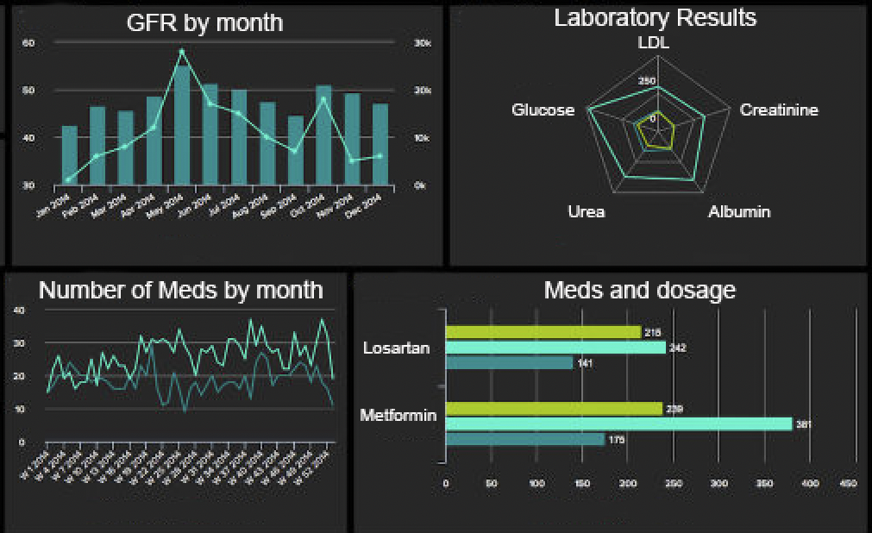
5: Next steps and ideal deliverable product
Develop the front-end of the tool with a perspective of precision medicine
Tailored to track and give the best recomendations and alerts per patient
If possible, integrate the results from the laboratory exams provider or EHR with the tool to ease the usage by medical staff

Slide 19
Thank you for your attention

