Slide 1
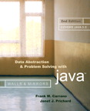
Chapter 4
Data Abstraction: The Walls
© 2006 Pearson Addison-Wesley. All rights reserved
4-<number>

Slide 2

Abstract Data Types
Typical operations on data
  Add data to a data collection
  Remove data from a data collection
  Ask questions about the data in a data collection
Data abstraction
  Asks you to think what you can do to a collection of data independently of how you do it
  Allows you to develop each data structure in relative isolation from the rest of the solution
  A natural extension of procedural abstraction
© 2006 Pearson Addison-Wesley. All rights reserved
4-<number>

Slide 3
Abstract Data Types
Abstract data type (ADT)
  An ADT is composed of
    A collection of data
    A set of operations on that data
  Specifications of an ADT indicate
    What the ADT operations do, not how to implement them
  Implementation of an ADT
    Includes choosing a particular data structure
© 2006 Pearson Addison-Wesley. All rights reserved
4-<number>

Slide 4
Abstract Data Types
Data structure
  A construct that is defined within a programming language to store a collection of data
  Example: arrays
ADTs and data structures are not the same
Data abstraction
  Results in a wall of ADT operations between data structures and the program that accesses the data within these data structures
© 2006 Pearson Addison-Wesley. All rights reserved
4-<number>

Slide 5
Definition of ADT and Data Structures
An ADT is a collection of data and a set of operations on that data.
A data structure is a construct within a programming language that stores a collection of data
© 2006 Pearson Addison-Wesley. All rights reserved
4-<number>

Slide 6
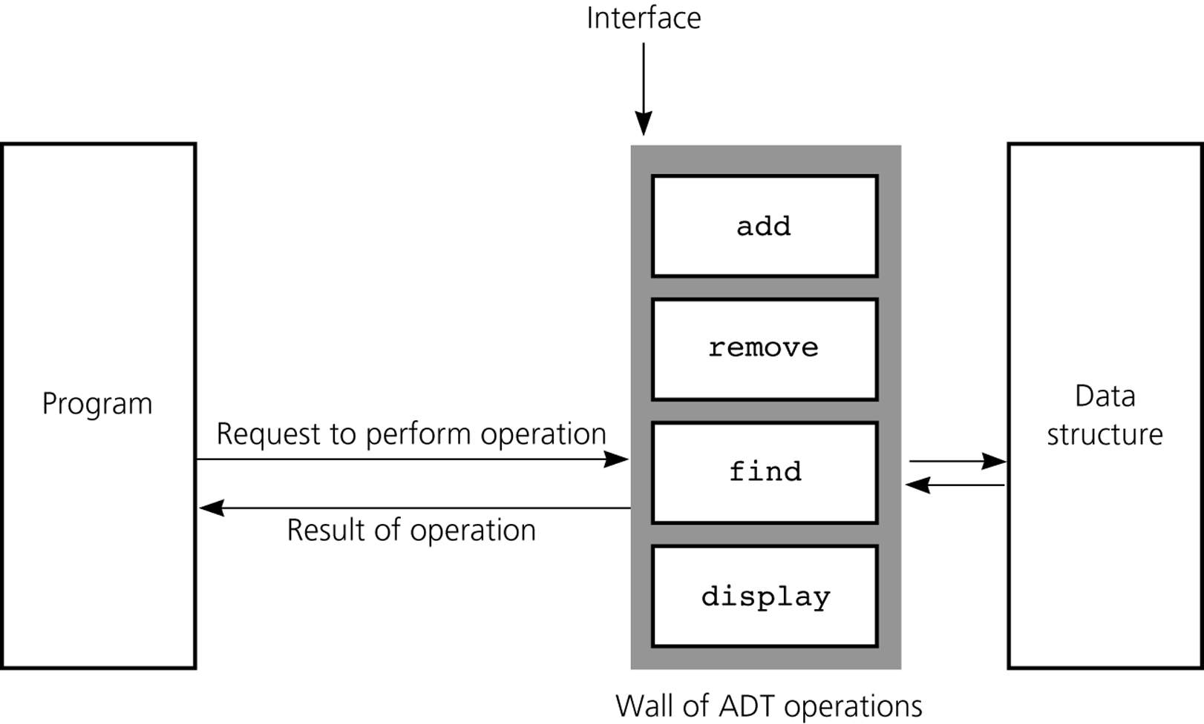
Abstract Data Types
Figure 4-4
A wall of ADT operations isolates a data structure from the program that uses it
© 2006 Pearson Addison-Wesley. All rights reserved
4-<number>

Slide 7
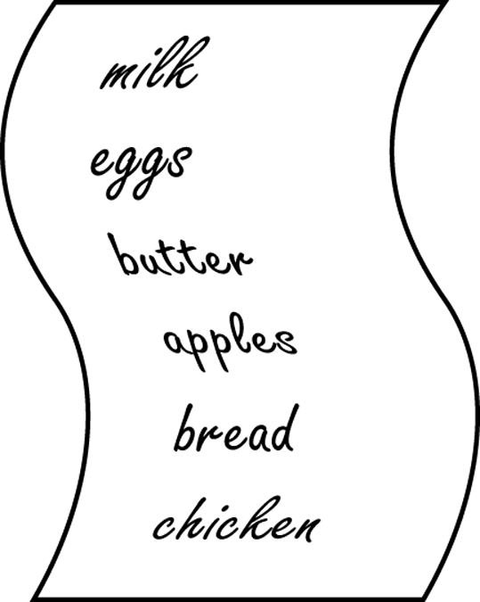
Specifying ADTs
In a list
  Except for the first and last items, each item has
    A unique predecessor
    A unique successor
  Head or front
    Does not have a predecessor
  Tail or end
    Does not have a successor
Figure 4-5
list A grocery
© 2006 Pearson Addison-Wesley. All rights reserved
4-<number>

Slide 8
The ADT List
ADT List operations
  Create an empty list
  Determine whether a list is empty
  Determine the number of items in a list
  Add an item at a given position in the list
  Remove the item at a given position in the list
  Remove all the items from the list
  Retrieve (get) the item at a given position in the list
Items are referenced by their position within the list
© 2006 Pearson Addison-Wesley. All rights reserved
4-<number>

Slide 9
The ADT List
Specifications of the ADT operations
  Define the contract for the ADT list
  Do not specify how to store the list or how to perform the operations
ADT operations can be used in an application without the knowledge of how the operations will be implemented
© 2006 Pearson Addison-Wesley. All rights reserved
4-<number>

Slide 10
The ADT Sorted List
The ADT sorted list
  Maintains items in sorted order
  Inserts and deletes items by their values, not their positions
© 2006 Pearson Addison-Wesley. All rights reserved
4-<number>

Slide 11
Designing an ADT
The design of an ADT should evolve naturally during the problem-solving process
Questions to ask when designing an ADT
  What data does a problem require?
  What operations does a problem require?
© 2006 Pearson Addison-Wesley. All rights reserved
4-<number>

Slide 12
Axioms (Optional)
For complex abstract data types, the behavior of the operations must be specified using axioms
  Axiom: A mathematical rule
© 2006 Pearson Addison-Wesley. All rights reserved
4-<number>

Slide 13
Axioms (Optional)
Axioms for the ADT List
  (aList.createList()).size() = 0
  (aList.add(i, x)).size() = aList.size() + 1
  (aList.remove(i)).size() = aList.size() – 1
  (aList.createList()).isEmpty() = true
  (aList.add(i, item)).isEmpty() = false
  (aList.createList()).remove(i) = error
  (aList.add(i, x)).remove(i) = aList
  (aList.createList()).get(i) = error
  (aList.add(i, x)).get(i) = x
  aList.get(i) = (aList.add(i, x).get(i+1)
  aList.get(i+1) = (aList.remove(i)).get(i)
© 2006 Pearson Addison-Wesley. All rights reserved
4-<number>

Slide 14
Implementing ADTs
Choosing the data structure to represent the ADT’s data is a part of implementation
  Choice of a data structure depends on
    Details of the ADT’s operations
    Context in which the operations will be used
Implementation details should be hidden behind a wall of ADT operations
  A program would only be able to access the data structure using the ADT operations
© 2006 Pearson Addison-Wesley. All rights reserved
4-<number>

Slide 15
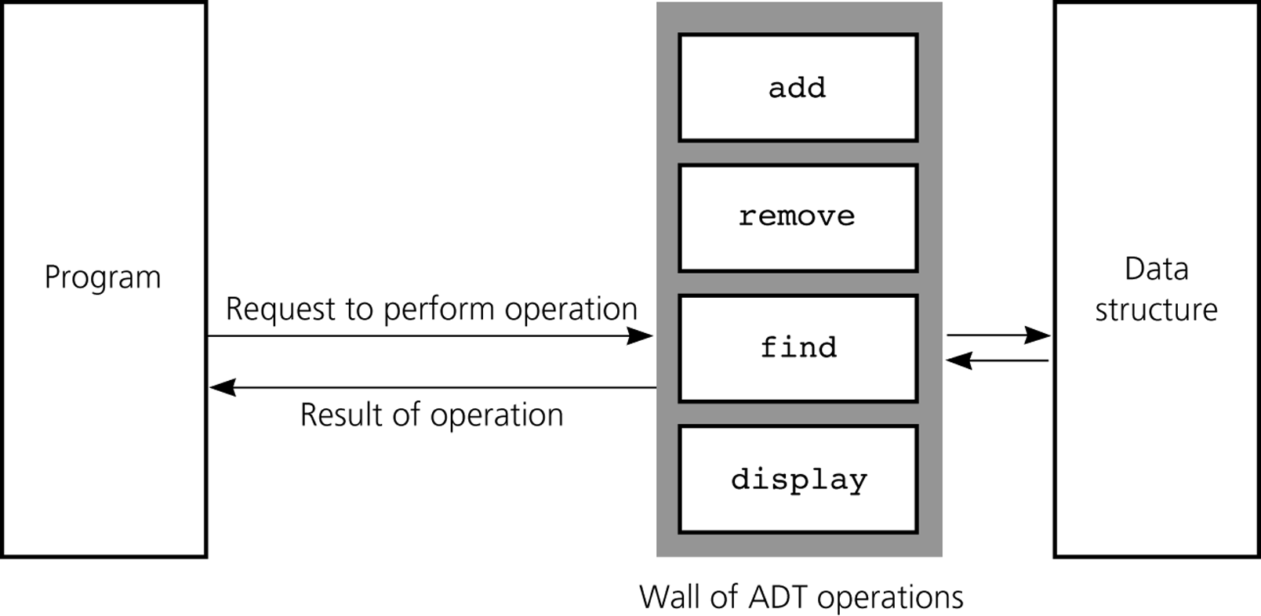
Implementing ADTs
Figure 4-8
ADT operations provide access to a data structure
© 2006 Pearson Addison-Wesley. All rights reserved
4-<number>

Slide 16
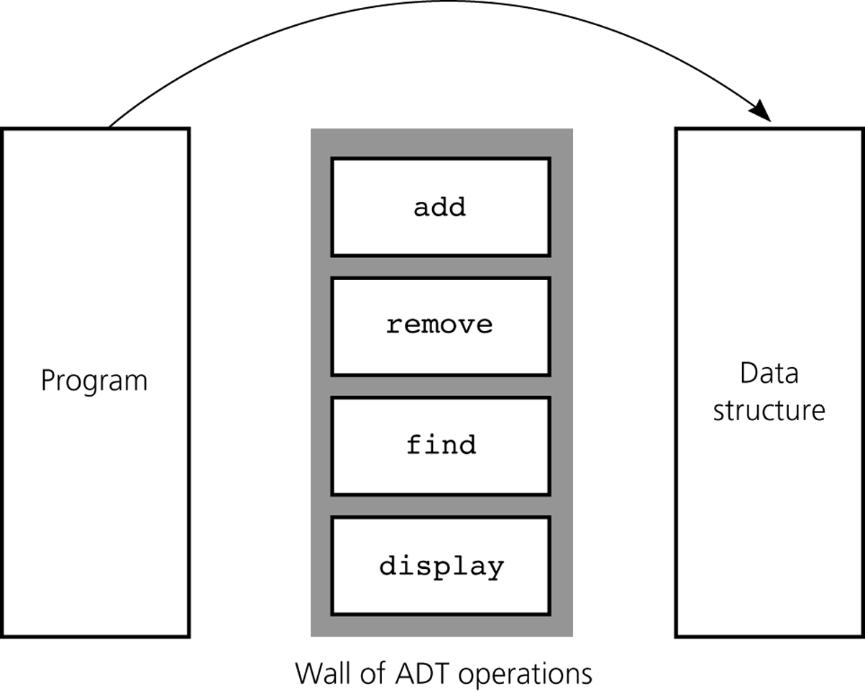
Implementing ADTs
Figure 4-9
Violating the wall of ADT operations
© 2006 Pearson Addison-Wesley. All rights reserved
4-<number>

Slide 17
Java Interfaces
An interface
  Specifies methods and constants, but supplies no implementation details
  Can be used to specify some desired common behavior that may be useful over many different types of objects
  The Java API has many predefined interfaces
    Example: java.util.Collection
© 2006 Pearson Addison-Wesley. All rights reserved
4-<number>

Slide 18
Java Interfaces
A class that implements an interface must
  Include an implements clause
  Provide implementations of the methods of the interface
To define an interface
  Use the keyword interface instead of class in the header
  Provide only method specifications and constants in the interface definition
© 2006 Pearson Addison-Wesley. All rights reserved
4-<number>

Slide 19
An Array-Based Implementation of the ADT List
An array-based implementation
  A list’s items are stored in an array items
  A natural choice
    Both an array and a list identify their items by number
  A list’s k^{th} item will be stored in items[k-1]
© 2006 Pearson Addison-Wesley. All rights reserved
4-<number>

Slide 20
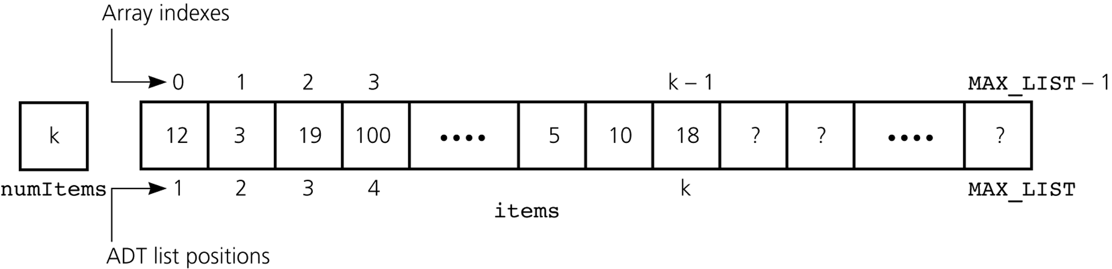
An Array-Based Implementation of the ADT List
Figure 4-11
An array-based implementation of the ADT list
© 2006 Pearson Addison-Wesley. All rights reserved
4-<number>

Slide 21
Summary
Data abstraction: a technique for controlling the interaction between a program and its data structures
An ADT: the specifications of a set of data management operations and the data values upon which they operate
The formal mathematical study of ADTs uses systems of axioms to specify the behavior of ADT operations
Only after you have fully defined an ADT should you think about how to implement it
© 2006 Pearson Addison-Wesley. All rights reserved
4-<number>

