Slide 1
Handling errors
4.2
Notes:
Objects First with Java
© David J. Barnes and Michael Kölling

Slide 2
Main concepts to be covered
Defensive programming.
  Anticipating that things could go wrong.
Exception handling and throwing.
Error reporting.
Simple file processing.
Objects First with Java - A Practical Introduction using BlueJ, © David J. Barnes, Michael Kölling

Slide 3
Some causes of error situations
Incorrect implementation.
  Does not meet the specification.
Inappropriate object request.
  E.g., invalid index.
Inconsistent or inappropriate object state.
  E.g. arising through class extension.
Objects First with Java - A Practical Introduction using BlueJ, © David J. Barnes, Michael Kölling

Slide 4
Not always programmer error
Errors often arise from the environment:
  Incorrect URL entered.
  Network interruption.
File processing is particular error-prone:
  Missing files.
  Lack of appropriate permissions.
Objects First with Java - A Practical Introduction using BlueJ, © David J. Barnes, Michael Kölling

Slide 5
Exploring errors
Explore error situations through the address-book projects.
Two aspects:
  Error reporting.
  Error handling.
Objects First with Java - A Practical Introduction using BlueJ, © David J. Barnes, Michael Kölling

Slide 6
Defensive programming
Client-server interaction.
  Should a server assume that clients are well-behaved?
  Or should it assume that clients are potentially hostile?
Significant differences in implementation required.
Objects First with Java - A Practical Introduction using BlueJ, © David J. Barnes, Michael Kölling

Slide 7
Issues to be addressed
How much checking by a server on method calls?
How to report errors?
How can a client anticipate failure?
How should a client deal with failure?
Objects First with Java - A Practical Introduction using BlueJ, © David J. Barnes, Michael Kölling

Slide 8
An example
Create an AddressBook object.
Try to remove an entry.
A runtime error results.
  Whose ‘fault’ is this?
Anticipation and prevention are preferable to apportioning blame.
Objects First with Java - A Practical Introduction using BlueJ, © David J. Barnes, Michael Kölling

Slide 9
Argument values
Arguments represent a major ‘vulnerability’ for a server object.
  Constructor arguments initialize state.
  Method arguments often contribute to behavior.
Argument checking is one defensive measure.
Objects First with Java - A Practical Introduction using BlueJ, © David J. Barnes, Michael Kölling

Slide 10
Checking the key
public void removeDetails(String key)
{
if(keyInUse(key)) {
ContactDetails details = book.get(key);
book.remove(details.getName());
book.remove(details.getPhone());
numberOfEntries--;
}
}
Objects First with Java - A Practical Introduction using BlueJ, © David J. Barnes, Michael Kölling

Slide 11
Server error reporting
How to report illegal arguments?
  To the user?
    Is there a human user?
    Can they solve the problem?
  To the client object?
    Return a diagnostic value.
    Throw an exception.
Objects First with Java - A Practical Introduction using BlueJ, © David J. Barnes, Michael Kölling

Slide 12
Returning a diagnostic
public boolean removeDetails(String key)
{
if(keyInUse(key)) {
ContactDetails details = book.get(key);
book.remove(details.getName());
book.remove(details.getPhone());
numberOfEntries--;
return true;
}
else {
return false;
}
}
Objects First with Java - A Practical Introduction using BlueJ, © David J. Barnes, Michael Kölling

Slide 13
Client responses
Test the return value.
  Attempt recovery on error.
  Avoid program failure.
Ignore the return value.
  Cannot be prevented.
  Likely to lead to program failure.
Exceptions are preferable.
Objects First with Java - A Practical Introduction using BlueJ, © David J. Barnes, Michael Kölling

Slide 14
Exception-throwing principles
A special language feature.
No ‘special’ return value needed.
Errors cannot be ignored in the client.
  The normal flow-of-control is interrupted.
Specific recovery actions are encouraged.
Objects First with Java - A Practical Introduction using BlueJ, © David J. Barnes, Michael Kölling

Slide 15
Throwing an exception
/**
* Look up a name or phone number and return the
* corresponding contact details.
* @param key The name or number to be looked up.
* @return The details corresponding to the key,
* or null if there are none matching.
* @throws NullPointerException if the key is null.
*/
public ContactDetails getDetails(String key)
{
if(key == null) {
throw new NullPointerException(
"null key in getDetails");
}
return book.get(key);
}
Objects First with Java - A Practical Introduction using BlueJ, © David J. Barnes, Michael Kölling
Notes:
Objects First with Java
© David J. Barnes and Michael Kölling
The method comment is included to illustrate the @throws javadoc documentation.

Slide 16
Throwing an exception
An exception object is constructed:
  new ExceptionType("...")
The exception object is thrown:
  throw ...
Javadoc documentation:
  @throws ExceptionType reason
Objects First with Java - A Practical Introduction using BlueJ, © David J. Barnes, Michael Kölling

Slide 17
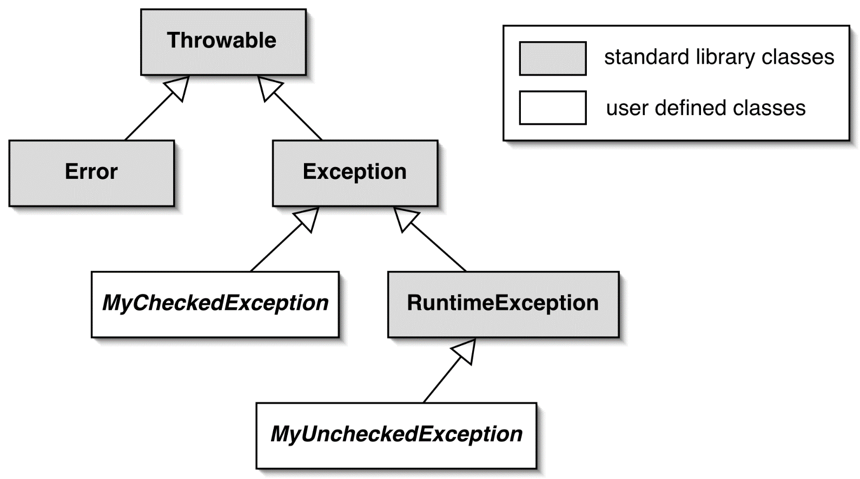
The exception class hierarchy
Objects First with Java - A Practical Introduction using BlueJ, © David J. Barnes, Michael Kölling

Slide 18
Exception categories
Checked exceptions
  Subclass of Exception
  Use for anticipated failures.
  Where recovery may be possible.
Unchecked exceptions
  Subclass of RuntimeException
  Use for unanticipated failures.
  Where recovery is unlikely.
Objects First with Java - A Practical Introduction using BlueJ, © David J. Barnes, Michael Kölling

Slide 19
The effect of an exception
The throwing method finishes prematurely.
No return value is returned.
Control does not return to the client’s point of call.
  So the client cannot carry on regardless.
A client may ‘catch’ an exception.
Objects First with Java - A Practical Introduction using BlueJ, © David J. Barnes, Michael Kölling

Slide 20
Unchecked exceptions
Use of these is ‘unchecked’ by the compiler.
Cause program termination if not caught.
  This is the normal practice.
IllegalArgumentException is a typical example.
Objects First with Java - A Practical Introduction using BlueJ, © David J. Barnes, Michael Kölling

Slide 21
Argument checking
public ContactDetails getDetails(String key)
{
if(key == null) {
throw new NullPointerException(
"null key in getDetails");
}
if(key.trim().length() == 0) {
throw new IllegalArgumentException(
"Empty key passed to getDetails");
}
return book.get(key);
}
Objects First with Java - A Practical Introduction using BlueJ, © David J. Barnes, Michael Kölling

Slide 22
Preventing object creation
public ContactDetails(String name, String phone, String address)
{
if(name == null) {
name = "";
}
if(phone == null) {
phone = "";
}
if(address == null) {
address = "";
}
this.name = name.trim();
this.phone = phone.trim();
this.address = address.trim();
if(this.name.length() == 0 && this.phone.length() == 0) {
throw new IllegalStateException(
"Either the name or phone must not be blank.");
}
}
Objects First with Java - A Practical Introduction using BlueJ, © David J. Barnes, Michael Kölling

Slide 23
Exception handling
Checked exceptions are meant to be caught.
The compiler ensures that their use is tightly controlled.
  In both server and client.
Used properly, failures may be recoverable.
Objects First with Java - A Practical Introduction using BlueJ, © David J. Barnes, Michael Kölling

Slide 24
The throws clause
Methods throwing a checked exception must include a throws clause:
public void saveToFile(String destinationFile)
throws IOException
Objects First with Java - A Practical Introduction using BlueJ, © David J. Barnes, Michael Kölling

Slide 25
The try statement
Clients catching an exception must protect the call with a try statement:
try {
Protect one or more statements here.
}
catch(Exception e) {
Report and recover from the exception here.
}
Objects First with Java - A Practical Introduction using BlueJ, © David J. Barnes, Michael Kölling

Slide 26
The try statement
1. Exception thrown from here
try {
addressbook.saveToFile(filename);
tryAgain = false;
}
catch(IOException e) {
System.out.println("Unable to save to " + filename);
tryAgain = true;
}
2. Control transfers to here
Objects First with Java - A Practical Introduction using BlueJ, © David J. Barnes, Michael Kölling

Slide 27
Catching multiple exceptions
try {
...
ref.process();
...
}
catch(EOFException e) {
// Take action on an end-of-file exception.
...
}
catch(FileNotFoundException e) {
// Take action on a file-not-found exception.
...
}
Objects First with Java - A Practical Introduction using BlueJ, © David J. Barnes, Michael Kölling

Slide 28
The finally clause
try {
Protect one or more statements here.
}
catch(Exception e) {
Report and recover from the exception here.
}
finally {
Perform any actions here common to whether or not
an exception is thrown.
}
Objects First with Java - A Practical Introduction using BlueJ, © David J. Barnes, Michael Kölling

Slide 29
The finally clause
A finally clause is executed even if a return statement is executed in the try or catch clauses.
A uncaught or propagated exception still exits via the finally clause.
Objects First with Java - A Practical Introduction using BlueJ, © David J. Barnes, Michael Kölling

Slide 30
Defining new exceptions
Extend RuntimeException for an unchecked or Exception for a checked exception.
Define new types to give better diagnostic information.
  Include reporting and/or recovery information.
Objects First with Java - A Practical Introduction using BlueJ, © David J. Barnes, Michael Kölling

Slide 31
public class NoMatchingDetailsException extends Exception
{
private String key;
public NoMatchingDetailsException(String key)
{
this.key = key;
}
public String getKey()
{
return key;
}
public String toString()
{
return "No details matching '" + key +
"' were found.";
}
}
Objects First with Java - A Practical Introduction using BlueJ, © David J. Barnes, Michael Kölling

Slide 32
Assertions
Used for internal consistency checks.
  E.g. object state following mutation.
Used during development and normally removed in production version.
  E.g. via a compile-time option.
Java has an assert statement.
Objects First with Java - A Practical Introduction using BlueJ, © David J. Barnes, Michael Kölling

Slide 33
Java Assertion Statement
Two forms available:
  assert boolean-expression
  assert boolean-expression :
  expression
The boolean-expression expresses something that should be true at this point.
An AssertionError is thrown if the assertion is false.
Objects First with Java - A Practical Introduction using BlueJ, © David J. Barnes, Michael Kölling

Slide 34
Assert Statement
public void removeDetails(String key)
{
if(key == null){
throw new IllegalArgumentException("...");
}
if(keyInUse(key)) {
ContactDetails details = book.get(key);
book.remove(details.getName());
book.remove(details.getPhone());
numberOfEntries--;
}
assert !keyInUse(key);
assert consistentSize() :
"Inconsistent book size in removeDetails";
}
Objects First with Java - A Practical Introduction using BlueJ, © David J. Barnes, Michael Kölling

Slide 35
Guidelines for Assertions
They are not an alternative to throwing exceptions.
Use for internal checks.
Remove from production code.
Don’t include normal functionality:
// Incorrect use:
assert book.remove(name) != null;
Objects First with Java - A Practical Introduction using BlueJ, © David J. Barnes, Michael Kölling

Slide 36
Error recovery
Clients should take note of error notifications.
  Check return values.
  Don’t ‘ignore’ exceptions.
Include code to attempt recovery.
  Will often require a loop.
Objects First with Java - A Practical Introduction using BlueJ, © David J. Barnes, Michael Kölling

Slide 37
Attempting recovery
// Try to save the address book.
boolean successful = false;
int attempts = 0;
do {
try {
addressbook.saveToFile(filename);
successful = true;
}
catch(IOException e) {
System.out.println("Unable to save to " + filename);
attempts++;
if(attempts < MAX_ATTEMPTS) {
filename = an alternative file name;
}
}
} while(!successful && attempts < MAX_ATTEMPTS);
if(!successful) {
Report the problem and give up;
}
Objects First with Java - A Practical Introduction using BlueJ, © David J. Barnes, Michael Kölling

Slide 38
Error avoidance
Clients can often use server query methods to avoid errors.
  More robust clients mean servers can be more trusting.
  Unchecked exceptions can be used.
  Simplifies client logic.
May increase client-server coupling.
Objects First with Java - A Practical Introduction using BlueJ, © David J. Barnes, Michael Kölling

Slide 39
Avoiding an exception
// Use the correct method to put details
// in the address book.
if(book.keyInUse(details.getName() ||
book.keyInUse(details.getPhone()) {
book.changeDetails(details);
}
else {
book.addDetails(details);
}
The addDetails method could now throw an unchecked exception.
Objects First with Java - A Practical Introduction using BlueJ, © David J. Barnes, Michael Kölling

Slide 40
Text input-output
Input-output is particularly error-prone.
  It involves interaction with the external environment.
The java.io package supports input-output.
java.io.IOException is a checked exception.
Objects First with Java - A Practical Introduction using BlueJ, © David J. Barnes, Michael Kölling

Slide 41
Readers, writers, streams
Readers and writers deal with textual input.
  Based around the char type.
Streams deal with binary data.
  Based around the byte type.
The address-book-io project illustrates textual IO.
Objects First with Java - A Practical Introduction using BlueJ, © David J. Barnes, Michael Kölling

Slide 42
Text output to file
Use the FileWriter class.
  Open a file.
  Write to the file.
  Close the file.
Failure at any point results in an IOException.
Objects First with Java - A Practical Introduction using BlueJ, © David J. Barnes, Michael Kölling

Slide 43
Text output to file
try {
FileWriter writer = new FileWriter("name of file");
while(there is more text to write) {
...
writer.write(next piece of text);
...
}
writer.close();
}
catch(IOException e) {
something went wrong with accessing the file
}
See dome-simple-output
Objects First with Java - A Practical Introduction using BlueJ, © David J. Barnes, Michael Kölling

Slide 44
Text input from file
Use the FileReader class.
Augment with BufferedReader for line-based input.
  Open a file.
  Read from the file.
  Close the file.
Failure at any point results in an IOException.
Objects First with Java - A Practical Introduction using BlueJ, © David J. Barnes, Michael Kölling

Slide 45
Text input from file
try {
BufferedReader reader =
new BufferedReader(new FileReader("filename"));
String line = reader.readLine();
while(line != null) {
do something with line
line = reader.readLine();
}
reader.close();
}
catch(FileNotFoundException e) {
the specified file could not be found
}
catch(IOException e) {
something went wrong with reading or closing
}
See tech-support-io
Objects First with Java - A Practical Introduction using BlueJ, © David J. Barnes, Michael Kölling

Slide 46
Text input from the terminal
System.in maps to the terminal.
  java.io.InputStream
Often wrapped in a java.util.Scanner.
Scanner supports parsing of textual input.
  nextInt, nextLine, etc.
Scanner with File an alternative to BufferedReader with FileReader.
Objects First with Java - A Practical Introduction using BlueJ, © David J. Barnes, Michael Kölling

Slide 47
Review
Runtime errors arise for many reasons.
  An inappropriate client call to a server object.
  A server unable to fulfill a request.
  Programming error in client and/or server.
Objects First with Java - A Practical Introduction using BlueJ, © David J. Barnes, Michael Kölling

Slide 48
Review
Runtime errors often lead to program failure.
Defensive programming anticipates errors – in both client and server.
Exceptions provide a reporting and recovery mechanism.
Objects First with Java - A Practical Introduction using BlueJ, © David J. Barnes, Michael Kölling

