Slide 1
StyleSync
ACIT 2911 Agile Development Project
Group 11 - Week #2
Notes:
Title page

Slide 2
StyleSync Team
Member Name Term / BCIT Email
Angad Bains | 1B / abains101@my.bcit.ca
Tanish Bansal | 2B / tbansal7@my.bcit.ca
Matthew Chow | 2B / mchow123@my.bcit.ca
Matilda Kim | 1B / ckim170@my.bcit.ca
Charley Liao | 2B / cliao32@my.bcit.ca
Misha Makaroff | 1B / mmakaroff@my.bcit.ca
For communication & collaboration: Discord, Google, GitHub, Trello
Notes:
Introduce team members with contact information and explain how we collaborate with each other.

Slide 3
StyleSync Team Roles
* Our team will rotate Scrum Master & Product Owner roles on a weekly basis.
Angad Bains
Tanish Bansal
Matthew Chow
Back-End Developer
(Database)
Front-End Developer
Coding Lead
Back-End Developer
Middleware Developer
Scrum Master (week 2)
Front-End Developer
(User Interface)
Application Testing
Matilda Kim
Charley Liao
Misha Makaroff
Secretary
Administrative Work
Middleware Developer
Group Leader
Version Control
Administrative Work
Application Testing
Product Owner (week 2)
Version Control
Front-End Designer
(User Interface)
Notes:
Breakdown of everyone’s duties

Slide 4
WHOA!
Virtual Stylist & Wardrobe Management
Notes:
What does your application do? ½
Recap of what our app does.

Slide 5
StyleSync
How does it work?
Simply upload photos of your clothes
Set preferences
Let algorithms curate personalized outfits
Or unleash your own sense of style and create your own
Save time, enhance style, and promote sustainability with effortless wardrobe management.
Notes:
What does your application do? 2/2

Slide 6
Log In Capability
Open Wardrobe
Minimalistic User Interface
Sync of application
Share favorite outfits
Easy access and use
Notes:
How is your web app different from any similar, existing app? 2/2
We have a user login and authentication.
Unique user database? As in their outfits will only display only to them
Security?
Trying to type in url redirect you to login page.

Slide 7
MVP
01
02
03
04
Basic HomePage Layout
Creating Database
Syncing Database
Log-in Page
Working Database of Accounts
Sign Up Page
Navigation Bar
Item Boxes Layout & Population
Table of inventory with categories
Notes:
MVP
Recap of Week 1 sprints
Describe the functions we worked on.
Login page authentication now works
Registration page works as well
Wardrobe page
Database
tables
Middleware
Sync database
Homepage basic layout with bootstrap

Slide 8
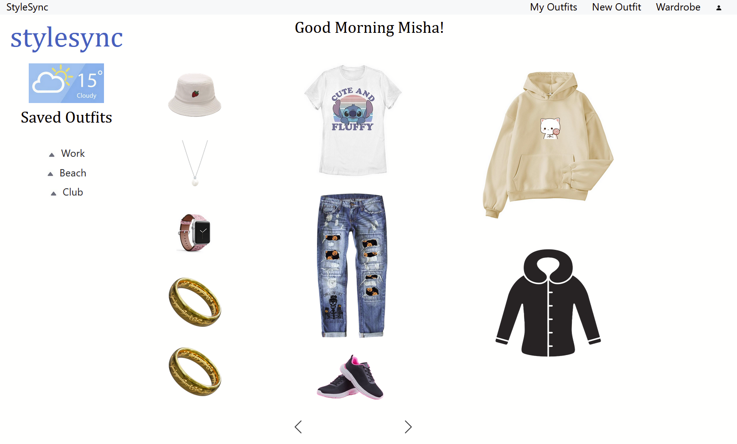
HTML
Login Page
Register User Page
Home Page
Wardrobe Page
Custom Outfit Page
Notes:
Demonstrate HTML
This week we wrote html/css for:
registration/login/my outfits/new outfit/wardrobe pages
Show registration - Details are stored in database and passwords are hashed
the site is not fully accessible unless you are a registered user, and users only see their individual data
Now we’ll show login
Home page/my outfits page item layout is set
New outfit layout is a work in progress, it will be similar to My outfits with black and white silhouettes for each item, when you click on an item an overlay pops up and you can select and save an item for that outfit
Demonstrate overlay for new outfit
For the wardrobe we have a dynamic grid that grows to fit the number of wardrobe items in the selected categories

Slide 9
Demonstration

Slide 10
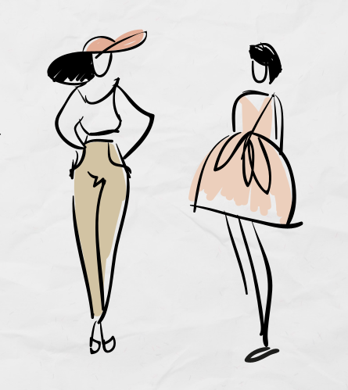
Database Relations
Demonstrate ERD
Models Python
Notes:
Demonstrate database relations

Slide 11
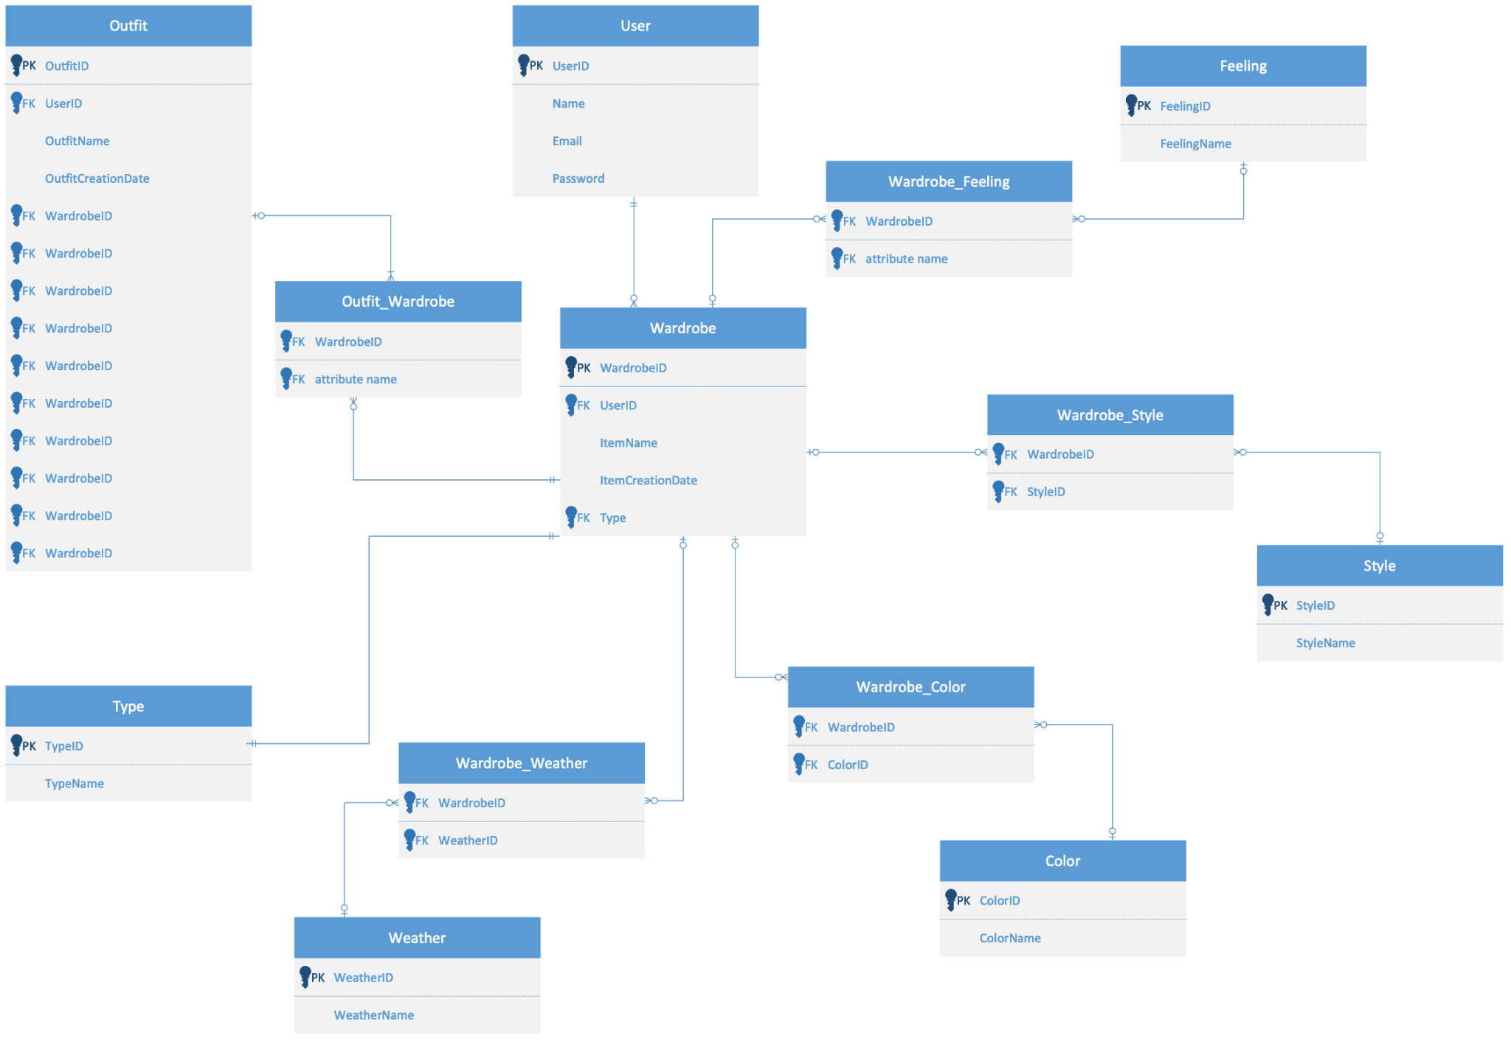
Database Relations
This ERD iteration demonstrates the database relations used for this app.
Notes:
Demonstrate database relations: (it is a simplified but functional database for our stylesync app)
The database is divided into 4 general sections:
Includes User Table (Used for identifying user as well as login purposes)
Wardrobe will have all items in the wardrobe/closet (main table which acts as the central point)
Outfit will demonstrate the combination of wardrobe items for the outfit (this combination will be depend on the type table and user choices)
We are currently working on the constraints on the outfit creation based on the type table
Type, Feeling, Weather, Style, color tables are categories types
To reduce the number of tables for categories, we will consider combining them into one table called categories

Slide 12
Demonstration

Slide 13
Reviewing GitHub Repository Setup
WorkFlow Diagram
GitHub Branches
GitHub Repository
Notes:
Demonstrate Workflow Diagram & GitHub Repo Setup:
Our Gi

Slide 14
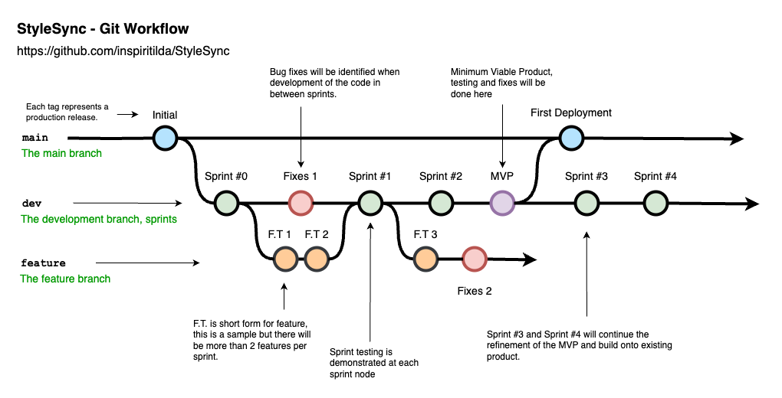
Reviewing GitHub Repository Setup
Notes:
Demonstrate Workflow Diagram & GitHub Repo Setup:
The image demonstrates how we manage our workflow.
Main Branch
Development Branch
Feature Branch
Sprints are nodes on the development branch, there will be fixes in between feature development and in between sprints
Fixes 1 node is a sample demonstration of identifying an issue between Sprint #0 and Sprint #1 → It can be placed in the feature development as well.
Members who are working on the same feature will be working in the same feature branch node, in the workflow above, it is just a sample demonstration of the feature
How we decide to push from the dev branch to the main branch is a group agreement, the code will be shared with the group and tested.
Then it would be reviewed by the Code Lead and bounced back to the group for a final look over.
Once everyone agrees the code leader will make a pull request to the main branch and will get the consensus of the group.

Slide 15
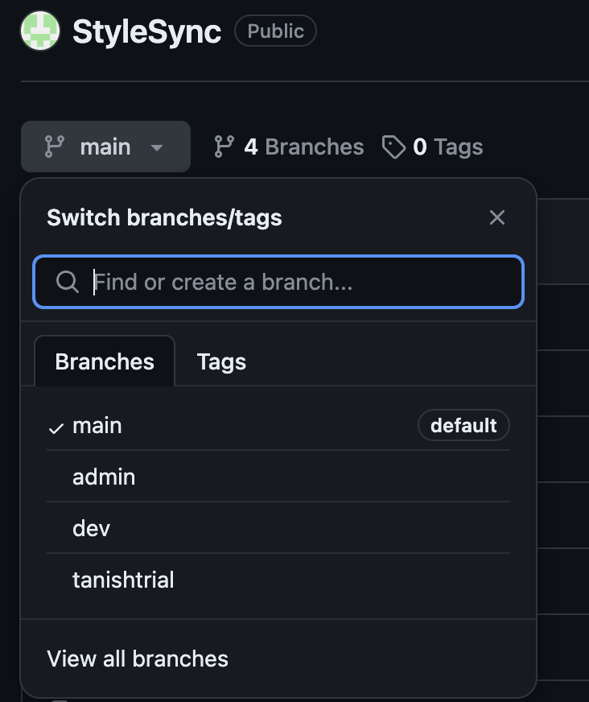
Reviewing GitHub Repository Setup
In our GitHub repo:
main
dev
The admin and the redbox are test branches to fix our git connection issues.
Notes:
Demonstrate Workflow Diagram & GitHub Repo Setup:
By following the workflow designed for this project, we have split our GitHub Repository into one main branch and one dev branch.
The dev branch is for development of the code for our sprints, we will be mainly pulling from the dev branch and make sub branches from the dev branch for features.
Note, as we are still learning on how to use branching on Git, we are still making mistakes while pushing and pulling.
So to test push and pull on using branches, we made a admin used to fix any git / version issues as well as used to practice push and pulling.
Eventually we will remove the admin and redbox branch as we are getting used to the main branch

Slide 16
Project Plan: Deliverable 2
01
02
03
Create routing for Adding and Removing
Saved Outfits & Clothing Articles
Add Clothing
Article HTML Page
Sync with Improved Database
Edit Outfit Article Page
Sync with Improve Database
-> Create HTML Buttons for
pages (Create, Delete, Edit)
Notes:
Make a clear outline of workflow for UI as a user
Instructions
Rename some of the labels
Introduction Page
** UI/UX Workflow

Slide 17
THANKS
DO YOU HAVE ANY QUESTIONS?
Please keep this slide for attribution

