Slide 1
StyleSync
ACIT 2911 Agile Development Project
Group 11 - Week #1
Notes:
Title page

Slide 2
StyleSync Team
Member Name Term / BCIT Email
Angad Bains | 1B / abains101@my.bcit.ca
Tanish Bansal | 2B / tbansal7@my.bcit.ca
Matthew Chow | 2B / mchow123@my.bcit.ca
Matilda Kim | 1B / ckim170@my.bcit.ca
Charley Liao | 2B / cliao32@my.bcit.ca
Misha Makaroff | 1B / mmakaroff@my.bcit.ca
For communication & collaboration: Discord, Google, GitHub, Trello
Notes:
Introduce team members with contact information and explain how we collaborate with each other.

Slide 3
StyleSync Team Roles
* Our team will rotate roles on a weekly basis.
Angad Bains
Tanish Bansal
Matthew Chow
Back-End Developer (Database)
Front-End Developer
Coding Lead
Back-End Developer
Middleware Developer
Front-End Developer (User Interface)
Designing unit testing
Testing application
Matilda Kim
Charley Liao
Misha Makaroff
Product Owner (week 1)
Secretary
Administrative Work
Middleware Developer
Group Leader
Version Control
Scrum Master (week 1)
Administrative Work
Designing unit testing
Testing application
Version Control
Front-End Designer (User Interface)
Notes:
Breakdown of everyone’s duties

Slide 4
WHOA!
Virtual Stylist & Wardrobe Management
Notes:
What does your application do?

Slide 5
StyleSync
How does it work?
Simply upload photos of your clothes
Set preferences
Let advanced algorithms curate personalized outfits
Or unleash your own sense of style and create your own
Save time, enhance style, and promote sustainability with effortless wardrobe management.
Notes:
What specific problem does our application help our users solve? 1/2

Slide 6
How does StyleSync solve problems?
Combats throw-away culture
Manufacturing Wastes
Maximum Utilization of Wardrobe
Repeated Outfits
StyleSync
Reduces decision fatigue
Indecisiveness
Virtual Stylist
Wardrobe Management
Reduces time when getting ready
Time-consuming
Stylish Outfit Recommendations
Low confidence
Notes:
What specific problem does our application help our users solve? 2/2

Slide 7
StyleSync is designed for people who…
Want to save time
Planning and deciding an outfit can be a hassle.
Want fashion tips
Boost your confidence and sense of style!
Want to save money
Reduce waste and save money by maximizing your wardrobe.
Notes:
Who is the target market?

Slide 8
StyleSync Competitors
Cladwell | Stylebook | Closet+ | Pureple | Chicisimo
Minimalist Wardrobe of user’s clothing | Digitize user’s wardrobe by inserting photos of users clothes | Organizes user’s clothes, shoes, and accessories with photos and tags | Creates outfits from user’s clothes and discover new ways to wear them | Outfit ideas based on user’s personal style, the weather, and the occasion
Personalized shopping recommendations | Mix and match items to create outfits | Outfit planning, packing lists, and style inspirations | Packing lists, style stats, and a virtual closet | Ability to save favourite outfits and shop for similar items
Limited customization options for user interface | Limited sync options, no user login to share outfits with friends | Pay wall to utilize entire app, no user login | User interface, difficult to navigate | Limited range of brands to shop from
Limited brand selection | Not user friendly, difficult to navigate the app | No sync capabilities, one device one usage | Lack of features | Outfit recommendations are limited
Notes:
How is your web app different from any similar, existing app? 1/2

Slide 9
Log In Capability
Open Wardrobe
Minimalistic User Interface
Sync of application
Share favorite outfits
Easy access and use
Notes:
How is your web app different from any similar, existing app? 2/2

Slide 10
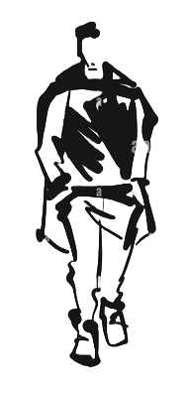


Sprint #0
01
02
Project Proposal
Team Charter
Notes:
MVP

Slide 11
MVP - Sprint #1
01
02
03
04
Basic HomePage Layout
Creating Database
Syncing Database
Log-in Page
Working Database of Accounts
Sign Up Page
Navigation Bar
Item Boxes Layout & Population
Table of inventory with categories
Notes:
MVP

Slide 12
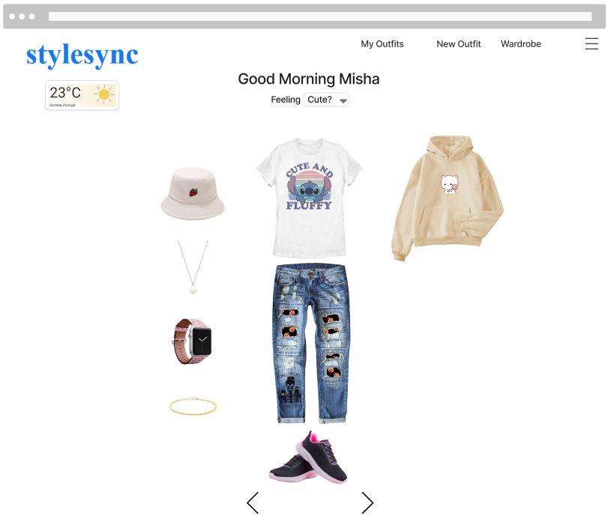
Notes:
Here is a mockup of a personalized home page you would see after you authenticate as a user.
In the top left we display weather for the user’s current location.
Then we have a personalized welcome message based on the user’s name and time of day.
There’s a dropdown menu where you can select how you’re feeling and below you’ll be shown a recommended outfit.
Above on our nav bar we’ll have links to a page with the users saved outfits, a page to create new outfits, and a page that contains all uploaded wardrobe items.
The settings menu in the top right indicated by 3 horizontal bars leads to user settings and a logout link.

Slide 13
Resources/ Technologies
VSCode
(Python, HTML, CSS)
01
GitHub
Google
(Doc, Slides)
02
SQLite
Discord
03
Trello
Office 365 Suite
04
Figma
Notes:
Here are some of the resources our team will be using.
VSCode to code in python, html, css
Integrating tech such as bootstrap/flask/sqlalchemy
Google Docs and google slides for collaboration on presentations
Discord for team communication
Office 365 suite for Excel/Word for admin
Github as a repository for our project
SQlite for database integration
Trello as a project board for team collaboration - track our progress
Figma for UI design

Slide 14
Sprint #0 Project Proposal: Review
Developed Mock-ups
Determine Tools Used
Discussed Topics, Problem and Solution
Technical Tools
Basic Functionality
Administrative Work
Team Charter
Status Update
Project Proposal
Notes:
Project Planning Review

Slide 15
Sprint #0 Project Proposal: Retro
What went well in the sprint: organization, participation, regular meetings
01 |  | Processes:
 |  | Simply designed and discussed among team members, outlining each individuals’ roles and responsibilities through their strengths and weaknesses
02 |  | Things to be improved on:
 |  | Group cohesion, communication, booking rooms for meetings
03 |  | Things to practice for the next sprint:
 |  | Coding skills/knowledge
Notes:
Project Planning Retro

Slide 16
THANKS
DO YOU HAVE ANY QUESTIONS?
Please keep this slide for attribution

