Slide 1
DARPG-Hackathon Data Driven Innovation For Citizens Grievance Redressal
Ankita Bhatia
Siddharth Singh

Slide 2
Category
Category:
Making the redressal process more robust and data-driven to reduce the Grievance submission and resolution lifecycle. Technology such as AI and ML could be used.

Slide 3
Velocity of complaint resolution
Complaints | Sum | % of Total
Total Receipts (01.01.2016 to 01.11.2019) | 4779587
Total Disposal (01.01.2016 to 01.11.2019) | 3798755 | 79.48
Total Pending as on 01.11.2019 | 980832 | 20.52
Pending More Than 1 Year | 599572 | 12.54
Pending Between 6 To 12 Months | 100096 | 2.09
Pending Between 2 To 6 Months | 118237 | 2.47
Pending Less Than 2 Months | 162927 | 3.41

Slide 4
What is the problem we are targeting?
One of the issue that we see is the transfer of complaint between multiple departments before being addressed. This takes a lot of time for the complaint to reach the right department/nodal officer to address it.
Other issues we see are complaints sent back for more evidence or complaints disposed off, without taking any action.
We also think that if nodal officers have information of previous remedial actions taken on similar complaints readily available, she/he might be able to take faster and affirmative action.
We are focusing on problem 1 as the MVP. Problem 2 and 3 will be treated as a stretch goal.

Slide 5
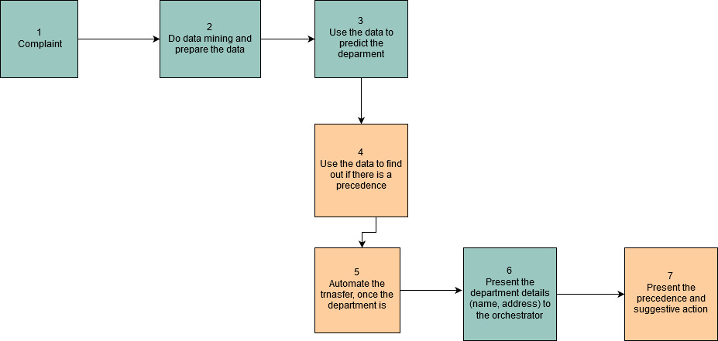
The workflow

Slide 6
The Demo

Slide 7
What to expect next
Automate the transfer of request to concerned department
Predict and suggest corrective actions
Better modeling techniques – Ensembling , Neural Networks, Word Embeddings
Challenges Faced
Subject_content is in many languages
The data is heavily imbalanced
Too Many departments. Need information on hierarchy of departments for accurate predictions.
Text contains spelling mistakes and abbreviations are used.
Feature matrix is too big and sparse.

Slide 8
Data Analysis
Total number of requests available in the dataset: from the Public Grievance details in CPGRAMS along with feedback details, we queried 2,60,000 records. From Public Grievance movement details across the organization in CPGRAMS we have queried 3,10,000 records.
We assume that the right department is the department where the action_name is equal to: 'INTERIM REPLY TO COMPLAINANT','CASE DISPOSED OF','EXAMINED AT OUR LEVEL’,
Class distribution and final number of classes

Slide 9
Details of final training data set
Data Set | No. of Records
Unique registration IDs in original data | 222129
Registration IDs available in movement file | 32890
Unique registration IDs where selected action_name available | 29365
data size after removing 7500 rows from dominant class | 21865
Final training set after removing 3000 (random) rows for blind test | 18865

Slide 10
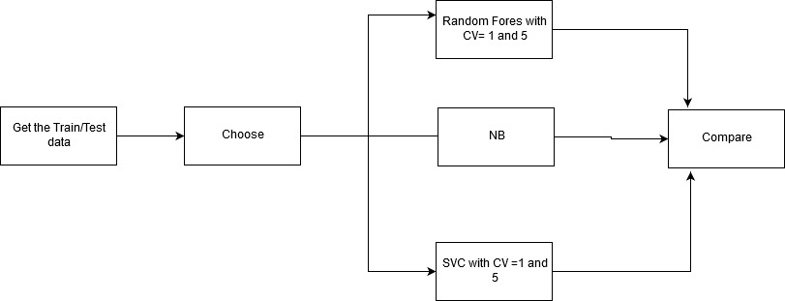
Model building

Slide 11
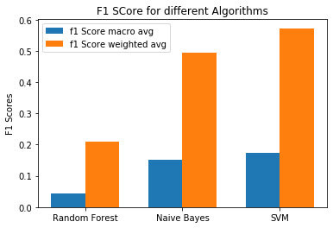
Metrics - 1

Slide 12
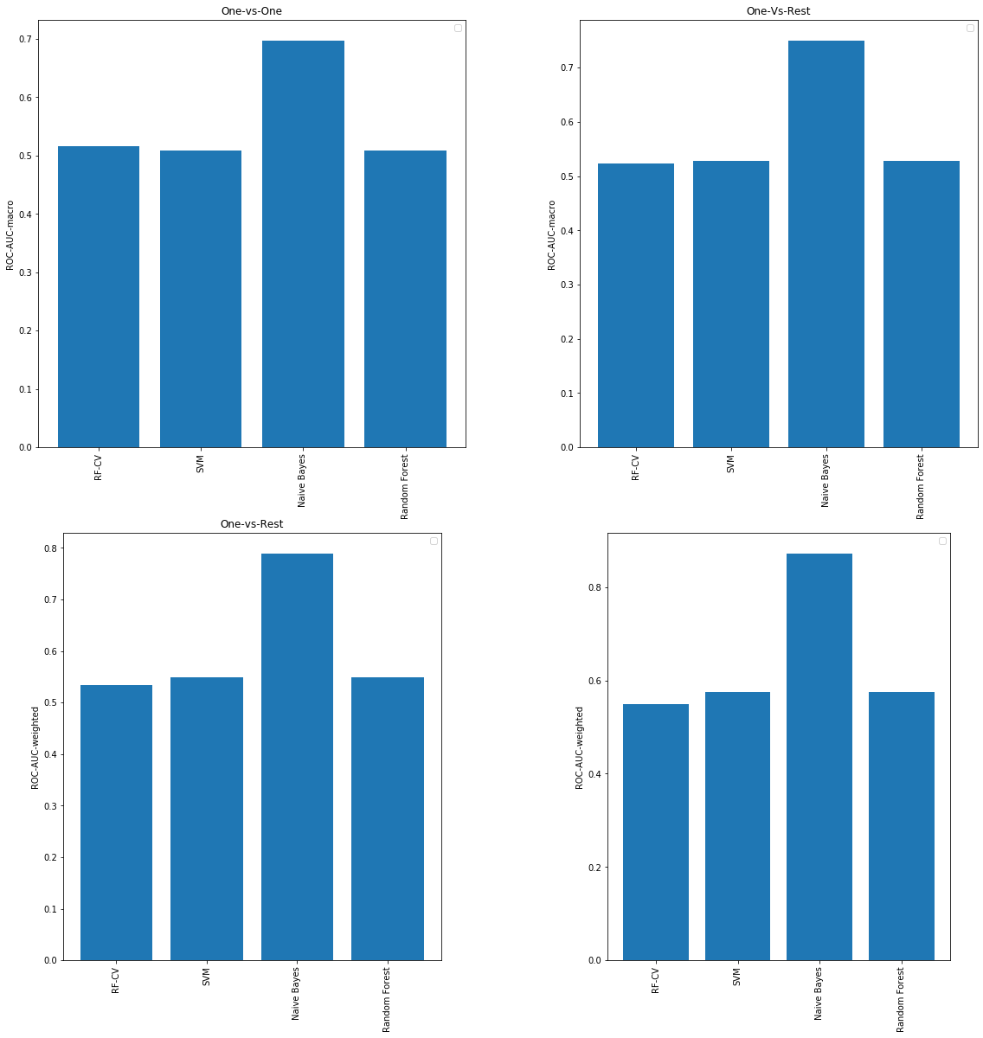
Metrics - 2

