Slide 1
MN906
MM Security
TP1 – Illustrations on image encryption aNd Steganography
Mihai MITREA, Carl DE SOUSA TRIAS - Département ARTEMIS
{mihai.mitrea; carl.de-sousa-trias}@telecom-sudparis.eu

Slide 2
TP1 - Illustrations on image encryption aNd Steganography
TP outline
CAESAR cypher applied to images
Simple substitution cypher applied to images
LSB technique
Conclusion

Slide 3
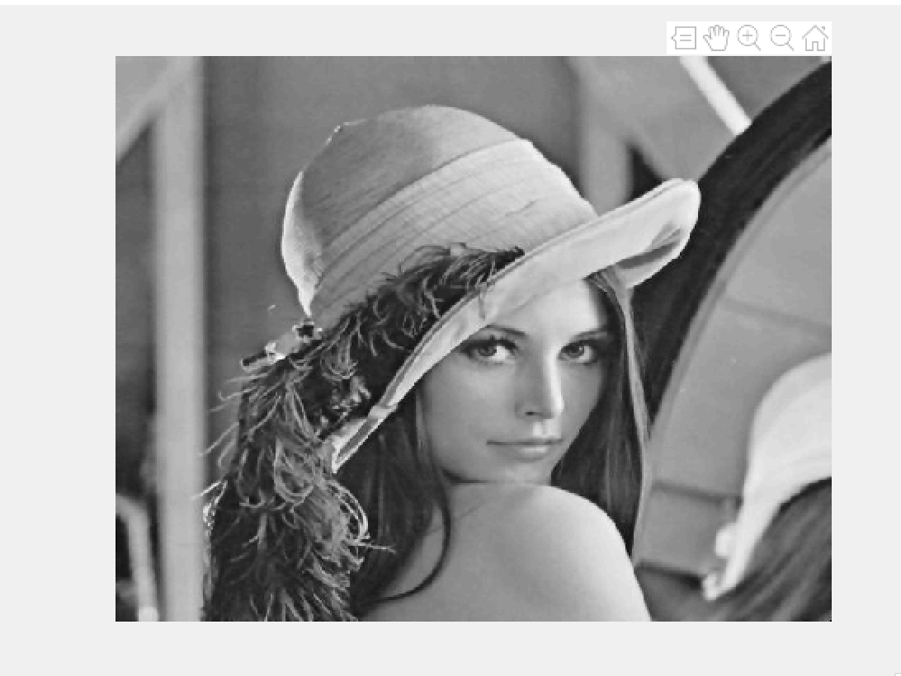
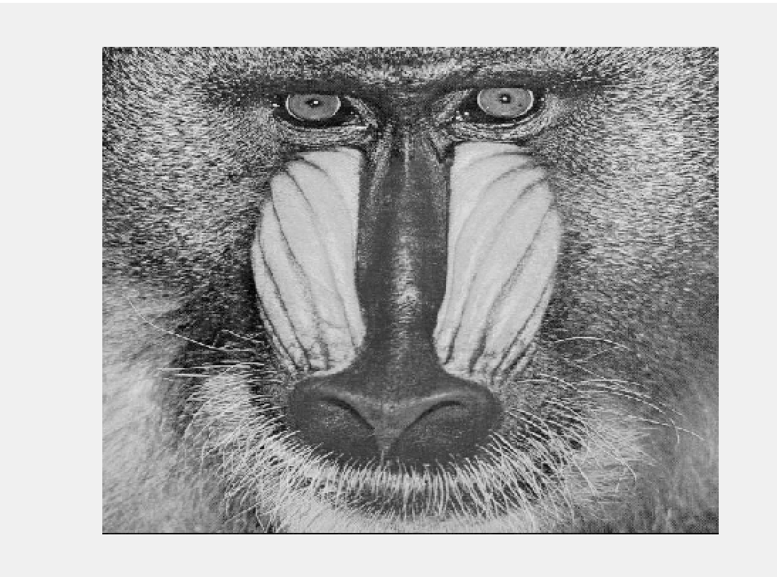
TP1 - Illustrations on image encryption aNd Steganography
Prerequisites
Lena and Babbon images (to be downloaded in your working environment)
512x512
Gray levels
Jpg format
Matlab (or Python) working environments

Slide 4
TP1 - Illustrations on image encryption aNd Steganography
TP outline
CAESAR cypher applied to images
Simple substitution cypher applied to images
LSB technique
Conclusion

Slide 5
TP1 - Illustrations on image encryption aNd Steganography
Example 1: CAESAR cipher applied to images – Lena test image
Read the Lena image and represent it as a matrix named lena
Make the required format conversion (if required)
Write the encryption and decryption equations for the CAESAR cypher and and alphabet of 256 symbols (pixels)
Compute the matrix lena_caesar as the CAESAR encrypted version of lena (consider at least 5 keys randomly generated)
Compute the matrix lena_recoverd as the CAESAR decrypted version of lena_caesar
Display the results and discuss the result
What do you notice?
Which is the difference between the CAESAR method applied to text and to images? Why?

Slide 6
TP1 - Illustrations on image encryption aNd Steganography
Example 2: CAESAR cipher applied to images – Baboon test image
Read the Example 1 for the Baboon image
Display the results and discuss the result
What do you notice?
Which is the difference between the CAESAR method applied to Lena and to the Baboon images? How do you explain it?
When can be the CAESAR method used?

Slide 7
TP1 - Illustrations on image encryption aNd Steganography
TP outline
CAESAR cypher applied to images
Simple substitution cypher applied to images
LSB technique
Conclusion

Slide 8
TP1 - Illustrations on image encryption aNd Steganography
Example 3: Simple substitution cipher applied to images – Lena test image
Read the Lena image and represent it as a matrix named lena
Make the required format conversion (if required)
Write the encryption and decryption equations for the simple substitution cypher and and alphabet of 256 symbols (pixels)
Compute the matrix lena_simple_subst as the encrypted version of lena (consider at least 5 keys randomly generated)
Compute the matrix lena_recoverd as the decrypted version of lena_simple_subst
Display the results and discuss the result
What do you notice?
Which is the difference between the simple substitution method applied to text and to images? Why?

Slide 9
TP1 - Illustrations on image encryption aNd Steganography
Example 4: Simple substitution cipher applied to images – Baboon test image
Read the Example 3 for the Baboon image
Display the results and discuss the result
What do you notice?
Which is the difference between the simple substitution method applied to Lena and to the Baboon images? How do you explain it?
When can be the simple substitution method used?

Slide 10
TP1 - Illustrations on image encryption aNd Steganography
TP outline
CAESAR cypher applied to images
Simple substitution cypher applied to images
LSB technique
Conclusion

Slide 11
TP1 - Illustrations on image encryption aNd Steganography
TP outline
CAESAR cypher applied to images
Simple substitution cypher applied to images
LSB technique
Conclusion

Slide 12
TP1 - Illustrations on image encryption aNd Steganography
result= PIL.Image.fromarray(im_a) result.save(“nom_lsb_"+’png',format=“PNG“,compress_level=param) or
cv.imwrite(path, img, [cv.IMWRITE_PNG_COMPRESSION, param])
Example 7: LSB (lowest significant bit) steganography – visual impact on Lena test image
Read the Lena image and represent it as a matrix named lena
Make the required format conversion (if required)
Compute the lena_lsb image by modifying the LSB of each pixel according to the following rule: LSB = 0 if the pixel belongs to the upper-left or bottom-right quarters and LSB=1 is the pixel belongs to the upper-right or bottom-left quarters
Display the decoded message, what did you insert?
Display the corresponding image and save the lena_lsb in three jpg files (lena_lsb_100.jpg, lena_lsb_99.jpg, lena_lsb_75.jpg) by using jpg compression with the quality factors of Q=100, Q=99 and Q=75, respectively
Discuss the result
What do you notice?
Who can you be sure you work correctly ?

Slide 13
TP1 - Illustrations on image encryption aNd Steganography
Example 8: LSB (lowest significant bit) steganography – resilience against jpg compression for the Lena test image
Read the the three files lena_lsb_100.jpg, lena_lsb_99.jpg, lena_lsb_75.jpg and represent them as three matrixes named lena_lsb_100, lena_lsb_99, lena_lsb_75
Make the required format conversion (if required)
Display the corresponding images
Detect the inserted information from these three images and display them as three images
Discuss the result
What do you notice?
Who can you be sure you work correctly ?

Slide 14
TP1 - Illustrations on image encryption aNd Steganography
Example 9: LSB (lowest significant bit) steganography – visual impact and resilience against jpg compression for the Baboon test image
Repeat the the Examples 4 and 5 for the Baboon test image

Slide 15
TP1 - Illustrations on image encryption aNd Steganography
Example 10: 2bit - LSB (lowest significant bit) steganography – visual impact and resilience against jpg compression
Read the Lena image and represent it as a matrix named lena
Make the required format conversion (if required)
Compute the lena_lsb2 image by modifying the 2bit-LSB of each pixel according to the following rule: LSB = 0 if the pixel belongs to the upper-left quarter, LSB=1 if the pixel belongs to the upper-right quarter, LSB=2 if the pixel belongs to the bottom-left quarter and LSB=3 if the pixel belongs to the bottom-right quarter
Repeat the Examples 5, 6 and 7 for this case

Slide 16
TP1 - Illustrations on image encryption aNd Steganography
TP outline
CAESAR cypher applied to images
Simple substitution cypher applied to images
LSB technique
Conclusion

Slide 17
TP1 - Illustrations on image encryption aNd Steganography
Conclusion
Can the CAESAR cipher provide privacy of the image content? If so, under which circumstances?
Can the simple substitution ensure privacy for the image content? If so, under which circumstances?
What happens if you iterate the simple substitution method for images?
How would you describe the differences between the two examples of text (cf. lecture slides) and image steganography?
Can LSB steganography ensure hidden message resilience against image modifications?

Slide 18



Matlab tutorial
Install :
Putty (remote connecter)
Xming X server –sourceforge.net (ssh client)
WinSCP (ssh file exchanger)
How to Start Matlab:
Launch X11 server
Configure putty (next slide)
Launch Putty

Slide 19
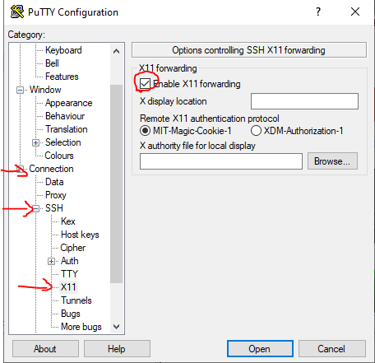
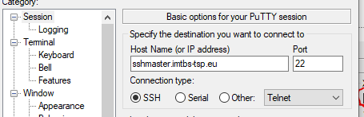
Matlab tutorial – putty
Putty configuration :
Enable X11 forwarding
ssh address for TSP server:
sshmaster.imtbs-tsp.eu
(optional) save configuration with a name
Type:
/opt/matlab-disi-R2023a
/bin/matlab

Slide 20
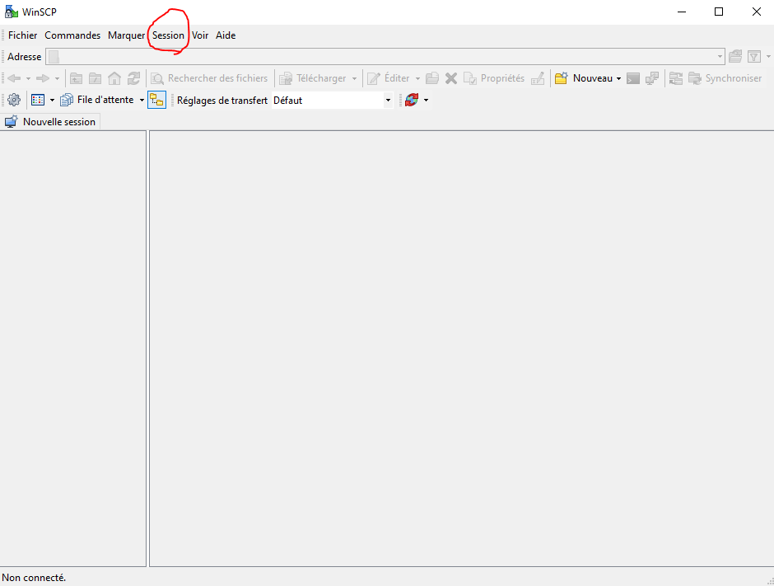
Matlab tutorial – share files
Session > Nouvelle session [EN] Tabs>new tabs
Host name :
sshmaster.imtbs-tsp.eu
Type your credentials

