Slide 1
Progress Report
2021/02/02
Student: Ho Chi En

Slide 2
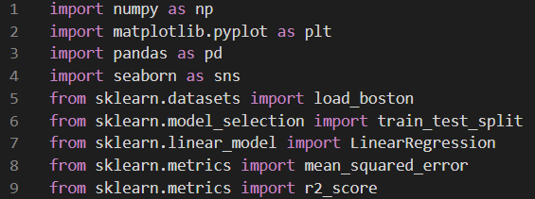
Assign the whole data package to the boston_dataset
Data type: Dictionary
Keys: ['data', 'target', 'feature_names', 'DESCR', 'filename']

Slide 3
What is inside the boston_dataset?
boston_dataset.feature_names:
['CRIM' 'ZN' 'INDUS' 'CHAS' 'NOX' 'RM' 'AGE' 'DIS' 'RAD' 'TAX' 'PTRATIO’ 'B' 'LSTAT']
The description of these feature_names is in the boston_dataset.DESCR:
- CRIM per capita crime rate by town
- ZN proportion of residential land zoned for lots over 25,000 sq.ft.
- INDUS proportion of non-retail business acres per town
- CHAS Charles River dummy variable (= 1 if tract bounds river; 0 otherwise)
- NOX nitric oxides concentration (parts per 10 million)
- RM average number of rooms per dwelling
- AGE proportion of owner-occupied units built prior to 1940
- DIS weighted distances to five Boston employment centres
- RAD index of accessibility to radial highways
- TAX full-value property-tax rate per $10,000
- PTRATIO pupil-teacher ratio by town
- B 1000(Bk - 0.63)^2 where Bk is the proportion of blacks by town
- LSTAT % lower status of the population
- MEDV Median value of owner-occupied homes in $1000's

Slide 4
What is inside the boston_dataset?
The data of these different objects is in
boston_dataset.data ---['CRIM' 'ZN' 'INDUS' 'CHAS' 'NOX' 'RM' 'AGE' 'DIS' 'RAD' 'TAX' 'PTRATIO’ 'B' 'LSTAT']
boston_dataset.target ---[‘MEDV’]
Using pandas to convert the datatype from dictionary to the dataframe
CRIM ZN INDUS CHAS NOX RM AGE DIS RAD TAX PTRATIO B LSTAT MEDV
0 0.00632 18.0 2.31 0.0 0.538 6.575 65.2 4.0900 1.0 296.0 15.3 396.90 4.98 24.0
1 0.02731 0.0 7.07 0.0 0.469 6.421 78.9 4.9671 2.0 242.0 17.8 396.90 9.14 21.6
2 0.02729 0.0 7.07 0.0 0.469 7.185 61.1 4.9671 2.0 242.0 17.8 392.83 4.03 34.7
3 0.03237 0.0 2.18 0.0 0.458 6.998 45.8 6.0622 3.0 222.0 18.7 394.63 2.94 33.4
4 0.06905 0.0 2.18 0.0 0.458 7.147 54.2 6.0622 3.0 222.0 18.7 396.90 5.33 36.2
.. ... ... ... ... ... ... ... ... ... ... ... ... ... ...
501 0.06263 0.0 11.93 0.0 0.573 6.593 69.1 2.4786 1.0 273.0 21.0 391.99 9.67 22.4
502 0.04527 0.0 11.93 0.0 0.573 6.120 76.7 2.2875 1.0 273.0 21.0 396.90 9.08 20.6
503 0.06076 0.0 11.93 0.0 0.573 6.976 91.0 2.1675 1.0 273.0 21.0 396.90 5.64 23.9
504 0.10959 0.0 11.93 0.0 0.573 6.794 89.3 2.3889 1.0 273.0 21.0 393.45 6.48 22.0
505 0.04741 0.0 11.93 0.0 0.573 6.030 80.8 2.5050 1.0 273.0 21.0 396.90 7.88 11.9

Slide 5
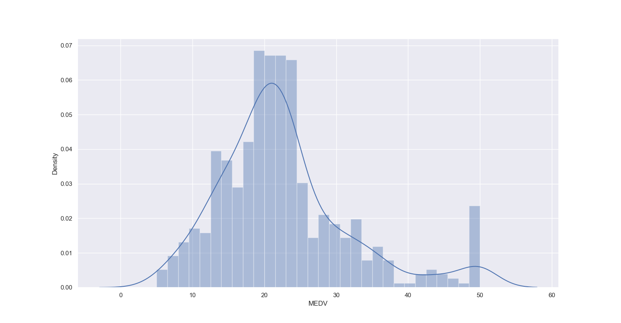
Target: MEDV (data visualization)
Almost distributed normally

Slide 6
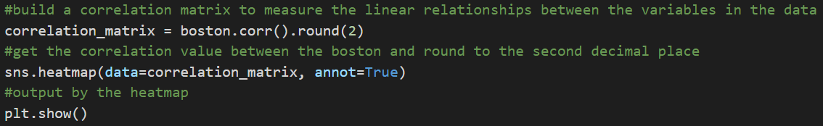
Want to know the correlation between each features
Build the correlation matrix and it is easier to compare

Slide 7
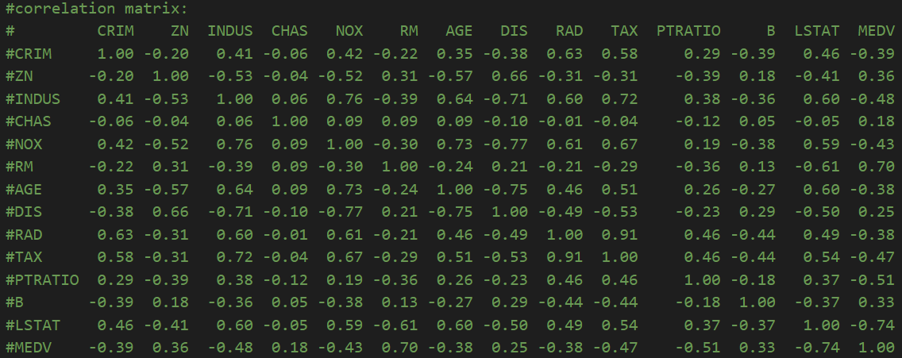
Data visualization
(correlation matrix to the heatmap)

Slide 8
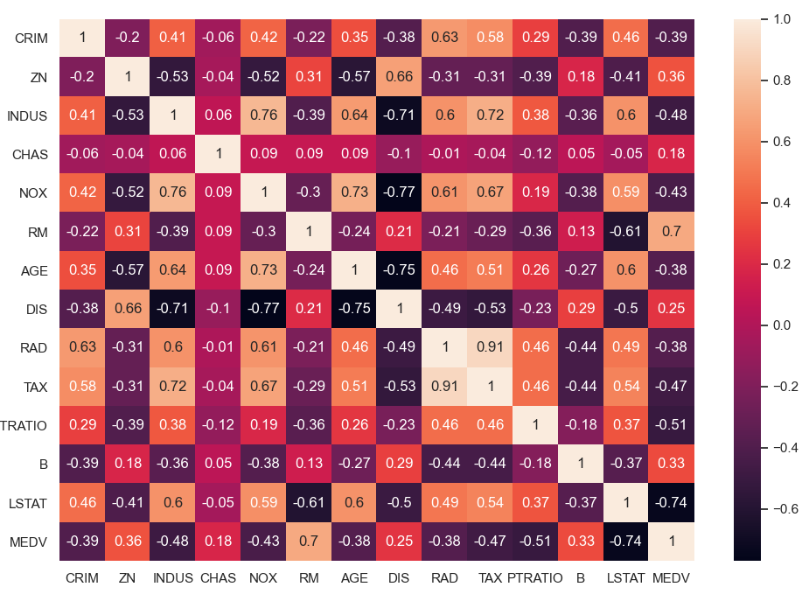
Data visualization
(correlation matrix to the heatmap)

Slide 9
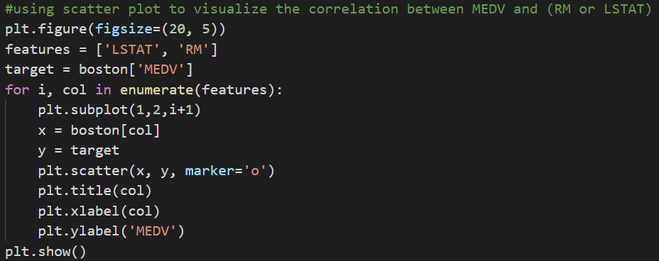
Scatter plot (RM & LSTAT V.S. MEDV)
Amazing coding process!!!!!

Slide 10
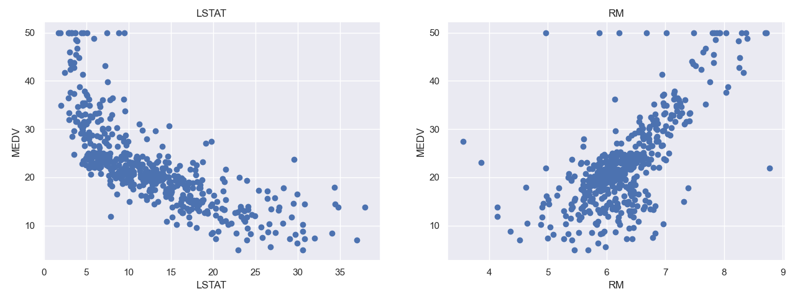
Corr:-0.74
Corr:0.7

Slide 11
Building the model (pseudocode)
Prepare the dataset
input X (LSTAT,RM)
output Y (MEDV)
Split
80%: training set
20%: testing set
Train the model
Using testing set to test the model
model
RMSE & R2 score
Analyze the model and the error

Slide 12
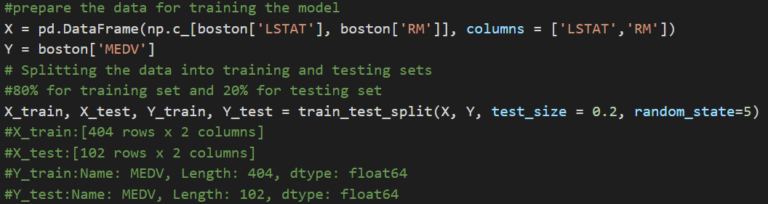
Prepare the data and split the data into training set and testing set

Slide 13
