Slide 1
Processes in Linux
instigate-training-center.am

Slide 2
Agenda
Process types
Permissions
Monitoring processes
Links
Creation/Ending
State
Times and timers
Scheduling
Process intercommunication

Slide 3
Process types
Multi-user and multi-tasking
Process types
  init – parent of all processes
  Interactive processes - initialized and controlled through a terminal session
  Automatic processes - queued into a spooler area, where they wait to be executed on a FIFO basis
  Daemons – server processes that run continuously

Slide 4
Permissions
Unique identifier (pid)
user (uid) identifier (chown)
group (gid) identifiers (chgrp)
Effective UID – SUID (chmod u+s)
  The SUID permission makes a script to run as the user who is the owner of the script
Effective GID – GUID (chmod g+s)
  If a file is SGID, it will run with the privileges of the files group owner
TTY – the terminal to which the process is connected
Nice number – the friendliness of the process towards other processes
(the priority of the process is calculated from nice numbers and recent CPU usage)

Slide 5
Monitoring processes
ps - report a snapshot of the current processes
  ps -ef - show every process on the system using standard syntax
top - display Linux tasks
pgrep - look up processes based on name and other attributes
  pgrep -u student named - find the process ID of the named daemon run by student
free - display amount of free and used memory in the system
uptime - tell how long the system has been running

Slide 6
Links
Every process in the system, except the initial process has a parent process (ppid)
Every process keeps info about parent, child and sibling (processes with the same parent) processes
We can see the family relationship between running processes using pstree command
init(1)-+-crond(98)
|-gpm(146)
|-inetd(110)
|-kerneld(18)
|-kflushd(2)
|-login(160)---bash(192)---emacs(225)
|-lpd(121)

Slide 7
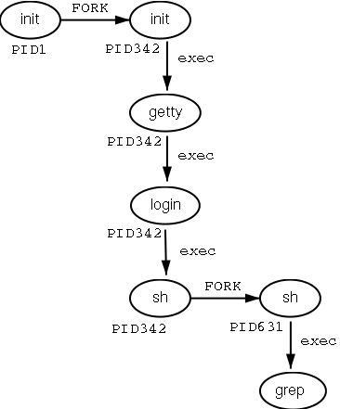
Process Creation/Ending
New process creation by forking
The address space of the child
process is overwritten with the new
data (exec)
To send a signal to the process
kill command can be used
SIGTERM 15 Terminate the
process in an orderly way.
SIGINT 2 Interrupt the process.
A process can ignore this
signal.
SIGKILL 9 Interrupt the process.
A process can not ignore this
signal.
SIGHUP 1 For daemons: reread the
configuration file.

Slide 8
Process state
Running - the process is either running (it is the current process in the system) or it is ready to run (it is waiting to be assigned to one of the system's CPUs).
Waiting - the process is waiting for an event or for a resource.
  Interruptible - can be interrupted by signals
  Uninterruptible - are waiting directly on hardware conditions and cannot be interrupted
Stopped - the process has been stopped, usually by receiving a signal. A process that is being debugged can be in a stopped state.
Zombie - this is a halted process, though its process data structure is not destroyed

Slide 9
Controlling processes
(part of) command | Meaning
regular_command | Runs this command in the foreground
command & | Run this command in the background (release the terminal)
jobs | Show commands running in the background
Ctrl+Z | Suspend (stop, but not quit) a process running in the foreground
Ctrl+C | Interrupt (terminate and quit) a process running in the foreground
bg | Reactivate a suspended program in the background
fg | Puts the job back in the foreground (e.g. fg %2)
kill, killall, pkill | End a process

Slide 10
Times and Timers
The Kernel keeps track of a
  processes creation time
  CPU time that it consumes during its lifetime
Processes can open/close files and in the internal process structure kernel stores
  Descriptors for each open file
  Pointers to 2 VFS inodes – process home directory and pwd (current directory)
Processes have virtual memory and Kernel maps that virtual memory to physical memory
When process is suspended registers, stacks, etc which are used during running are stored in the process data structure

Slide 11
Scheduling
Processes have 2 types of policy
  Round Robin (RR) – is preemptive – releases the CPU from long running jobs periodically based on timer interrupts
  First In First Out (FIFO) – is nonpreemptive – process keeps running on a CPU until it is blocked/terminated
The command chrt can be used for manipulating process policy
User can alter the priority of the process using system calls and the renice command

Slide 12
Process intercommunication
Inter-process communication
  Signals
  Pipes
  Semaphores
  Shared memory
  Message queues
Unnamed pipes
  e.g. ls -l | less
  e.g. ps -ef | grep bash
Named pipes - can be created with mkfifo command
  e.g. mkfifo named_pipe
  e.g. cat film.mp4 > named_pipe&; mplayer named_pipe;

