Slide 1
Disk partitioning, File system type, Dual booting
instigate-training-center.am

Slide 2
Agenda
Disc partitioning
  Hard Disc Drive
  PC partition types
    Primary partition
    Extended partition
File system type
Dual booting

Slide 3
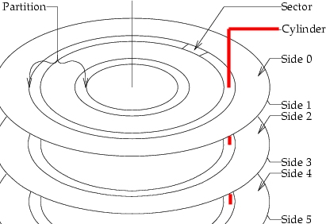
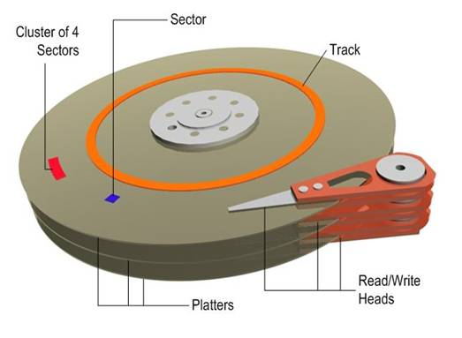
Disk partitioning: Hard Disk Drive
A hard disk drive is a non-volatile storage device for digital data. It features one or more rotating rigid platters on a motor-driven spindle within a protective enclosure. Data is encoded magnetically by read/write heads that float on a cushion of air above the platters.
The first HDD was invented by IBM in 1956.

Slide 4
Disk partitioning
Creating more than one partition has the following advantages:
  Separation of the operating system (OS) and program files from user files
  Having an area for operating system virtual memory swapping/paging
  Keeping frequently used programs and data near each other
A partition editor software program can be used to create, resize, delete, and manipulate these partitions on the hard disk.

Slide 5
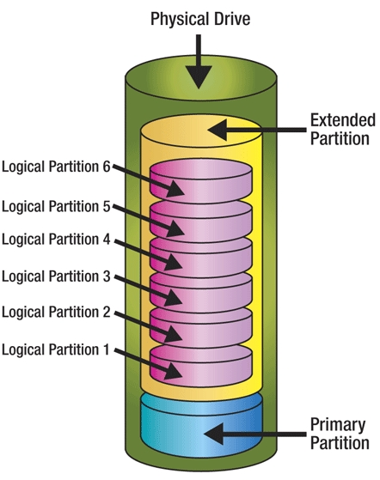
Disk partitioning
Hard drive of the computer can be divided into several logical drives (partitions), each of which is treated as an separate hard drive by the operating system.
Primary partitions are used for storing operating system files, and boot loader.
Extended partitions can be repartitioned into several partitions, so theses are kind of containers for logical drives.

Slide 6
Disk partitioning: PC partition types
Master boot record (MBR) partitioning scheme is used in DOS, Microsoft Windows and Linux on PC compatible computer systems.
The total data storage space of a PC hard disk can be divided into at most 4 primary partitions, or alternatively 3 primary partitions and an "extended partition". These partitions are described by 16-byte entries that constitute the Partition Table, located in the master boot record.
The partition type is identified by a 1-byte code found in its partition table entry. Some of these codes (such as 0x05 and 0x0F) may be used to indicate the presence of an extended partition.

Slide 7
Disk partitioning: Primary partition
A primary partition contains one file system. In Windows OS the system partition was required to be the first partition. Other operating systems do not have this peculiar requirement.
A hard disk may contain only one extended partition; the extended partition can be subdivided into multiple logical partitions.

Slide 8
Disk partitioning: Extended partition
In DOS/Windows systems, each logical partition may then be assigned an additional drive letter. Linux operating systems can be installed into (and run from) logical partitions, whereas Windows operating systems are restricted to primary partitions.
At lease two partitions should exists for Linux OS:
  root partition, on which system files are stored
  swap partition, which is used for virtual memory.

Slide 9
File system type
A file system is a method of storing and organizing computer files and their data.
File systems are used on data storage devices such as hard disks or CD-ROMs to maintain the physical location of the files. They might provide access to data on a file server by acting as clients for a network protocol (e.g., NFS, SMB, or 9P clients), or they may be virtual and exist only as an access method for virtual data (e.g., procfs).
Most file systems make use of an underlying data storage device that offers access to an array of fixed-size physical sectors. The file system is responsible for organizing these sectors into files and directories.

Slide 10
File system type
There are the following types of file systems:
  Disk file systems
  Network file systems
  Special purpose file systems

Slide 11
File system type
A disk file system is a file system designed for the storage of files on a data storage device, most commonly a disk drive, which might be directly or indirectly connected to the computer.
  FAT, NTFS
  HFS, HFS+, HPFS
  Ext2, Ext3, Ext4
  ReiserFS, Linux Swap
  ISO 9660, UDF (CD and DVD format)

Slide 12
File system type
A network file system (NFS) is a file system that acts as a client for a remote file access protocol, providing access to files on a server. Examples of network file systems include clients for the NFS, AFS, SMB protocols, and file-system-like clients for FTP and WebDAV.
A special purpose file system is basically any file system that is not a DFS or NFS. This includes systems where the files are arranged dynamically by software, intended for such purposes as communication between computer processes or temporary file space. Example the procfs (/proc) file system used by some Unix variants, which grants access to information about processes and other operating system features.

Slide 13
Dual booting (Multi booting)
Multi-boot or Multi-booting is the act of installing multiple operating systems on a computer, and being able to choose which one to boot when starting the computer. The term dual-booting refers to the common configuration of exactly two operating systems. Multi-booting requires a program called a boot loader (NTLDR, LILO, or GRUB).

Slide 14
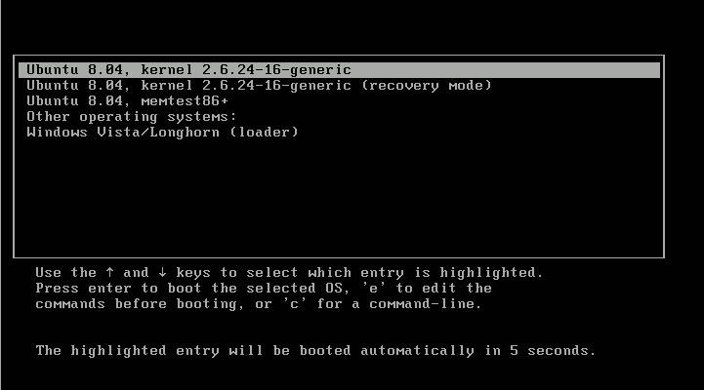
Dual booting (Multi booting)
One popular multi-boot configuration is to dual-boot Linux and Windows operating systems, each contained within its own partition. Windows does not facilitate or support multi-boot systems, other than allowing for partition-specific installations, and no choice of boot loader is offered.
However, most current Linux installers accommodate dual-booting (although some knowledge of partitions is desirable).

