Slide 1
Desktop Environment
instigate-training-center.am

Slide 2
Agenda
Introduction
X Window System
Window managers
Desktop Environments
Default programs packaged
Window management shortcuts

Slide 3
Introduction
A desktop environment is a collection of software designed to give functionality and a certain look and feel to an operating system
A fundamental part of a DE is the window manager or WM
Another important element of a DE is the file manager
A desktop environment typically consists of icons, windows, toolbars, folders, wallpapers, shortcuts, desktop widgets and panels
A window manager is system software that controls the placement and appearance of windows within a windowing system in a graphical user interface

Slide 4
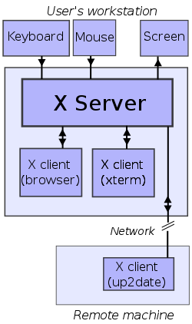
X Window System
X Window System is a computer software system and network protocol that provides a graphical user interface (GUI) for networked computer
X provides the basic framework, or primitives, for building such GUI environments: drawing and movings windows on the screen and interacting with a mouse and/or keyboard

Slide 5
Window Managers

Slide 6
Desktop Environments

Slide 7
Default programs packaged

Slide 8
Window management shortcuts
Alt+F1 – Open the Applications Menu
Alt+F2 – Display the Run Application Dialog
Ctrl+Alt+Arrow – Switch the workspace to the specified direction of the current workspace
Shift+Ctrl+Alt+Arrow – Move the window to another workspace in the specified direction
Ctrl+Alt+D – Minimize all windows
Alt+Tab – Switch between windows
Alt+Spacebar – Open the window menu
Alt+F7 – Move the currently focused window
Alt+F4 – Close the currently focused window

