Slide 1
Linux Installation
instigate-training-center.am

Slide 2
Agenda
Installation of Linux OS
  Boot process
  Device detection
  Partitioning
  Configuration
Summary

Slide 3
Installation
Installation consists of the following steps
  Boot from installation media
  Launching installation program
  Device detection
  Partitioning
  Package selection
  Package installation
  Boot loader installation
  Configuration
  Reboot

Slide 4
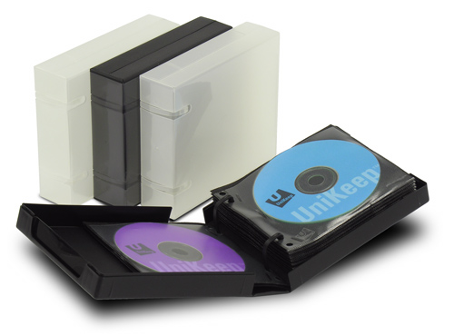
Boot from installation media
After initialization BIOS loads special program called “Boot loader” (GRUB, Lilo), which is stored in the first sectors of media storage. The Boot loader is responsible for further actions. It calls the installation program or loads the operating system.
GRUB is the reference implementation of the Multiboot Specification, which provides a user the choice to boot one of multiple operating systems installed on a computer or select a specific kernel configuration available on a particular operating system's partitions.

Slide 5
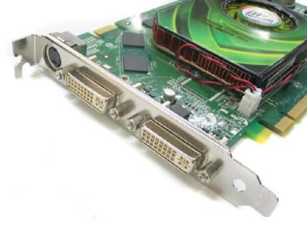
Device Detection
Device detection is a special operation performed by installation program in order to find out and configure various hardware components in the system. Without detection procedure the hardware components will not be configured properly and can not be used.

Slide 6
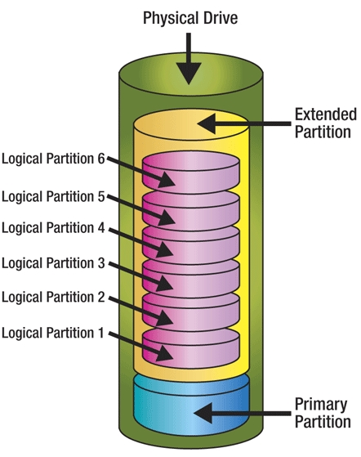
Partitioning
Hard drive of the computer can be divided into several logical drives (partitions), each of which is treated as an separate hard drive by the operating system. Primary partitions are used for storing operating system files, and boot loader. Extended partitions can be repartitioned into several partitions, so theses are kind of containers for logical drives.

Slide 7
Partitioning (continuation)
At lease two partitions should exists for Linux OS:
  root partition, on which system files are stored.
  swap partition, which is used for virtual memory.

Slide 8
Installation and Configuration
Installation program allows user to select system configuration (packages to install, graphical environment, etc.).
After installing selected components, installation program writes the boot loader and configures hardware components. For some components user can select configuration options.
Booting is also possible from LiveCD without installation an Operating System

Slide 9
Boot from LiveCD
A live CD, live DVD, or live disc is a CD or DVD containing a bootable computer operating system. Live CDs are unique in that they have the ability to run a complete, modern operating system on a computer lacking mutable secondary storage, such as a hard disk drive. Live USB flash drives are similar to live CDs, but often have the added functionality of automatically and transparently writing changes back to their bootable medium.
It allows the user to return the computer to its previous state when the live CD is ejected and the computer is rebooted. It is able to run without permanent installation by placing the files that typically would be stored on a hard drive into RAM, typically in a RAM disk, though this does cut down on the RAM available to applications.

Slide 10
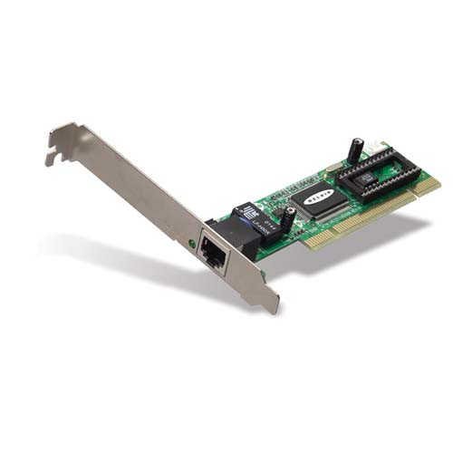
Network Configuration
Network configuration consists of following steps:
  IP address configuration (static or via DHCP server)
  DNS server(s) configuration
  Routing configuration (gateway selection)

Slide 11
Summary
BIOS loads Boot loader from installation media.
Boot loader allow to invoke installation program.
Installation program allows to:
  partition hard drive
  select desired system configuration
  configure hardware components
  install boot loader

