Slide 1
GIT Repository
www.instigatedesign.com

Slide 2
Agenda
Introduction to Git
Git preparation
Basic Git commands
Common aliases
.git directory structure
Git branches
Multiple repositories
Bare repositories
Useful links

Slide 3
Introduction to Git
Git - is a powerful, sophisticated system for distributed version control. Gaining an understanding of its features opens to developers a new and liberating approach to source code management.
Designed and developed by Linus Torvalds for Linux kernel development.
Every Git working directory is a full-fledged repository with complete history and full revision tracking capabilities, not dependent on network access or a central server.
Git doesn’t need to go out to the server to get the history and display it for you — it simply reads it directly from your local database.
Git is free software distributed under the terms of the GNU General Public License version 2.

Slide 4

Introduction to Git(cont.)
The Git directory is where Git stores the metadata
object database for your project.It is what is copied
when you clone a repository from another computer.
The working directory is a single checkout of one
version of the project. These files are pulled out of the
compressed database in the Git directory.
The staging area is a simple file, generally contained
in your Git directory, which stores information about
what will go into your next commit.

Slide 5
Git preparation
// For installing git package in your ubuntu or other Debian based system, type the following command:
$ sudo apt-get install git-core
// Set our username and email id.
$ git config --global user.name "User Name"
$ git config --global user.email username@example.com
// Creates a git repository in the current directory.
$ git init

Slide 6
Basic Git commands
$ git add “filename”
$ git add .
$ git commit -m 'first commit'
// The commit command allows interactively editing comments for the commit:
$ export GIT_EDITOR=vim
$ git commit
$ git status
$ git diff
$ git log
$ git clone url

Slide 7
Basic Git commands(cont.)
git reset HEAD “filename” // Cancel Staged changes (before committing)
git checkout “filename” // checkout the repository’s version of the file
git checkout “hash_code”
git checkout “branch name”
// Change the previous commit
git add “filename”
git commit --amend -m "Add commit command"
git mv source_file dest_dir

Slide 8
Common aliases
Git status, git add, git commit, and git checkout are common commands so it is a good idea to have abbreviations for them.
Add the following to the .gitconfig file in your $HOME directory.
[alias]
co = checkout
ci = commit
st = status
br = branch
hist = log --pretty=format:\"%h %ad | %s%d [%an]\" --graph --date=short
type = cat-file -t
dump = cat-file -p
Usage: git hist

Slide 9
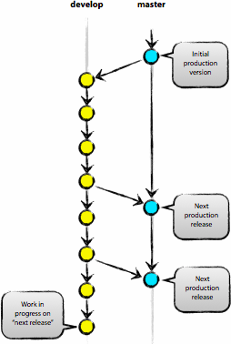
Git branches
The central repo holds two main branches with an infinite lifetime:
master
develop

Slide 10
Git branches(cont.)
git checkout -b “branch name” // Creates a branch and switches to it.
git checkout “branch name” // Switches to specified branch
Merging to a single branch:
  git checkout newBranch
  git merge master // Merging master into newBranch

Slide 11
.git directory structure
Object Database
Config File. // This configuration file is created for each individual project. At least in this project, entries in this file will overwrite the entries in the .gitconfig file of your main directory.
Branches and Tags.
HEAD File. // Keeps a reference to the current branch in the HEAD file. At the moment it must be the master branch.

Slide 12
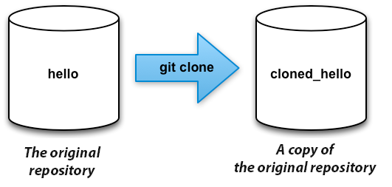
Multiple repositories
Git is great for working with several repositories. These additional repositories can be stored locally, or accessed via network connection.
git clone hello cloned_hello
git remote // default name of the remote repository, by default origin;
git branch -a // gets list of the remote branches

Slide 13
Bare repositories
Bare repos (without working directories) are typically needed for sharing.
Typically repositories ending in ‘.git’ are bare. As you can see there is no working directory in the hello.git repository.
git clone --bare hello hello.git // creates bare repo
git clone ssh://user@server/project.git //creates a new git repository by copying an existing one located at the URI you specify
git remote add origin ssh://user@server/project.git // add the project.git repository to our original repository
git push origin master // Send changes to the origin repository

Slide 14
Useful links
http://githowto.com/
http://git-scm.com/book/
http://nvie.com/posts/a-successful-git-branching-model/
http://en.wikipedia.org/wiki/Git_%28software%29

