Slide 1

Carbon Monoxide Sensor – IoT Project 2020
Giuseppe Pappadia
Simone Vitiello

Slide 2
Summary
Problem
Motivations
Solution
State of The Art
Implementation

Slide 3
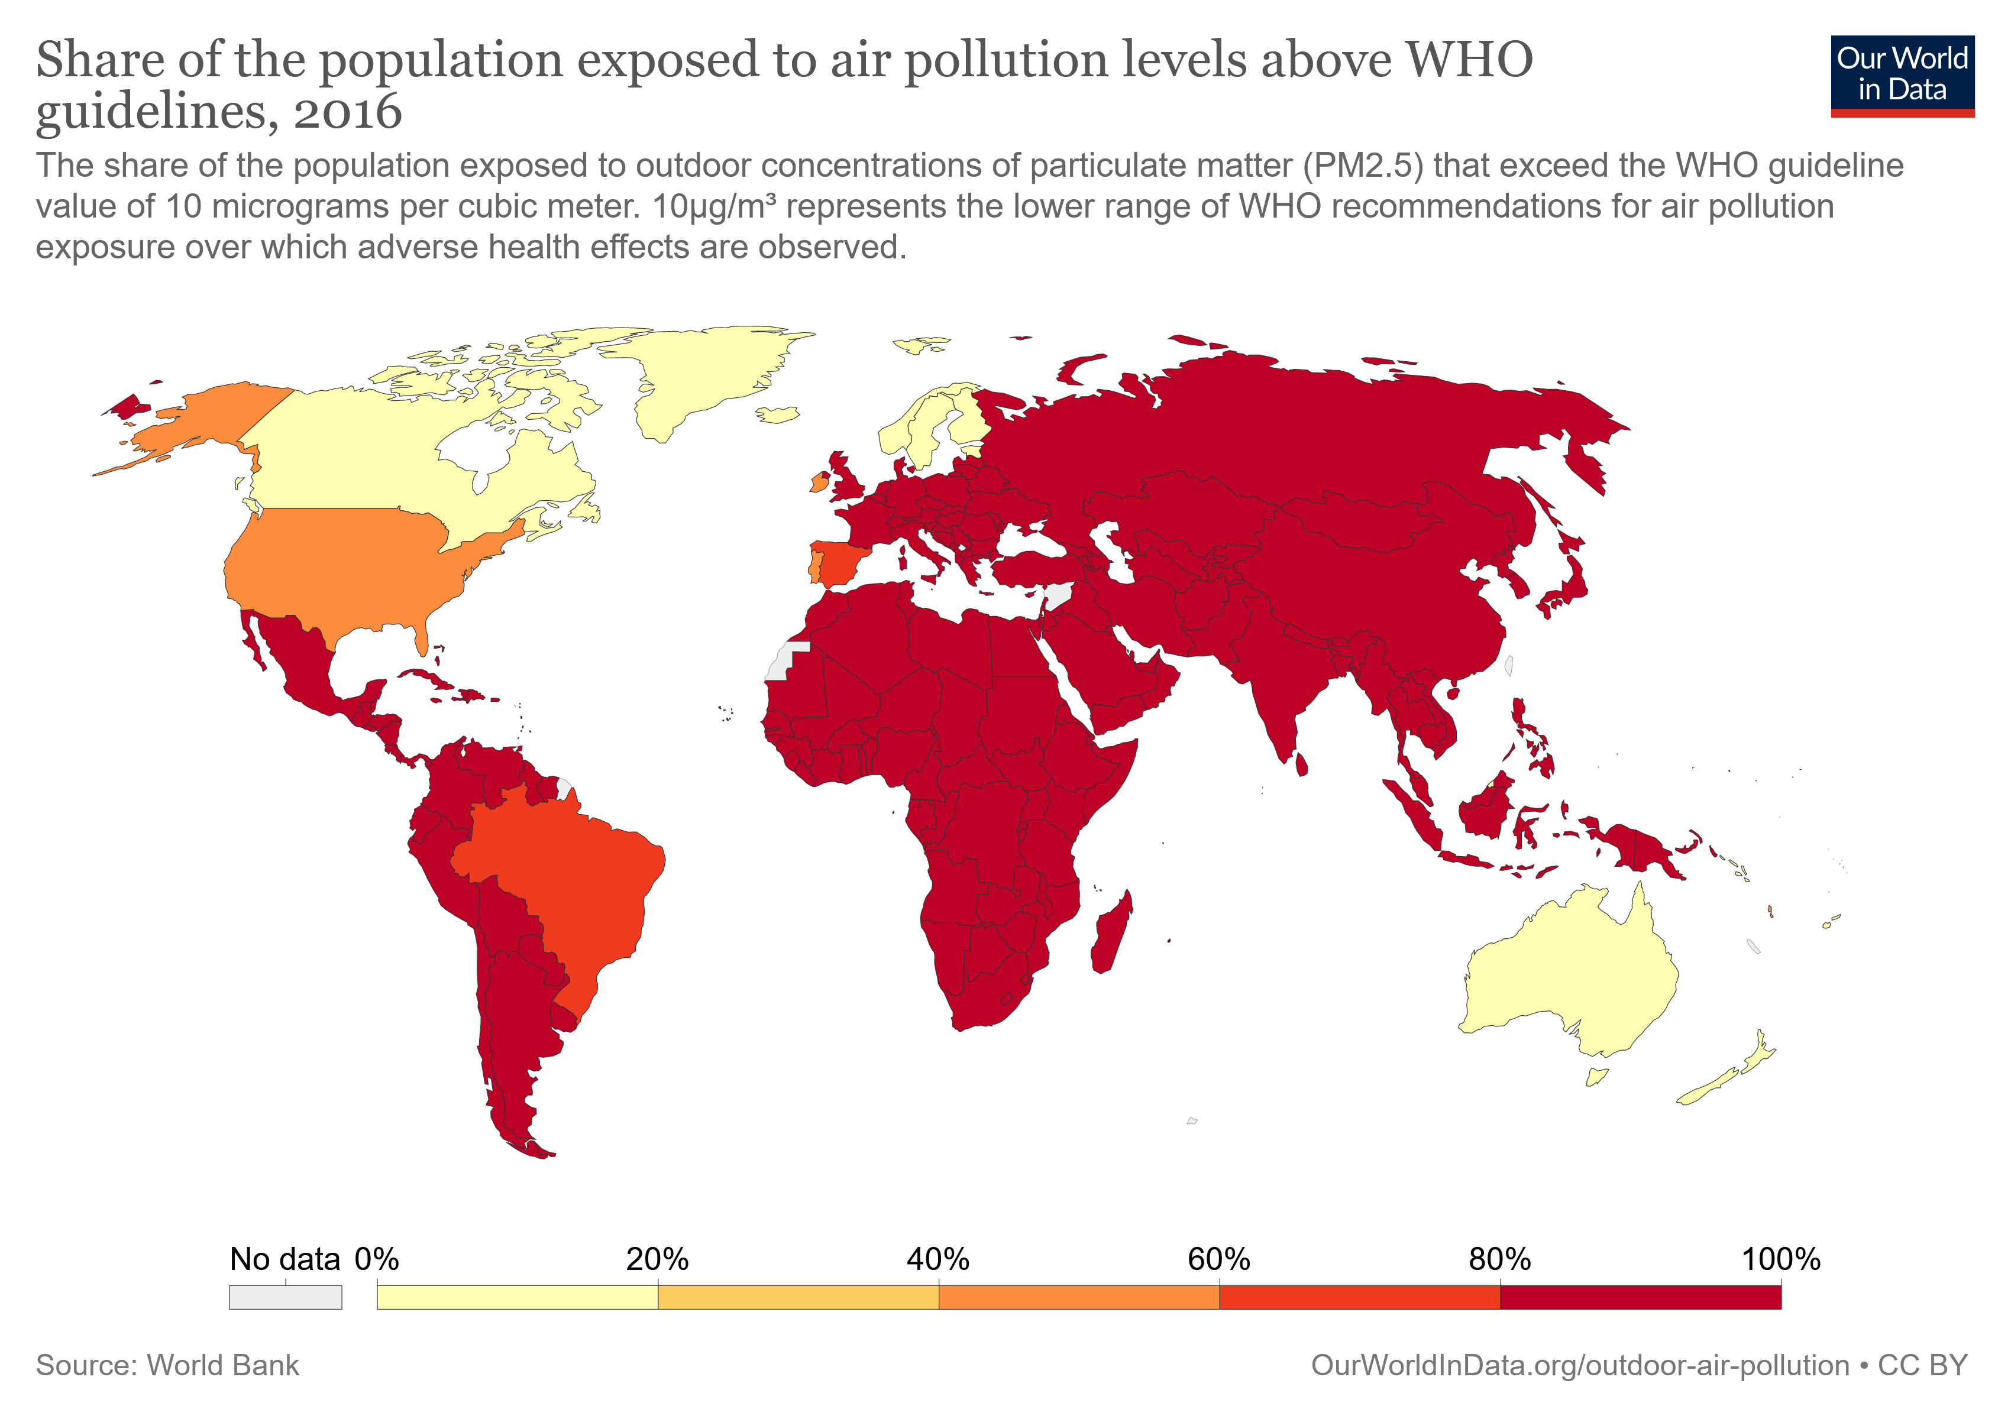
What are we talking about ?
Air Pollution is one of the worst problems which affect our society ;
It is due to the huge presence in the athmosphere of different chemical agents (CO2,CO,CH4,etc.) ;
Only a little part of the world population lives in partially safe places ;

Slide 4

According to the scientific world, air pollution is strongly linked to many issues, even if the most pressing are :
The set of pollution-related diseases, such as lung cancer, heart diseases and respiratory infections ;
A catalyst action for global warming and, so, for climate change ;
But, in which way is this linked to our project ?

Slide 5
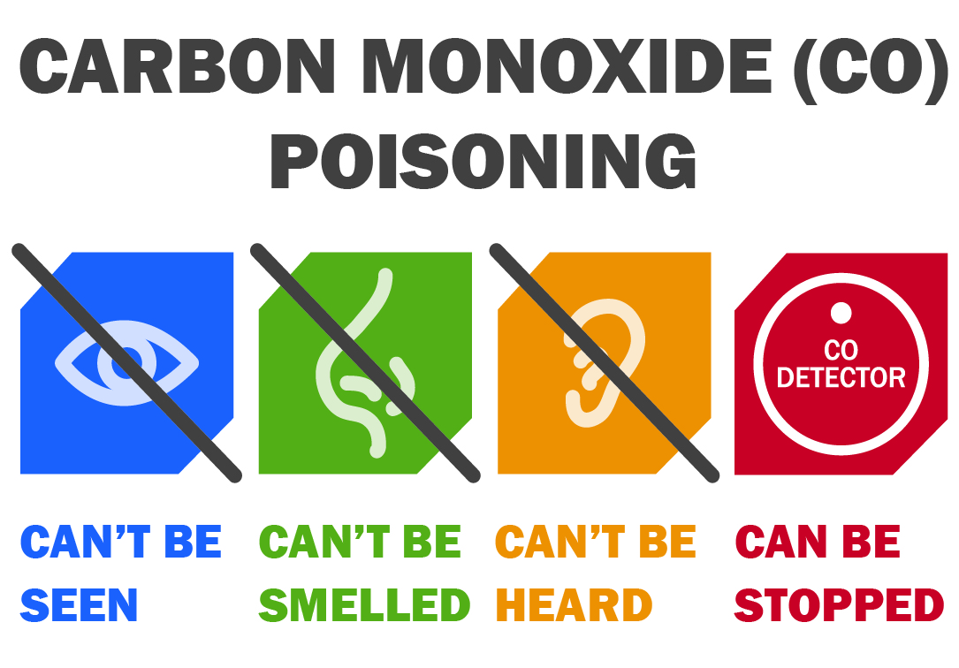
The Problem of Carbon Monoxide
From combustion of fuel, like natural gas and coal ;
From some natural processes ;
Some Bad Sides :
Carbon Monoxide Poisoning ;
Lung Diseases and Nervous System Damages ;
One of the most polluting chemical agents ;

Slide 6
Our Solution
The simplest solution is to install a carbon monoxide detector, but, what makes our product different from the other ones ?
Pros :
No installation required ;
Trasportable ;
Affordable/Cheap ;
Easily Improvable ;
Cons :
No measurements after 2000 ppm ;
Few functionalities ;
Not high durability

Slide 7
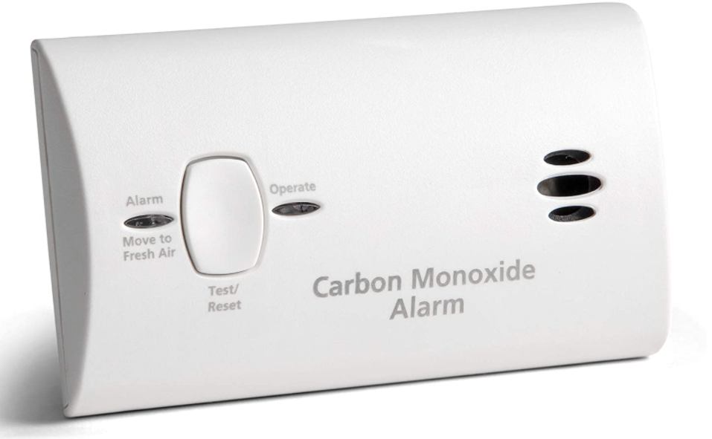
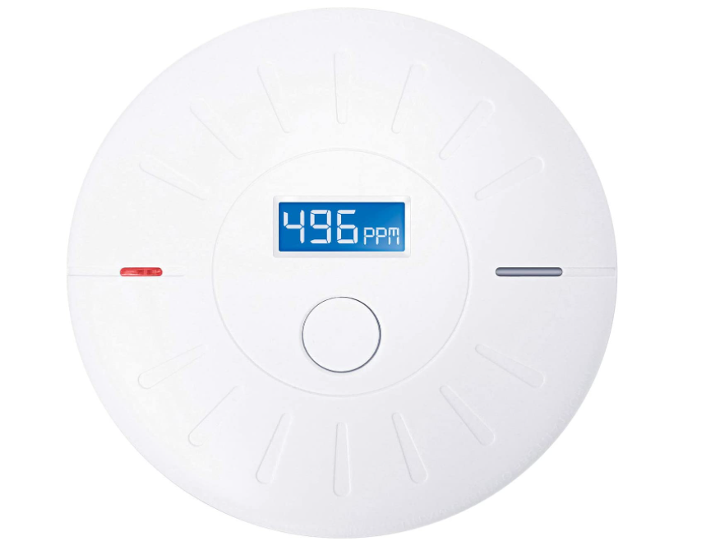
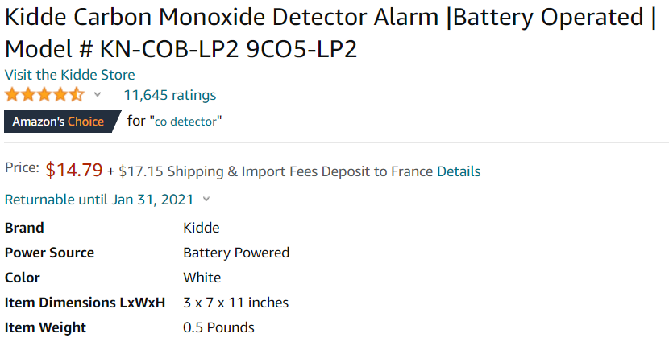
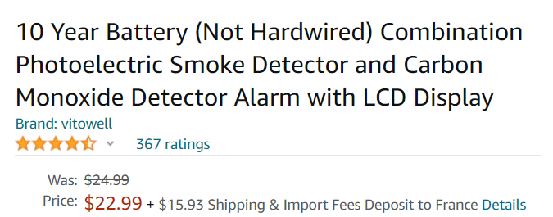
State of the Art

Slide 8
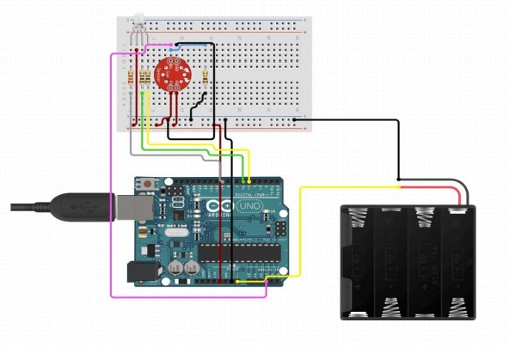
OUR IMPLEMENTATION
100 Ohm Resistor
220 Ohm Resistor
Gas Sensor Breakout Board
10K Ohm Resistor
BreadBoard - Half Size
Jumper Wires Pack - M/M
Male Headers Pack- Break-Away
Arduino Uno
Carbon Monoxide Sensor - MQ-7
RGB Led Common Anode
USB Cable A to B
Battery Holder - 4xAA

Slide 9
Thank you for your patience and attention …

