Slide 1
A Very Brief History of Computing 1948 - 2015
Martyn Thomas CBE FREng
Livery Company Professor of Information Technology

Slide 2
Key messages from the previous talk: Should We Trust Computers?
Most software has more than 10 defects in every 1000 lines of software
Many important systems contain >1,000,000 lines and are very complex
Testing the software can only find a tiny fraction of these errors – usually the most common ones
So testing leaves a lot of relatively obscure errors.
This is why most software works well enough - but there are still too many failures - and why so much software is easy to cyber-attack.

Slide 3
A Very Brief (and partial) History
Tonight’s lecture tries to answer two questions:
how we got from slide-rules to driverless cars in less than a lifetime
and why most hardware is well engineered and very reliable yet most software is not well engineered and has lots of defects that put us all at risk.
I have to leave out many important and interesting developments. The transcript gives far more detail than I have time for, and the most important themes introduced here will be developed much further in later lectures.

Slide 4
Please join in the discussions
Please share your opinions, knowledge and questions on http://cyberliving.uk
And tweet with hashtag #cyberliving

Slide 5
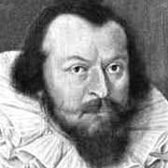
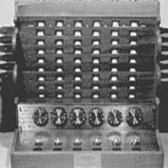
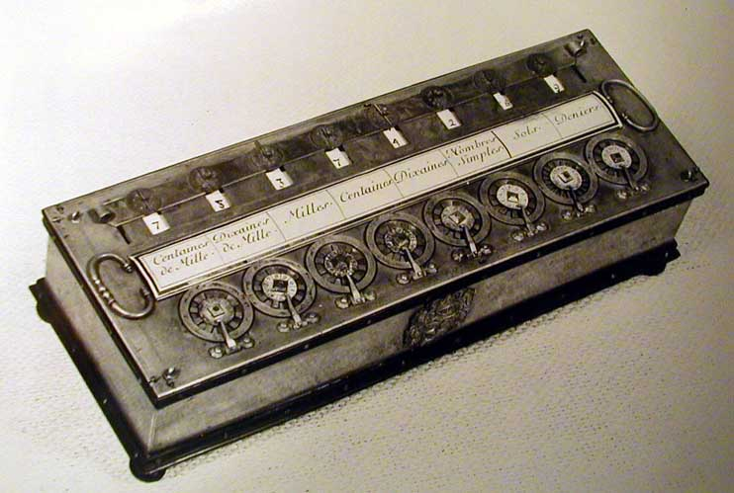
Calculating machines
1623, Wilhelm Schickard: first automatic calculator.
1642: Blaise Pascal’s Arithmetique
Then, in the early 20th Century, electronic circuits started to replace mechanical calculators

Slide 6
Alan Turing
Mathematician and Computer Scientist
Turing is Well known for his code-breaking work at Bletchley Park in WWII
But Turing’s contribution to computing was even more important (see later lectures)
He showed (1930s) that a machine that can obey a very small set of instructions and that has a memory can perform all possible calculations.
The Universal Turing Machine plus electronic circuits replacing mechanical calculators created the basis for the universal electronic computer
And an electronic computer needs an electronic memory.

Slide 7

dots on a cathode-ray tube can represent binary digits 0,1. If they fade slowly and you can read them and rewrite them, you have created an electronic memory

Slide 8
The Williams Storage Tube (F C Williams and Tom Kilburn)
Pick-up plate
emitter
Storage tube
regenerate
Amplify

Slide 9
The Manchester “Baby” Small-Scale Experimental Machine was built to test the storage tube

Slide 10
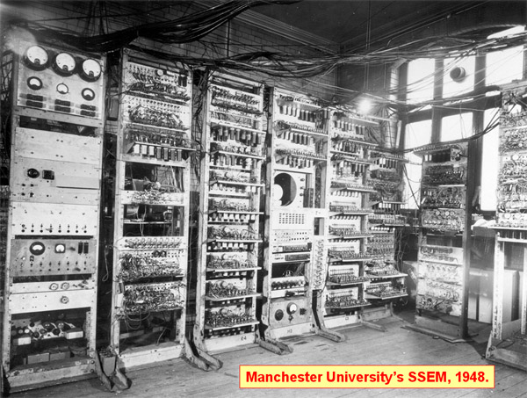
Manchester Baby
7 instructions. ~500 valves, 32 words of 32 bits memory + A + C + display

Slide 11
Programs were held in the storage tube (and had to be entered through the switches): it was the first stored-program computer

Slide 12
June 21 1948 F C Williams remembers the first successful program
“A program was laboriously inserted and the start switch pressed. Immediately the spots on the display tube entered a mad dance. In early trials it was a dance of death leading to no useful result, and what was even worse, without yielding any clue as to what was wrong. But one day it stopped, and there, shining brightly in the expected place, was the expected answer. It was a moment to remember. This was in June 1948, and nothing was ever the same again.”

Slide 13
Things moved quickly after June 1948
The UK Government instructed Ferranti Limited in October 1948 to “construct an electronic calculating machine to the instructions of Professor F C Williams”. The Ferranti Mark 1 was completed in February 1951, whilst research continued.
By the end of 1956, Manchester University had filed 81 computer patents.

Slide 14
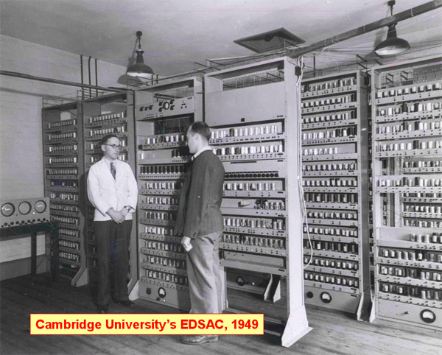
Meanwhile, in Cambridge University
Maurice Wilkes’ EDSAC was the first computer with practical Input/Output. It used mercury delay lines for memory

Slide 15
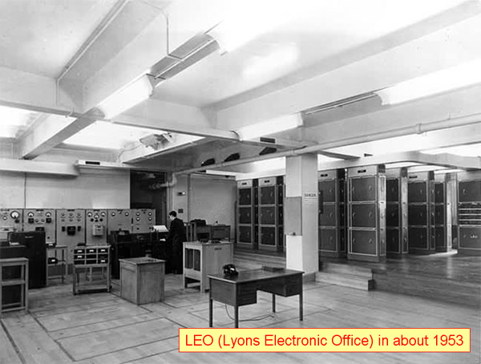
By 1953, LEO (based on EDSAC) was running the payroll for Lyons’ café and bakery business!
John Pinkerton turned EDSAC into a reliable computer for business applications
It was such a success that Lyons founded LEO Computers Limited

Slide 16
The UK Government did not understand the enormous potential market
In 1946, Turing proposed building a computer, giving a full description including circuit diagrams.
In 1949, Treasury paid English Electric Limited £15,000 p.a. to assist NPL with developing Turing’s Automatic Computing Engine.
The Chief Scientist wrote in 1950: “work on the development of high-speed calculating machines is also proceeding at other centres … … there is not likely to be a need for more than a few of them in the country”.

Slide 17
But the Age of Computing had arrived and the US Government did realise the huge potential
The US Government gave IBM $350 million to develop computers, as a military contract.
Many companies and research groups, in the UK and overseas, were developing computers, with many of them licensing Manchester patents
In the UK, R&D continued at Manchester, Ferranti, Cambridge, LEO Computers, Birkbeck (Andrew & Kathleen Booth), Elliot Automation, BTM, English Electric and elsewhere.

Slide 18
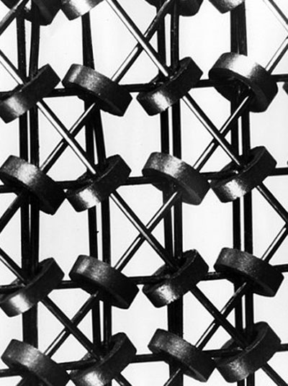
Hardware engineers focused on bigger, faster, cheaper computers and rigorous engineering
Transistors replaced thermionic valves
Magnetic drum storage replaced mercury delay lines and storage tubes
Magnetic core storage for RAM
Integrated circuits (ICs), then LSI
VLSI: the number of components on a chip doubled every year.
Exponential growth in computing power for the same cost.
Rework was hugely expensive so there was a strong focus on rigorous engineering.

Slide 19
Moore’s Law prediction
Gordon Moore: “Cramming more components onto integrated circuits” (1965)
Doubling every year would continue …

Slide 21
What about the Software?
Machine language, then symbolic assembler / Autocode
EDSAC introduced subroutines (David Wheeler)
Loaders grew into Operating Systems
LEO software David Caminer, Mary Coombs, Frank Land)
First business software
Payroll and scheduling
Very successful
Higher-level languages
Notes:
Alick Glennie, Manchester and Fort Halstead, wrote the first Autocode compiler. David Caminer, Mary Coombs and Frank Land wrote LEO software.

Slide 22
Major Developments in Programming Languages and Compilers
First compiler: The A-0 system compiler: written by Grace Hopper in 1951 and 1952 for the UNIVAC I.
Higher-Level Languages were needed, for faster programming and fewer errors
FORTRAN (Backus, 1957) for IBM (17 person yr)
Algol introduced recursion and important features for structured programming. “a great advance on its predecessors and most of its successors” (Tony Hoare)
Advances in the computer science of programming language definition made it possible to analyse programs and to reason about them.

Slide 23
Software Engineering and the first software crisis
In the 1960s, computer use was growing very rapidly worldwide . By 1968 there were at least 10,000 installed in Europe alone.
Large software systems were needed. OS/360 cost IBM over $50m per year during development and at least 5000 person years of effort – and it was 2 years late.
The growing costs, delays, overruns and failures led to the view that there was a software crisis and to a decision by the NATO Science Council to arrange two expert conferences to address the problems of software. Brian Randell has put the reports online
Notes:
Mention Honeywell Multics? Hugely influential

Slide 24
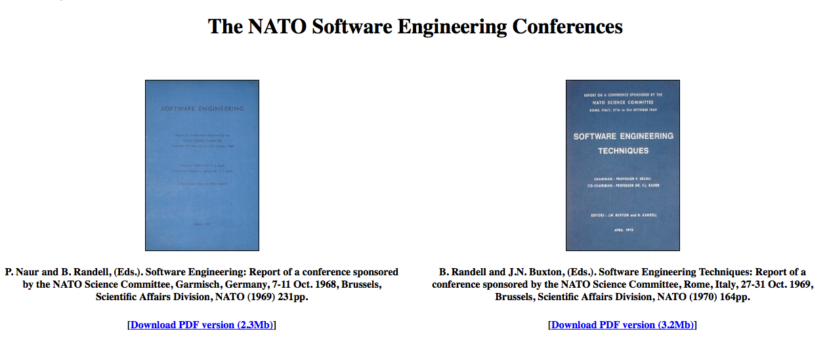
http://homepages.cs.ncl.ac.uk/brian.randell/NATO/

Slide 25
One insight was the need for analysable programming languages
“ Any significant advance in the programming art is sure to involve very extensive automated analyses of programs. … … Doing thorough analyses of programs is a big job. … It requires a programming language which is susceptible to analysis. I think other programming languages will head either to the junk pile or to the repair shop for overhaul, or they will not be effective tools for the production of large programs.”
E S Lowry (IBM) Nato Conference, October 1969.

Slide 26
Another on the limitations of testing
“One can construct convincing proofs quite readily of the ultimate futility of exhaustive testing of a program and even of testing by sampling. Tony Hoare
“Testing shows the presence, not the absence of bugs”. Edsger Dijkstra

Slide 27
1969-1972, Unix was created at Bell Labs by Dennis Richie and Ken Thompson
Both worked at Bell Labs as part of the Multics team
Unix was designed by Thompson in 1969 to provide a similar service to Multics but much more simply.
C language (Richie 1972)
Unix re-implemented in C for portability
Read the code! It’s wonderful!

Slide 28
By the 1970s, there were scientific foundations for software engineering
IBM were preparing a mathematically formal definition of their programming language, PL/I (in VDM)
Edsger Dijkstra had introduced “Structured Programming”, underpinned by a theorem by Jacopini and Bohm.
Tony Hoare had published An Axiomatic Basis for Computer Programming, introducing the practical use of preconditions, postconditions, invariants and formal proof.
Ole-Johan Dahl and Kristen Nygaard had invented object-oriented programming in their language SIMULA
See: Structured Programming, Dahl, Dijkstra and Hoare 1972
Notes:
See https://www.cs.cmu.edu/~crary/819-f09/Hoare69.pdf

Slide 29
1970s: Software Engineering progress
Advances in Structured methods
Top-down functional design, stepwise refinement
Data-led design (Jackson Structured Programming)
Practical formal methods: mathematically rigorous methods for specifying and developing programs
VDM (Jones), Z (Abrial) … …
Advances in software development processes
Mythical Man Month (Fred Brooks), Harlan Mills
Software Engineering Economics (Barry Boehm)
We had the basis for professional software engineering!

Slide 30
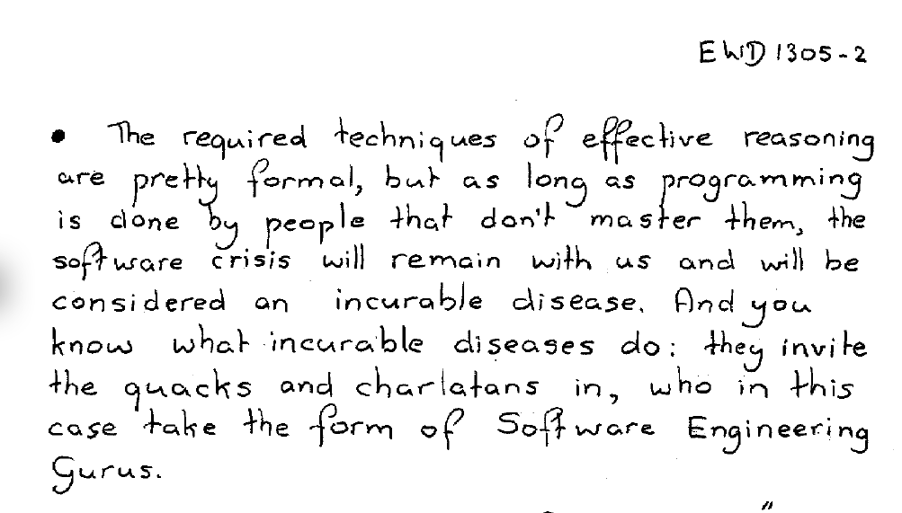
But most programmers still saw software development as a craft, not as engineering, and informal methods were widely promoted

Slide 31
So in the 1980s, Moore’s Law led to the second software crisis
Cheap personal computers and microprocessors spread computing into many more application areas
Mainframe tools and languages were often unavailable for these processors and systems: COBOL, FORTRAN, BASIC and C were widely used.
The poor design of most of the popular programming languages made it easy to make errors and hard to find them.
Many more programmers were needed – and few were available with computer science or engineering expertise.
To make money, low cost and innovation were far more important than quality
Inevitably, there were many more failing projects, costing many $m and £m
In the USA, this second software crisis led DoD to set up a Software Engineering Institute at CMU. The SEI were asked to devise a way to assess defense contractors’ competence and devised the Capability Maturity Model (CMM)

Slide 32
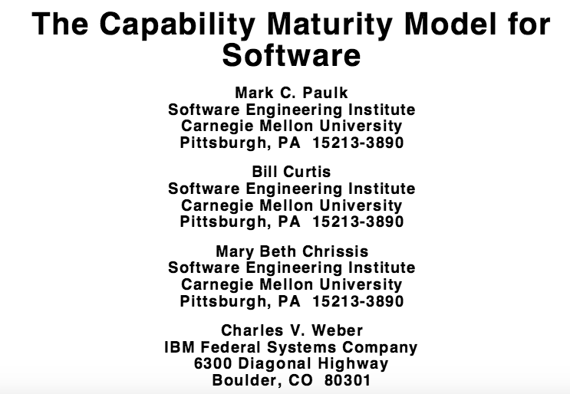
http://homepages.inf.ed.ac.uk/dts/pm/Papers/cmm.pdf

Slide 33
The Capability Maturity Model of the Software Engineering Institute at CMU
Level 1: Initial
Software development processes are ad hoc and unstable (“chaotic”)
Level 2: Repeatable
The organisation can (usually) repeat processes successfully
Level 3: Defined
The development processes are a documented company standard. Staff are trained in them and follow them (Broadly equivalent to a professional implementation of ISO 9001 quality management)
Level 4: Managed
Processes are measured and the measurements are used in estimating and project management
Level 5: Optimising
Continuous improvement of the development processes has become routine
Most Defense Contractors were found to be at Level 1
See Watts Humphrey. http://www.sei.cmu.edu/reports/87tr011.pdf
Notes:
Most defence contractors were assessed at Level 1

Slide 34
Responses to this 2nd Software Crisis
UK: STARTS guide; BS 5750/ISO 9001 quality management became almost mandatory; SSADM and other structured methods were introduced
A very few companies in the UK, USA and Europe adopted mathematically formal methods
Most software companies continued with informal specifications and profited from the inevitable “change requests” (CRs).
Suppliers whose estimates were evidence-based and accurate, lost most contracts on price – to companies that either did not understand the requirements or that had a policy of bidding at a loss to win the contract and relying on CRs to restore profit

Slide 35
1995: Standish Group CHAOS report
A survey of 8,380 application projects
31.1% were cancelled before delivery
Only 16.2% were on time, on budget and met the requirements
For every 100 projects that started, there were 94 restarts

Slide 36
1995: Standish Group CHAOS report
Average cost overrun: 189%
Average time overrun: 222%
Average number of features delivered: 61% of those originally specified
Source: https://net.educause.edu/ir/library/pdf/NCP08083B.pdf
Data © http://standishgroup.com

Slide 37
Exponential growth in the internet
http://www.internetsociety.org/internet/what-internet/history-internet/brief-history-internet

Slide 38
Software Development in the 1990s
By the end of the 1990s, many practical lessons had been learnt, but these were craft skills not engineering
Understand the customer’s business needs
Build prototypes and involve the end-users wherever possible
Add new features in short, manageable “sprints”
Integrate frequently and test for regression
Work in small teams and review each others’ work
Such agile methods worked fairly well, if the application was neither novel to the developers, nor critical.
But such methods went wrong with novel or complex systems or if safety or security were essential.
Notes:
XP: Kent Beck’s evidence to the Jackson NAS/CSTB study

Slide 39
21st Century Computing
Y2K came and went.
Moore’s Law had led to iPads and smartphones and computers in almost everything
Almost all software was developed without a rigorous specification
Almost all verification and validation was still done by running tests
Millions of new programmers writing Apps, many of them with no training in computer science or software engineering and little understanding of computer security

Slide 40
How many programmers worldwide ?
Source: http://www.infoq.com/news/2014/01/IDC-software-developers, quoting IDC

Slide 41
The Third Software Crisis
Hardware is mostly well engineered and reliable, because that has been the business priority
But software is often neither of these, because the business priorities have been different
We have a rapidly growing dependence on software (e.g. a cashless society, driverless cars, “digital by default” services) and cyberattacks are now seen by Government as a threat that is as great as war, terrorism or pandemic infections such as ebola.
Notes:
e.g. banking systems, major Government projects

Slide 42
Why have software developers largely ignored software engineering?
We are like the barber-surgeons of earlier ages, who prided themselves on the sharpness of their knives and the speed with which they dispatched their duty -- either shaving a beard or amputating a limb.
Imagine the dismay with which they greeted some ivory-towered academic who told them that the practice of surgery should be based on a long and detailed study of human anatomy, on familiarity with surgical procedures pioneered by great doctors of the past, and that it should be carried out only in a strictly controlled bug-free environment, far removed from the hair and dust of the normal barber's shop.
Tony Hoare

Slide 43
Please join in the discussions
Many here tonight or who view this online will have been part of computing’s history. Many will disagree with what I have chosen to present.
Please share your views on http://cyberliving.uk or by using the Twitter hashtag #cyberliving

Slide 44
Please join in the discussions
Please share your views on http://cyberliving.uk or by using the Twitter hashtag #cyberliving

