Slide 1

DrivenLogic
Capstone Presentation

Slide 2
Itinerary
Initial Concept and Planning
Drawings
Project Management
Back End
Front End
Walk-through
Future implementation

Slide 3

INITIAL CONCEPT

Slide 4
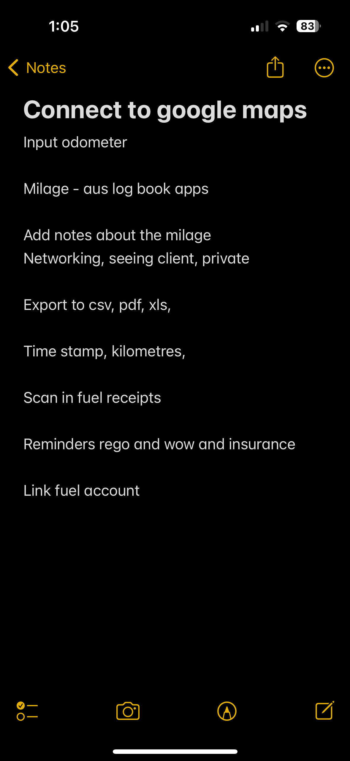
Initial design meeting: 02/02/24
Participants: Kay Ridge & Georgia Ridge

Slide 5
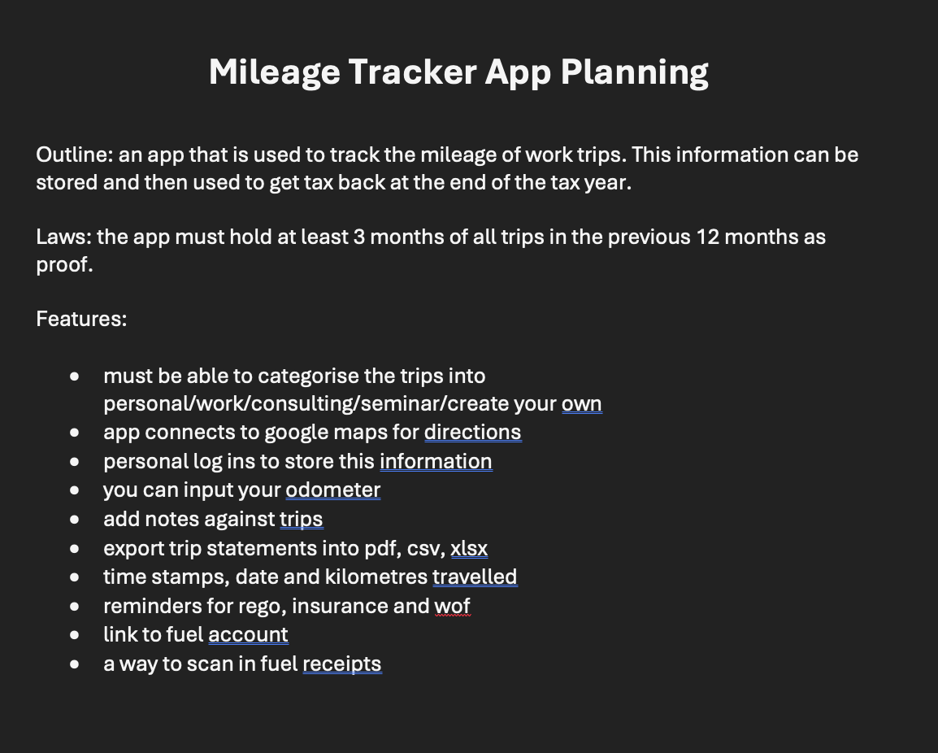

Slide 6

DRAWINGS AND DIAGRAMS

Slide 7
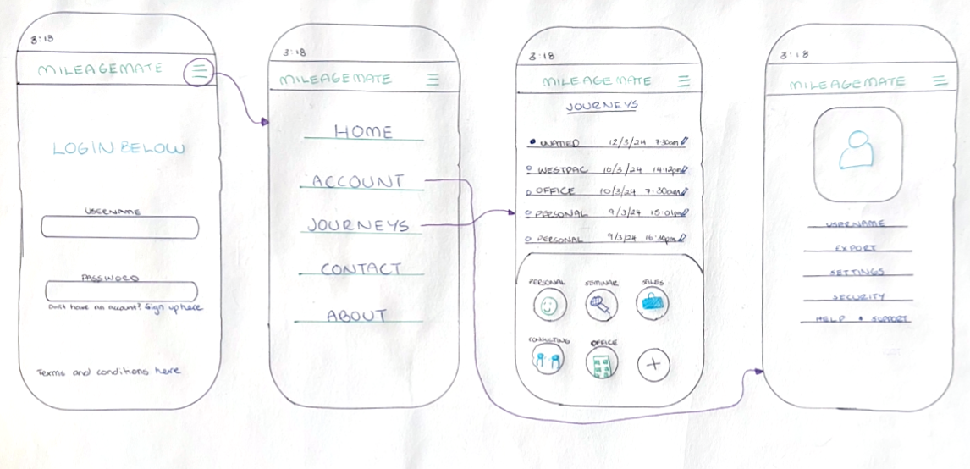
Low Fidelity Wireframe

Slide 8
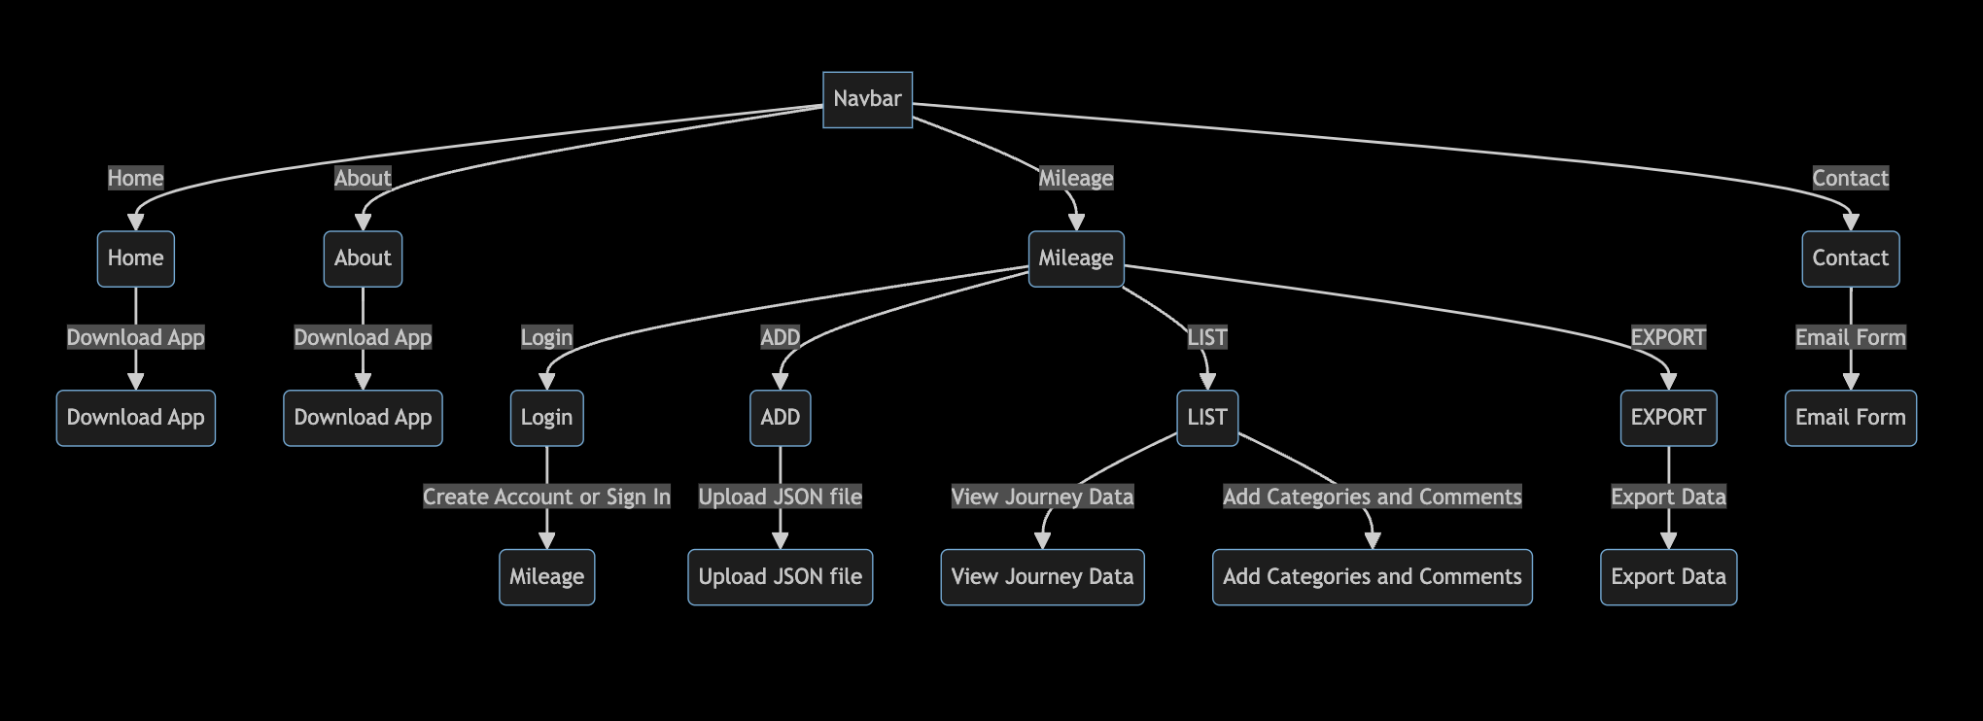
Mermaid Diagram

Slide 9

PROJECT MANAGEMENT

Slide 10
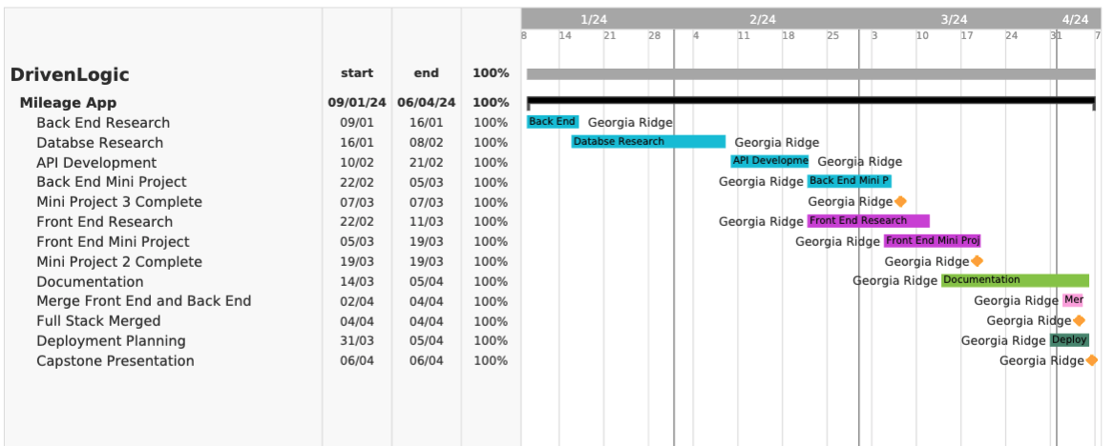
Gantt Chart

Slide 11
Front End

Slide 12
Dependencies
Tailwind CSS
Google OAuth Provider
React-Router-Dom
Mui/Material

Slide 13
Features
Login/Create account
Login to Google Account
Modular code i.e. welcome bar
Links to tax resources

Slide 14
Back End

Slide 15
Dependencies
Mongoose
Docker
MongoDB
Multer

Slide 16
Features
MongoDB Database
Export Data: PDF, XSLX, CSV
Import JSON file
Docker Container

Slide 17
Walk-Through Demonstration

Slide 18
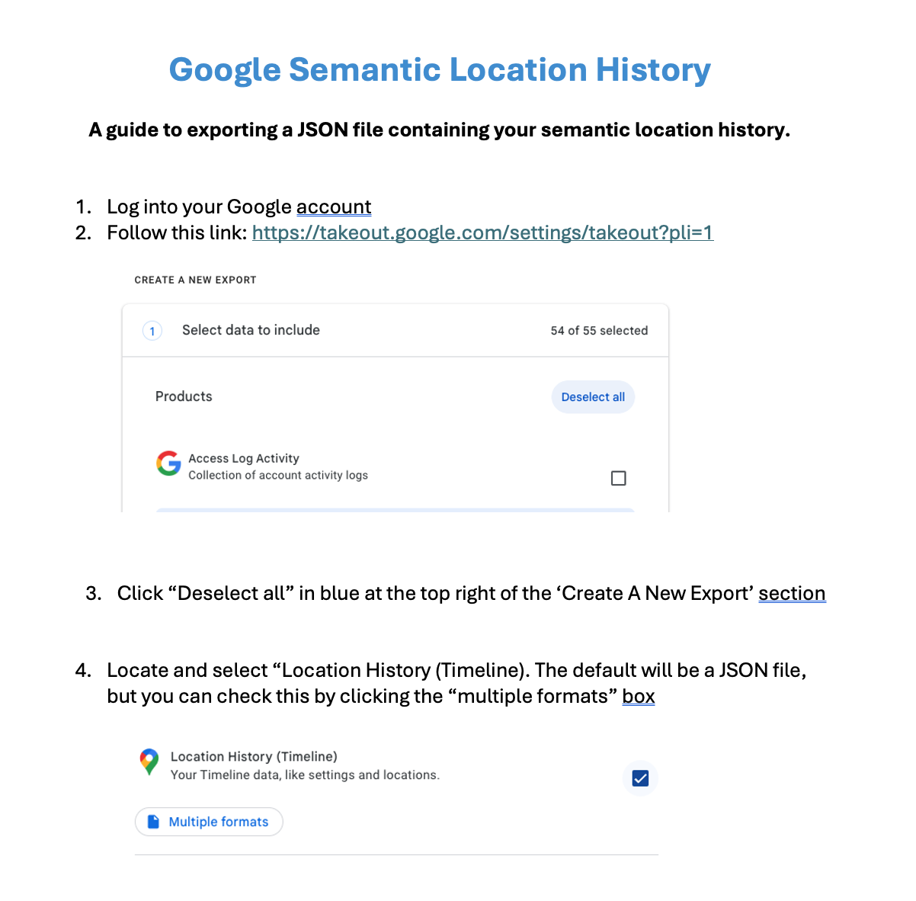

Slide 19
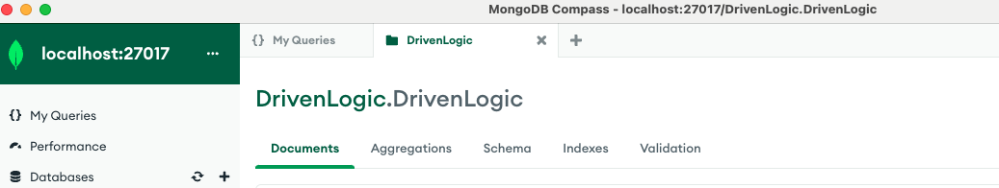
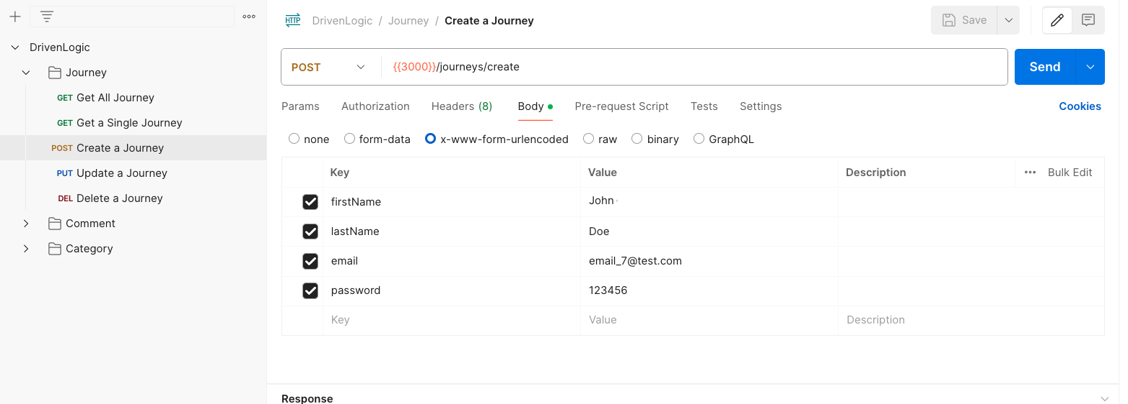

Slide 20

FUTURE IMPLEMENTATION

Slide 21
Future Implementation
Streamline the Google Semantic Location History download
Create an on-the-go app
More options for categorizing and commenting
Link to fuel cards and other tax deductibles for transport

Slide 22
Stay in touch
Linkedin: /georgia-ridge
Github: /gmridge
Email: georgiamayridge97@gmail.com

