Slide 1
pharmacyShelfPlus

Slide 2
outline
User Stories
Planning
Design

Slide 3
User stories
'Printing Shelf Labels with our current system is complicated and can't be bothered'
Shelf labels for specials are currently printed by exporting a CSV from the Point of Sale system and then hacking a mail merge in Word
'Sometimes when Specials come through from Buying Group – our standard prices are cheaper...'
Staff would like to see some sort of alert that warns that standard prices are cheaper than the buying group Specials Price
'When there are changes we have to hear it word of mouth or find random notices in the staff notice board'
Staff would like to have notices in one place where they can be viewed easily. Also they would like to be able to place notices if needed.

Slide 4
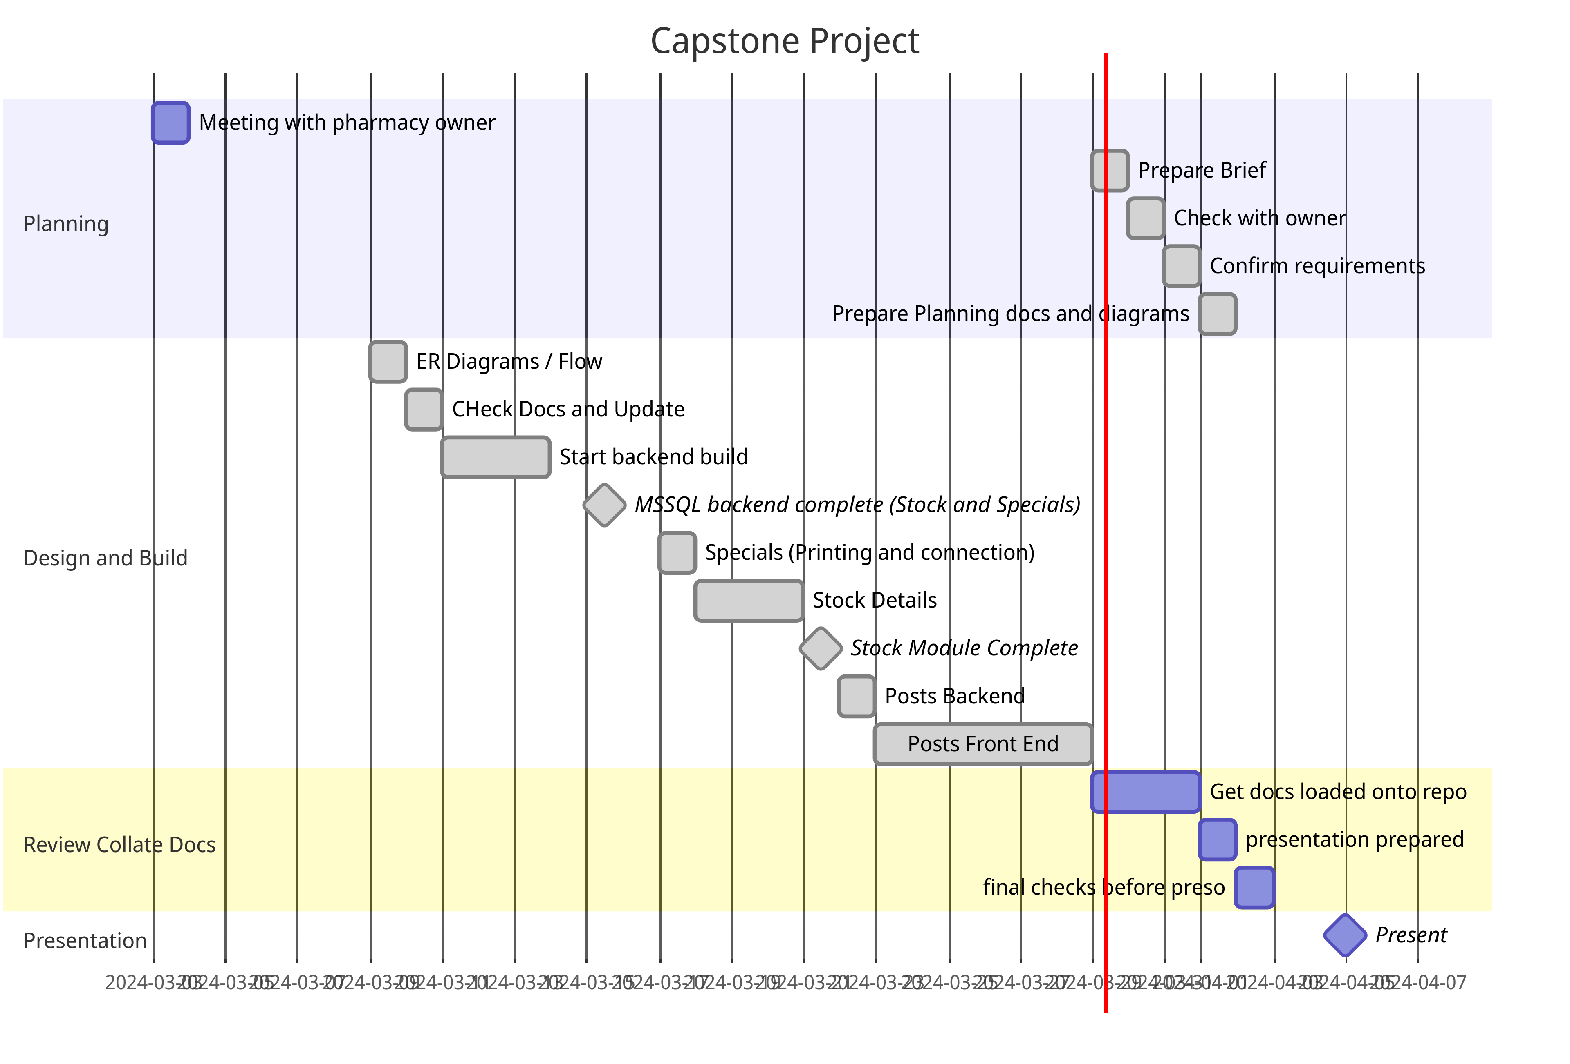
planning
Planning Documents
GANTT Chart
Entity Relationship Diagrams
UI Design

Slide 5
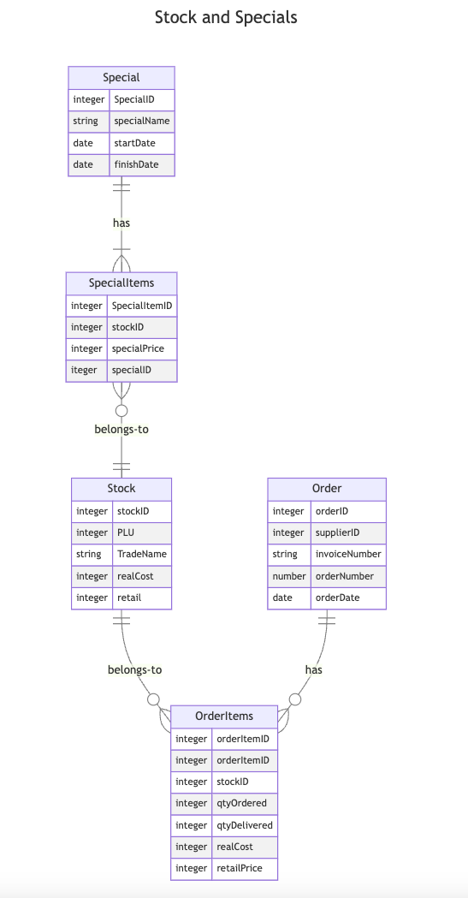
Back End Services
Microsoft SQL Server
Main Database for Stock / Specials / Orders and Sales
Relationship models built into back end and based on the original database set up.
Now uses live data rather than JSON files.
MySQL
Currently holds Notices data table and will ultimately add tables for notice acknowledgements – so we can track staff who have viewed the posts. May add the ability to ask questions about a notice

Slide 6
User Interface
React Library for UI
Material MUI for most pages
Stock Details Page –
The main addition to the project since the mini project
Uses Axios to fetch data first to stock api call for basic stock details – search by stock ID
Chart component makes call to Stock History for monthly sales data – last 12 months
Order History makes call to Order Items table to get 12 months order history.
Stock Details can be accessed by searching for the item in Stock Search page, or through the specials page
Weird thing is that Cost Price and Retail price are stored as integers in database (so cents) and have to be converted to a dollar value
Specials Page
Added code to highlight where our standard retail is actually cheaper than the special price – allows user to identify when not to put out Special Shelf Labels
Notices – this displays on Front Page – decided that this was not the most pressing part – so at this stage no user interaction, but can edit and delete posts.

Slide 7
Next steps
Stock Details
Show additional sales details (last 3 months sales list) – ability to click in and view the sales
Use the “Days Supply” column in Stock Tableto report on customers who may be close to running out of a supplement (For example customer buys 60 Magnesium capsules, and we can report on those who are close to running out and direct market them)
User login – proposed way is have a “Super User” who logs in in the morning, and then staff can use pins to access on that device for the rest of the day. Loosely this would mean the super user state is stored as logged in and anyone else with a pin can use – device will log out Super User after an hour of non use
Debtors reports – this is a bigger project but will allow us to view Debtors and edit payments to report back to main database – this has to be done carefully.

