Slide 1
Lab 2: Deep Q-Network (DQN)
312551133
鄧長軒

Slide 2
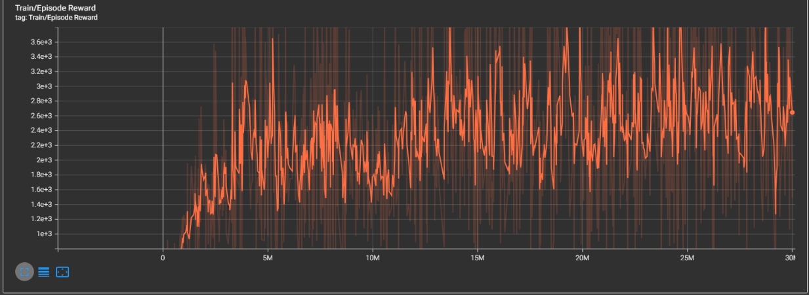
MsPacman-v5: Training curve

Slide 3
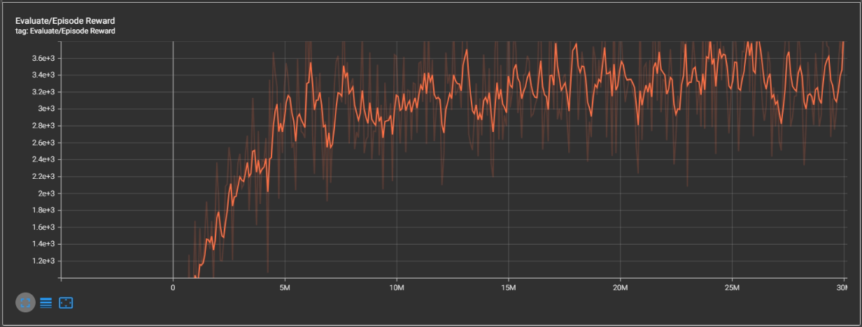
MsPacman-v5: Training curve

Slide 4
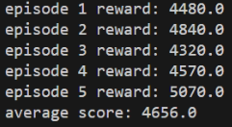
MsPacman-v5: testing results

Slide 5
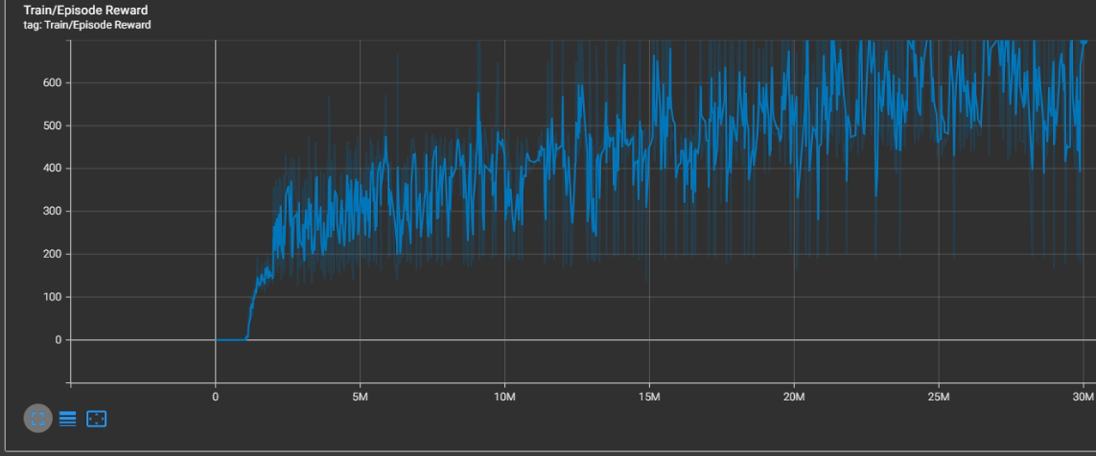
Enduro-v5: Training curve

Slide 6
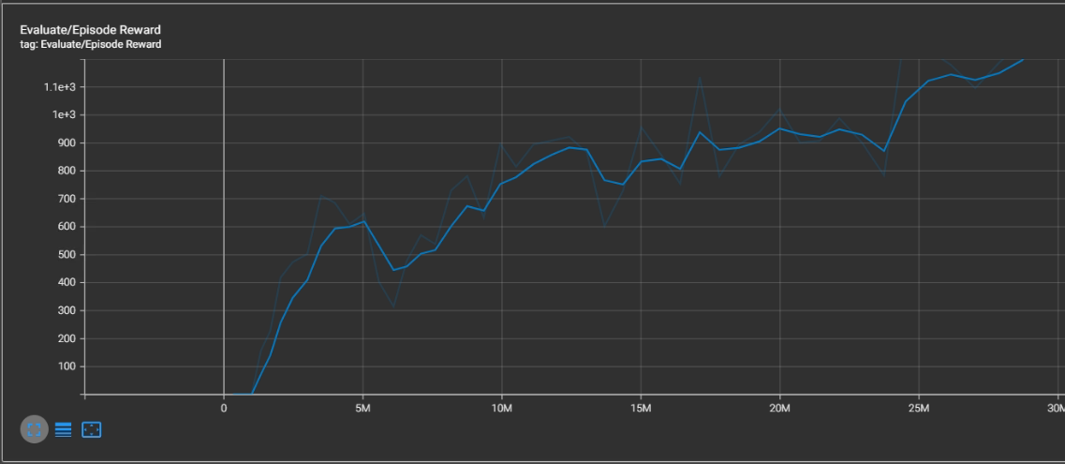
Enduro-v5: Training curve

Slide 7
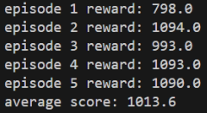
Enduro-v5: testing results

