Slide 1
Lab 3: Proximal Policy Optimization (PPO)
312551133
鄧長軒

Slide 2
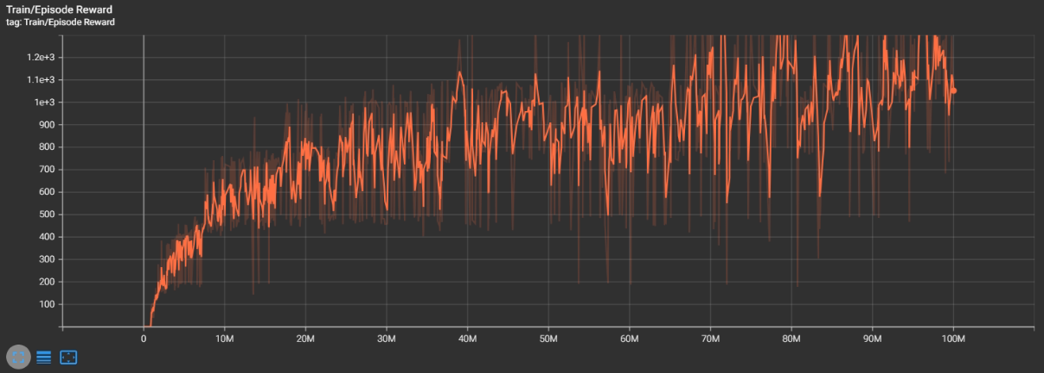
Enduro-v5: Training curve - Train Reward
step 0 ~ step 100000000
learning_rate: 2.5e-4

Slide 3
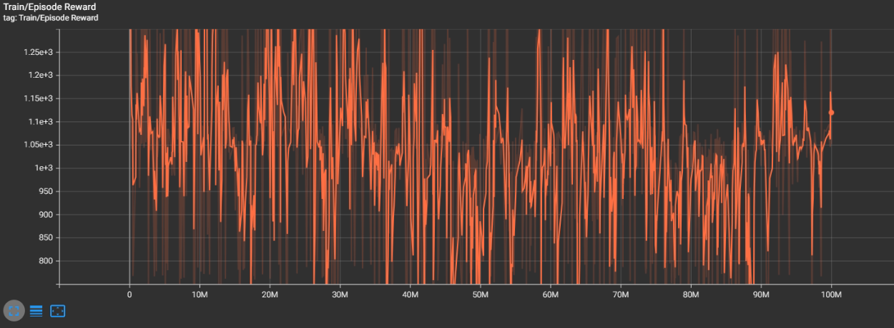
Enduro-v5: Training curve - Train Reward
step 100000000 ~ step 200000000
learning_rate: 2.5e-4

Slide 4
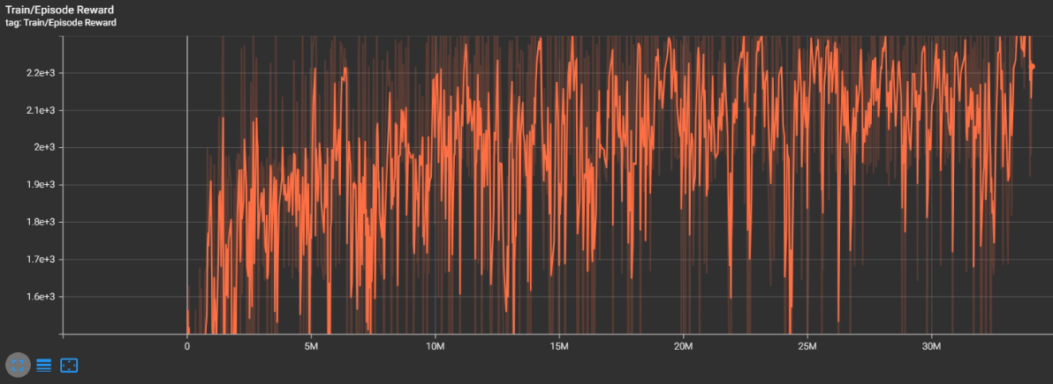
Enduro-v5: Training curve - Train Reward
step 200000000 ~ step 230000000
learning_rate: 1e-5

Slide 5
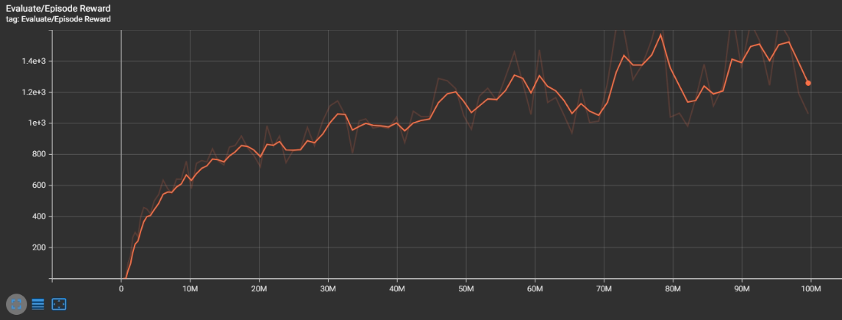
Enduro-v5: Training curve - Evaluate Reward
step 0 ~ step 100000000
learning_rate: 2.5e-4

Slide 6
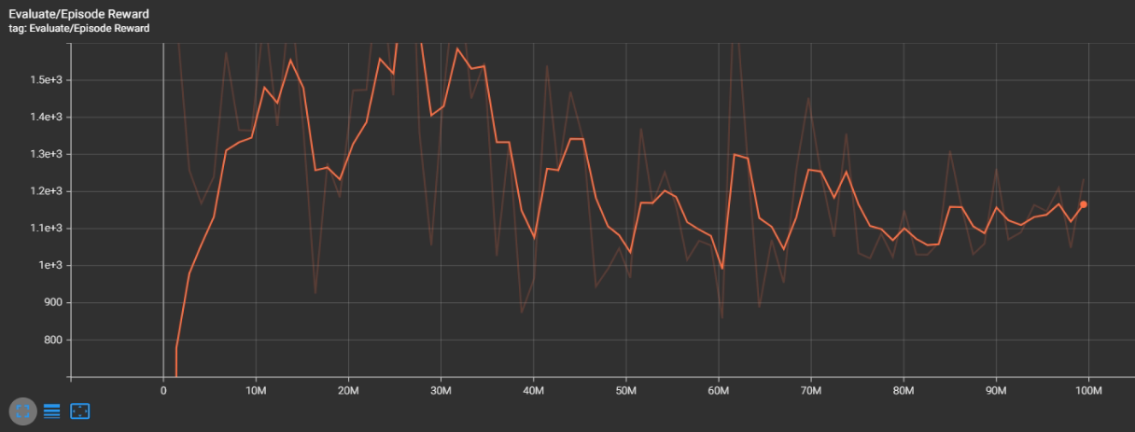
Enduro-v5: Training curve - Evaluate Reward
step 100000000 ~ step 200000000
learning_rate: 2.5e-4

Slide 7
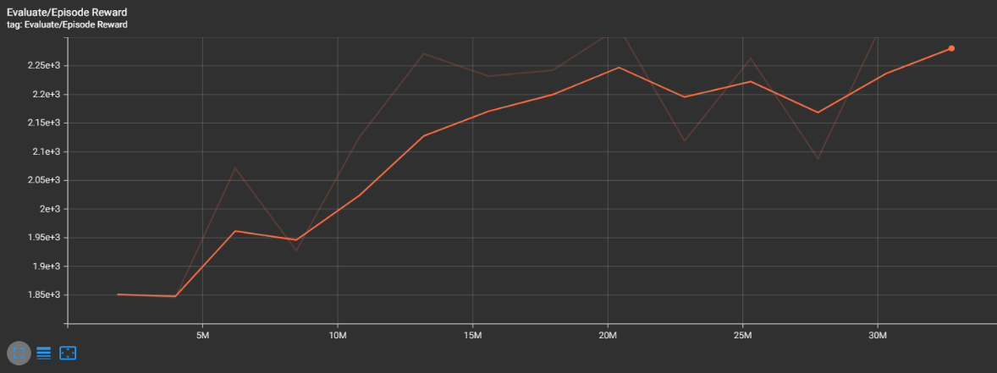
Enduro-v5: Training curve - Evaluate Reward
step 200000000 ~ step 230000000
learning_rate: 1e-5

Slide 8
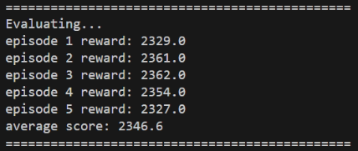
Enduro-v5: testing results

Slide 9
Bonus

Slide 10
PPO is an on-policy or an off-policy algorithm? Why?
PPO 是 on-policy 演算法。
因為它利用當前 policy 產生的 experience 來更新 policy，且這些 experience 不會重複用於下次更新。

Slide 11
Explain how PPO ensures that policy updates at each step are not too large to avoid destabilization.
它使用 clip ratio 來防止更新幅度過大。
如果更新後與更新前的機率 ratio 大於 1+epsilon 或小於 1-epsilon ，則改變機率讓 ratio 控制在 1+epsilon～1-epsilon 之間。

Slide 12
Why is GAE-lambda used to estimate advantages in PPO instead of just one-step advantages? How does it contribute to improving the policy learning process?
使用 GAE-lambda 可以減少 bias，降低 one-step advantages 帶來的波動影響。
可以讓訓練變穩定。

Slide 13
Please explain what the lambda parameter represents in GAE-lambda, and how adjusting the lambda parameter affects the training process and performance of PPO?
lambda 代表估計 advantage 時，有多少 step 要加入計算。
lambda 越大，代表估計 advantage 時，越多 step 會加入計算，注重長期的 reward。
lambda 越小，則越少 step 會加入計算，具有較小的 variance。

