Slide 1

Song Topic Presentation
Exercise Motivation
Through
Strong Warning Messages
Lee Insung and Friends
Lee Minjae · Lee Yeongu · Lee Insung · Lee Hayul
Notes:
Good morning, everyone! Today, our team will show you our project. It is a song about exercise. The song has a strong warning message. Our team members are Lee Minjae, Lee Yeongu, Lee Insung, and Lee Hayul. Let's start!

Slide 2

Listen to the Song
“Kids Who Exercise” (운동하는 아이들) · Music & Lyrics by insung20402 · Created with Suno AI
▶ Click to Play the Song
VERSE 1
Wake up early in the morning light
I should eat some veggies, make it right
No breakfast, no success,
study's struggle nothing less
CHORUS
Let's go take a walk outside
Exercise every day, feel the pride
Healthy habits make me strong
Singing this happy morning song!
VERSE 2
I should move my body every day
Eating a good breakfast is the way
Let's jump and run under the sun
Healthy life is so much fun!
BRIDGE
Sometimes it is hard to do
But it is good for me and you
Step by step and day by day
We can chase the lazy away!
Notes:
Now, let's listen to our song! It is called "Kids Who Exercise." We made it with Suno AI. The song starts with a warning. Then it becomes happy and exciting. (Play the song now. If you need more time, you can stop after the chorus, about 1 minute.)

Slide 3
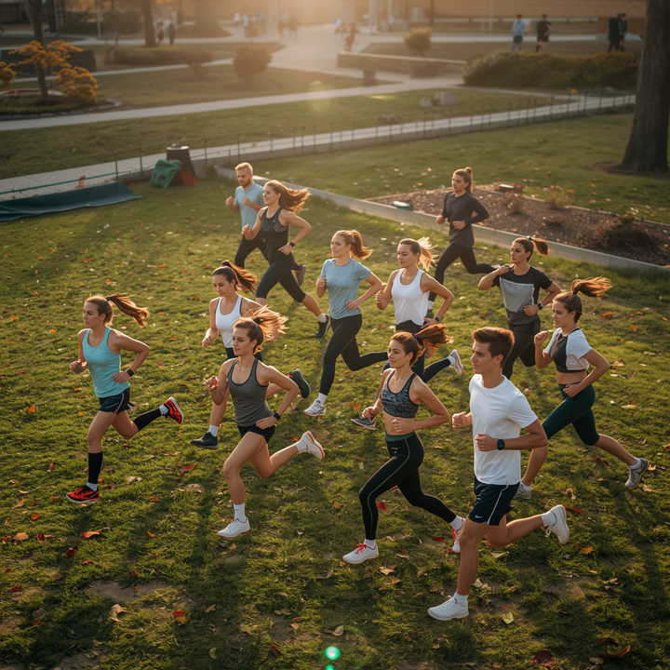
Lee Insung and Friends
Song Introduction
It gives motivation for exercise through a strong warning message.
🎵
This song is about exercise. It uses a strong warning message to make people move. The message is, 'If you do not move, tomorrow will be worse.' It shows why exercise is important.
Exercise helps our body and mind. It improves fitness, mental health, and daily life. Please think about the importance of exercise with this song.
"If you do not move, tomorrow will be worse."
Notes:
What is this song about? It is about exercise. The song gives a strong warning: "If you do not move, tomorrow will be worse." This warning shows why exercise is important. Exercise is good for your body and your mind. We hope this song makes you want to move more!

Slide 4
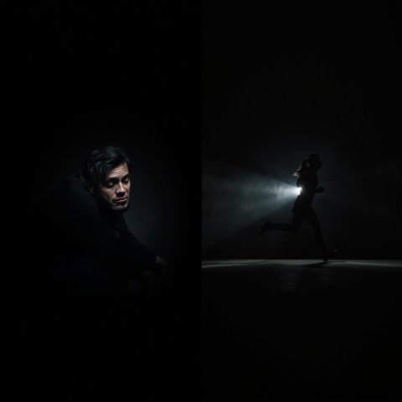
Meaning and Examples of Strong Warning Messages
"If you do not move, tomorrow will be worse" — A message that leads people to act
⚠️
What happens without exercise: low fitness, low energy, and poor health
"Move now, or your future will be worse."
No Exercise vs Exercise — A clear contrast that gives motivation
A strong warning message can make people act by showing a real problem. The message, 'Move now or your future will be worse,' shows why exercise is needed.
Notes:
Let's look at our warning message again: "If you do not move, tomorrow will be worse." This message is strong. It makes people want to take action. Without exercise, people have low energy and bad health. With exercise, people feel much better. This big difference gives us motivation to move.

Slide 5

Song Topic Presentation - Lee Insung and Friends
Negative Effects
Lack of exercise has serious effects on health and daily life.
Low Fitness and Disease Risk
Worse Mental Health
Lower Quality of Life
Lack of exercise makes muscles and heart health weaker. It also increases the risk of obesity, diabetes, and heart disease.
Not being active can increase stress, anxiety, and sadness. It can also reduce sleep quality.
People may feel tired, lose focus, and enjoy daily life less.
Notes:
Now, let's talk about problems from not exercising. First: weak muscles and a weak heart, with more risk of getting sick. Second: bad mental health, more stress, and bad sleep. Third: low energy and less fun in daily life. Not exercising is really bad for our health and our life!

Slide 6
Lee Insung and Friends
Team Members
📝
🎨
🎤
🎵
Lee Minjae
Script Writer
Lee Yeongu
PPT & Design Lead
Lee Insung
Presenter & Design
Lee Hayul
Team Leader & Composer
Wrote the full presentation script.
Built the slides and led the visual design.
Delivered the presentation and supported the design.
Led the team and composed the song with Suno AI.
Notes:
Here is our team! Lee Minjae wrote our script. Lee Yeongu made the slides and the design. Lee Insung gave the presentation and helped with the design. Lee Hayul was our team leader and made the song. We all worked together to make this project!

Slide 7

Lee Insung and Friends
Key Message Summary
Warning is the start. Exercise is the first step to change.
🏃
"Move today for a better tomorrow."
Change starts when we face reality. If we do not exercise, our health can get worse. But one small step today can change tomorrow.
Start moving now. Small actions make a healthy life!
"Move today for a better tomorrow."
Notes:
Our key message is: "Move today for a better tomorrow." If we don't exercise, our health can get worse. But one small step today can change tomorrow. Start moving now! Small steps make a healthy life.

Slide 8

Lee Insung and Friends
The end
Let us move together and make a healthy tomorrow!
Lee Minjae · Lee Yeongu · Lee Insung · Lee Hayul
Song Topic Presentation
Warning is the Start, Exercise is Change
Notes:
Thank you for listening! Let's move together and make a healthy tomorrow! Our team is Lee Minjae, Lee Yeongu, Lee Insung, and Lee Hayul. Remember: warning is the start, exercise is the change. Thank you!

