Slide 1

A Song About Exercise
Our Song Project
Introducing
Kids Who Exercise
Lee Insung and Friends
Lee Minjae · Lee Yeongu · Lee Insung · Lee Hayul
Notes:
Good morning, everyone! Today, our team will show you our project. We made a song about exercise, and we want to introduce it to you. Our team members are Lee Minjae, Lee Yeongu, Lee Insung, and Lee Hayul. Let's start!

Slide 2

Listen to the Song
“Kids Who Exercise” (운동하는 아이들) · Music & Lyrics by insung20402 · Created with Suno AI
▶ Click to Play the Song
VERSE 1
Wake up early in the morning light
I should eat some veggies, make it right
No breakfast, no success,
study's struggle nothing less
CHORUS
Let's go take a walk outside
Exercise every day, feel the pride
Healthy habits make me strong
Singing this happy morning song!
VERSE 2
I should move my body every day
Eating a good breakfast is the way
Let's jump and run under the sun
Healthy life is so much fun!
BRIDGE
Sometimes it is hard to do
But it is good for me and you
Step by step and day by day
We can chase the lazy away!
Notes:
Now, let's listen to our song! It is called "Kids Who Exercise." We made it with Suno AI. The song starts with a warning. Then it becomes happy and exciting. (Play the song now. If you need more time, you can stop after the chorus, about 1 minute.)

Slide 3
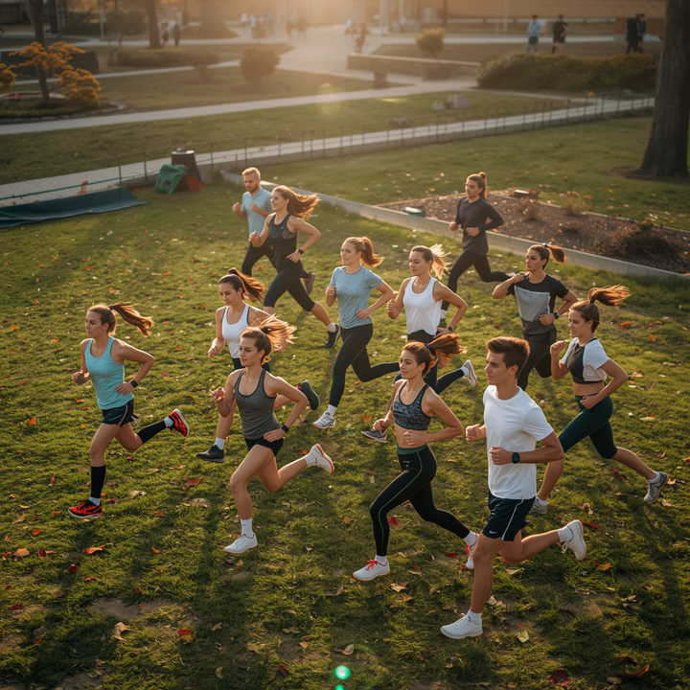
Lee Insung and Friends
About Our Song
Our song shares a fun and powerful message about exercise.
🎵
We made a song called "Kids Who Exercise." It is about exercise and healthy morning habits. We wrote the lyrics and made the music using Suno AI.
The song starts with a warning about skipping breakfast and not moving. Then it becomes a happy, energetic song about exercising every day. We hope it makes you want to move!
"Let's go take a walk outside, exercise every day!"
Notes:
So, what is our song about? We made a song called "Kids Who Exercise." It is about exercise and healthy morning habits. We wrote the lyrics and made the music using Suno AI. The song starts with a warning about skipping breakfast and not moving, then becomes a happy, energetic song about exercising every day. We hope it makes you want to move!

Slide 4
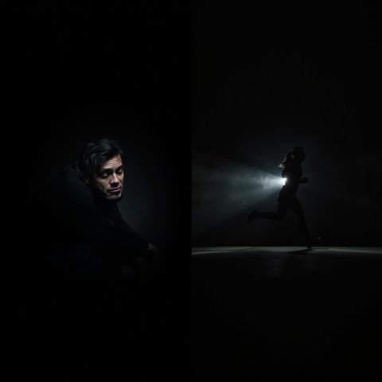
What Our Song Says
Verse 1 — A morning with no breakfast and no exercise feels hard and tiring
🎶
Chorus — "Let's go take a walk outside, exercise every day, feel the pride!"
"Let's go take a walk outside, exercise every day!"
Verse 2 & Bridge — Moving your body and eating well make every day more fun
Our song moves from a warning to an exciting call to action. Step by step, it shows how small daily habits, like a morning walk and a good breakfast, can make us healthier and happier.
Notes:
Let's look at what our song says. Verse 1 talks about a morning with no breakfast and no exercise, which feels hard and tiring. The chorus says: "Let's go take a walk outside, exercise every day, feel the pride!" Verse 2 and the bridge talk about moving your body and eating well to make every day more fun. Our song moves from a warning to an exciting call to action.

Slide 5

Our Song: Kids Who Exercise
The Story in Our Song
Our song tells a simple story: from a tired morning to an active, happy life.
Verse 1: The Problem
Verse 2: The Change
Bridge & Chorus: The Message
In Verse 1, a child skips breakfast and doesn't move. The morning feels hard, and studying feels like a struggle.
In Verse 2, the child moves every day, eats a good breakfast, and runs and jumps under the sun. Life feels fun again!
The bridge and chorus repeat our message: small steps, day by day, can chase the lazy away and build healthy habits.
Notes:
Now let's look at the story in our song. Verse 1 is the problem: a child skips breakfast and doesn't move, and the morning feels hard. Verse 2 is the change: the child moves every day, eats well, and has fun in the sun. The bridge and chorus repeat our message: small steps, day by day, build healthy habits.

Slide 6
Lee Insung and Friends
Team Members
📝
🎨
🎤
🎵
Lee Minjae
Script Writer
Lee Yeongu
PPT & Design Lead
Lee Insung
Presenter & Design
Lee Hayul
Team Leader & Composer
Wrote the full presentation script.
Built the slides and led the visual design.
Delivered the presentation and supported the design.
Led the team and composed the song with Suno AI.
Notes:
Here is our team! Lee Minjae wrote our script. Lee Yeongu made the slides and the design. Lee Insung gave the presentation and helped with the design. Lee Hayul was our team leader and made the song. We all worked together to make this project!

Slide 7

Lee Insung and Friends
In Conclusion: Our Song's Message
Our song's message: a small step today can make a big difference tomorrow.
🏃
"Move today for a better tomorrow."
This is the main message of our song. It starts with a warning, but it ends with hope: small steps today can change tomorrow.
Listen to our song, and start moving, one step at a time!
"Move today for a better tomorrow."
Notes:
In conclusion, here is our song's message: "Move today for a better tomorrow." This is the main message of our song. It starts with a warning, but it ends with hope: small steps today can change tomorrow. Listen to our song, and start moving, one step at a time!

Slide 8

Lee Insung and Friends
Thank You!
Thanks for listening to our song. Let's move together and make a healthy tomorrow!
Lee Minjae · Lee Yeongu · Lee Insung · Lee Hayul
Song Topic Presentation
Our Song: Kids Who Exercise
Notes:
Thank you for listening! Thanks for listening to our song. Let's move together and make a healthy tomorrow! Our team is Lee Minjae, Lee Yeongu, Lee Insung, and Lee Hayul. Thank you!

