Slide 1

Song Introduction
Song Introduction
Kids Who Exercise
Lee Insung and Friends
Lee Minjae · Lee Yeongu · Lee Insung · Lee Hayul
Notes:
Good morning, everyone! Today, we will introduce a song we made about exercise. Our team members are Lee Minjae, Lee Yeongu, Lee Insung, and Lee Hayul. Let's start!

Slide 2


Listen to the Song
“Kids Who Exercise” (운동하는 아이들) · Music & Lyrics by insung20402 · Created with Suno AI
▶ Click to Play the Song
VERSE 1
Wake up early in the morning light
I should eat some veggies, make it right
No breakfast, no success,
study's struggle nothing less
CHORUS
Let's go take a walk outside
Exercise every day, feel the pride
Healthy habits make me strong
Singing this happy morning song!
VERSE 2
I should move my body every day
Eating a good breakfast is the way
Let's jump and run under the sun
Healthy life is so much fun!
BRIDGE
Sometimes it is hard to do
But it is good for me and you
Step by step and day by day
We can chase the lazy away!
Notes:
Now, let's listen to our song! It is called "Kids Who Exercise." We made it with Suno AI. The song starts with a warning. Then it becomes happy and exciting. (Play the song now. If you need more time, you can stop after the chorus, about 1 minute.)

Slide 3
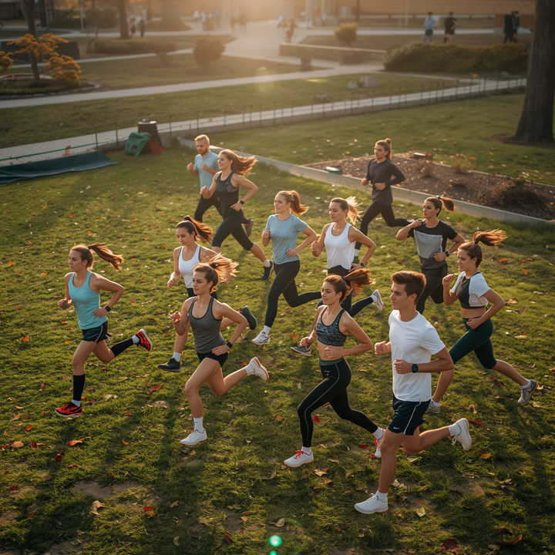
Lee Insung and Friends
About Our Song
Our song shares a fun and powerful message about exercise.
🎵
We made a song called "Kids Who Exercise." It is about exercise and healthy morning habits. We wrote the lyrics and made the music using Suno AI.
The song starts with a warning about skipping breakfast and not moving. Then it becomes a happy, energetic song about exercising every day. We hope it makes you want to move!
"Let's go take a walk outside, exercise every day!"
Notes:
We made this song for our English class. It is called "Kids Who Exercise." We wrote the words ourselves, and we used Suno AI to create the music. We wanted to share a message: stay active every day!

Slide 4
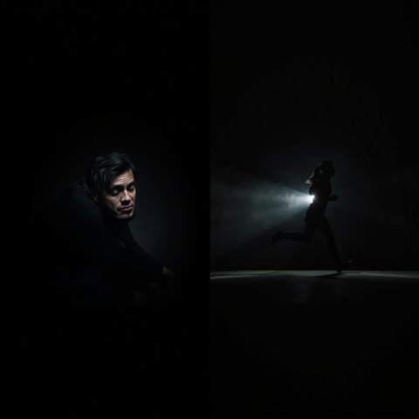
What Our Song Says
Verse 1 — A morning with no breakfast and no exercise feels hard and tiring
🎶
Chorus — "Let's go take a walk outside, exercise every day, feel the pride!"
"Let's go take a walk outside, exercise every day!"
Verse 2 & Bridge — Moving your body and eating well make every day more fun
Our song moves from a warning to an exciting call to action. Step by step, it shows how small daily habits, like a morning walk and a good breakfast, can make us healthier and happier.
Notes:
The most important part is the chorus. It says: "Let's go take a walk outside, exercise every day, feel the pride!" This line is our main idea. Even a simple walk can make you feel proud and happy.

Slide 5

Our Song: Kids Who Exercise
The Story in Our Song
Our song tells a simple story: from a tired morning to an active, happy life.
Verse 1: The Problem
Verse 2: The Change
Bridge & Chorus: The Message
In Verse 1, a child skips breakfast and doesn't move. The morning feels hard, and studying feels like a struggle.
In Verse 2, the child moves every day, eats a good breakfast, and runs and jumps under the sun. Life feels fun again!
The bridge and chorus repeat our message: small steps, day by day, can chase the lazy away and build healthy habits.
Notes:
Our song tells a short story. At first, the character has no energy and stays inside. Then, the character starts walking, eating breakfast, and playing outside. By the end, the character feels much happier, and that change came from small daily habits.

Slide 6
Lee Insung and Friends
Team Members
📝
🎨
🎤
🎵
Lee Minjae
Script Writer
Lee Yeongu
PPT & Design Lead
Lee Insung
Presenter & Design
Lee Hayul
Team Leader & Composer
Wrote the full presentation script.
Built the slides and led the visual design.
Delivered the presentation and supported the design.
Led the team and composed the song with Suno AI.
Notes:
Here is our team: Lee Minjae wrote the script, Lee Yeongu made the design, Lee Insung was our presenter, and Lee Hayul, our team leader, made the song. Let's keep going!

Slide 7

Lee Insung and Friends
In Conclusion: Our Song's Message
Our song's message: a small step today can make a big difference tomorrow.
🏃
"Move today for a better tomorrow."
This is the main message of our song. It starts with a warning, but it ends with hope: small steps today can change tomorrow.
Listen to our song, and start moving, one step at a time!
"Move today for a better tomorrow."
Notes:
To finish, here is our main idea: "Move today for a better tomorrow." Even one small action, like a short walk, can make tomorrow better. We hope this song gives you a reason to get up and try it!

Slide 8

Lee Insung and Friends
Thank You!
Thanks for listening to our song. Let's move together and make a healthy tomorrow!
Lee Minjae · Lee Yeongu · Lee Insung · Lee Hayul
Song Topic Presentation
Our Song: Kids Who Exercise
Notes:
Thank you for listening to our presentation. We hope you enjoyed our song. Let's all try to move a little more every day. Goodbye!

